Slide 1
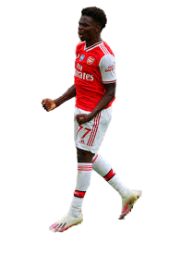

My Hobby Project
ARSENAL STATS
By: Imran Subhan

Slide 2

Concept
I chose to base my project on Arsenal FC
Why?
Arsenal FC is the team I support
In my free time I watch them play
I go to their games
I read up on Arsenal news
I look up player info

Slide 3
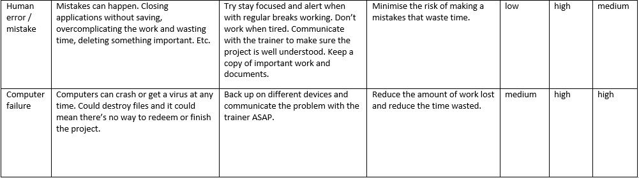
Creation of Arsenal Stats
I started the project by carrying out the planning stages stated in the specification:
Risk-Assessment
SPRINT Plan
Outline
ERD

Slide 4
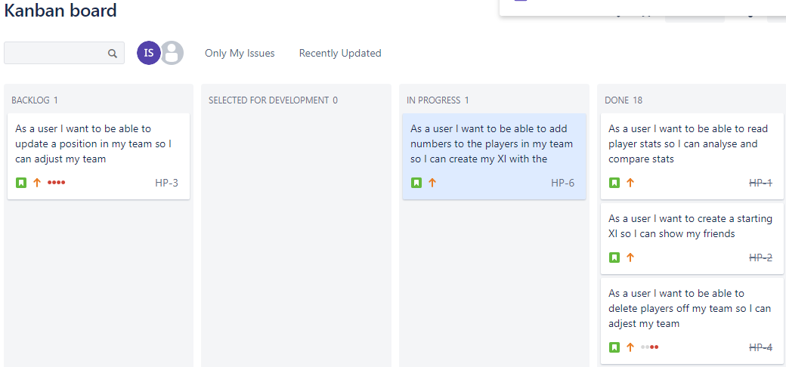
SPRINT Plan

Slide 5
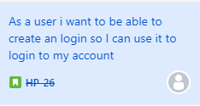
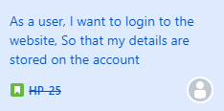
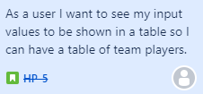
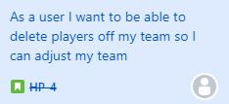
User Stories
User Stories for Login page
User Stories for Create Page

Slide 6
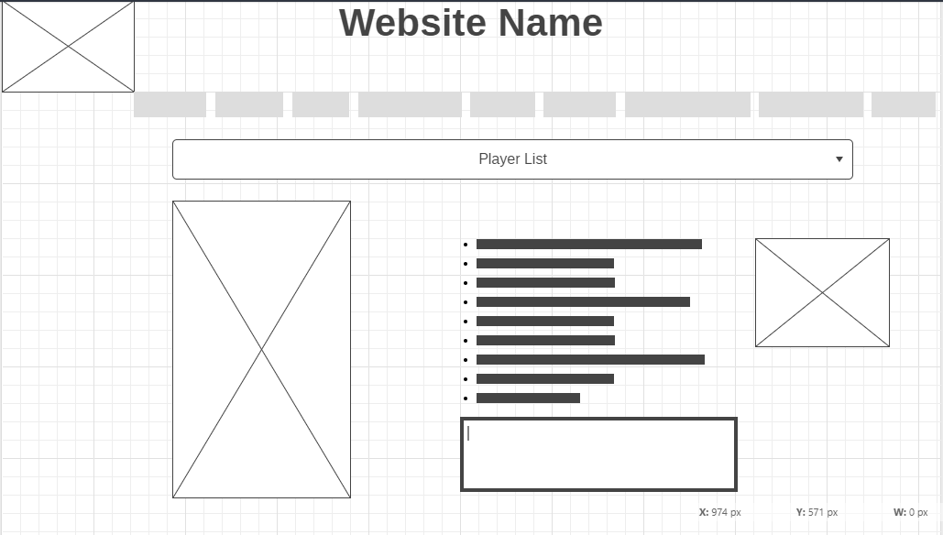
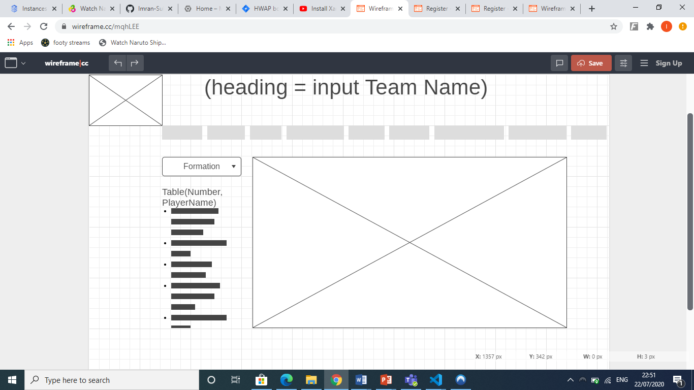
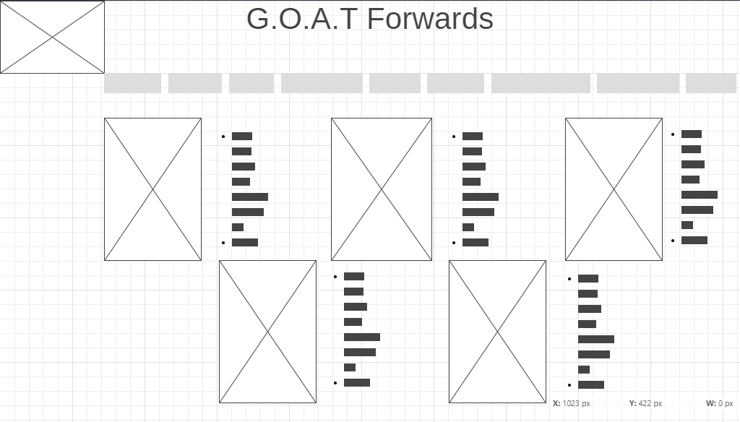
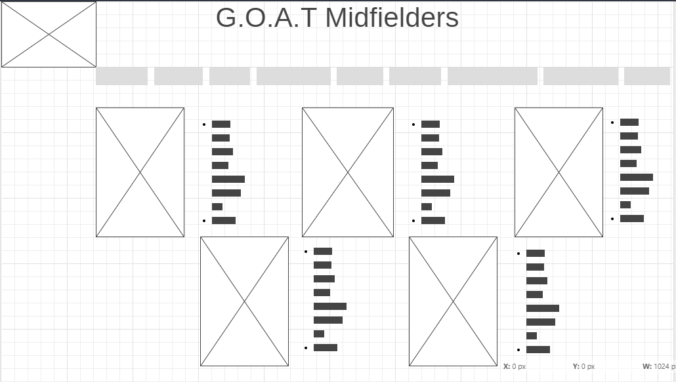


Outline

Slide 7
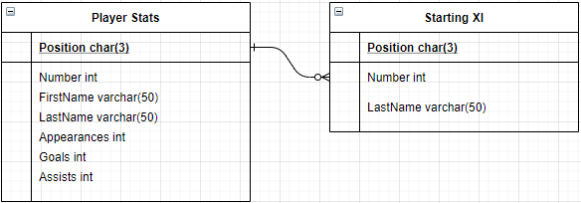
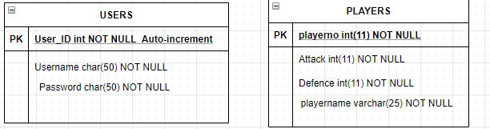
ERD

Slide 8
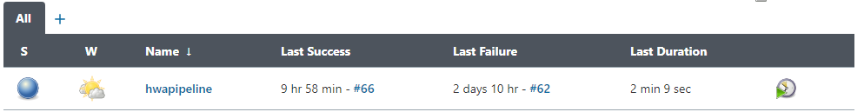
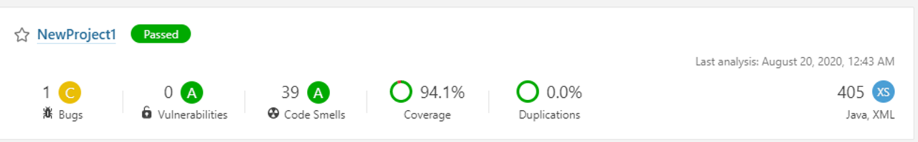
CI Pipeline & Sonarqube
Set up on a GCP VM Instance using Ubuntu

Slide 9
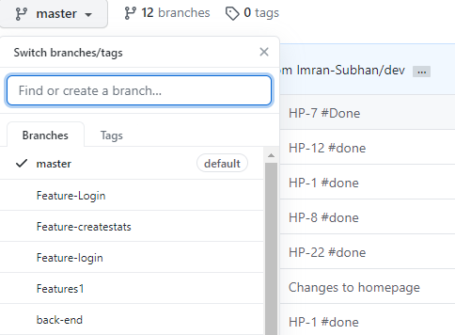
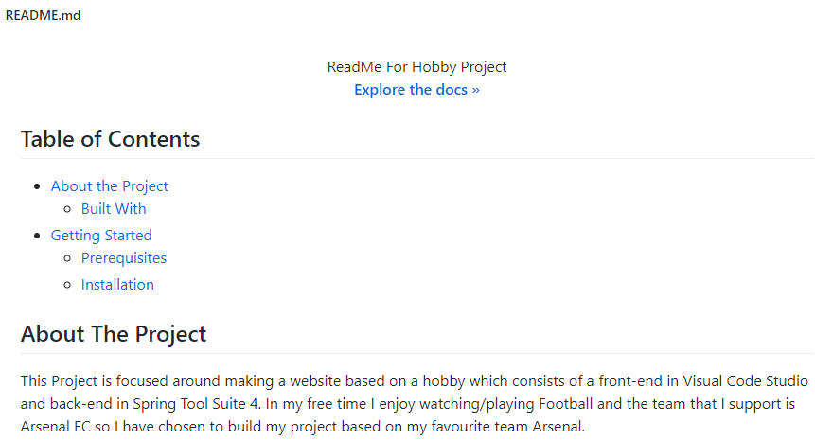
GitHub
Feature branch model
README.md

Slide 10
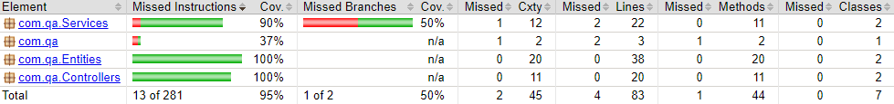
Testing
Surefire report – 95% coverage
Selenium Automation Testing

Slide 11
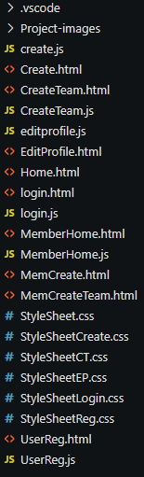
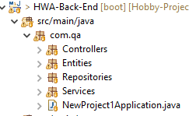
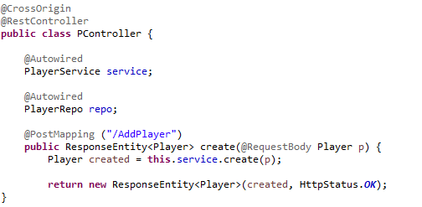
New technologies
Spring boot project – SpringFramework, Annotations, Application properties, Repository-Entity-Service-Controller model.
Visual Code Studio – Fetch, DOM, JS, CSS, Functions, Tags, Bootstrap
Automation testing – Selenium

Slide 12
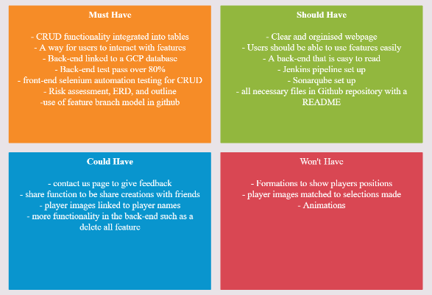
MoSCoW

Slide 13
SPRINT Retrospective
I included most of my features I put into the user stories
Implemented CRUD functionality to 2 tables
Gave the user an easy to read clean layout
Completed the back-end with testing
I left out features because some features took more time to add than initially expected
I also left out features because I changed my plan for my project
Initially the SPRINT included a way to scroll through players to get stats but I then changed directions to make a login page .

Slide 14

Conclusion
Enjoyed the project. Very challenging.
Got to see all sides of making a website.
Learned a lot of new technologies.

Slide 15


QUESTIONS?
Please ask any questions

