Slide 1
My Hobby Project
ARSENAL STATS
By: Imran Subhan

Slide 2

Concept
I chose to base my project on Arsenal FC
Why?
Arsenal FC is the team I support
In my free time I watch them play
I go to their games
I read up on Arsenal news
I look up player info

Slide 3
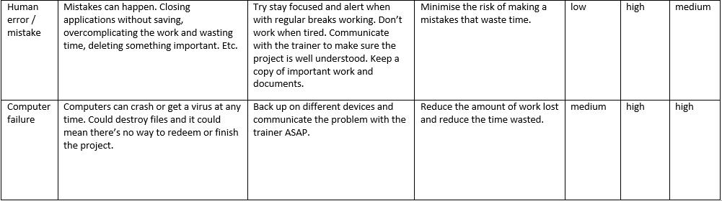
Creation of Arsenal Stats
I started the project by carrying out the planning stages stated in the specification:
Risk-Assessment
SPRINT Plan
Outline
ERD

Slide 4
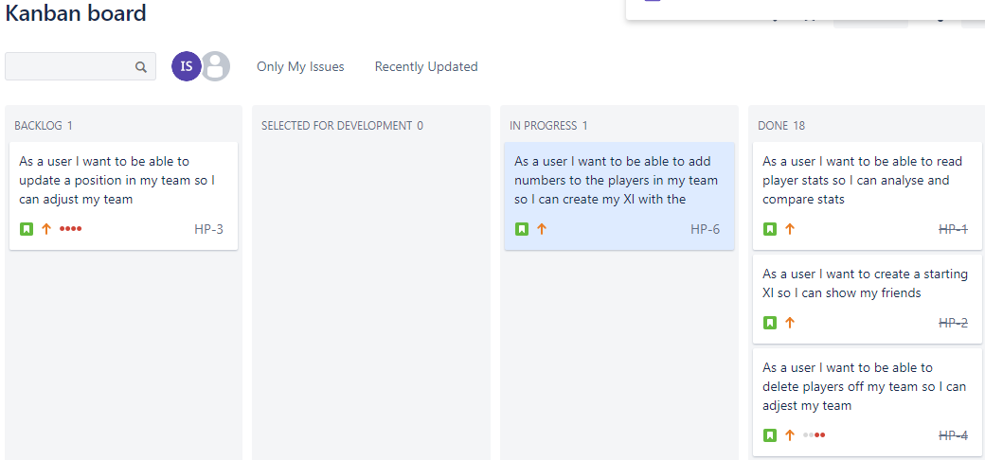
SPRINT Plan

Slide 5
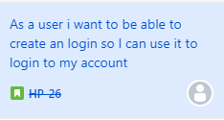
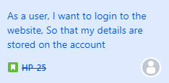
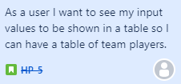
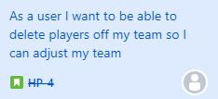
User Stories
User Stories for Login page
User Stories for Create Page

Slide 6
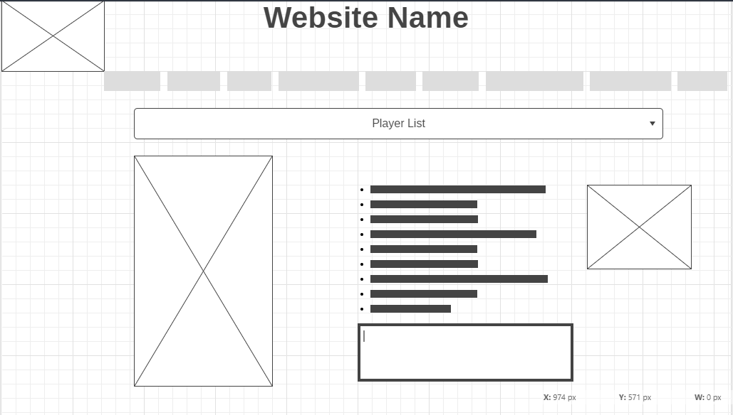
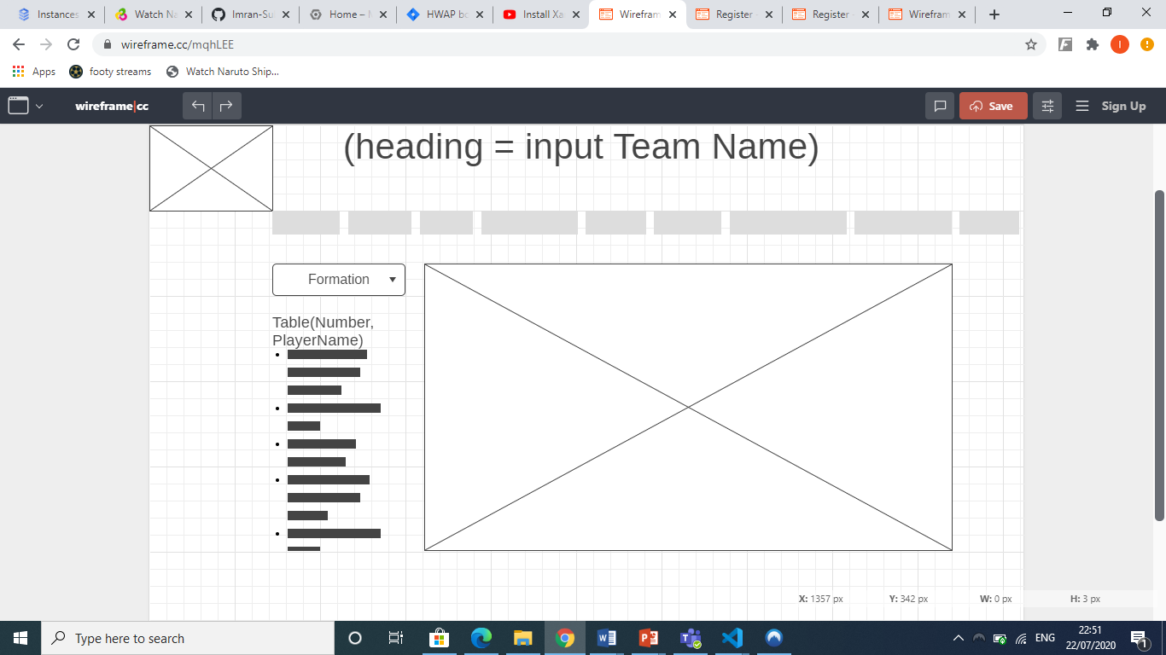
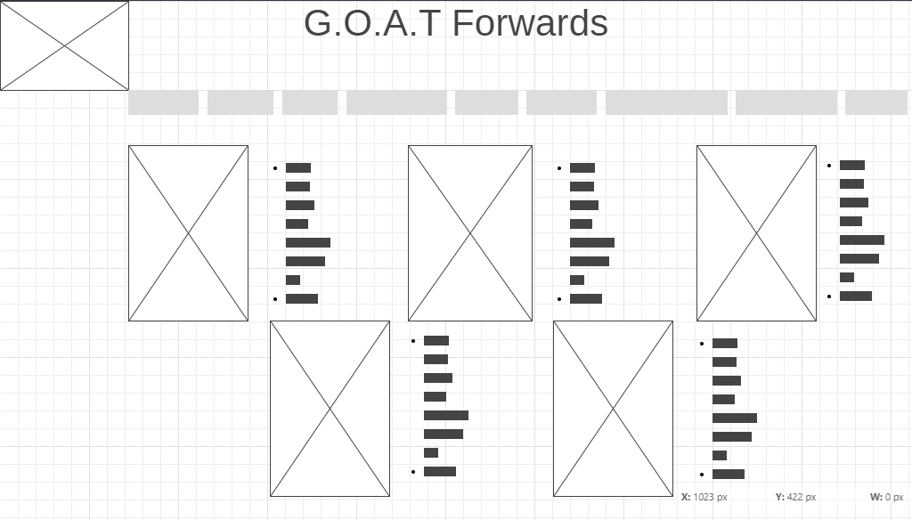
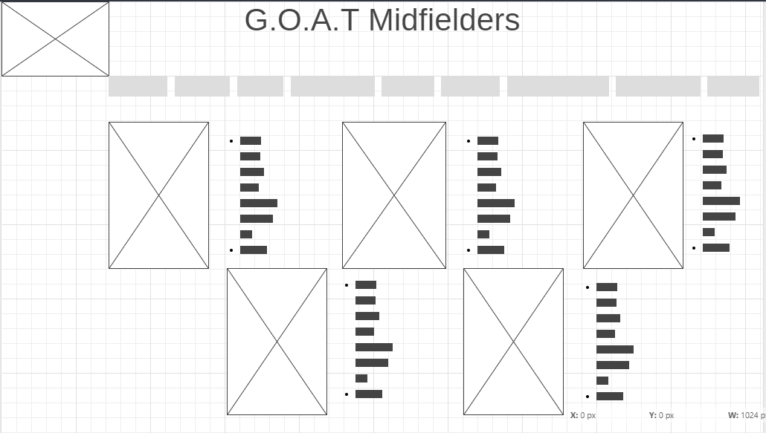


Outline

Slide 7
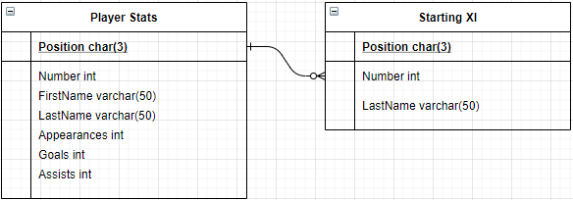
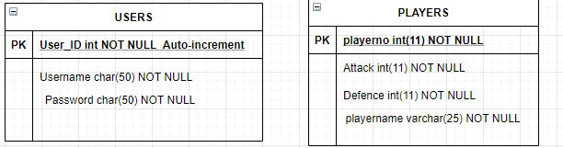
ERD

Slide 8
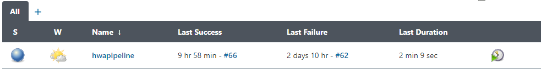
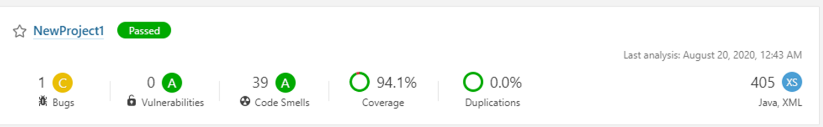
CI Pipeline & Sonarqube
Set up on a GCP VM Instance using Ubuntu

Slide 9
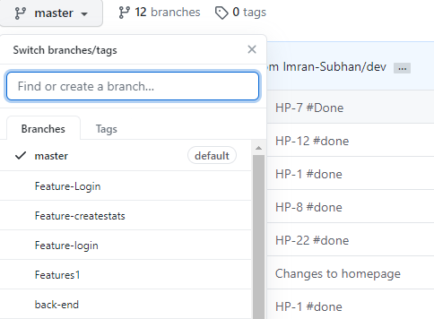
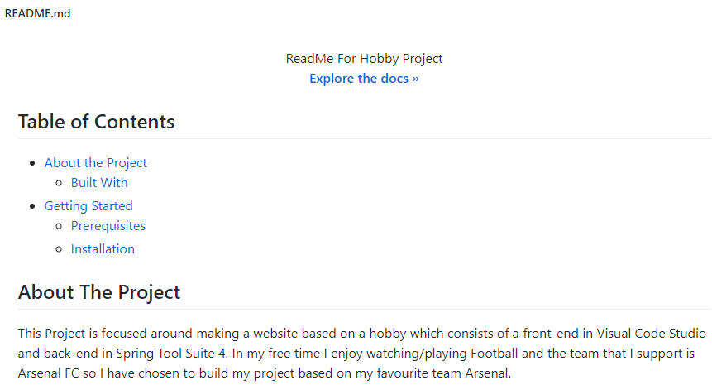
GitHub
Feature branch model
README.md

Slide 10
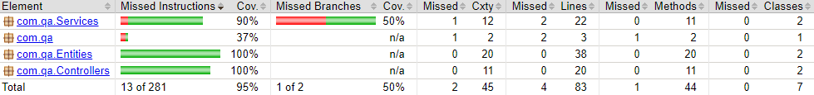
Testing
Surefire report – 95% coverage
Selenium Automation Testing

Slide 11
New technologies
Spring boot project – SpringFramework, Annotations, Application properties, Reposotory-Entity-Service-Controller model.
Visual Code Studio – Fetch, DOM, JS, CSS, Functions, Tags, Bootstrap
Automation testing – Selenium

Slide 12
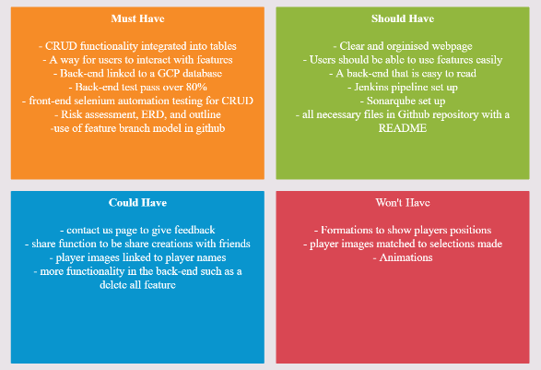
MoSCoW

