Slide 1
Computer Architecture
Pipelining

Slide 2
Pipelining
To arrange the hardware so that more than one operation can be performed at the same time.
In this way, the number of operations performed per second is increased even though the elapsed time needed to perform any operation is not changed.

Slide 3
Basic Idea of Pipelining
Execution of a program consists of a sequence of fetch and execute steps.
  Let F_{i} refers to fetch step for Instruction I_{i}
  Let E_{i} refers to execution step for Instruction I_{i}
Consider computer has two hardware units
  One for instruction fetch
  Other for instruction execution

Slide 4
Basic Idea of Pipelining
The Instruction fetched by the fetch unit is deposited in an intermediate storage buffer, B1.
This buffer is needed to enable the execution unit to execute the instruction while the fetch unit is fetching the next instruction.
Assume both the source and the destination of the data operated on by the instructions are inside Execution unit.

Slide 5
Basic Idea of Pipelining
In the first clock cycle, the fetch unit fetches an instruction I₁ (Step F₁) and stores it in buffer B1 at the end of the clock cycle.
In the second clock cycle
  The instruction fetch unit proceeds with the fetch operation for instruction I₂ (Step F₂)
  The execution unit performs the operation specified by instruction I₁, which is available in buffer B1 (Step E₁)
  By the end of the second clock cycle
    The execution of I₁ is completed
    I₂ is stored in B1, replacing I₁

Slide 6
Basic Idea of Pipelining
In this manner
  Both fetch and execution units are kept busy all the time
  The completion rate of instruction execution will be twice that achievable by the sequential operation
Two stage pipeline in which each stage performs one step in processing an instruction,

Slide 7
I
I
I
T
ime
1
2
3
F
1
E
1
F
2
E
2
F
3
E
3
(a) Sequential execution
Interstage buffer
B1
Instruction
Ex
ecution
fetch
unit
unit
(b) Hardware organization
Clock cycle
1
2
3
4
T
ime
Instruction
I
1
F
1
E
1
I
2
F
2
E
2
I
3
F
3
E
3
(c) Pipelined execution
Figure 8.1. Basic idea of instruction pipelining.

Slide 8
4-stage Pipeline
A pipelined processor may process each instruction in 4 steps:
  F Fetch: read the instruction from the memory
  D Decode: decode the instruction and fetch the source operand(s)
  E Execute: perform the operation specified by the instruction
  W Write: store the result in the destination location.

Slide 9
4-stage Pipeline: Buffer
Information is passed from one unit to the next through a storage buffer
During clock cycle 4, the information in the buffer:
  Buffer B1 holds I_{3.}
  Buffer B2 holds both the source operand(s) for I₂ , the specification of the operation to be performed, information needed for the write step of I_{2.}
  Buffer B3 holds the result produced by the execution unit and the destination information for I_{1.}

Slide 10
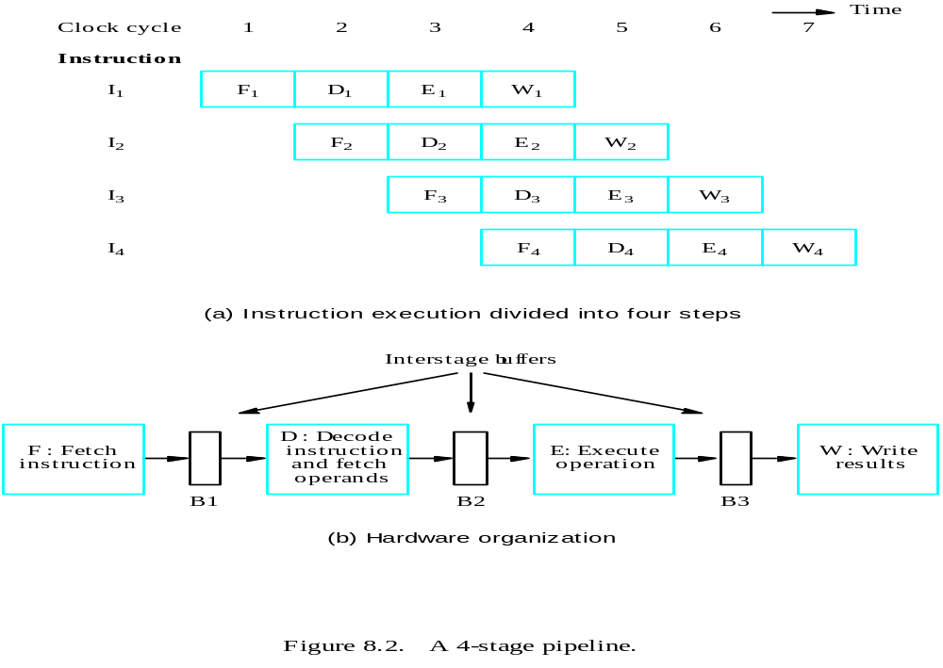

Slide 11
Role of Cache Memory
Each stage in a pipeline is expected to completes its operation in one clock cycle.
  The clock period should be sufficiently long to perform the task being performed in any stage.
If different units require different amounts of time, the clock period must allow the longest time to be completed.
Consider the fetch step:
  The access time of the main memory may be as much as greater than the time needed to perform basic pipeline stage operations.
  Pipelining would be of little value
The use of cache memories solves the problem.

Slide 12
Pipeline Performance
For a variety of reasons, one of the pipeline stages may not be able to complete its processing task for a given instruction in the time allotted.
Any time if one of the stages in the pipeline cannot complete its operation in one clock cycle, the pipeline stalls.
Any condition that causes the pipeline to stall is called a hazard.

Slide 13
Pipeline Performance
Three types of hazard:
  Data hazard
  Instruction or control hazard
  Structural hazard
Hazards result in degradation in performance.
An important goal in designing processors is
  to identify all hazards that cause the pipeline to stall
  To find ways to minimize their impact.

Slide 14
Data Hazard
This is a situation in which the pipeline is stalled because the data to be operated on are delayed for some reason.
Example
  Stage E is responsible for arithmetic and logic operations and one cycle is assigned for this task
  But some operations such as divide may require more time and the pipeline stalls.

Slide 15
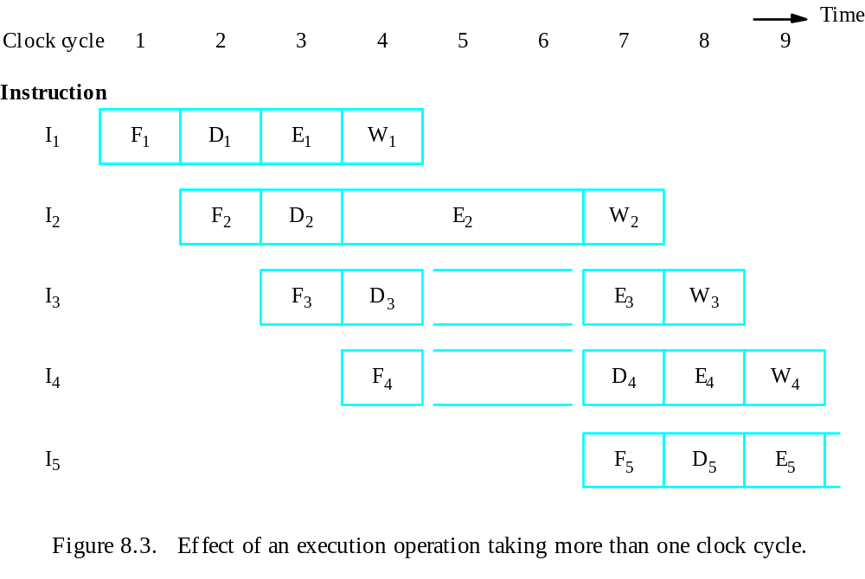

Slide 16
Instruction Hazard
The pipeline may be stalled because of a delay in the availability of an instruction
  This may be a result of a miss in the cache
  Required to be fetched from the main memory

Slide 17
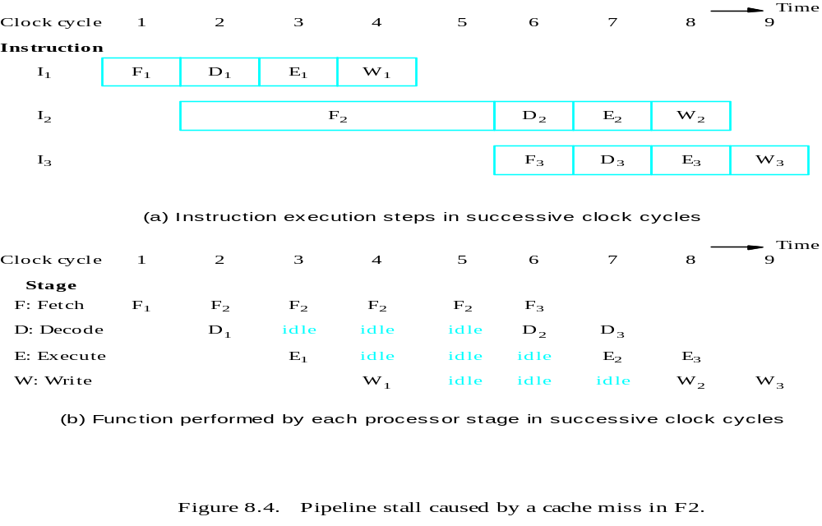

Slide 18
Structural hazard
This is the situation when two instructions require the use of a given hardware resource at the same time
One instruction may need to access memory as a part of the execute or write stage while another instruction being fetched
  Only one instruction can proceed
  Other is delayed
  Solution: Separate data and instruction cache
Another example: consider the following instruction
  Load X(R1), R2

Slide 19
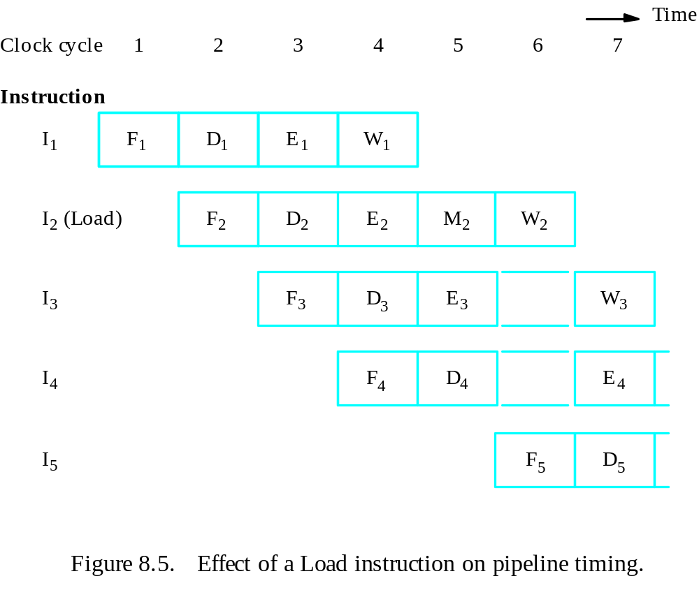

Slide 20
Data Hazard:More Example
We must ensure that the results obtained when instructions are executed in a pipelined processor are identical to those obtained when the same instructions are executed sequentially
Consider the following example
  Mul R2, R3, R4
  Add R5, R4, R6
Data dependency arises when the destination of one instruction is used as a source in the next instruction
When two operations depend on each other, they must be performed sequentially in the correct order.

Slide 21
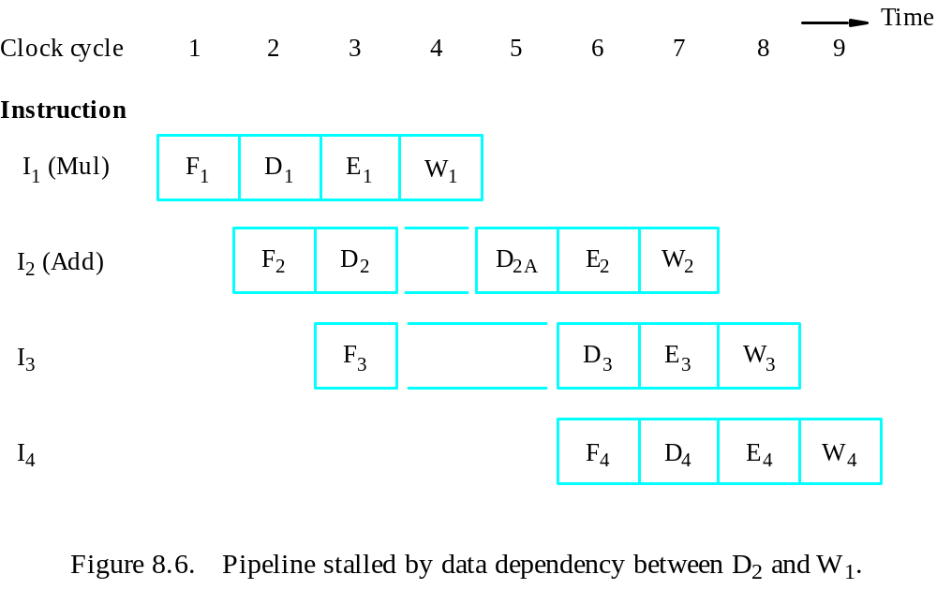
Figure 8.6. Pipeline stalled by data dependency between D₂ and W₁.

Slide 22
Operand Forwarding
Data hazard arises because I₂ is waiting for data to be written in the register file.
However, these data are available at the output of the ALU once the Execute stage completes step E₁.
The delay can be reduced or possibly eliminated, if we arrange the result of I₁ to be forwarded directly for use in step E₂

Slide 23
Operand Forwarding
What happens?
After decoding instruction I₂ and detecting data dependency, a decision is made to use data forwarding.
The operand not involved in the dependency, register R5 is read and loaded in register SRC1 in clock cycle 3.
In the next clock cycle, the product produced by instruction I₁ is available in register RSLT and because of forwarding connection it can be used in step E₂.
Hence execution of I₂ proceeds without interruption.

Slide 24
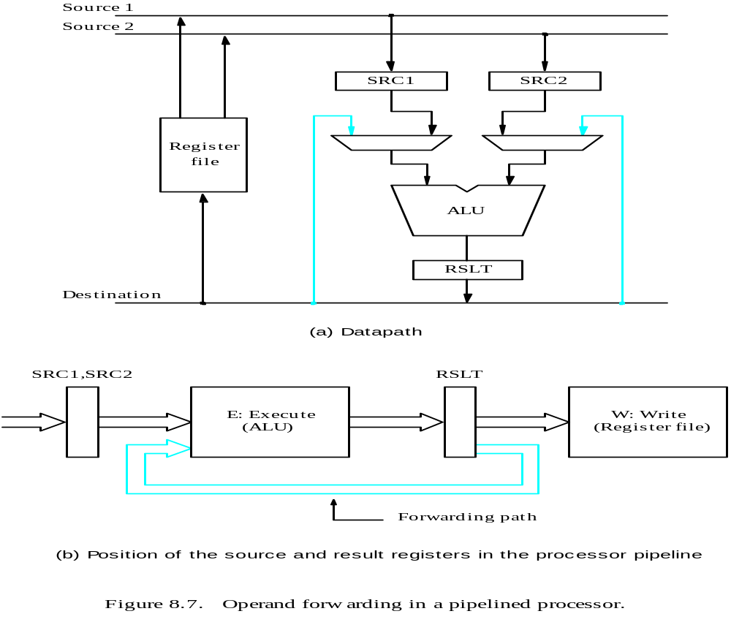

Slide 25
Handling Data Hazards
In Software
An alternative approach is
  to leave the task of detecting data dependencies
  and dealing with them to the software
In this case, the compiler can introduce the two-cycle delay needed between instructions I₁ and I₂ by inserting NOP (No-operation) instructions, as follows:
I₁: Mul R2, R3, R4
NOP
NOP
I₂: Mul R5, R4, R6

Slide 26
Handling Data Hazards
In Software
So such dependencies can be detected in two ways:
  Software (compiler) and hardware
Leaving tasks such as inserting NOP instructions to the compiler leads simpler hardware.
Being aware of the need for a delay, the compiler can attempt to reorder instructions to perform useful tasks in the NOP slots and thus achieve better performance.
On the other hand, the insertion of NOP instruction leads to larger code size.

Slide 27
Side Effects
When a location other than one explicitly named in an instruction as a destination is affected, the instruction is said to have side effect
  All the precautions needed to handle data dependencies involving the destination location must be applied to all these registers
Another possible side effect involves the condition code flags, which are used by instructions such as
  Conditional branches
  Add with carry

Slide 28
Instruction Hazard: Unconditional Branch
The time lost as a result of a branch instruction is often referred to as the branch penalty
For a longer pipeline, the branch penalty may be higher.
Reducing the branch penalty requires the branch address to be computed earlier in the pipeline.
The instruction fetch unit has dedicated hardware
  to identify a branch instruction
  to compute the branch target address as early as possible after an instruction is fetched.

Slide 29
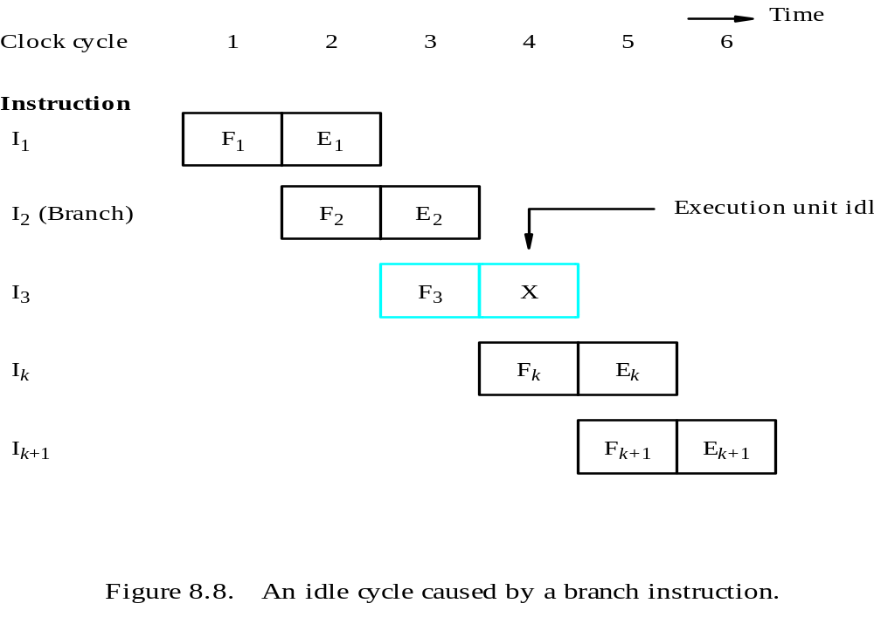

Slide 30
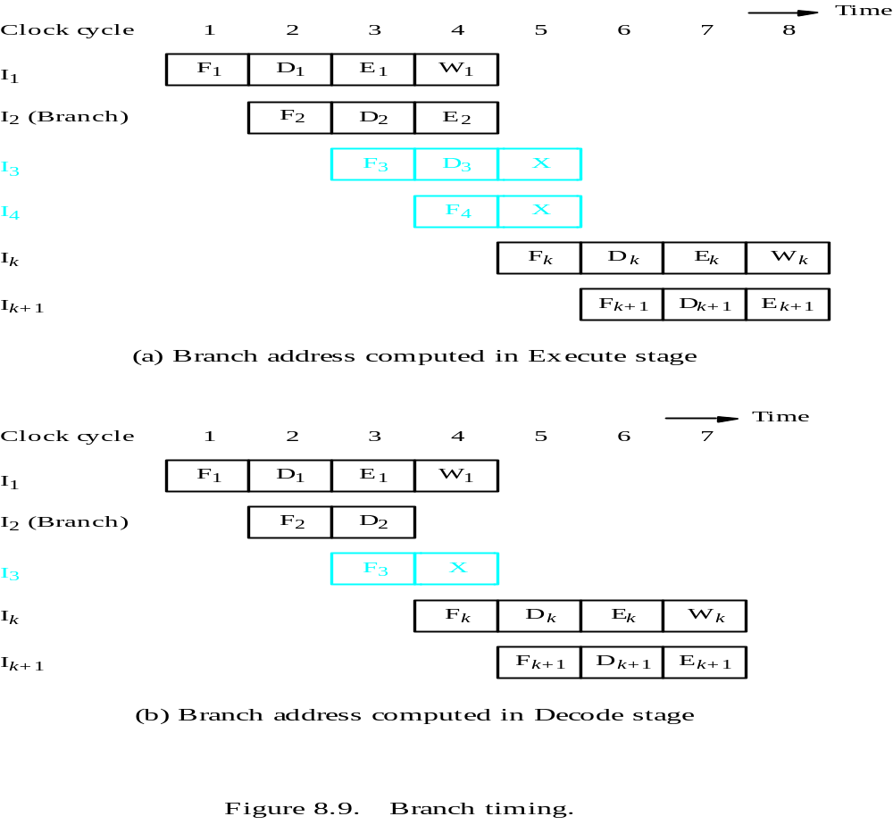

Slide 31
Instruction Queue and Prefetching
Many processors employ sophisticated fetch units that can fetch instructions before they are needed and put them in instruction queue.
The instruction queue can store several instructions.
A separate unit called dispatch unit
  Takes instructions from the front of the queue
  Sends them to the execution unit
  Also Performs decoding function

Slide 32
Instruction Queue and Prefetching
Fetch unit has sufficient decoding and processing capabilities.
It attempts to keep the instruction queue filled at all times to reduce the impact of occasional delays when fetching instruction.

Slide 33
Instruction Queue and Prefetching
When the pipeline stalls because of data hazard
  Dispatch unit is not able to issue instructions from the instruction queue.
  Fetch unit continues to fetch instructions and add them to the queue
When there is delay in fetching instruction
  Dispatch unit continues to issue instructions from the instruction queue.

Slide 34
Instruction fetch unit
Instruction queue
F : Fetch
instruction
D : Dispatch/
E : Ex
ecute
W : Write
Decode
instruction
results
unit
Figure 8.10. Use of an instruction queue in the hardware organization of Figure 8.2b.

Slide 35
Clock c
ycle
1
2
3
4
5
6
7
8
9
10
T
ime
Queue length
1
1
1
1
2
3
2
1
1
1
I
F
1
D
1
E
1
E
1
E
1
W
1
1
I
2
F
2
D
2
E
2
W
2
I
3
F
3
D
3
E
3
W
3
I
4
F
4
D
4
E
4
W
4
I
5
(Branch)
F
5
D
5
I
6
F
6
X
I
k
F
k
D
k
E
k
W
k
I
k+
1
F
k+
1
D
k+
1
E
k+
1
Figure 8.11. Branch timing in the presence of an instruction queue.
Branch target address is computed in the D stage.

Slide 36
Instruction Queue and Prefetching
Branch instruction does not increase the overall execution time
The instruction fetch unit has executed the branch instruction(by computing the branch address) concurrently with the execution of other instructions.
This technique is called branch folding
Branch folding occurs only if at the time a branch instruction is encountered , at least one instruction is available in the queue other than the branch instruction.

Slide 37
Conditional Branch
A Conditional Branch instruction introduces added hazard caused by the dependency of the branch condition on the result of a preceding instruction.
The decision to branch cannot be made until the execution of that instruction has been completed.

Slide 38
Delayed Branch
The location following a branch instruction is called a branch delay slot.
A technique called delayed branching can minimize the penalty incurred as a result of branch instruction.
  The instructions in the delay slots are always fetched
  They are arranged to be fully executed whether or not the branch is taken
  The objective is to place useful instructions in these slots
  If no useful instruction can be placed in the delay slots, these slots must be filled with NOP instructions
Branching takes place later than when branch instruction appears in the instruction sequence in the memory , hence the name delayed branch

Slide 39
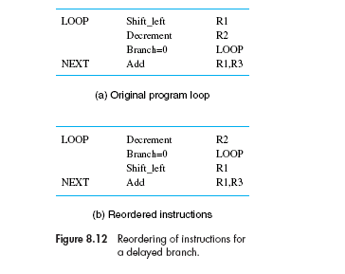

Slide 40
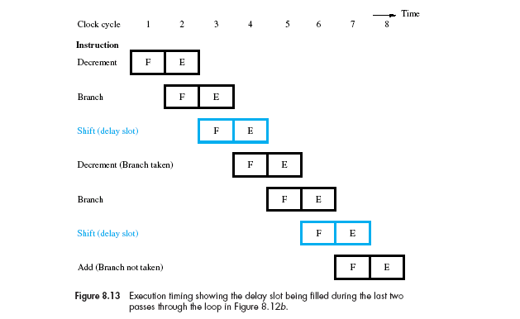

Slide 41
Branch Prediction
Another technique for reducing the branch penalty associated with conditional branches is to attempt to predict whether or not a particular branch will be taken
The simplest form of branch prediction is to assume that the branch will not take place and to continue to fetch instructions in sequential address order
Until the branch condition is evaluated, instruction execution along the predicted path must be done on a speculative basis

Slide 42
Branch Prediction
Speculative execution means the instructions are executed before the processor is certain that they are in the correct execution sequence
Care must be taken that no processor registers and memory locations are updated until it is confirmed that these instructions should indeed be executed
If the branch decision indicates otherwise
  The instructions and all their associated data in the execution units must be purged
  The correct instruction should be fetched and executed

Slide 43
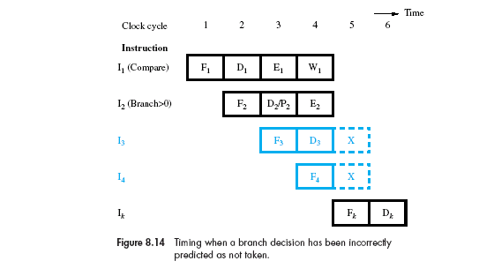

Slide 44
Branch Prediction
If branches outcomes were random, then half the branches would be taken
Simple Approach:
  Assuming that the branches will not be taken
  Would save time lost to conditional branches 50 percent of the time
Better performance can be achieved if we arrange some branch instructions to be predicted as taken and others as not taken, depending on the expected program behavior

Slide 45
Branch Prediction
Static Branch Prediction
  The branch prediction decision is always the same every time a given instruction is executed
Dynamic Branch Prediction
  Decision may change depending on execution history

Slide 46
Static Branch Prediction
By observing whether the target address of the branch is lower than or higher than the address of the branch instruction.
To have the compiler decide whether a given branch instruction should be predicted taken or not taken.
  include a branch prediction bit, which is set to 0 or 1 by the compiler to indicate the desired behavior.
  The instruction fetch unit checks this bit to predict whether the branch will be taken or not taken

Slide 47
Dynamic Branch Prediction
The objective of branch prediction algorithms is to reduce the probability of making a wrong decision,
  to avoid fetching instructions that eventually have to be discarded.
In dynamic branch prediction schemes, the processor hardware assesses the likelihood of a given branch being taken by keeping track of branch decisions every time that instruction is executed.

Slide 48
Dynamic Branch Prediction
In its simplest form, the execution history used in predicting the outcome of a given branch instruction is the result of the most recent execution of that instruction.
The processor assumes that the next time the instruction is executed, the result is likely to be the same.
Hence, the algorithm may be described by the two-state machine in Figure 8.15a. The two states are:
  LT: Branch is likely to be taken
  LNT: Branch is likely not to be taken

Slide 49
Dynamic Branch Prediction
Better performance can be achieved by keeping more information about execution history.
An algorithm that uses 4 states, thus requiring two bits of history information for each branch instruction, is shown in Figure 8.15b. The four states are:
  ST: Strongly likely to be taken
  LT: Likely to be taken
  LNT: Likely not to be taken
  SNT: Strongly likely not to be taken

Slide 50
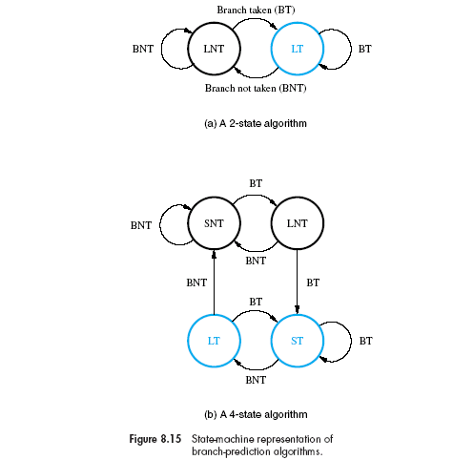

Slide 51
Influence on instruction sets
Some instructions are much better suited to pipelined execution than others.
  For example, instruction side effects can lead to undesirable data dependencies
Relationship between pipelined execution and machine instruction features.
Two key aspects of machine instructions —
  Addressing modes and condition code flags.

Slide 52
Addressing Modes
Addressing modes should provide the means for accessing a variety of data structures simply and efficiently.
  Useful addressing modes include index, indirect, autoincrement, and autodecrement.
  Many processors provide various combinations of these modes to increase the flexibility of their instruction sets.
  Complex addressing modes, such as those involving double indexing, are often encountered.

Slide 53
Addressing Modes
In choosing the addressing modes to be implemented in a pipelined processor,
  We must consider the effect of each addressing mode on instruction flow in the pipeline.
Two important considerations in this regard are
  The side effects of modes such as autoincrement and autodecrement
  The extent to which complex addressing modes cause the pipeline to stall.

Slide 54
Addressing Modes
The load instruction Load X(R1),R2 takes five cycles to complete execution, as indicated in Figure 8.5.
The instruction Load (R1),R2 can be organized to fit a four-stage pipeline because no address computation is required.
A more complex addressing mode may require several accesses to the memory to reach the named operand.

Slide 55
Addressing Modes
For example, the instruction Load (X(R1)),R2 may be executed as shown in Figure 8.16a, assuming that the index offset, X, is given in the instruction word.
If R2 is a source operand in the next instruction, that instruction would be stalled for three cycles, which can be reduced to two cycles with operand forwarding, as shown.

Slide 56
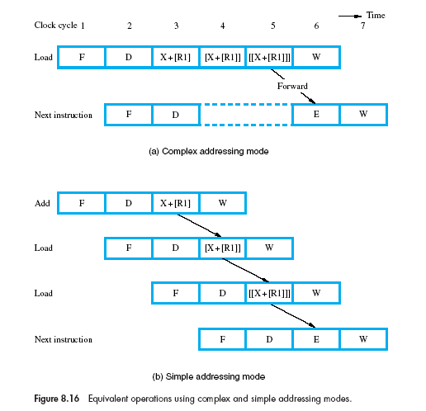

Slide 57
Addressing Modes
To implement the same Load operation using only simple addressing modes requires several instructions.
Add #X,R1,R2
Load (R2),R2
Load (R2),R2

Slide 58
Addressing Modes
Complex addressing modes that involve several accesses to the memory do not necessarily lead to faster execution.
The main advantage of such modes is
  They reduce the number of instructions needed to perform a given task
  and thereby reduce the program space needed in the main memory.
Their main disadvantage is
  Their long execution times cause the pipeline to stall, thus reducing its effectiveness.
  They require more complex hardware to decode and execute them.
  Also, they are not convenient for compilers to work with.

Slide 59
Addressing Modes
The instruction sets of modern processors are designed to take maximum advantage of pipelined hardware.
Because complex addressing modes are not suitable for pipelined execution, they should be avoided.
The addressing modes used in modern processors often have the following features:
  Access to an operand does not require more than one access to the memory.
  Only load and store instructions access memory operands.
  The addressing modes used do not have side effects.

Slide 60
Condition Codes
An optimizing compiler for a pipelined processor attempts to reorder instructions to avoid stalling the pipeline when
  branches or data dependencies between successive instructions occur.
In doing so, the compiler must ensure that reordering does not cause a change in the outcome of a computation.
The dependency introduced by the condition-code flags reduces the flexibility available for the compiler to reorder instructions.

Slide 61
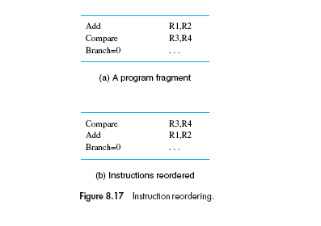

Slide 62
Condition Codes
These observations lead to two important conclusions about the way condition codes should be handled.
  To provide flexibility in reordering instructions
  The compiler should be able to specify in which instructions of a program the condition codes are affected and in which they are not.

Slide 63
Datapath and Control Consideration
Consider the modified three-bus structure for 4-stage pipeline.
The resources involved in stages F and E are shown in blue and those used in stages D and W in black.

Slide 64
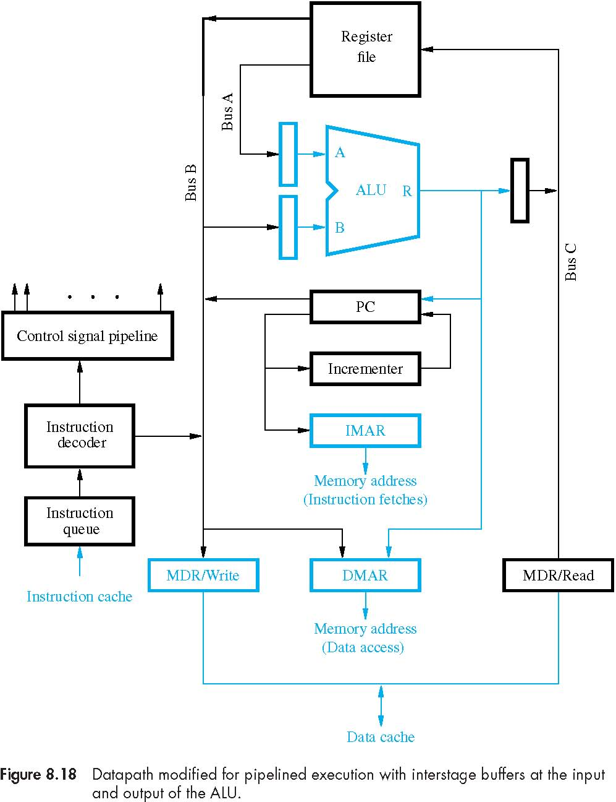

Slide 65
There are separate instruction and data caches that use separate address and data connections to the processor.
The PC is connected directly to the IMAR.

Slide 66
There The data address in DMAR can be obtained directly from the register file or from the ALU to support the register indirect and indexed addressing modes.

Slide 67
There Separate MDR registers are provided for read and write operations.
Buffer registers have been introduced at the inputs and output of the ALU.

Slide 68
The instruction register has been replaced with an instruction queue, which is loaded from the instruction cache.
The output of the instruction decoder is connected to the control signal pipeline.

Slide 69
Datapath and Control Consideration
The following operations can be performed independently in the processor
  Reading an instruction from the instruction cache
  Incrementing the PC
  Decoding an instruction
  Reading from or writing into the data cache
  Reading the contents of up to two registers from the register file
  Writing into one register in the register file
  Performing an ALU operation

Slide 70
Superscaler Operation
A more aggressive approach is to equip the processor with multiple processing units to handle several instructions in parallel in each processing stage
Several instructions start execution in the same clock cycle, and the processor is said to use multiple-issue.
Throughput of more than one instruction per cycle. They are known as superscalar processors.

Slide 71
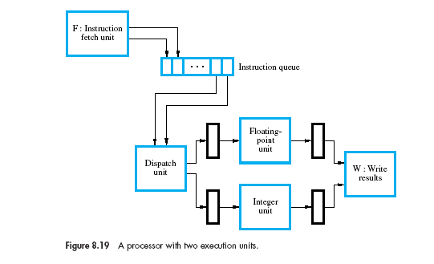

Slide 72
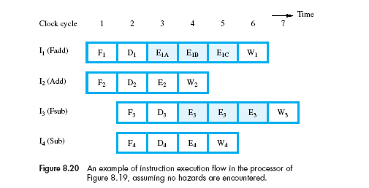

Slide 73
Superscaler Operation
In a superscalar processor, the detrimental effect on performance of various hazards becomes even more pronounced.
The compiler can avoid many hazards through judicious selection and ordering of instructions.
In general, high performance is achieved if the compiler is able to arrange program instructions to take maximum advantage of the available hardware units.

Slide 74
Out-of-Order Execution
In Figure 8.20, instructions are dispatched in the same order as they appear in the program.
However, their execution is completed out of order.
Does this lead to any problems?

Slide 75
Precise and Imprecise Exception
Complication arises when we consider the possibility of an instruction causing an exception.
Exceptions may be caused by a bus error during an operand fetch or by an illegal operation, such as an attempt to divide by zero.

Slide 76
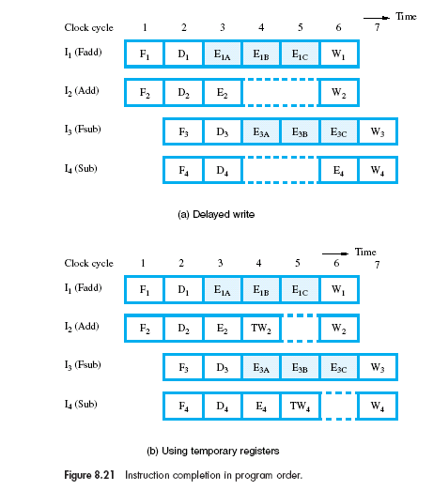

Slide 77
Precise and Imprecise Exception
The results of I2 are written back into the register file in cycle 4.
If instruction I1 causes an exception, program execution is in an inconsistent state.
The program counter points to the instruction in which the exception occurred.
However, one or more of the succeeding instructions have been executed to completion.
If such a situation is permitted, the processor is said to have imprecise exceptions.

Slide 78
Precise and Imprecise Exception
To guarantee a consistent state when exceptions occur, the results of the execution of instructions must be written into the destination locations strictly in program order.
  This means we must delay stepW2 in Figure 8.20 until cycle 6.
  In turn, the integer execution unit must retain the result of instruction I2,
  hence it cannot accept instruction I4 until cycle 6, as shown
If an exception occurs during an instruction, all subsequent instructions that may have been partially executed are discarded.
This is called a precise exception.

Slide 79
Execution Completion
It is desirable to use out-of-order execution, so that an execution unit is freed to execute other instructions as soon as possible.
At the same time, instructions must be completed in program order to allow precise exceptions.
Conflicting Requirements?

Slide 80
Execution Completion
Execution is allowed to proceed as shown in Figure 8.20, but the results are written into temporary registers.
The contents of these registers are later transferred to the permanent registers in correct program order.
This step is often called the commitment step
  the effect of the instruction cannot be reversed after that point.
  If an instruction causes an exception, the results of any subsequent instruction that has been executed would still be in temporary registers and can be safely discarded.

Slide 81
Execution Completion
When out-of-order execution is allowed, a special control unit called commitment unit is needed to guarantee in-order commitment.
It uses a queue called the reorder buffer to determine which instruction(s) should be committed next.
Instructions are entered in the queue strictly in program order as they are dispatched for execution.

Slide 82
Execution Completion
When an instruction reaches the head of that queue and the execution of that instruction has been completed
  the corresponding results are transferred from the temporary registers to the permanent registers
  the instruction is removed from the queue.
  All resources that were assigned to the instruction, including the temporary registers are released.
The instruction is retired only when it is at the head of the queue, all instructions that were dispatched before it must also have been retired.
Instructions may complete execution out of order, but they are retired in program order.

Slide 83
Dispatch Completion
When dispatching decisions are made, the dispatch unit must ensure that all the resources needed for the execution of an instruction are available.
Should instructions be dispatched out of order?
We must ensure that there is no possibility of a deadlock occurring.

Slide 84
Dispatch Completion
A deadlock is a situation that can arise when two units, A and B, use a shared resource.
Suppose that unit B cannot complete its task until unit A completes its task.
At the same time, unit B has been assigned a resource that unit A needs.
If this happens, neither unit can complete its task.
Unit A is waiting for the resource it needs, which is being held by unit B. At the same time, unit B is waiting for unit A to finish before it can release that resource.

Slide 85
Dispatch Completion
Thus, the program order of instructions is enforced
  At the time instructions are dispatched.
  Again at the time instructions are retired.
Between these two events, the execution of several instructions can proceed at their own speed.

Slide 86

Performance Consideration
T = the execution time of a program
N = number of dynamic instruction
S = the average number of clock cycles it takes
to fetch and execute one instruction,
R = the clock rate

Slide 87
Performance Consideration
For sequential execution, the throughput, Ps is given by
Ps = R / S
The only real measure of performance is the total execution time of a program.
Higher instruction throughput will not necessarily lead to higher performance if a larger number of instructions is needed to implement the desired task.

Slide 88
Effect of Instruction Hazards
Any time a pipeline is stalled, the instruction throughput is reduced.
Hence, the performance of a pipeline is highly influenced by factors such as
  branch and cache miss penalties.

Slide 89
Effect of Instruction Hazards
Let the delay through the ALU be the critical parameter.
  This is the time needed to add two integers. Thus, if the ALU delay is 2 ns, a clock of 500 MHz can be used.
The on-chip instruction and data caches for this processor should also be designed to have an access time of 2 ns.
Under ideal conditions, this pipelined processor will have an instruction throughput, Pp, given by
Pp = R = 500 MIPS (million instructions per second)

Slide 90
Effect of Instruction Hazards
Let T_{I} be the time between two successive instruction completions completions.
  For sequential execution, T_{I} = S.
  However, in the absence of hazards, a pipelined processor completes the execution of one instruction each clock cycle, thus T_{I} = 1.
A cache miss stalls the pipeline by an amount equal to the cache miss penalty.
  This means that the value of T_{I} increases by an amount equal to the cache miss penalty for the instruction in which the miss occurs

Slide 91
Effect of Instruction Hazards
The average increase in the value of TI as a result of cache misses is given by
The cache miss penalty, Mp = 17 clock cycles.
h_{i} and h_{d} are the hit ratios for instructions and data, respectively.
Assume that 30 percent of the instructions access data in memory. With a 95-percent instruction hit rate and a 90-percent data hit rate, δ_{miss} is given by
  δ_{miss} = (0.05 + 0.3x 0.1) X 17 = 1.36 cycles

Slide 92
Effect of Instruction Hazards
Taking this delay into account, the processor’s throughput would be
P_{p} = (R / T_{I}) = R /(1+ δ_{miss})=0.42R
For R = 500 MHz P_{P}= 210 MIPS
Let us compare this value to the throughput obtainable without pipelining.
A processor that uses sequential execution requires four cycles per instruction. Its throughput would be
P_{s} = (R / T_{I}) = R /(4+ δ_{miss})=0.19R
For R = 500 MHz P_{P}= 95 MIPS
Performance gain = (0.42/0.19) = 2.2

Slide 93
Effect of Instruction Hazards
Introduce a secondary cache between the primary, on-chip cache and the memory.
Assume that the time needed to transfer an 8-word block from the secondary cache is 10 ns.
Hence, a miss in the primary cache for which the required block is found in the secondary cache introduces a penalty, M_{s} of 5 cycles.
In the case of a miss in the secondary cache, the full 17-cycle penalty (M_{p}) is still incurred.
Hence, assuming a hit rate h_{s} of 94 percent in the secondary cache,
Find the average increase in T_{I}

Slide 94
Effect of Instruction Hazards
Taking this delay into account, the processor’s throughput would be
P_{p} = (R / T_{I}) = R /(1+ δ_{miss})=0.68R
For R = 500 MHz P_{P}= 340 MIPS
Let us compare this value to the throughput obtainable without pipelining.
A processor that uses sequential execution requires four cycles per instruction. Its throughput would be
P_{s} = (R / T_{I}) = R /(4+ δ_{miss})=0. 22R
For R = 500 MHz P_{P}= 110 MIPS
Performance gain = (0.68/0.22) = 3.1

Slide 95
Effect of Instruction Hazards
Estimation of the effect of branch penalty on instruction throughput
A processor that uses an instruction queue benefits from branch folding.
  In this case, the branch instruction is executed by the instruction fetch unit in parallel with other instructions
  It does not add to the execution time of the program.
  Program execution proceeds as if the branch instruction is not there
Where branch prediction is used, correctly predicted branches also benefit from branch folding.

Slide 96
Effect of Instruction Hazards
This effect can be modeled by saying that the branch penalty is –1 for unconditional branch instructions and for conditional branch instructions in which the branch condition is already known.
In case of an incorrectly predicted branch or in situations where branch prediction is not used, a penalty of several cycles is incurred.

Slide 97
Effect of Instruction Hazards
Assume 20% of dynamic instruction count in a program consists of branch instructions
No branch prediction is used
30 percent branch instructions benefit from branch folding
Remaining branch instructions incur a penalty of 2 cycles
The average branch penalty is
δ_{branch} = 0.2(0.3 X –1 + 0.7 X 2) = 0.82 cycle
Throughput = 0.55R

Slide 98
Effect of Instruction Hazards
Assume 20% of dynamic instruction count in a program consists of branch instructions
Branch prediction is used
80 percent branch instructions benefit from branch folding
Remaining branch instructions incur a penalty of 2 cycles
The average branch penalty is
δ_{branch} = 0.2(0.8 X –1 + 0.2 X 2) = -0.08 cycle
Throughput = 1.09R

Slide 99
Effect of Instruction Hazards
The combined effect of cache miss and branch penalties on instruction throughput can be computed as follows:
Assume that the computer has primary and secondary caches and uses branch prediction
Throughput = R/(1+ δ_{branch}+ δ_{miss})
= R/(1+(-0.8)+0.46)
= 0.72R

Slide 100
Number of Pipeline Stages
Four-stage pipeline may increase instruction throughput by a factor of four.
In general, an n-stage pipeline has the potential to increase throughput n times.
Thus, it would appear that the higher the value of n, the larger the performance gain
What is a good value for n?

Slide 101
Number of Pipeline Stages
As the number of pipeline stages increases, so does the probability of the pipeline being stalled, because
  More instructions are being executed concurrently.
  Thus, dependencies between instructions that are far apart may still cause the pipeline to stall.
  Also, branch penalties may become more significant
For these reasons, the gain from increasing the value of n begins to diminish, and the associated cost is not justified.

Slide 102
Number of Pipeline Stages
Another important factor is the inherent delay in the basic operations performed by the processor.
  The most important among these is the ALU delay.
  In many processors, the cycle time of the processor clock is chosen such that one ALU operation can be completed in one cycle.
  Other operations are divided into steps that take about the same time as an add operation

Slide 103
Thank You

