Slide 1
What is Object Oriented Programming(OOP) ?
OOP is a programming paradigm which mainly focuses on the concept of “objects” to construct the real world scenario to solve real world problem through programming.

Slide 2
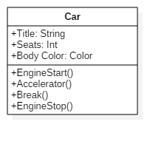

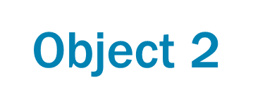
Class
Object 1

Slide 3
Principles of OOP
Abstraction
Encapsulation
Inheritance
Polymorphism

Slide 4
Abstraction
Abstraction means implementation hiding
When a user calls printf() and use it C program without knowing how it is implemented, Then it is Abstraction

Slide 5
Encapsulation
Encapsulation means data hiding
Encapsulation is binding data and methods together to protect it from outer world

Slide 6
Abstraction vs Encapsulation
Encapsulation means data hiding
Encapsulation is binding data and methods together to protect it from outer world

Slide 7

Why is it important?
Secure data storage

Slide 8

Why is it important?
Ease of access

Slide 9

Why is it important?
Always availability

Slide 10

Why is it important?
Saves your money

Slide 11
Types of Enterprise Storage
Direct attached storage
Network attached storage
Storage area network

Slide 12
DAS Direct Attached Storage
DAS referred to a storage that is directly attached to a server

Slide 13

Advantages of DAS
High availability
High access rate
Data security

Slide 14

Disdvantages of DAS
Not Scalable
Allow only one user at a time
High administrative cost

Slide 15
NAS Network Attached Storage
Provides a file sharing system or storage management system
Act Upon Ethernet

Slide 16


