Slide 1
What is Object Oriented Programming(OOP) ?
OOP is a programming paradigm which mainly focuses on the concept of “objects” to construct the real world scenario to solve real world problem through programming.

Slide 2
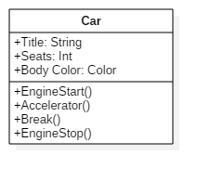


Class
Object 1

Slide 3
Principles of OOP
Abstraction
Encapsulation
Inheritance
Polymorphism

Slide 4
Abstraction
Abstraction means implementation hiding
When a user calls printf() and use it C program without knowing how it is implemented, Then it is Abstraction

Slide 5
Encapsulation
Encapsulation means data hiding
Encapsulation is binding data and methods together to protect it from outer world

Slide 6

Abstraction vs Encapsulation
ATM Machine
Abstraction – Cash withdraw
Encapsulation – Can not change statements

Slide 7
Inheritance
Inheritance means borrowing
In OOP, Inheritance is a mechanism in which one class acquires the property of another class

Slide 8


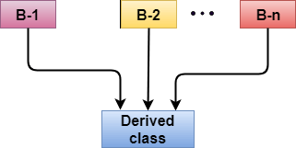
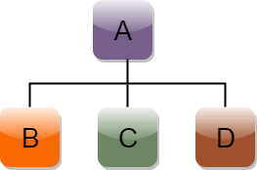
Types of Inheritance
Single
Multiple
Hierarchical
Multilevel

Slide 9
Polymorphism
The term polymorphism is the combination of “poly” + “morphs” means which means many forms

Slide 10
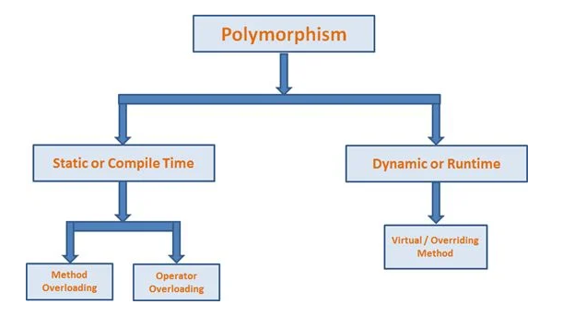
Types of Polymorphism

Slide 11


