Slide 1
Object Oriented Programming
Muhammad Sad Al Munir
Tracking ID: 480484

Slide 2
What is Object Oriented Programming(OOP)
OOP is a programming paradigm which mainly focuses on the concept of “objects” to construct the real world scenario to solve real world problem through programming.

Slide 3
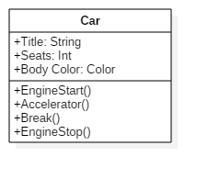


Class
Object 1

Slide 4
Principles of OOP
Abstraction
Encapsulation
Inheritance
Polymorphism

Slide 5
Abstraction
Abstraction means implementation hiding
When a user calls printf() and use it C program without knowing how it is implemented, Then it is Abstraction

Slide 6
Encapsulation
Encapsulation means data hiding
Encapsulation is binding data and methods together to protect it from outer world

Slide 7

Abstraction vs Encapsulation
ATM Machine
Abstraction – Cash withdraw
Encapsulation – Can not change statements

Slide 8
Inheritance
Inheritance means borrowing
In OOP, Inheritance is a mechanism in which one class acquires the property of another class

Slide 9


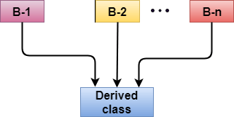
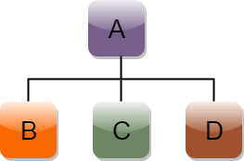
Types of Inheritance
Single
Multiple
Hierarchical
Multilevel

Slide 10
Polymorphism
The term polymorphism is the combination of “poly” + “morphs” means which means many forms

Slide 11
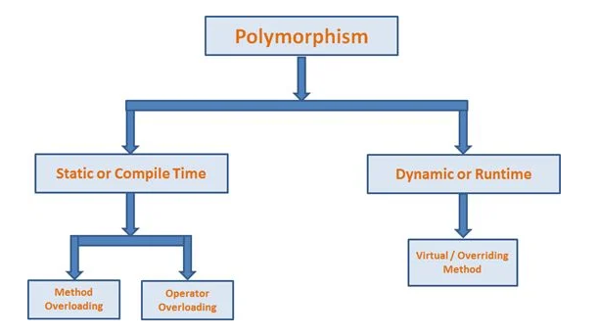
Types of Polymorphism

Slide 12
Compile Time Polymorphism
Invoked at compile time
Faster than run time polymorphism
Less flexible than run time polymorphism
Also known as early binding

Slide 13
Run Time Polymorphism
Invoked at run time
slower than compile time polymorphism
flexible than compile time polymorphism
Also known as late binding

Slide 14


