Slide 1

Enterprise Storage System
Presentation by
Shah Mohammad Imran Hossain

Slide 2
What is Enterprise?
Enterprise basically means big or large business entity

Slide 3
What is Enterprise Storage?
Enterprise storage means the data storage system which is used for storing, manipulating, backing up data of an enterprise

Slide 4

Why is it important?

Slide 5
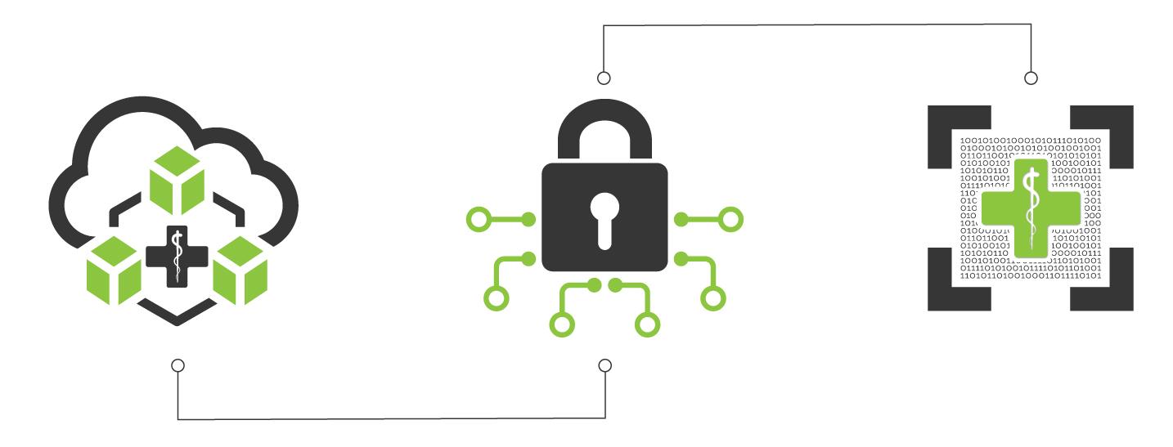
Why is it important?
Secure data storage

Slide 6

Why is it important?
Ease of access

Slide 7
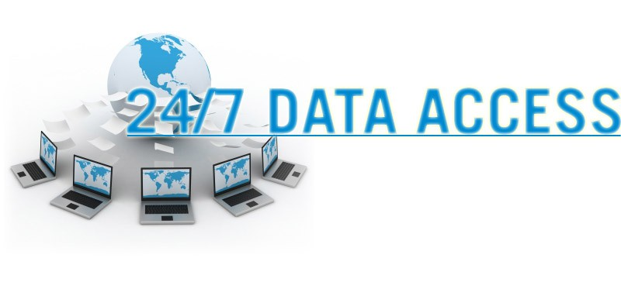
Why is it important?
Always availability

Slide 8

Why is it important?
Saves your money

Slide 9
Types of Enterprise Storage
Direct attached storage
Network attached storage
Storage area network

Slide 10
DAS Direct Attached Storage
DAS referred to a storage that is directly attached to a server

Slide 11

Advantages of DAS
High availability
High access rate
Data security

Slide 12

Disdvantages of DAS
Not Scalable
Allow only one user at a time
High administrative cost

Slide 13
NAS Network Attached Storage
Provides a file sharing system or storage management system
Act Upon Ethernet

Slide 14
Advantages of NAS
Accessibility
Scalability
Cheaper
User friendly

Slide 15
Disadvantages of NAS
Slower Process
Dependency upon network

Slide 16
SAN Storage Area Network
SAN describes a data network
It provides block-level storage
SAN runs on LAN or WAN type network

Slide 17
Advantages of SAN
Scalability
Performance
Data Isolation
Uptime

Slide 18
Disdvantages of SAN
Distance Problem
Costly

Slide 19


