Slide 1

Object Oriented Programming
Presentation
by
Shad Al Munir

Slide 2
What is Object Oriented Programming(OOP) ?
OOP is a programming paradigm which mainly focuses on the concept of “objects” to construct the real world scenario to solve real world problem through programming.

Slide 3
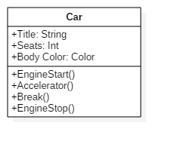

Object 1

Slide 4
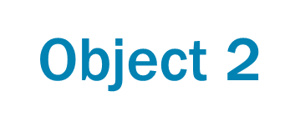
Object 1

Slide 5
Why is it important?

Slide 6
What is Enterprise Storage?
Enterprise storage means the data storage system which is used for storing, manipulating, backing up data of an enterprise

Slide 7

Why is it important?
Secure data storage

Slide 8

Why is it important?
Ease of access

Slide 9
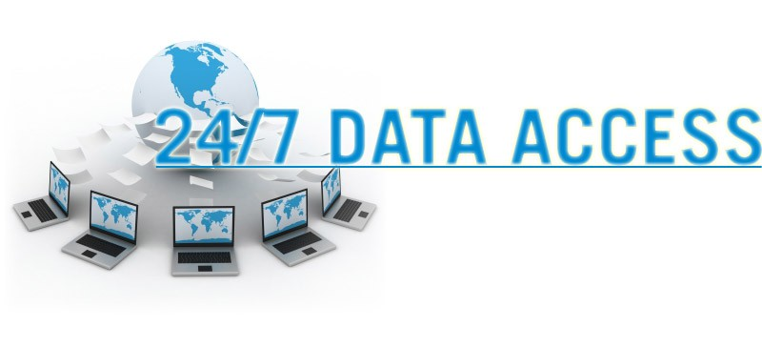
Why is it important?
Always availability

Slide 10

Why is it important?
Saves your money

Slide 11
Types of Enterprise Storage
Direct attached storage
Network attached storage
Storage area network

Slide 12
DAS Direct Attached Storage
DAS referred to a storage that is directly attached to a server

Slide 13

Advantages of DAS
High availability
High access rate
Data security

Slide 14

Disdvantages of DAS
Not Scalable
Allow only one user at a time
High administrative cost

Slide 15
NAS Network Attached Storage
Provides a file sharing system or storage management system
Act Upon Ethernet

Slide 16


