Slide 1

Object Oriented Programming
Presentation
by
Shad Al Munir

Slide 2
What is Object Oriented Programming(OOP) ?
OOP is a programming paradigm which mainly focuses on the concept of “objects” to construct the real world scenario to solve real world problem through programming.

Slide 3
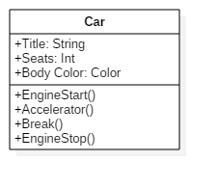

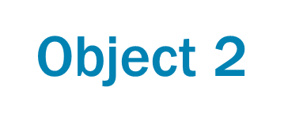
Class
Object 1

Slide 4
What is Enterprise Storage?
Enterprise storage means the data storage system which is used for storing, manipulating, backing up data of an enterprise

Slide 5

Why is it important?
Secure data storage

Slide 6

Why is it important?
Ease of access

Slide 7
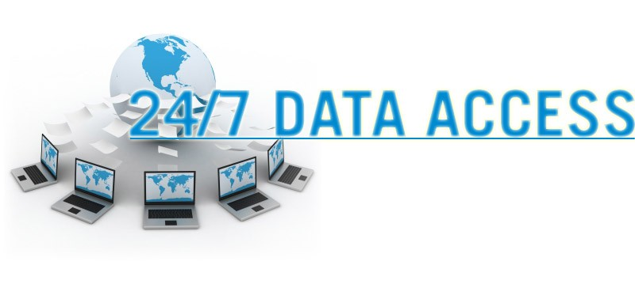
Why is it important?
Always availability

Slide 8

Why is it important?
Saves your money

Slide 9
Types of Enterprise Storage
Direct attached storage
Network attached storage
Storage area network

Slide 10
DAS Direct Attached Storage
DAS referred to a storage that is directly attached to a server

Slide 11

Advantages of DAS
High availability
High access rate
Data security

Slide 12

Disdvantages of DAS
Not Scalable
Allow only one user at a time
High administrative cost

Slide 13
NAS Network Attached Storage
Provides a file sharing system or storage management system
Act Upon Ethernet

Slide 14


