Slide 1
What is Object Oriented Programming(OOP) ?
OOP is a programming paradigm which mainly focuses on the concept of “objects” to construct the real world scenario to solve real world problem through programming.

Slide 2
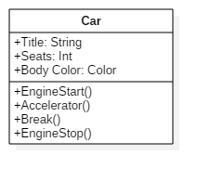

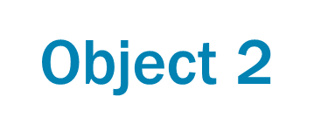
Class
Object 1

Slide 3
Principles of OOP
Abstraction
Encapsulation
Inheritance
Polymorphism

Slide 4
Abstraction
Abstraction means implementation hiding
When a user calls printf() and use it C program without knowing how it is implemented, Then it is Abstraction

Slide 5
Encapsulation
Encapsulation means data hiding
Encapsulation is binding data and methods together to protect it from outer world

Slide 6

Abstraction vs Encapsulation
ATM Machine
Abstraction – Cash withdraw
Encapsulation – Can not change statements

Slide 7
Inheritance
Inheritance means

Slide 8
Inheritance
Inheritance means

Slide 9
Polymorphism
Inheritance means

Slide 10

Why is it important?
Secure data storage

Slide 11

Why is it important?
Ease of access

Slide 12

Why is it important?
Always availability

Slide 13

Why is it important?
Saves your money

Slide 14
Types of Enterprise Storage
Direct attached storage
Network attached storage
Storage area network

Slide 15
DAS Direct Attached Storage
DAS referred to a storage that is directly attached to a server

Slide 16

Advantages of DAS
High availability
High access rate
Data security

Slide 17

Disdvantages of DAS
Not Scalable
Allow only one user at a time
High administrative cost

Slide 18
NAS Network Attached Storage
Provides a file sharing system or storage management system
Act Upon Ethernet

Slide 19


