Slide 1
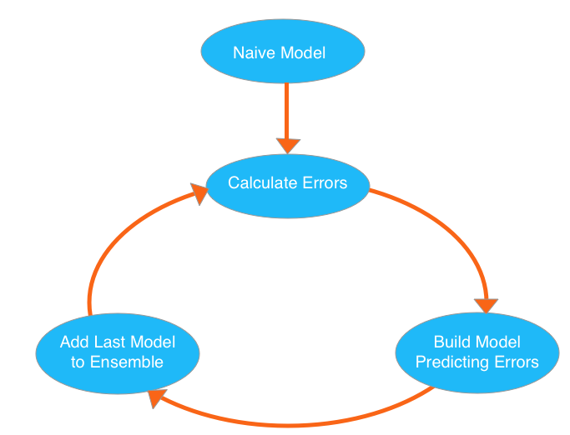
XGBoost (Extreme gradient boosting)
The idea behind this is to start with a simple model and then build another model that corrects the errors of that model
This process is repeated until accuracy cannot be improved

