Slide 1
COVASIM Analysis P3
Produced: 01/14/2021

Slide 2
COVASIM Parameters - Health
# Population parameters
pars['pop_size'] = 20e3 # Number of agents, i.e., people susceptible to SARS-CoV-2
pars['pop_infected'] = 10 # Number of initial infections
pars['pop_type'] = 'random' # What type of population data to use -- random (fastest), synthpops (best), hybrid (compromise), or clustered (not recommended) # Efficacy of protection measures
pars['asymp_factor'] = 1.0 # Multiply beta by this factor for asymptomatic cases; no statistically significant difference in transmissibility
pars['quar_period'] = 14 # Number of days to quarantine for; assumption based on standard policies

Slide 3
COVASIM Parameters - Health
# Duration parameters: time for disease progression
pars['dur'] = {}
Duration from exposed to infectious
Duration from infectious to symptomatic
Duration from symptomatic to severe symptoms
Duration from severe symptoms to requiring ICU # Health system parameters
The number of hospital (adult acute care) beds available for severely ill patients (default is no constraint)
The number of ICU beds available for critically ill patients (default is no constraint)
Multiplier for how much more likely severely ill people are to become critical if no hospital beds are available
Multiplier for how much more likely critically ill people are to die if no ICU beds are available

Slide 4
Program Elements
Covasim is a pre-populated with demographic data on population age structures and household sizes by country, and uses these data to generate population contact networks for the setting
Covasim accounts for testing strategies via parameters that determine the probabilities with witch people with different symptoms receive a test each day
Examples of these strategies can include; wearing masks to prevent the spread, isolation or quarantine of a specific population or the closure of the workforce / schools

Slide 5
Known(s) / Assumptions
We assume that transmission within schools is proportional to school years going back, witch allows parents to go back to work. We thus assume that the return of workplace is proportional to schools
We assume that 30% of the workforce will remain working from home for the foreseeable future.
High Compliance to masks in community setting and in schools
Community contacts reduce to 68% of normal during termtime and 58% during the holidays

Slide 6
How The Data Was Aggregated
The COVASIM model uses a .XLXS file that takes in the number of infected vs recovered individuals from the beginning of 2019 (02/22/2019) to current date. This data was sourced from humandata.org
From A Simulation was based upon the following parameters
Begin with an infected population of 1,500
2020-03-05 #Testing Begins in Canada and increases every thirty days
2020-09-05 #Schools begin to reopen on a part time basis, ending in Dec, and reopening in Jan.

Slide 7
Intervention Dates
These are dates that are chosen to have non pharmaceutical interventions(NPI’s) throughout the course of the pandemic that have had a significant impact on the progression and transmission of cases.
2020-03-05 – Intervention of some basic testing begins
2020-04-05 – Increased testing occurs
2020-07-01 – Intervention of increased tracing and tracking
2020-07-15 – Mask wearing is beginning to take in effect
2020-08-15 – Mask wearing increased as bylaw takes in effect for Ontario
2020-09-11 – Secondary schools re-open
2020-10-23 – Holiday Lockdown Begins from late oct - Dec
2020-11-23 -- Ontario begins to lock down some portions of high risk cities
2020-12-26 -- Ontario enters into the holiday lockdown
2021-01-25 -- Ontario schools scheduled to reopen *Since change will no longer occure *Further Dates to include March Holiday Break,

Slide 8
Contact Tracing
From Emily’s study we can conclude that contact tracing levels where aprox around these values from Jun-Dec t_eff_june = 0.50
t_eff_july = 0.50
t_eff_aug = 0.60
t_eff_sept = 0.65
t_eff_oct = 0.70
t_eff_nov = 0.60
t_eff_dec = 0.60

Slide 9
Proposed Beta Days
These are the dates / weeks where we saw significant change in Rt and time periods where we saw transmission at it’s highest
2020-02-14
2020-03-20
2020-04-17
2020-07-17
2020-08-26
2020-09-04
2020-10-16
2020-11-06
2020-12-26
2021-01-11
2021-03-21 #March Break
2021-07-04 #School Ending In July 2021
2021-09-01 #School Reopening Sept 2021

Slide 10
Results From 01/13/2021
Baseline Simulation Cases – 653,874
30% Compliance to masking cases – 346,454
60% Compliance to masking cases – 325,088
90% Compliance to masking cases – 244,244

Slide 11
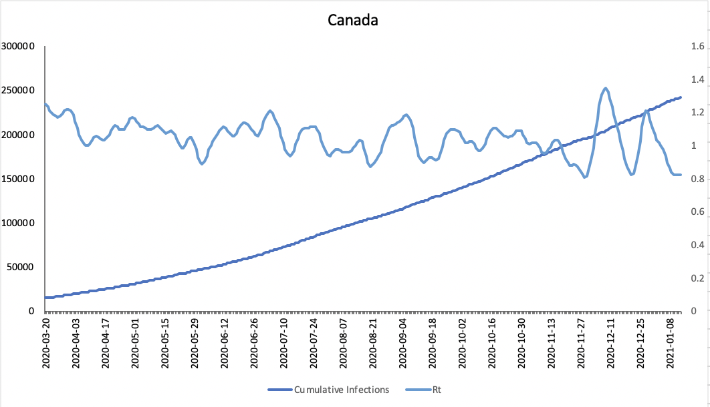
Overlay of Rt calculated x Rt covasim Baseline Simulation

Slide 12
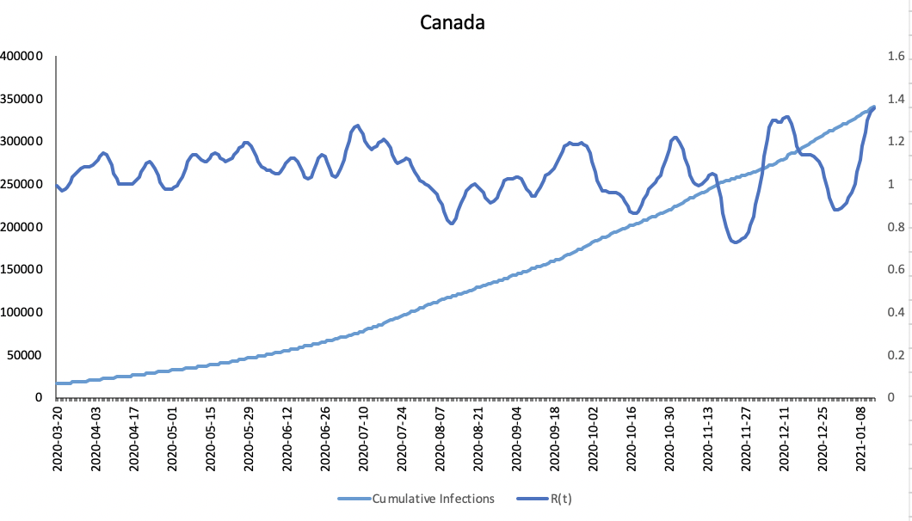
Overlay of simulated cases 30% Coverage Simulation

Slide 13
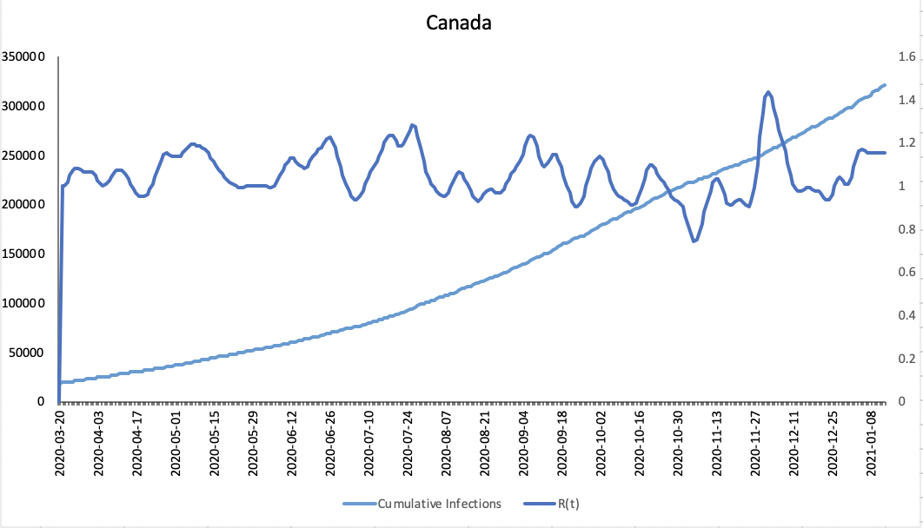
Overlay of Rt calculated x Rt covasim 60% Compliance to masking

Slide 14
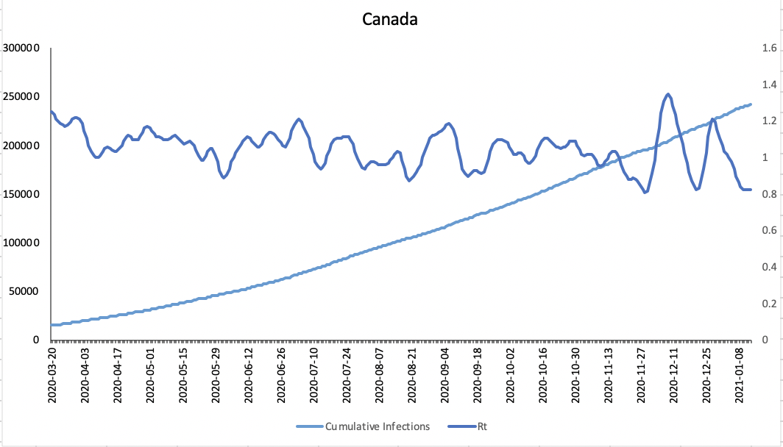
Overlay of Rt calculated x Rt covasim 90% Compliance to masking

Slide 15
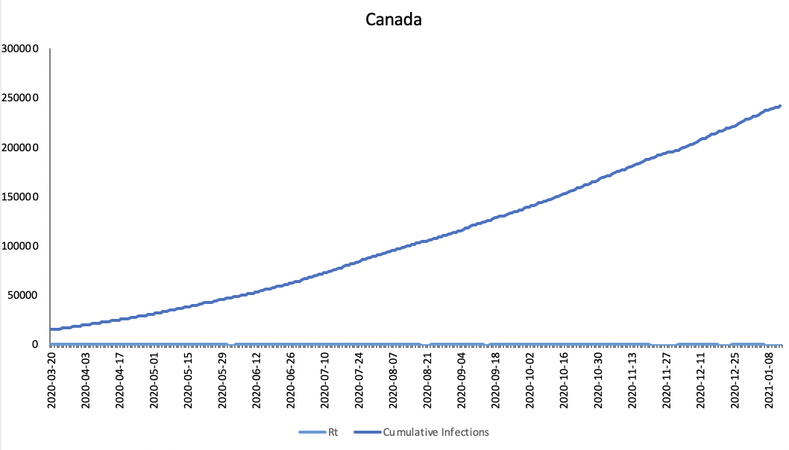
Overlay of simulated cases 90% Coverage Simulation

Slide 16
Results
Below is a graph showing the current R(t) number produced in our program vs those produced in COVASIM
What we can see here is that there is very minor differences in the historical data possibly indicating signs that if schools remain open we face resulting our situation back to what we saw in prior months May / June

