Slide 1

CARE: CARDIAC ATTACK RISK ESTIMATION USING MACHINE LEARNING
Under The Supervision of
Mr.N.Ashok M.Tech;
Assistant Professor
Presented By
PATAN IMRAN KHAN - 20BQ1A12C6
K. SURYA RATNA - 20BQ1A1287
M.N.V YASASWI - 21BQ5A1214
MEDA GOPI KRISHNA - 20BQ1A12A8
Department of Information Technology
Vasireddy Venkatadri Institute of Technology
Padakakani Mandal, Namburu, Guntur-522508

Slide 2
Contents Outline
1. Abstract
2. Introduction
3. Existing System with Architecture.
4. Proposed System Architecture with Advantages.
5. Proposed System Objectives
6. Hardware and Software Requirements.
7. Proposed System Design & Implementation.
7.1. Design: - Data Flow Diagrams, UML diagrams.
7.2. Implementation: -Modules& how Software/Hardware used
8. sample Test Cases are
9. Output
10. Conclusion.
11. Future Enhancement.
12. References.
13. Queries & Thankyou.

Slide 3
Abstract
Our project is a system that uses the predictive capability of machine learning models based on similar data points collected in the past. It predicts the risk of a heart attack based on the data provided by the user regarding their physicality,symptoms, and medical history. Our project will estimate the risk of having a heart attack in the coming future. Our system takes input data and runs a Machine Learning Model on the data and gives the result.
The aim is to provide users with remote access to screening facilities that are capable of identifying low and high-risk individuals, thereby reducing the load on the medical system. Heart attack risk predictor is an online platform designed and developed to explore the path of machine learning. The goal is to predict the risk of a heart attack in a patient from collective data, to be able to detect configurations at risk for the patient, andtherefore, in cases requiring emergency medical assistance, alert the appropriate medical staff of the situation of the latter.

Slide 4
Introduction
Heart attack risk predictor is an online platform designed and developed to explore the path of machine learning
The goal is to predict the risk of heart attack in a patient from collective data
so as to be able to detect configurations at risk for the patient, and therefore, in cases requiring emergency medical assistance
alert the appropriate medical staff of the situation of the latter.
By analyzing the data we can predict the risk of heart attack in our project
. Machine learning algorithms can also be helpful in providing vital statistics, real-time data and advanced analytics in terms of the patient’s disease, lab test results, blood pressure, family history, clinical trial data, etc., to doctors.
The heart is a crucial part of our bodies, and heart disease has become theleading cause of death globally. According to the WHO, anestimated 17.9 million people died from heart disease in 2016,representing 31% of all global deaths.

Slide 5
A prediction system to identify cardiac disease using a patient's medical data collection should be developed, according to Ashwini Shetty A and Chandra Naik 2016
15 risk factors were used as inputs for the system.
Data pre-processing and then, data integration were done after the initial study of data from the dataset.
A system was created which used a historical cardiac database to give the patient’s diagnosis
All of the 15 different parameters were used to make the system.
Cardiovascular diseases are still a major cause of morbidity among people all over the world. Risk prediction is a tough task for medical practitioners as it is a difficult task that demands a lot of information and experience in the medical field
Our goal is to create a good machine learning approach for predicting the risk of cardiac disease(heart attack) that is both computationally efficient and accurate.

Slide 6
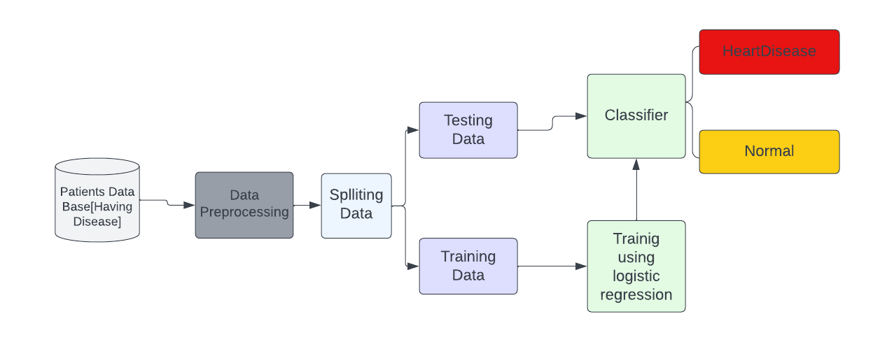
Existing System with Architecture

Slide 7
Existing System with Disadvantages
Heart Disease estimation using Logistic Regression
It's important to choose an appropriate model and follow a consistent methodology for accurate predictions
Depending on the distribution of the data and the inherent complexities of heart attack risk estimation, logistic regression might not achieve the desired level of accuracy and might not generalize well to new, unseen data.
Logistic regression is fundamentally a linear model, which means it might not be able to capture intricate and complex patterns in the data that more flexible models can.
If the dataset contains non-numeric features like categorical variables, they need to be converted into a suitable format for logistic regression. This can introduce complexities

Slide 8
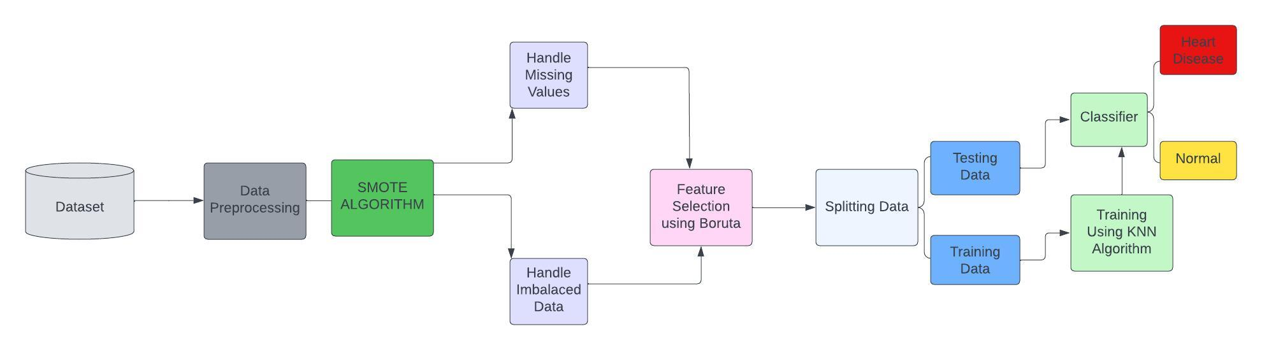
Proposed System with Architecture

Slide 9
Objectives of Proposed System
This proposed system have a data which classified if patients have heart disease or not according to features in it.
This proposed system can try to use this data to create a model which tries predict(reading data and data Exploration) if a patient has this disease or not
K Nearest Neighbor algorithm falls under the Supervised Learning category and is used for classification (most commonly) and regression
It is a versatile algorithm also used for imputing missing values and resampling datasets.
As the name (K Nearest Neighbor) suggests it considers K Nearest Neighbors (Data points) to predict the class or continuous value for the new Datapoint.
K-NN is a non-parametric algorithm, which means it does not make any assumption on underlying data.

Slide 10
System Requirements
Hardware Configuration
Disk Storage : 1TB HDD or 256GB SSD
Ram : 4GB or above
Processor : i3 or above
Software Configurations
Operating System : Microsoft Windows 08 or above
Code Editor : Google colab
Languages : Python 3.7 or above
Libraries : Sklearn, Borutapy, Matplotlib.

Slide 11
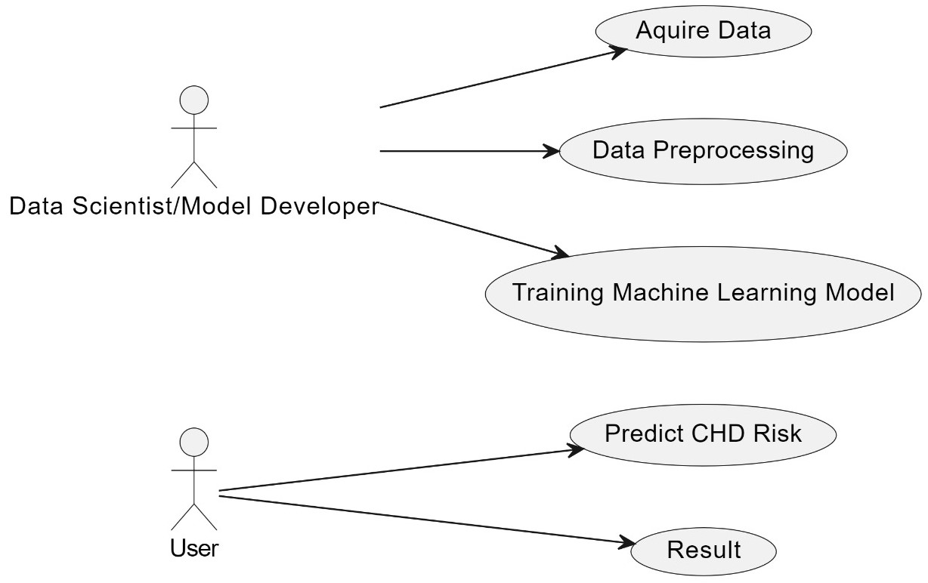
UseCase Diagram

Slide 12
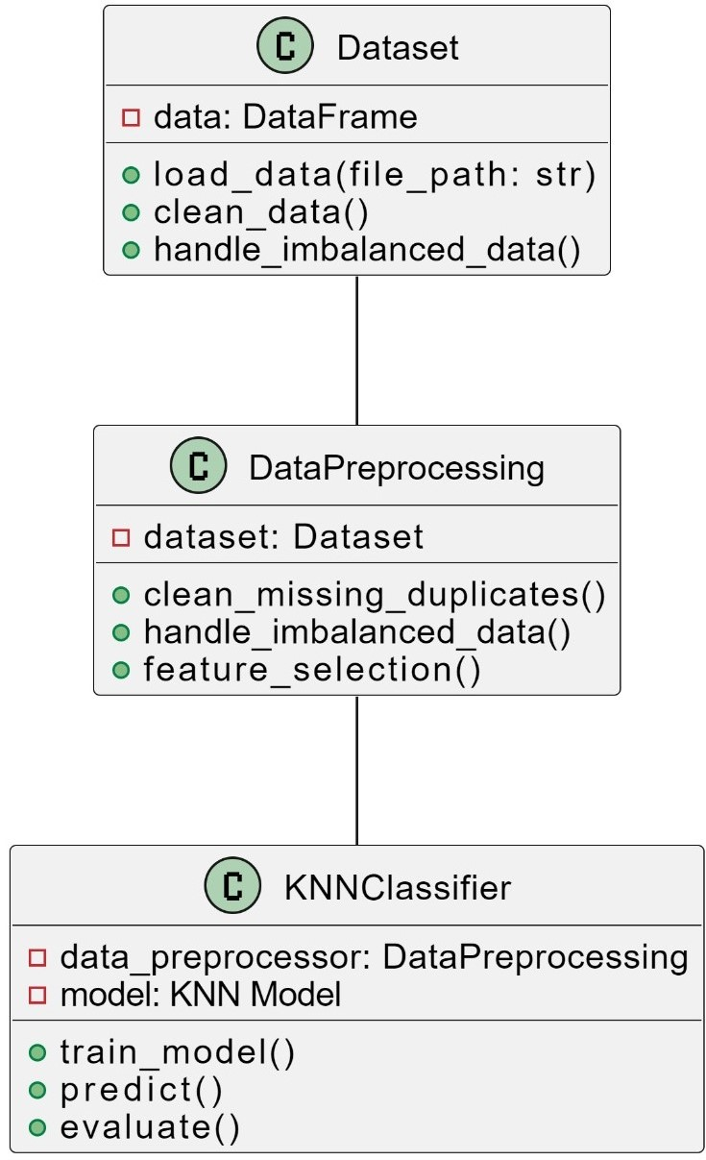
Class Diagram

Slide 13
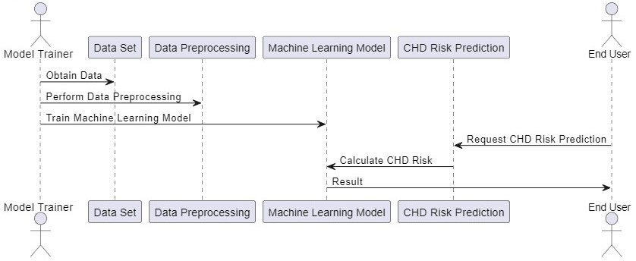
Sequence Diagram

Slide 14
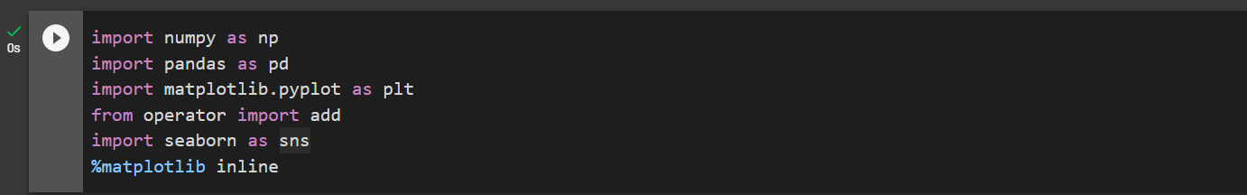
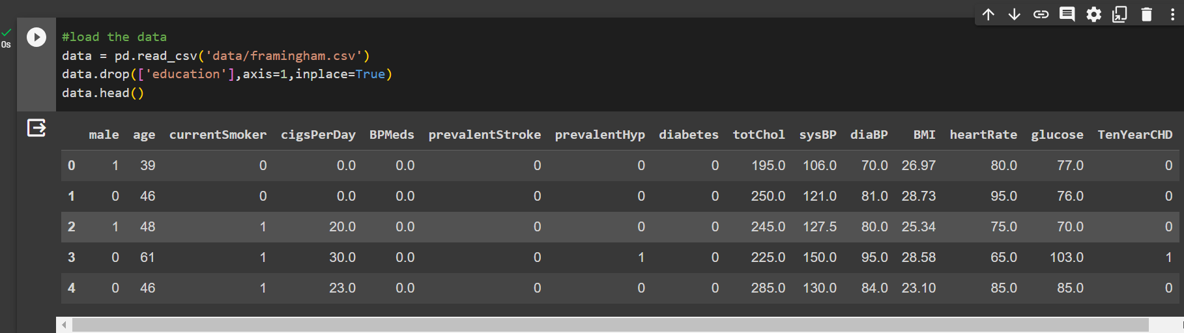
Implementation
step 1.Library Import and Environment
step 2.Data Loading

Slide 15
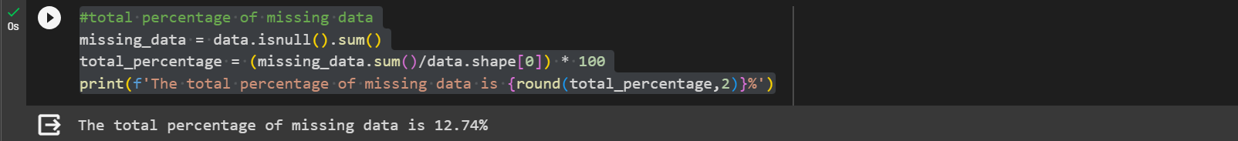
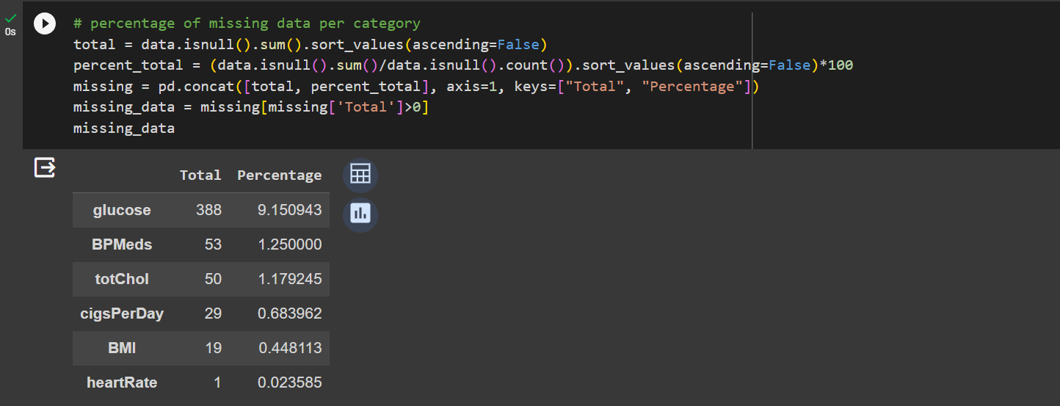
step 3.Calculate and Display Total Missing Data Percentage
step 4.Percentage of Missing data per category

Slide 16
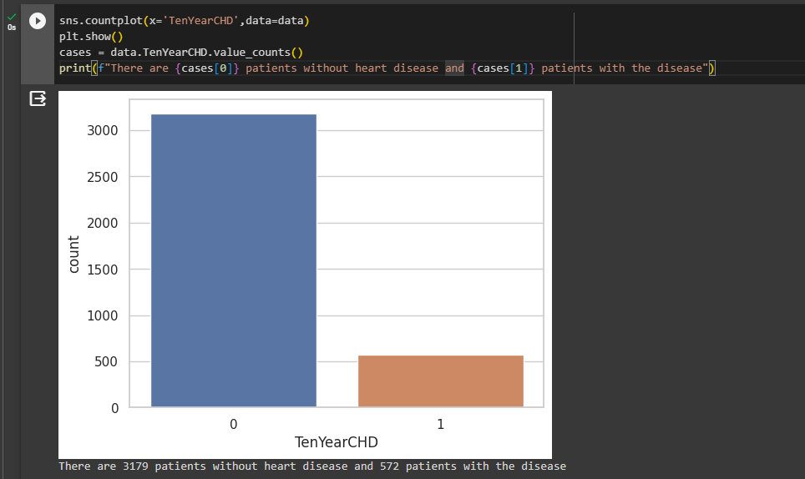
step 5.Calculating Number of patients without heart disease and with haert disease

Slide 17
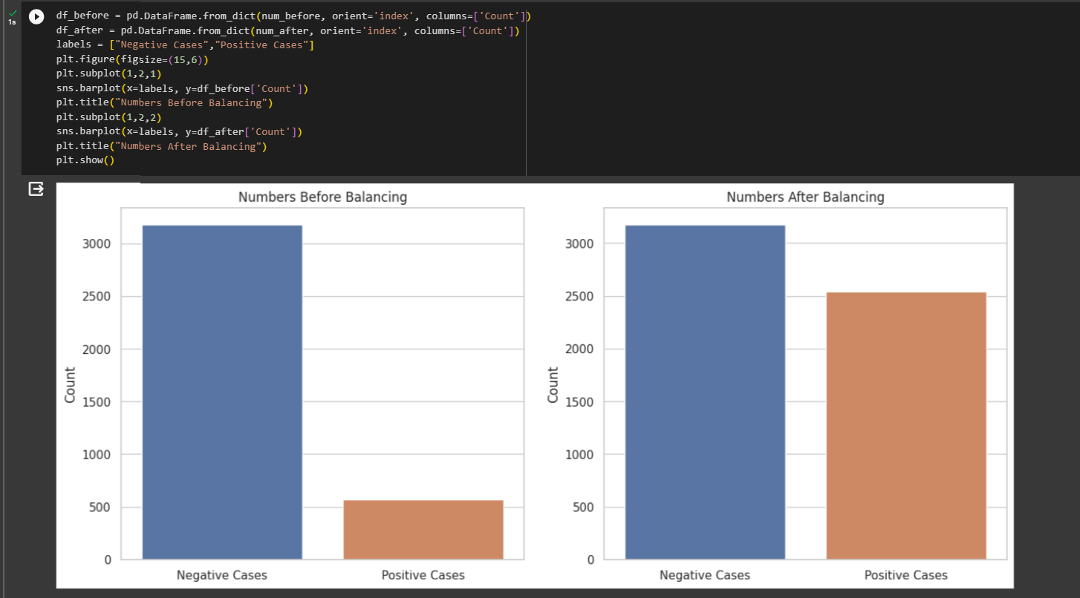
step 6.Visualizing Class Distribution Before and After Balancing

Slide 18
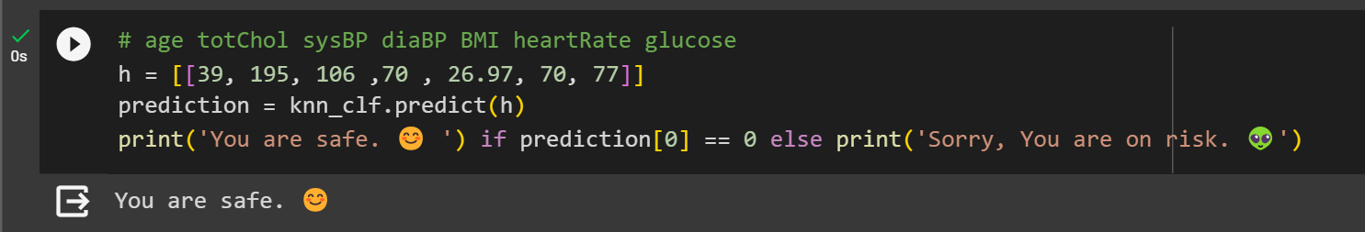
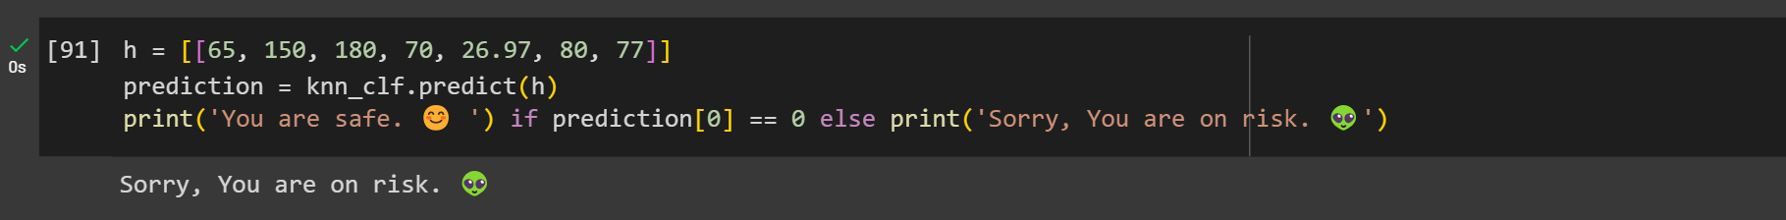
Test case 1
Test case 2

Slide 19
MODULES USED
NumPy: Used for numerical operations and data manipulation.
Pandas: Used for data handling and manipulation.
Matplotlib and Seaborn: Used for data visualization.
Scikit-learn: Used for machine learning tasks.
Boruta: Used for feature selection.
Imbalanced-learn (imblearn): Used for dealing with imbalanced datasets.
Statsmodels: Used for statistical analysis.
StandardScaler: Used for feature scaling.
KNeighborsClassifier: Used for implementing the k-nearest neighbors algorithm.
GridSearchCV: Used for hyperparameter tuning

Slide 20
Software/Hardware used
Jupyter Notebook: The code is implemented as a Jupyter Notebook, an interactive environment for data analysis and machine learning.
Python 3.10.5: The code is written in Python, with the specified version.
Google Colaboratory :Google Colaboratory, commonly known as Colab, is a free cloud-based platform that provides a collaborative environment for writing and running Python code, particularly popular for machine learning and data analysis tasks. It offers access to GPU resources and allows users to share and work on Jupyter notebooks online.
Data Source: The project uses a dataset (presumably related to heart attack prediction) loaded from a CSV file.
Hardware: The code does not specify any hardware requirements. It is expected to run on a standard personal computer or server with Python and the required libraries installed.

Slide 21
Unit Testing
1. Data Loading Test:
Test if the data is loaded successfully from the CSV file.
Check if the loaded data has the expected number of rows and columns.
2. Data Cleaning Test:
Test if missing data is properly handled, i.e., no missing values exist in the dataset.
Verify if the dataset size is reduced after removing rows with missing values.
3.Feature Selection Test:
Verify if the feature selection method (Boruta) identifies the relevant features.
Ensure that the selected features match the expected result.
4.Data Balancing Test:
Confirm that the dataset is properly balanced using SMOTE and random under-sampling.

Slide 22
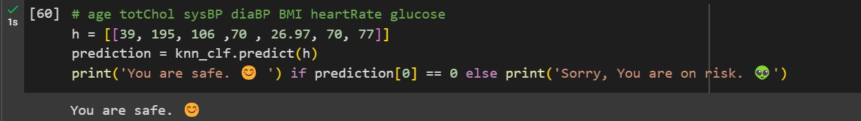
Output
In general Experiment on Heart Attack Disease we use KNN Algorithm
Our project Involves collecting a data set which consists of 4000 data sets from a city called Manchester
framingham data set consists of 15 parameters from which we consider only 7 parameters which are important for our project.
Using the parameters our machine learning model predicts the heart attack prediction of a person .

Slide 23
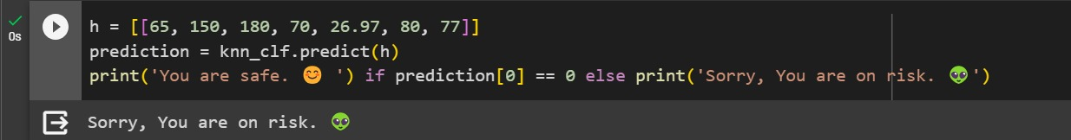
When we pass the important seven parameters such as age age , total choloestrol ,systolic BP ,diastolic BP, BMI, heart rate ,glucose.
Our trained machine Learning model will predict that the person will have the heart disease or not in the upcoming 10 years
If the system predicted that the person would go through the Heart Attack disease ,That person would take of him consulting doctor or taking medicine

Slide 24
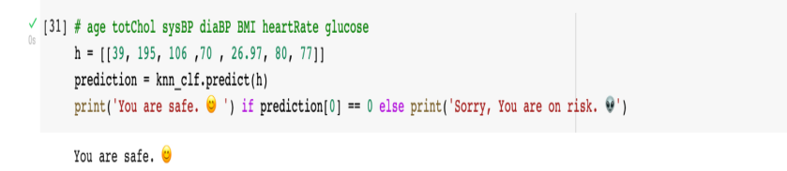
Conclusion
As we all are aware the number of deaths in today's world due to cardiovascular diseases and to be specific, heart attacks are gradually increasing.
The issue needs to be found: how can we find a way or method so that we can predict diseases with a lot more accuracy and also with precision.
The main aim of this project is that somehow we can predict the heart diseases in a person in 10 years. We have used different distance methods to find the closest neighbor and the K nearest neighbor algorithm
For the feature selection method, we used Boruta which is an improvised version of the random forest method.
A 39-year-old man with 195 total cholesterol, 106 systolic BP, 70 diastolic BP, a BMI of 26.97, a heart rate of 80, and glucose levels of 77.

Slide 25
Future Enhancement
In the future related to this project, we can develop a user interface that will help users to interact with our model and they can enter their details and can know the possibility of having a heart attack.
Also, we can relate age and gender to the trend of having heart attacks in a person. One of the major problems that we faced during this project is the dataset.
We can have more reliable sources of data that will lead to improved accuracy and that will eventually help us to predict more accurately. After having a reliable source of data we can focus on the data handling part and normalize it to avoid the overfitting and underfitting of our model.
In the future, more models can be evaluated and datasets can be fed and comparison can be done between the accuracy of different models. This will give higher chances of catching the heart attack in the earlier stage.
Also, we can include one more feature which will give suggestions based on age and other features to avoid a heart attack in the future. We can find any relation between the feature and the chances of having a heart attack in the future.

Slide 26
References
[1] Enriko, I. K. A., Suryanegara, M., & Gunawan, D. (2016). Heart disease prediction system using k-Nearest neighbor algorithm with simplified patient's health parameters. Journal of Telecommunication, Electronic and Computer Engineering (JTEC), 8(12), 59-65.
[2] Shetty, A., & Naik, C. (2016). Different data mining approaches for predicting heart disease. Int J Innov Res Sci Eng Technol, 5(9), 277-281.
[3] Sultana, M., Haider, A., & Uddin, M. S. (2016, September). Analysis of data mining techniques for heart disease prediction. In 2016 3rd international conference on electrical engineering and information communication technology (ICEEICT) (pp. 1-5). IEEE.
[4] Kirmani, M. M. (2017). Cardiovascular disease prediction using data mining techniques: A review. Oriental Journal of Computer Science & Technology, 10(2), 520-528.
[5] Dangare, C. S., & Apte, S. S. (2012). Improved study of heart disease prediction system using data mining classification techniques. International Journal of Computer Applications, 47(10), 44-48.

Slide 27
[6] Melillo, P., De Luca, N., Bracale, M., & Pecchia, L. (2013). Classification tree for risk assessment in patients suffering from congestive heart failure via long-term heart rate variability. IEEE journal of biomedical and health informatics, 17(3), 727-733.
[7] Guidi, G., Pettenati, M. C., Melillo, P., & Iadanza, E. (2014). A machine learning system to improve heart failure patient assistance. IEEE journal of biomedical and health informatics, 18(6), 1750-1756.
[8] Zhang, R., Ma, S., Shanahan, L., Munroe, J., Horn, S., & Speedie, S. (2017, November). Automatic methods to extract New York heart association classification from clinical notes. In 2017 ieee international conference on bioinformatics and biomedicine (bibm) (pp. 1296-1299). IEEE.
[9] Parthiban, G., & Srivatsa, S. K. (2012). Applying machine learning methods in diagnosing heart disease for diabetic patients. International Journal of Applied Information Systems, 3(7), 25-30.

Slide 28


