Slide 1

Lecture 4 – Data Visualization Course
Visualizing and Analyzing Time Series Data
Dr. Muhammad Sajjad
R.A: Imran Nawar
October 2024

Slide 2
Overview
Introduction to Time Series Data
Types of Time Series Data
Characteristics of Time Series Data
Importance of Time Series Data Visualization
Basic Time Series Data Visualization Techniques
Moving Averages and Smoothing (are techniques often visualized with line plots.)
Advanced Time Series Analysis
Trend Analysis
Seasonal Decomposition
Stationarity and Differencing
Time Series Forecasting
Forecasting
Key Components of Time Series Forecasting
Popular Forecasting Models
Applications of Time Series Data Analysis.
Case Study: Forecasting Stock Prices with LSTM
Coding: Visualizing and Analyzing Time Series Data.
Line Plot | Bar Chart
Area Chart | Stacked Area Chart

Slide 3
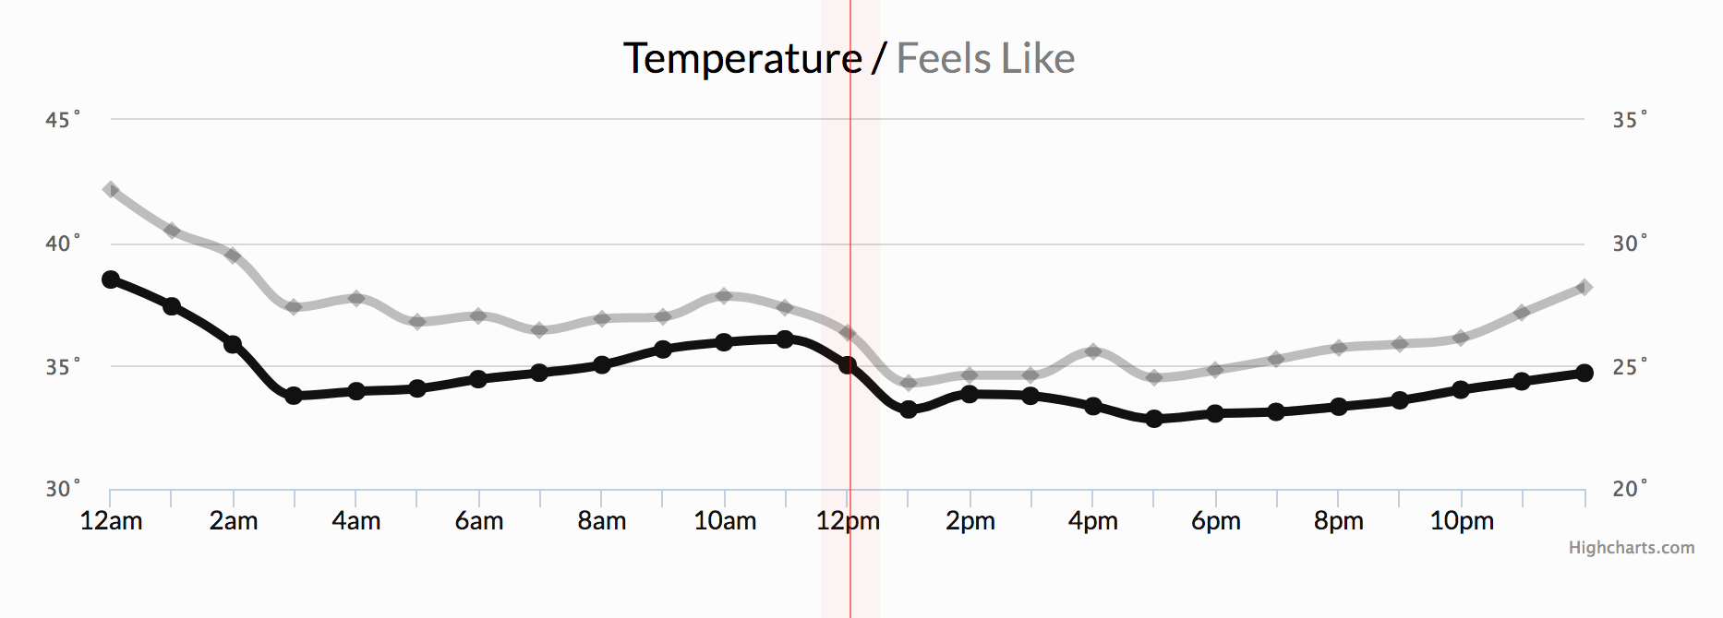
Introduction to Time Series Data
Time Series Data:
Time series data is information that is collected at regular, consistent intervals over time.
Examples:
Temperature measured every two hours
Daily stock prices
Weekly sales data
This data type helps us observe trends, patterns, and correlations across time, providing deeper insights into various processes.
Why Time Series Data Matters:
By analyzing and visualizing time series data, we can identify trends, spot anomalies, and uncover patterns that guide better decision-making and predictions.
Time series data is widely used in fields like economics, weather forecasting, finance, and more.
Weather condition
Notes:
Time-series data is simply a measurement and the time at which it was taken.

Slide 4
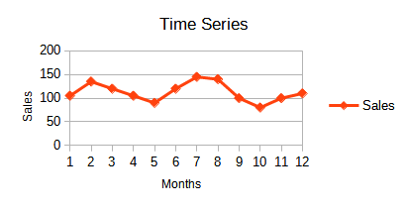
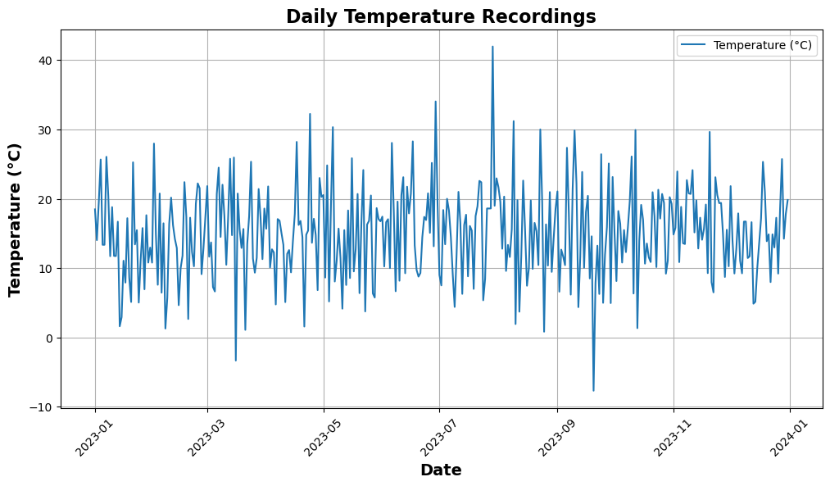
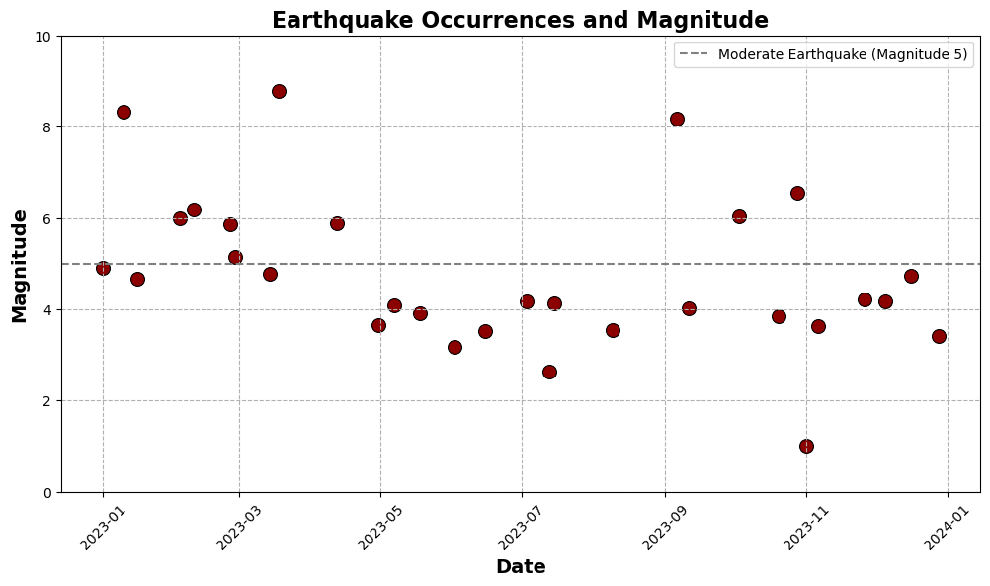
Types of Time Series Data
Based on Time Intervals
Regular (Equally Spaced):
Data points are collected at consistent, fixed intervals (e.g., daily, monthly, quarterly).
Example: Daily stock prices, monthly sales.
Irregular (Unequally Spaced):
Data points are collected at inconsistent intervals, often triggered by specific events.
Example: Earthquake occurrences, sensor measurements triggered by events.
Based on Number of Variables:
Univariate Time Series:
A single variable is measured and recorded over time.
Example: Daily temperature recordings.
Multivariate Time Series:
Multiple variables are measured and recorded over time.
Example: Simultaneous readings of temperature, humidity, and pressure.
Synthetic data representing daily temperature trends over time
Synthetic data representing earthquake occurrences and corresponding magnitudes over time.
Notes:
Sensor measurements triggered by events: e.g: Temperature sensor in a machine.

Slide 5
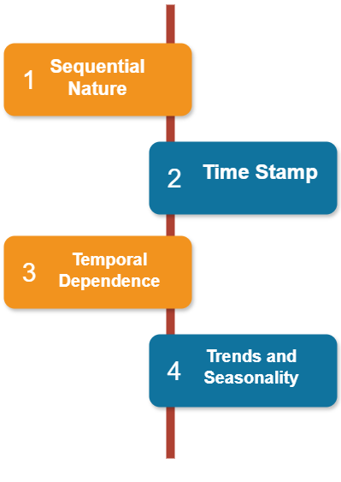
Characteristics of Time Series Data:
Sequential Nature
Data points are ordered chronologically, with each observation associated with a specific time.
The sequence is crucial for analysis, as the order affects how patterns are interpreted.
Timestamp
Each record comes with a timestamp that marks the exact time of the observation.
Timestamps serve as indices for analysis and computation.
Temporal Dependence
The current value often depends on past values, indicating a relationship over time.
Autocorrelation: The correlation between a variable and its past values is a key feature of time series data.
Trend and Seasonality
Trends: A long-term upward or downward movement in the data.
Seasonality: Regular patterns that repeat over fixed time periods, such as daily, monthly, or yearly cycles.
Notes:
Chronologically : in a way that follows the order in which events or records occurred.

Slide 6
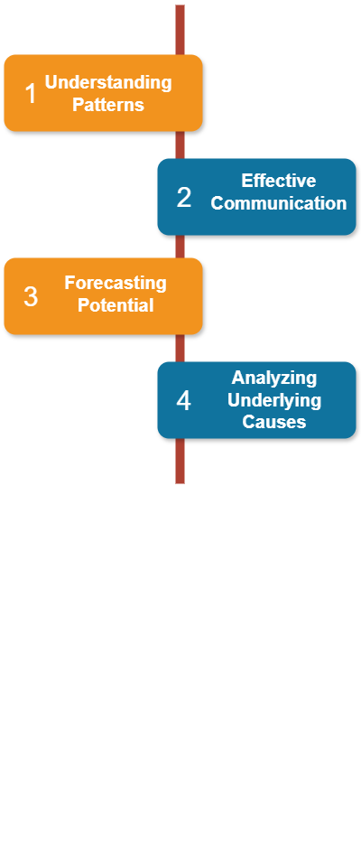
Importance of Time Series Data Visualization
Why Visualize Time Series Data?
Understanding Patterns:
Identifies trends, seasonal effects, and anomalies
Reveal hidden patterns and cyclical behaviors over time.
Effective Communication:
Simplifies complex temporal information, making insights accessible to stakeholders.
Enhances decision-making by providing clear visual representations.
Forecasting Potential:
Helps predict future outcomes by showcasing historical patterns.
Analyzing Underlying Causes:
Helps organizations pinpoint reasons behind trends or recurring events, facilitating deeper insights into data-driven decisions.
Notes:
Time series data visualization transforms complex temporal data into actionable insights, supporting better understanding, communication, and decision-making across various domains.
Temporal وقتی (Relating to time or changes over time)
Data-driven decisions: Choices made based on analysis rather than intuition.

Slide 7
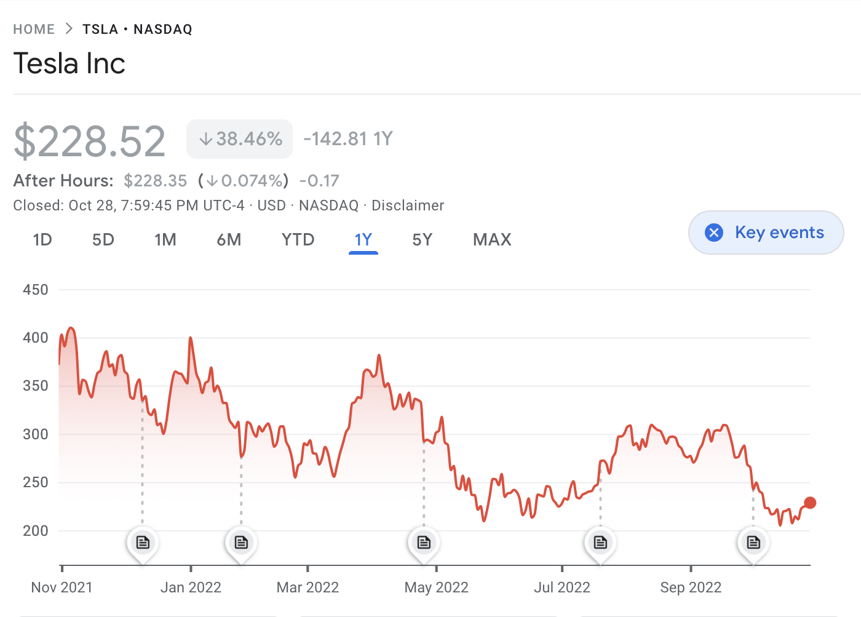
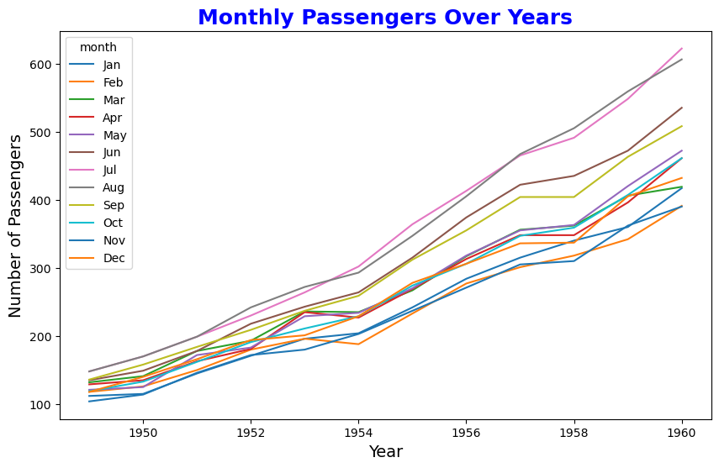
Basic Time Series Data Visualization Techniques
Graph of stock prices of Tesla
Time series data can be effectively visualized using various techniques to reveal trends, patterns, and changes over time.
Temporal visualizations help in analyzing data across a time axis, uncovering key insights such as seasonality or trends.
Key Visualization Techniques:
Line Plot:
A fundamental and most common visualization for time series data.
Show trends over time.
Axes:
X-axis: Represents time.
Y-axis: Represents the variable of interest.
Use Case: Perfect for showing how a variable changes over time.
Key Features:
Easy to understand
Useful for identifying trends and patterns.
Can display multiple lines for comparing variables.
Example: Monthly number of passengers over the years.

Slide 8
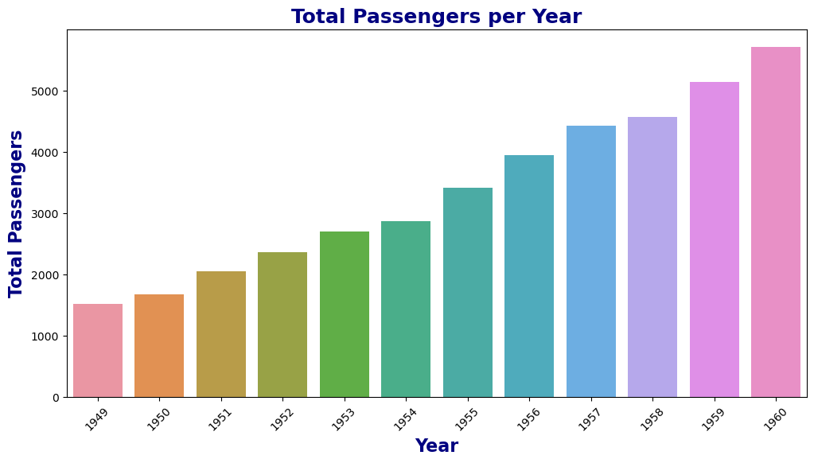
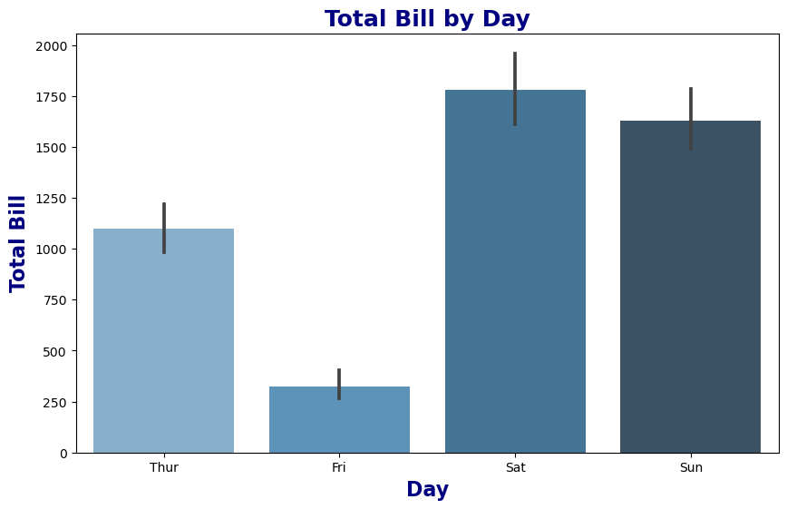
Basic Time Series Data Visualization Techniques
Bar Chart:
Represents data as horizontal or vertical bars.
Axes
X-axis: Time periods
Y-axis: Variable values
Key Features:
Bar height/length proportional to variable value.
Supports grouped or stacked bars for multiple variables.
Best for comparing discrete time intervals.
Advantages:
Easy to compare values across time periods
Effective for displaying multiple variables
Clear representation of discrete data.
Use Case:
Ideal for comparing discrete time intervals (e.g., yearly revenue comparisons).
Example:
Showing total bill amounts across different days of the week.
Notes:
Bar height/length proportional to variable value: The taller or longer the bar, the bigger the value it represents

Slide 9
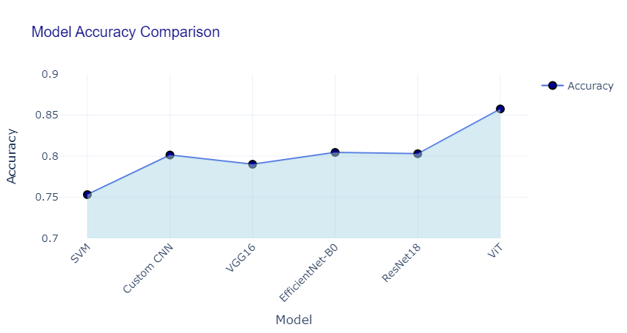
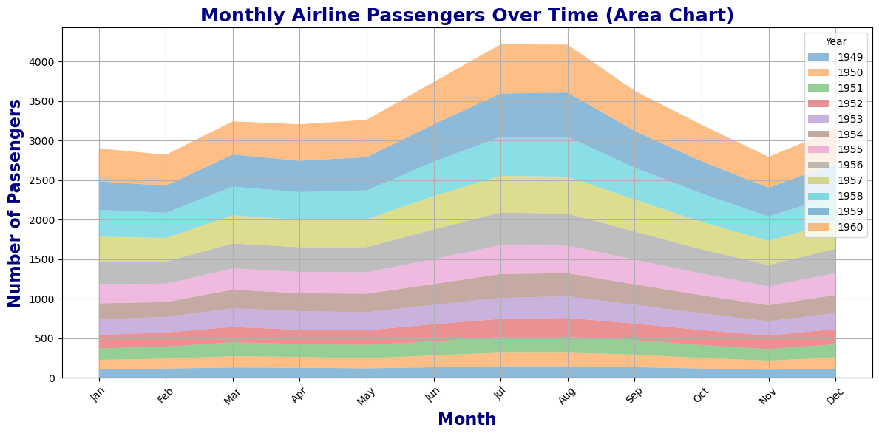
Basic Time Series Data Visualization Techniques
Area Chart
Area chart extend line plots by filling the area beneath the line to show trends over time.
Axes:
X-axis: Time
Y-axis: Variable values
Key Features:
Can represent one or more variables.
The area under the line(s) is filled, making it easier to see the magnitude of values over time.
Best for visualizing distributions or magnitude changes over time.
Use Case:
Shows cumulative totals or proportions over time.
Example: Yearly sales growth of different products.
Notes:
Area Chart: Visualizing Cumulative(مجموعی) Totals over Time

Slide 10
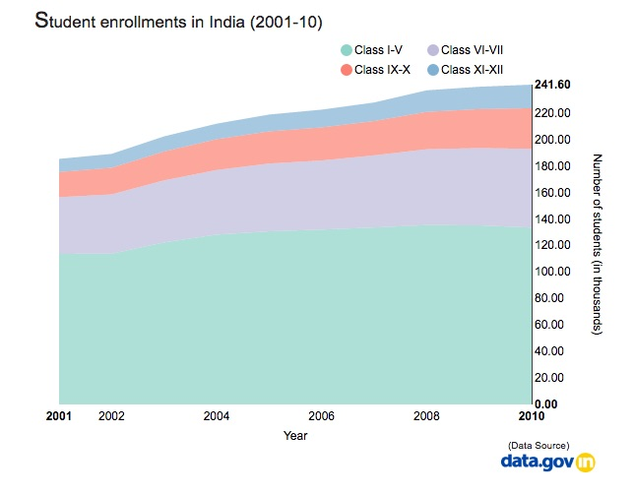
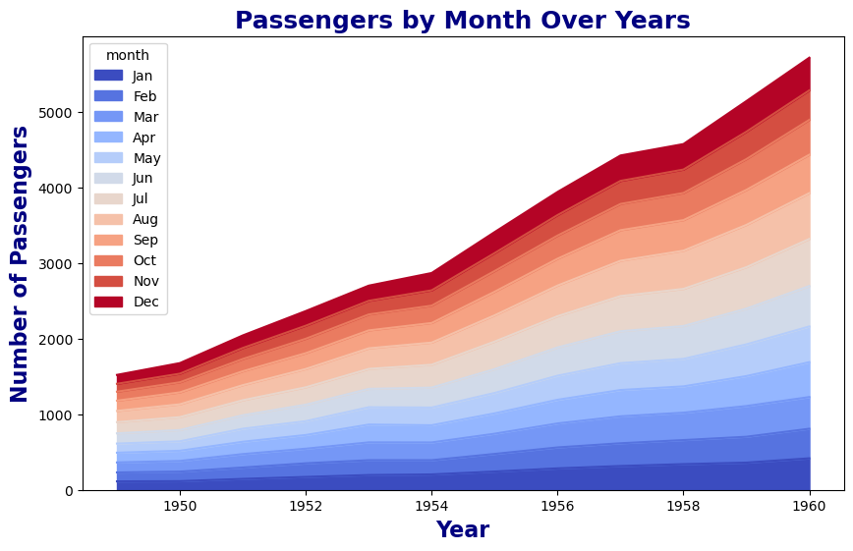
Basic Time Series Data Visualization Techniques
Stacked Area Chart
Stacked area charts allow for the comparison of multiple variables, showing both individual contributions and cumulative totals over times.
Axes:
X-axis: Time
Y-axis: Stacked variable values
Key Features:
Requires two or more variables.
Areas are stacked to show each variable’s contribution to the total.
Best for comparing multiple variables over time.
Use Case:
Comparing market share or other proportion-based data over time.
Example: Market share of different smartphone brands over the past decade.
Notes:
Area Chart: Shows a single variable’s trend over time, with the area under the line filled in for emphasis.
(It can have more than one variables)
Stacked Area Chart: Displays multiple variables over time, stacking their areas on top of each other to show the total and individual contributions.

Slide 11
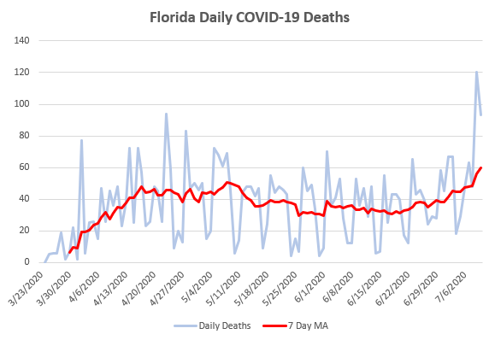
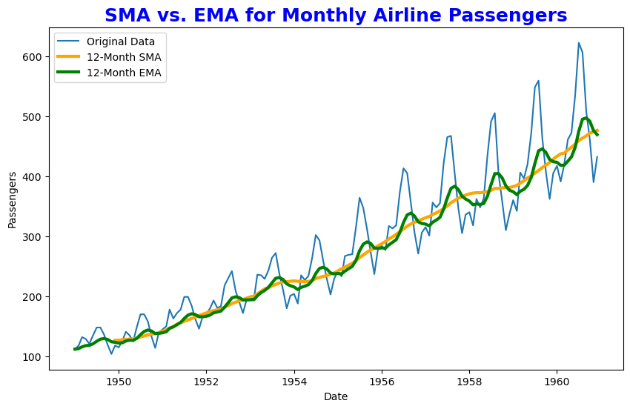
Basic Time Series Data Visualization Techniques
Moving Averages and Smoothing
Moving Averages are a type of smoothing techniques used to reduce noise and reveal the underlying trends in time series data.
Smoothing in general refers to techniques that reduce short-term fluctuations in data, making long-term trends easier to see.
Key Types:
Simple Moving Average (SMA):
Averages data over a specific window.
Equal weight for each data point.
Best for long-term trend visualization.
Use Case: Identifying long-term trends in stable time series data.
Exponential Moving Average (EMA):
More weight given to recent data points.
Reacts more quickly to changes.
Useful for identifying short-term changes while retaining a focus on trends.
Use Case: Detecting recent trends or shift in volatile data.
Purpose:
To reduce noise and make underlying trends more visible.
Facilitate better decision-making based on trend analysis.
Notes:
- Fluctuations اتار چڑھاو
Specified window: This refers to the number of data points (time periods) over which the moving average is calculated.
SMA: Calculates the unweighted mean of the previous n data points.
EMA: Applies exponentially decreasing weights to older data points, giving more importance to recent observations.

Slide 12
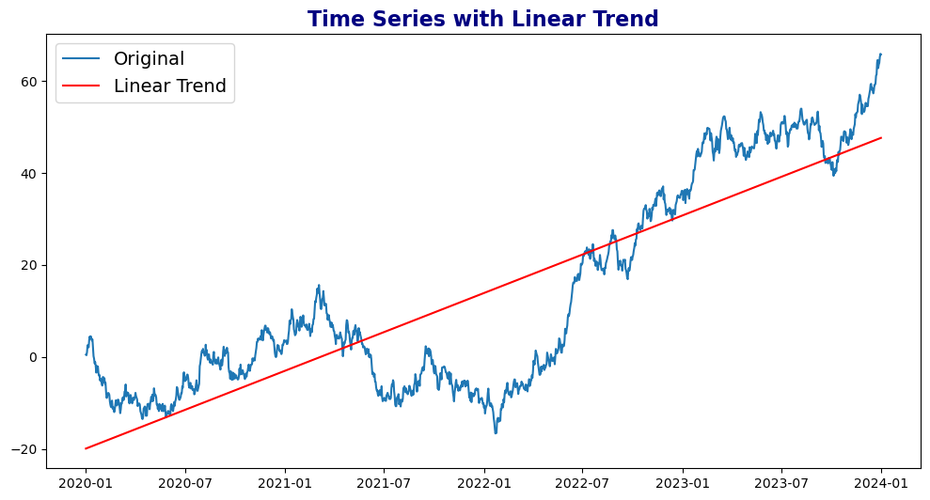
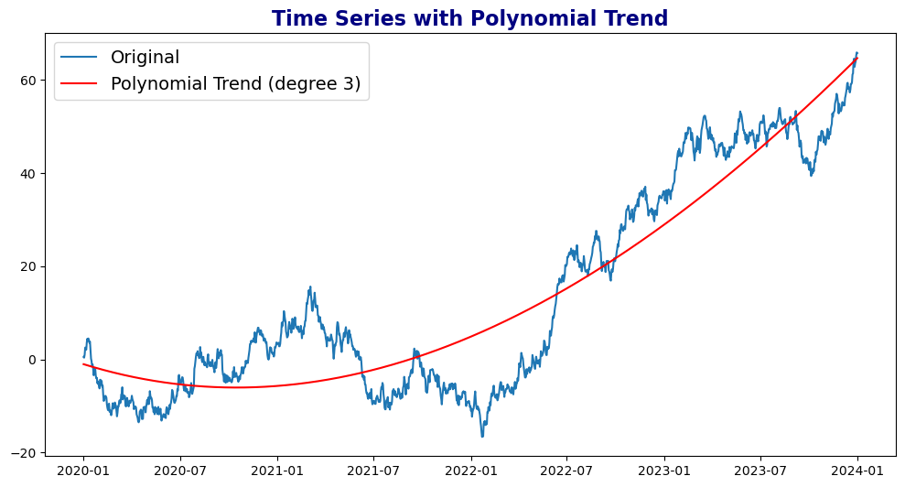
Advanced Time Series Analysis
Trend Analysis
Identifies the long-term direction of a time series, focusing on overall patterns.
Types:
Linear Trend: A straight line indicating a consistent rise or fall.
Polynomial Trend: A curved line representing more complex movements.
Methods:
Decomposition: Breaking time series into components (trend, seasonal, residual).
Regression Analysis: Fitting linear or polynomial models to data.
Use Cases:
Linear Trend: Economic growth, population trends.
Polynomial Trend: Sales growth with fluctuating patterns.
Example: Using linear regression to identify an upward trend in annual revenue.
Notes:
- Fluctuations اتار چڑھاو

Slide 13
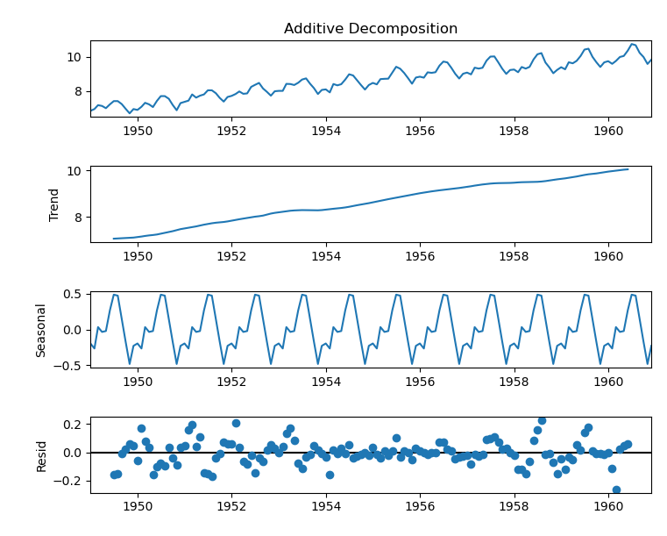
Advanced Time Series Analysis
Seasonal Decomposition
Breaks down time series into three parts.
Trend: Long-term direction (upward, downward, or flat).
Seasonal: Repeating patterns (e.g., monthly or yearly cycles).
Residual: The remaining noise or irregular variations after removing trend and seasonality.
Techniques:
Additive: Time series is expressed as the sum of its components.
Series = Trend + Seasonal + Residual
Multiplicative: Time series is expressed as the product of its components.
Series = Trend * Seasonal * Residual
Use Cases:
Helpful for analyzing repeated patterns, such as monthly sales fluctuations or yearly weather changes.
Notes:
Residual are essentially the “leftover” part of the data that doesn’t fit into the predictable trend or seasonal patterns.

Slide 14
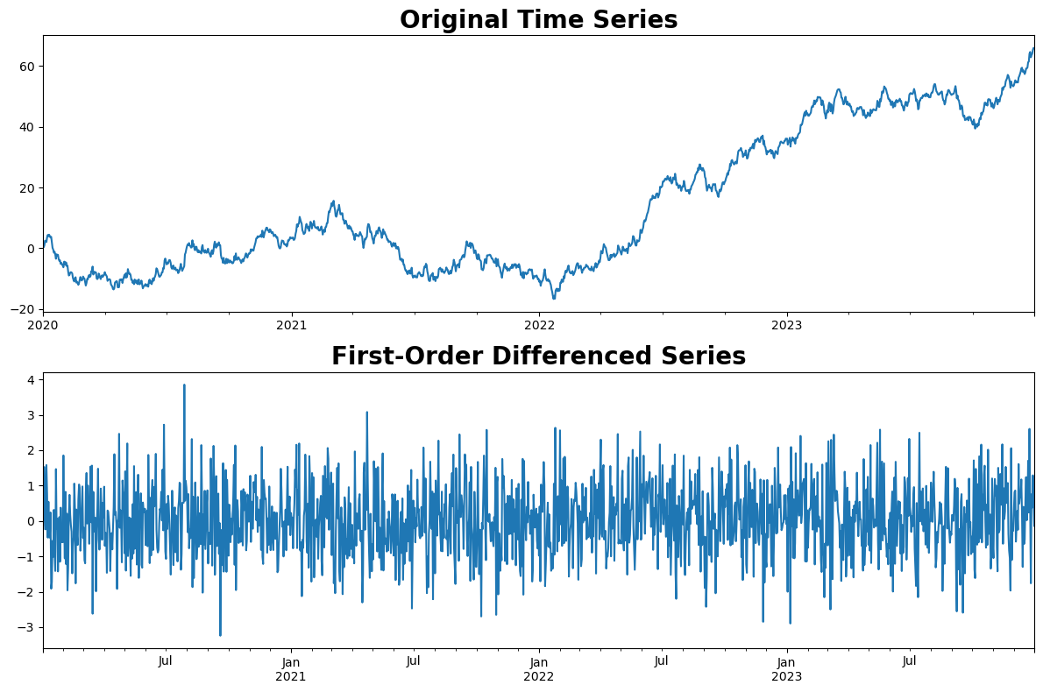
Advanced Time Series Analysis
Stationarity and Differencing
Stationarity:
A time series is stationary if its key statistical properties (mean, variance, etc.) do not change over time.
Why it matters: Many forecasting models assume that data is stationary.
Differencing:
A method used to transform a non-stationary time series into a stationary one by subtracting the previous observation from the current one.
Helps remove trends or seasonality in the data.
Why is this important?
Certain models like ARIMA require the data to be stationary to make reliable predictions.

Slide 15
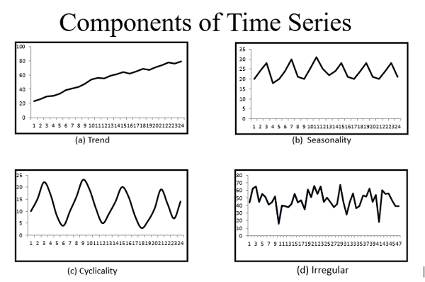
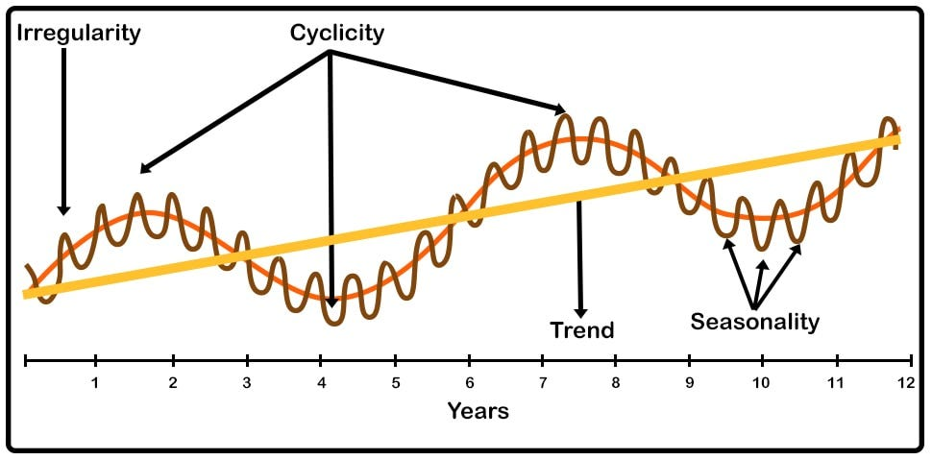
Time Series Forecasting Models and Techniques (Visualizing the Future)
Forecasting involves predicting future values based on historical data.
Time series forecasting involves predicting future data points based on previously observed values.
Applications:
Business: Sales forecasting
Weather: Temperature and precipitation forecasting
Finance: Stock price prediction.
Key Components of Time Series Forecasting
Trend
A Gradual upward or downward shift in the series over time.
Example: Rising global temperatures over decades
Cyclical Fluctuation Analysis
Repeating patterns that are not tied to a fixed period
Long-term oscillations unrelated to seasonality.
Example: Economic boom and bust cycles
Seasonality (Seasonal Pattern)
Regular, repeating patterns or cycles in data.
Example: Retail sales peaking during holidays
Notes:
Precipitation بارش

Slide 16
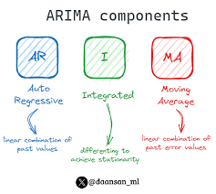
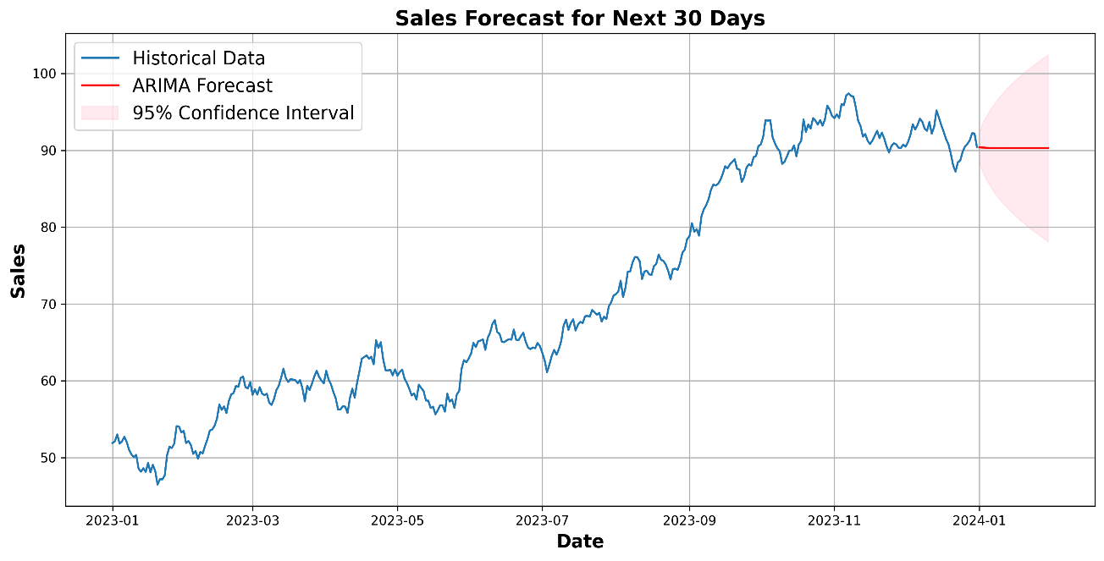
Popular Forecasting Models
Essential forecasting models used in time series analysis.
ARIMA (AutoRegressive Integrated Moving Average)
A popular model for forecasting univariate time series that combines three components.
AutoRegressive (AR): Predicts future values using past values.
Integrated (I): Differencing the data to make it stationary.
Moving Average (MA): Uses past forecast errors in a regression-like model.
Use Case: Best suited for data without strong seasonality.
Advantages:
Can handles non-stationary data.
Works well for linear relationships.
Notes:
forecasting models used in time series analysis.

Slide 17
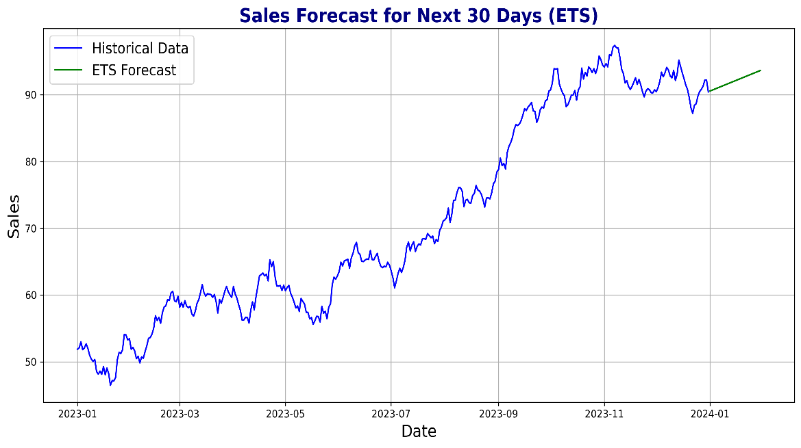
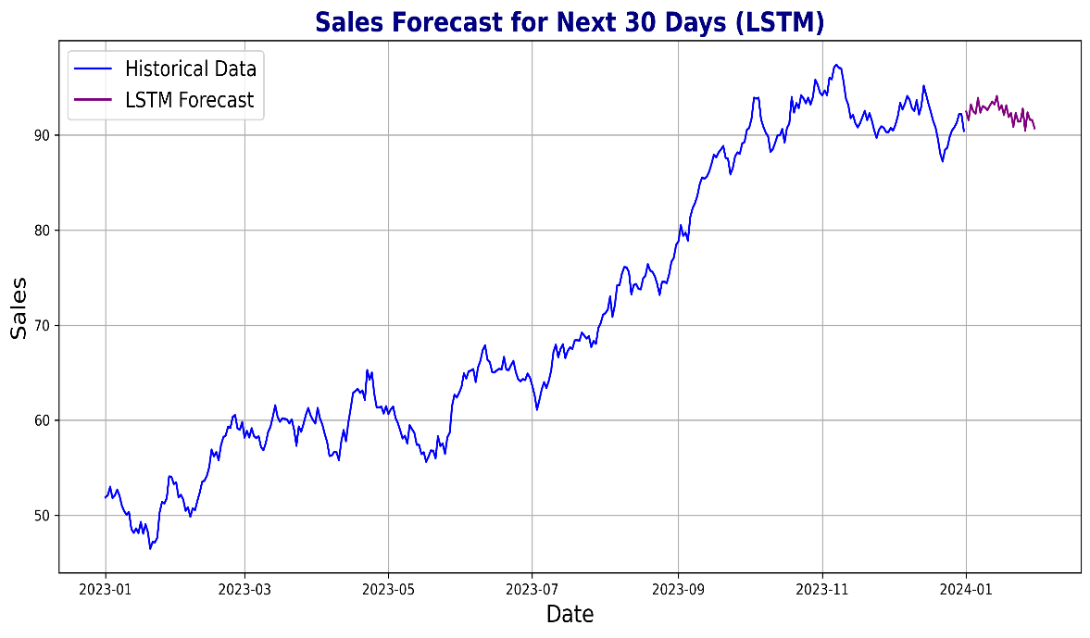
Popular Forecasting Models
Exponential Smoothing (ETS)
A forecasting method that applies weighted averages with exponentially decreasing weights.
Components:
Error, Trend, Seasonality ( hence the term ETS)
Use Case: Effective for data with trend and seasonality.
Example: Forecasting monthly sales figures
LSTM Networks (Long Short-Term Memory)
A type of deep learning model that learns from sequential data and remembers long-term patterns.
Advantages
Captures complex patterns in time series data.
Suitable for large datasets and non-linear relationships.
Use Case: Useful for advanced tasks like stock price prediction or sales forecasting.
Notes:
Prophet by Facebook
A robust forecasting tool developed by Facebook, designed to handle seasonality and holidays.
Features:
Handles missing data, outliers, and provides uncertainty intervals.
Use Case: User-friendly for business forecasting tasks.
Example: Predicting user engagement on social media.

Slide 18
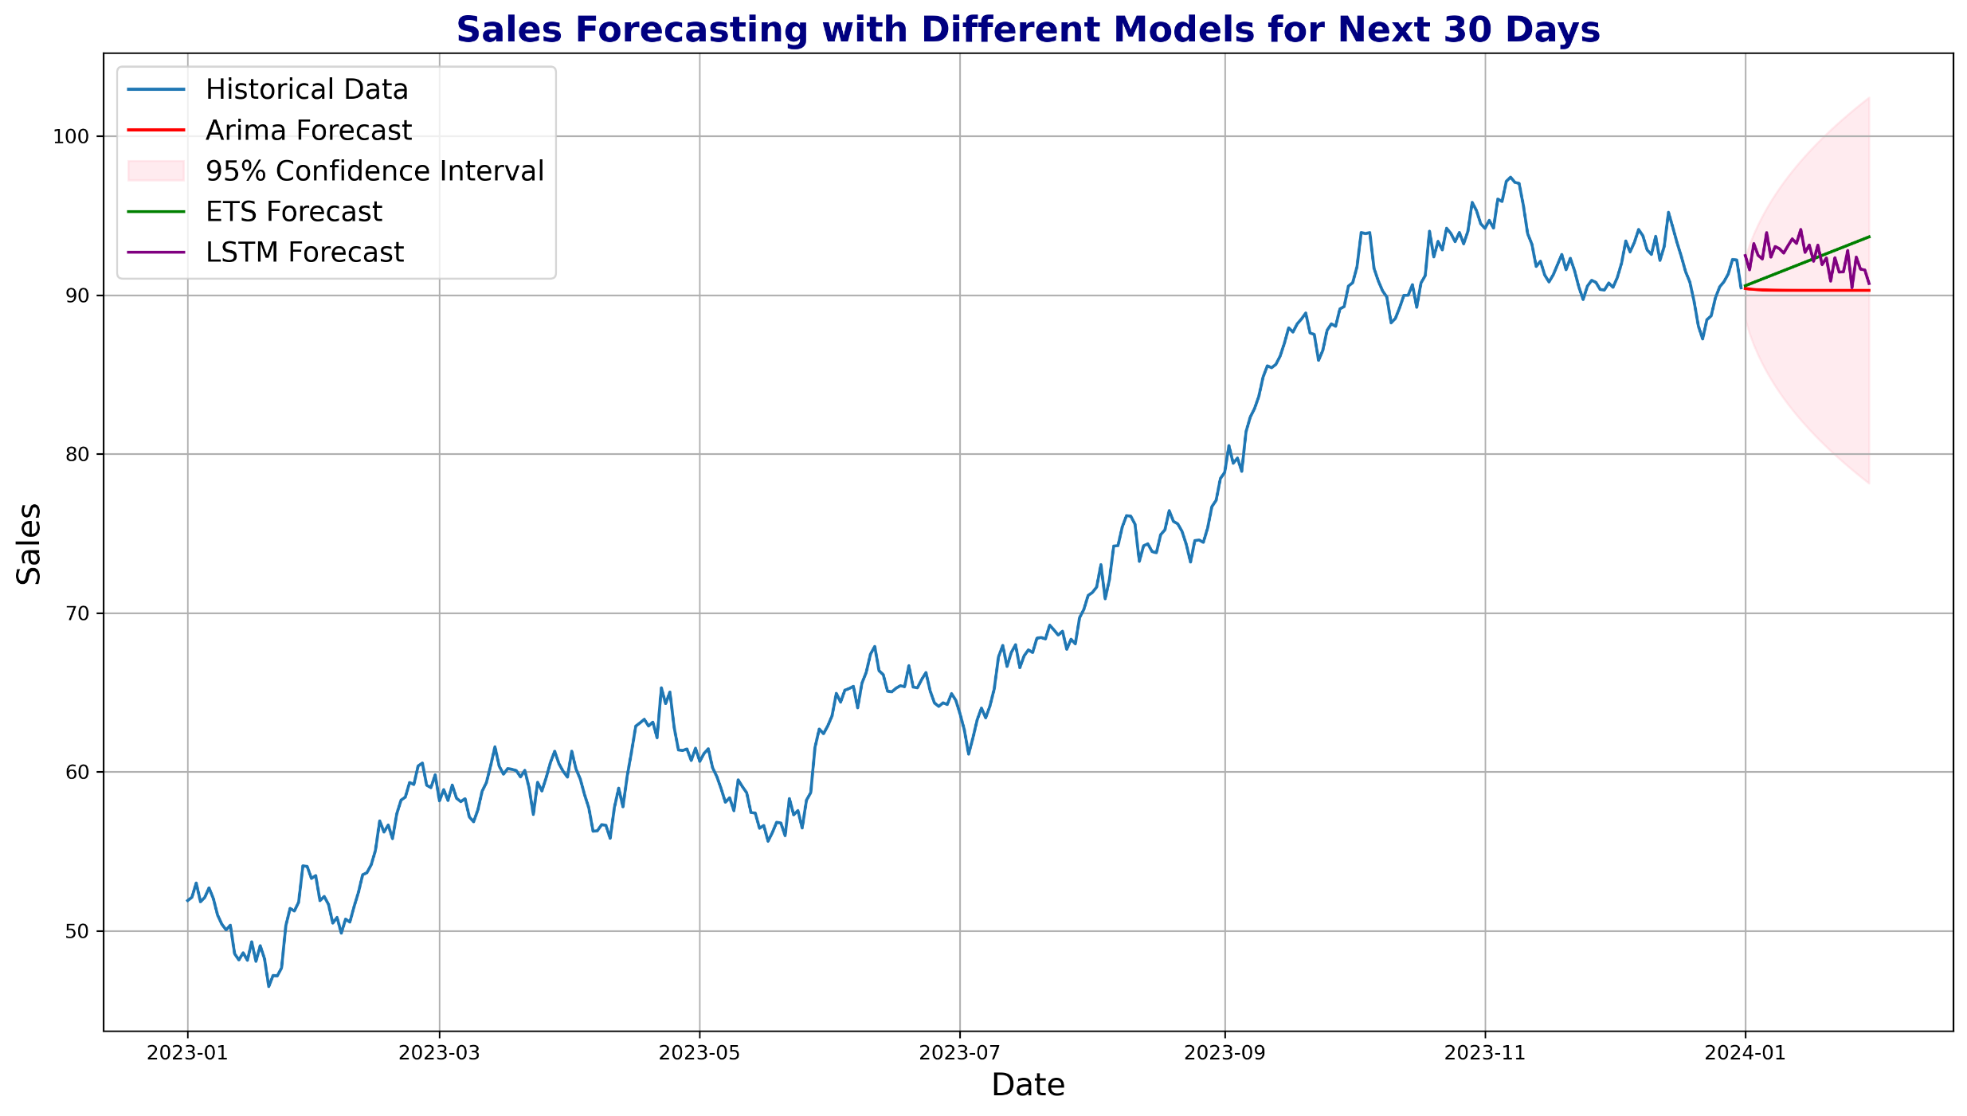
Popular Forecasting Models
Notes:
Example: Forecasting next 30 days of sales

Slide 19
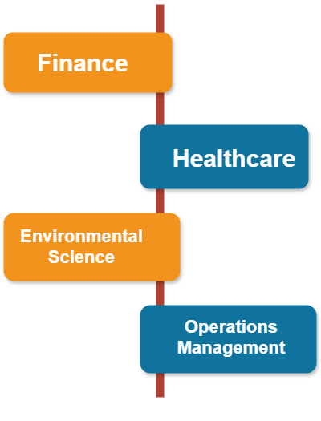
Applications of Time Series Data Analysis
Finance:
Stock Price Movements: Analyze trends and fluctuations in market prices.
Economic Indicators: Evaluate key economic metrics like GDP, inflation, and employment.
Algorithmic Trading: Utilizing historical data to automate trading strategies.
Healthcare:
Patient Monitoring: Track vital signs (heart rate, blood pressure) over time for health assessment.
Epidemic Forecasting: Predict the spread of diseases based on historical patterns.
Environmental Science:
Climate Change: Analyze long-term trends in temperature and atmospheric conditions.
Weather forecasting: Predict short-term weather patterns using historical data.
Operations Management:
Inventory Control: Optimize stock levels based on demand patterns.
Demand Forecasting: Anticipate future product demand to improve supply chain efficiency.
Notes:
Time series analysis is widely used in industries like finance and economics, providing critical insights for forecasting and decision-making
Anticipate - متوقع

Slide 20
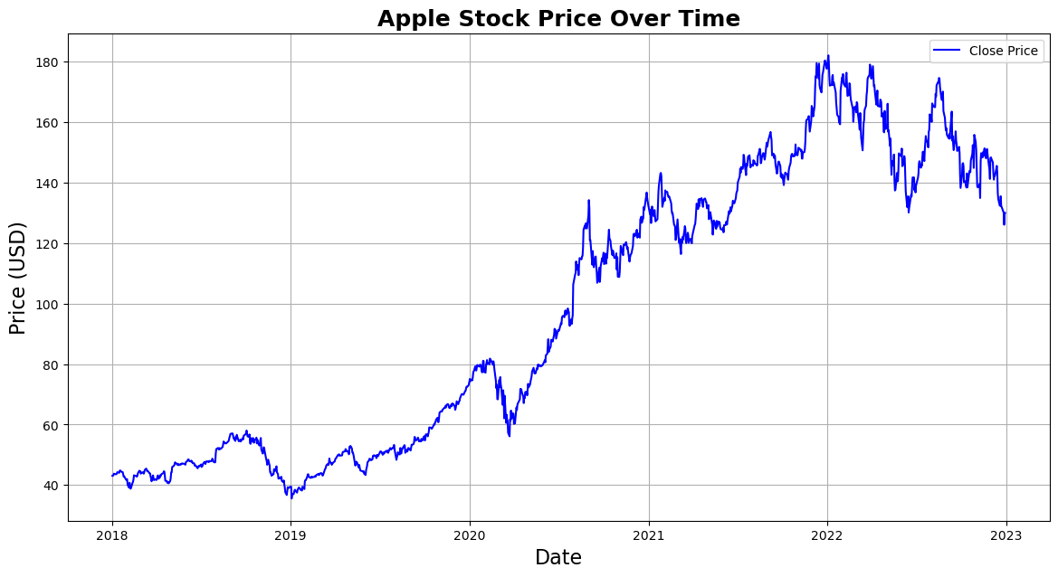
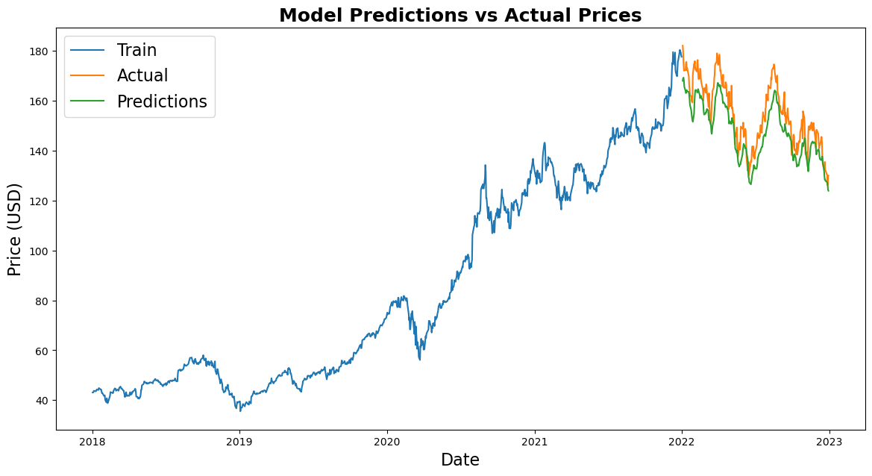
Case Study: Forecasting Stock Prices with LSTM
Objective
To visualize, analyze, and forecast Apple Inc. (AAPL) stock prices using Long Short-Term Memory (LSTM) models.
Dataset
Dataset Source: Yahoo Finance
Dataset: Daily stock prices for Apple Inc. (AAPL) over the last 5 years.
Steps:
Data Preprocessing: Convert dates, handle missing values, and visualize stock prices with moving averages.
Feature Engineering: Prepare the data by scaling and creating sequences for LSTM input.
Model Construction: Build an LSTM model with 2 layers and dropout for regularization.
Training the Model: Train the model on 80% of the data over 10 epochs.
Testing and Prediction: Predict future stock prices using the trained LSTM model and compare them to actual prices.
Conclusion:
This case study showcases how LSTM models can effectively forecast stock prices, offering practical experience in time series forecasting, feature engineering, and model evaluation.

Slide 21

Conclusion and Key Takeaways
Conclusion
Visualizing and analyzing time series data is a crucial skill in many fields. By mastering these techniques, you can uncover patterns, make informed predictions, and communicate complex temporal information effectively.
Key Takeaways:
Choose Appropriate Techniques: Use visualization and analysis techniques based on the nature of the time series data (trend, seasonality, stationarity).
Gain Better Insights: Visualizations reveal hidden patterns and facilitate more informed decision-making.
Embrace Advanced Forecasting: Modern tools, including machine learning and hybrid models, offer more robust and accurate forecasting solutions.
Stay Updated: Keep up with advancements in time series analysis for better predictive performance and practical applications.
Next Lecture: Interactive Data Visualization with Plotly.

Slide 22
Thank You

