Slide 1
Data Visualization
Presented BY:
Mehreen
Faiza

Slide 2
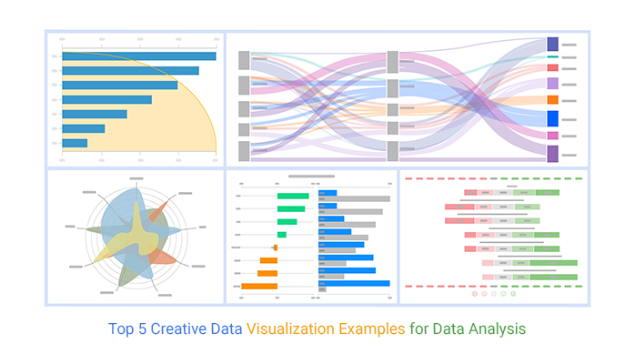
Introduction to Data Visualization
Data visualization is the graphical representation of information and data.
It utilizes visual elements like charts, graphs, and maps to communicate information clearly.
Effective data visualization helps in understanding complex data sets and identifying patterns.
Notes:
Image source: https://chartexpo.com

Slide 3
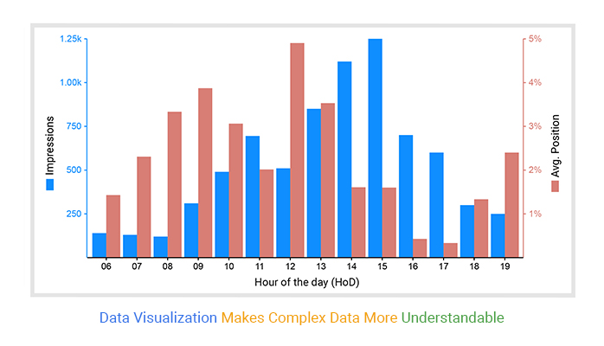
Importance of Data Visualization
Data visualization makes data more accessible and understandable.
It enhances the ability to analyze data quickly and make informed decisions.
Notes:
Image source: https://ppcexpo.com

Slide 4
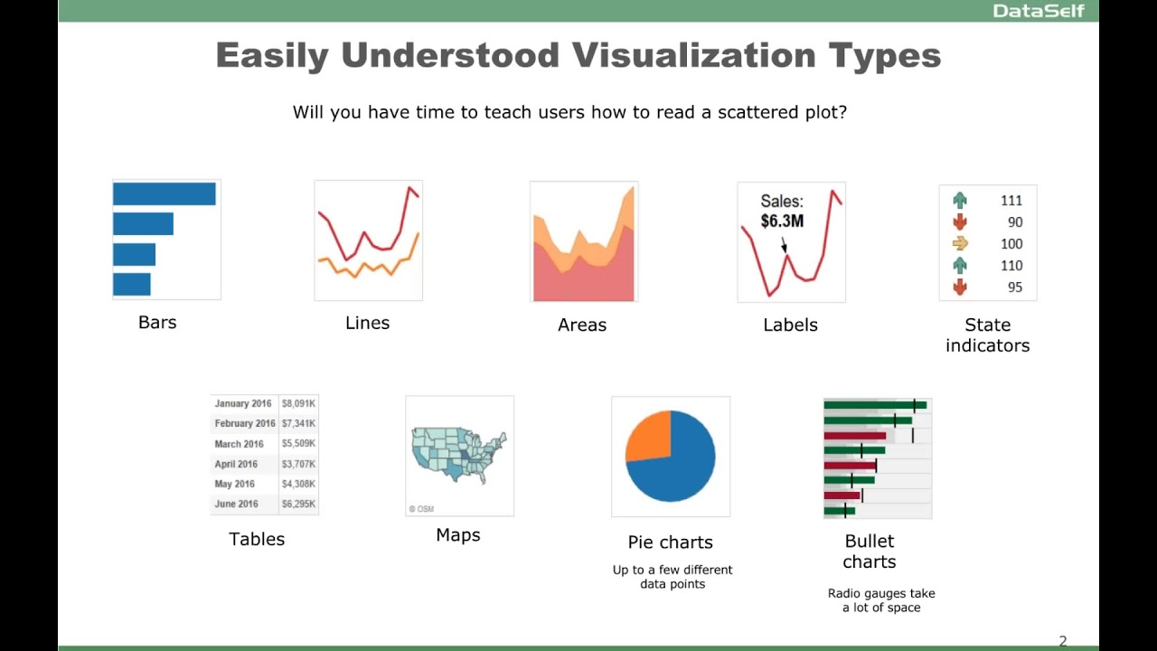
Types of Data Visualization
There are various types of data visualizations, each serving different purposes.
Common types include charts, graphs, maps, and infographics.
Notes:
Image source: https://i.ytimg.com

Slide 5
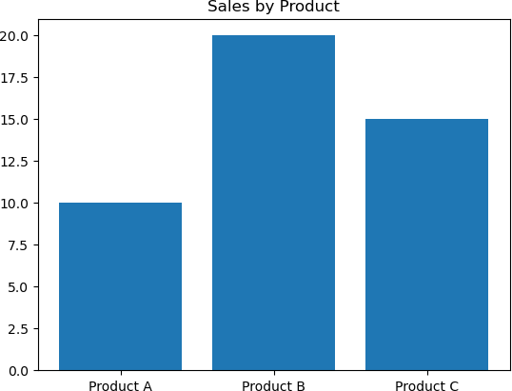

1. Bar Charts
Bar charts are used to compare different categories of data.
They consist of rectangular bars where the length represents the value of the data.
Bar charts are effective for displaying data changes over time or differences among groups.
Notes:
Image source: https://as1.ftcdn.net

Slide 6
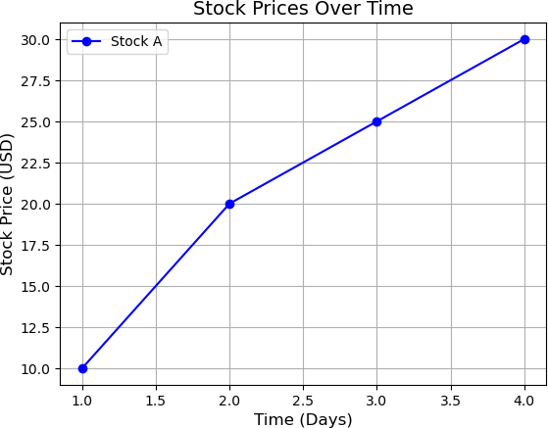
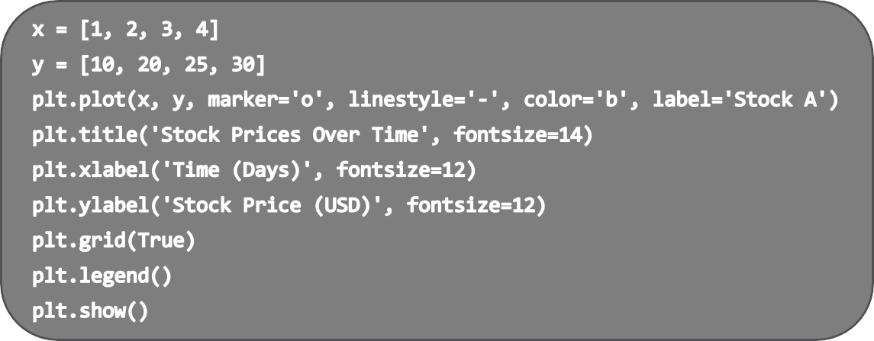
2. Line Plot
Line graphs are ideal for showing trends over time.
They connect data points with lines to illustrate changes in values.
Line graphs are particularly useful for
time-series data, such as stock prices.
Notes:
Image source: https://ppcexpo.com

Slide 7
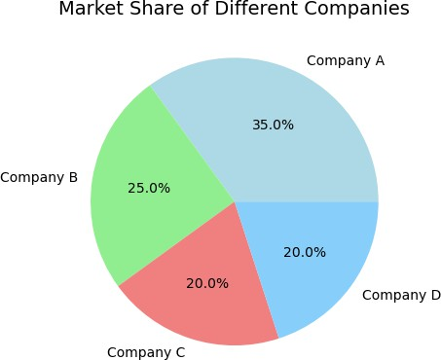
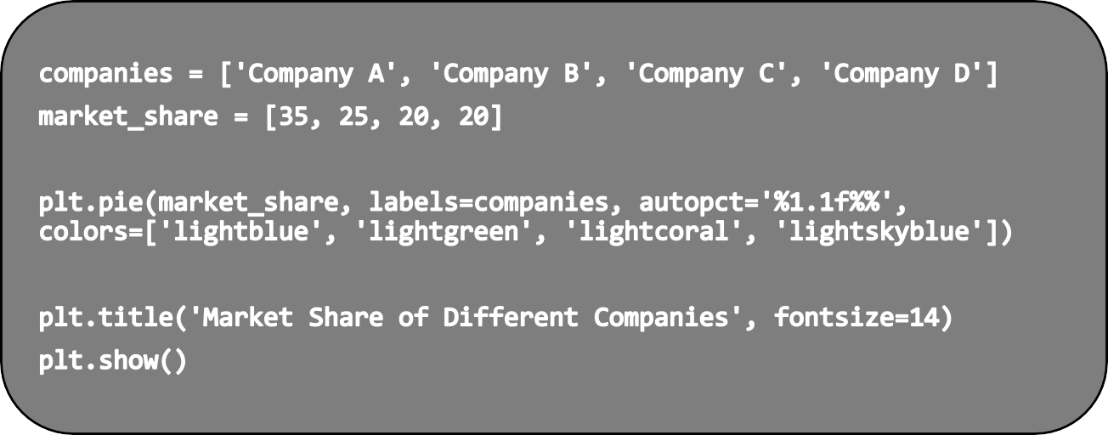
3. Pie Charts
Pie charts represent data as slices of a circular “ pie”.
Each slice shows the proportion of each category relative to the whole.
Notes:
Image source: https://www.slidemake.com

Slide 8
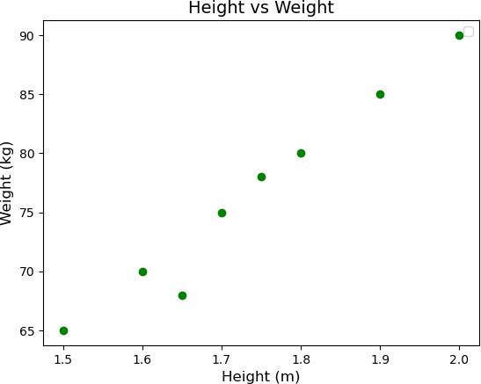
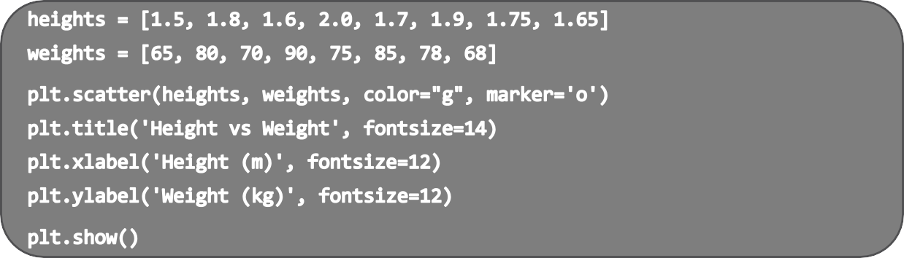
4. Scatter Plots
Scatter plots display values for two different variables on a two-dimentional plane.
They are useful for showing the relationship between two variables.
Notes:
Image source: https://c8.alamy.com

Slide 9
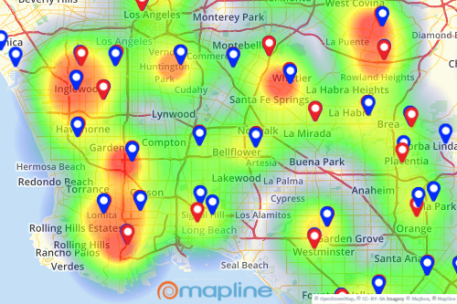
5. Heat Maps
Heat maps use color to represent data values in a grid format.
They make it easy to identify areas of high and low activity or intensity.
Heat maps are often used in fields like marketing and healthcare to showcase trends.
Notes:
Image source: https://mapline.com

Slide 10
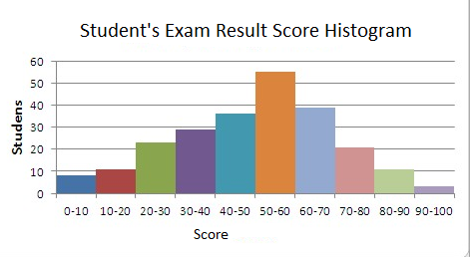
6. Histograms
Histograms are used to visualize the distribution of numerical data using bars.
Each bar represents a range of values showing how many data points fall within that range.
They help visualize the frquency and spread of data.
Notes:
Image source: https://365datascience.com

Slide 11
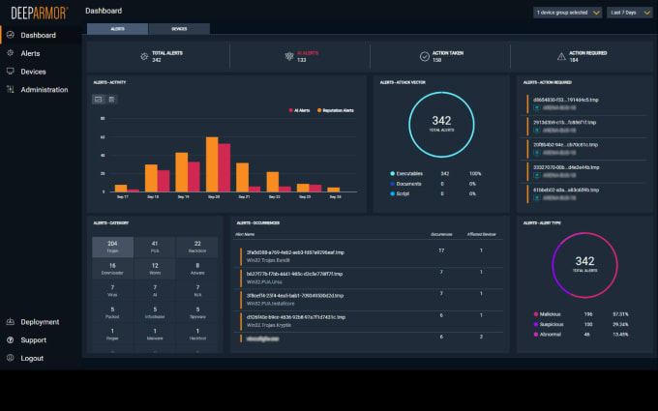
7. Dashboards
Dashboards are interactive tools that display multiple visualizations in one view.
They allow users to monitor key metrics and data points in real-time.
Dashboards are popular in business intelligence for quick decision making.
Notes:
Image source: https://fiverr-res.cloudinary.com

Slide 12
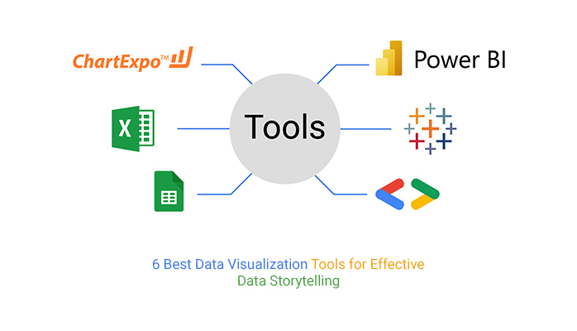
Tools for Data Visualization
There are numerous tools available for creating data visualizations.
Popular tools include Tableau, Microsoft Power BI, and Google Data Studio.
These tools offer various features to make the process of data visualization more efficient.
Notes:
Image source: https://cyber.ng

Slide 13

Conclusion
Data visualization is a powerfull tool for communicating information clearly.
Understanding different types of visualizations can greatly enhance data analysis.
Effective data visualization can lead to better decision-making and insights.
Notes:
Image source: https://www.rismedia.com

Slide 14
Thank You

