Slide 1
Differentiation In Calculus
Aliya batool
24 Feb 2025

Slide 2
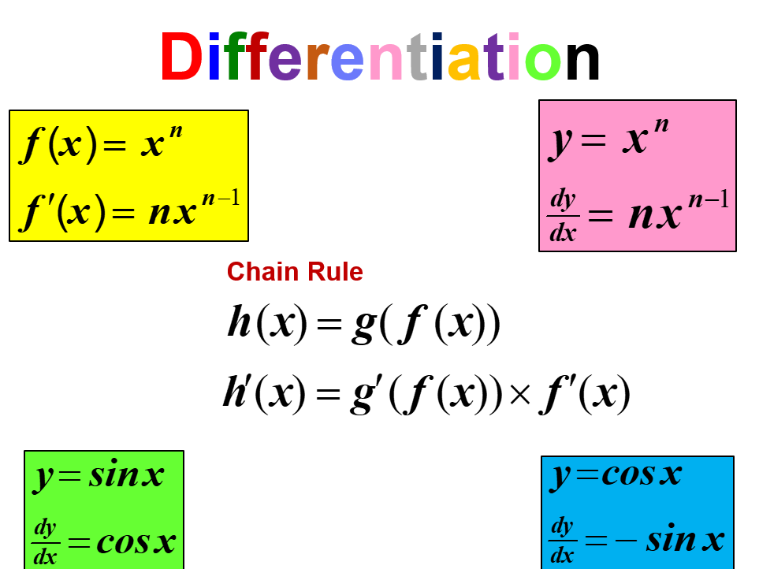
Introduction to Differentiation
Differentiation is a fundamental concept in calculus that deals with rates of change.
It helps us understand how a function changes as its input changes.
The derivative is the primary tool used for differentiation.
Notes:
Image source: https://d1e4pidl3fu268.cloudfront.net

Slide 3
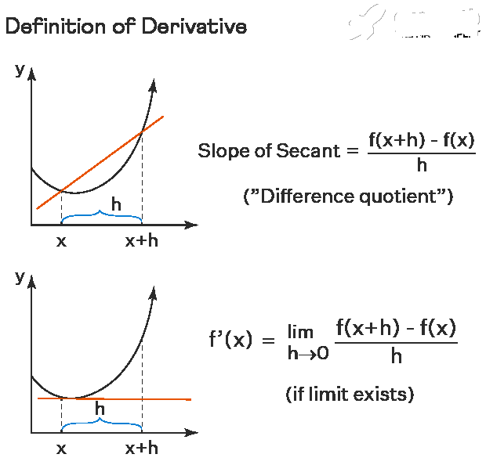
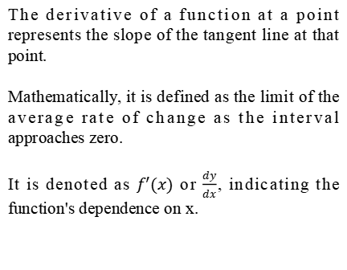
The Concept of the Derivative
The derivative of a function at a point represents the slope of the tangent line at that point.
Mathematically, it is defined as the limit of the average rate of change as the interval approaches zero.
It is denoted as $f′(x)$ or $\frac{dy}{dx}$, indicating the function's dependence on x.
Notes:
Image source: https://i.ytimg.com

Slide 4
Applications of Derivatives
Derivatives play a key role in physics, economics, engineering, and artificial intelligence.
Rate of Change: Used to calculate velocity, acceleration, and growth rates.
Optimization: Helps find maxima and minima, essential for cost reduction and efficiency.
Machine Learning: Powers gradient descent, optimizing models by minimizing loss functions.
Neural Networks: Adjusts weights during training to improve accuracy.

Slide 5

Derivatives of Trigonometric Functions
Trigonometric functions have specific derivatives that are essential in calculus.
For example, the derivative of $sin⁡(x)$ is $cos⁡(x)$, and the derivative of $\cos\left(x\right)$is $−sin\left(x\right)$.
These derivatives form the basis for solving problems involving periodic functions.
Notes:
Image source: https://calcworkshop.com

Slide 6
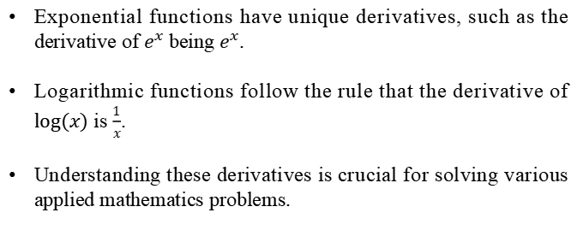
Derivatives of Exponential and Logarithmic Functions
Exponential functions have unique derivatives, such as the derivative of $e^{x}$ being $e^{x}$.
Logarithmic functions follow the rule that the derivative of $log⁡(x)$ is $\frac{1}{x}$.
Understanding these derivatives is crucial for solving various applied mathematics problems.

Slide 7
Rule Of Derivatives
There are several key rules that simplify the process of differentiation
Power rule
Product rule
Quotient rule
Chain rule

Slide 8
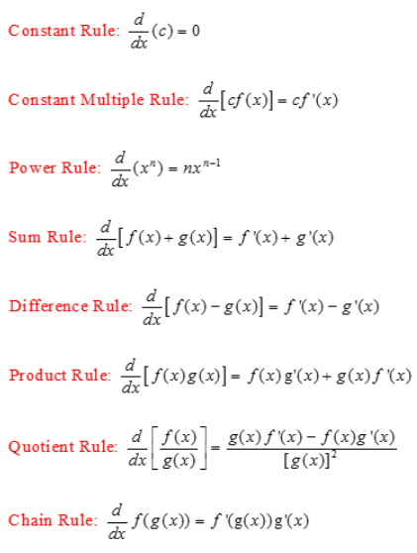

The Power Rule
The power rule is a basic differentiation rule for polynomial functions.
It states that the derivative of $x^{n}$ is ${nx}^{(n−1)}$, where n is a real number.
Notes:
Image source: https://www.w3schools.blog

Slide 9
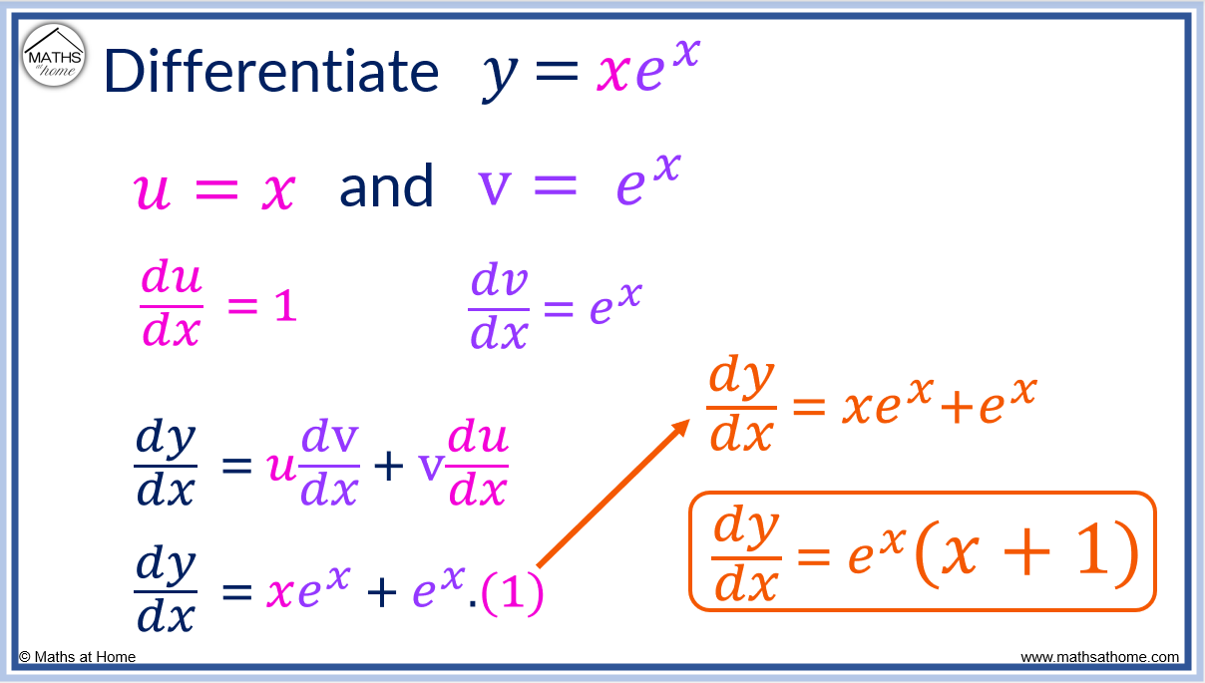
The Product Rule
The product rule is used to differentiate the product of two functions.
It states that if u and v are functions, then the derivative is u'v + uv'.
This rule is essential when dealing with products of varying functions.
Notes:
Image source: https://mathsathome.com

Slide 10
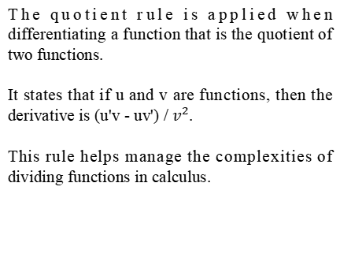
The Quotient Rule
The quotient rule is applied when differentiating a function that is the quotient of two functions.
It states that if u and v are functions, then the derivative is (u'v - uv') / $v^{2}$.
This rule helps manage the complexities of dividing functions in calculus.
Notes:
Image source: https://i.pinimg.com

Slide 11
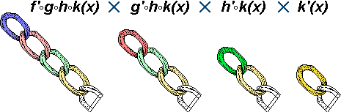
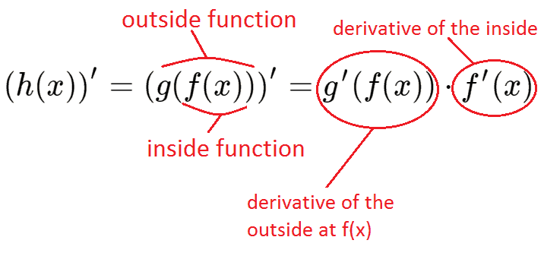

The Chain Rule
The chain rule is crucial for differentiating composite functions.
If $y= f′(g\left(x\right))$, then the derivative is $\frac{dy}{dx}$= $f^{′}\left(g\left(x\right)\right). g′(x)$
Notes:
Image source: https://images.examples.com

Slide 12
Machine Learning Coding:
# ** Multiple regression **
- Gradient descent
- scatter pltot
import numpy as np
import matplotlib.pyplot as plt
# ** standard devieasion **
- # x1=x1-mean(x1)/ std(x1)
X[:,1]=(X[:,1]-np.mean(X[:,1]))/np.std(X[:,1])
X[:,2]=(X[:,2]-np.mean(X[:,1]))/np.std(X[:,2])
y=(y-np.mean(y))/np.std(y)
plt.scatter(X[:,1],y,marker='x',c='r',label='Feater 1')
plt.scatter(X[:,2],y,marker='o',c='b',label='Feater 2')
plt.title('Data')
plt.legend()
plt.show()

Slide 13
plt.plot(epochs,costVal) plt.title('Epochs vs Cost') plt.xlabel('Epochs') plt.ylabel('Cost') plt.show() plt.scatter(x[:,0],y,marker='x',c='r',label=('Feater 1')) plt.scatter(x[:,1],y,marker='x',c='b',label=('Feater 2')) plt.plot(x[:,0],hypothesis(X,w),c='g',label=('fitted line')) plt.title('Datra vs fitted line ') plt.legend() plt.show() # ** Normal Equation Implementation** theta = np.linalg.inv(X.T @ X) @ X.T @ y theta theta2=np.linalg.pinv(X.T dot(X)).dot(np.dot(X.Tdot(y))) plt.scatter(x[:,0],y,marker='x',c='r',label=('Feater 1')) plt.scatter(x[:,1],y,marker='x',c='b',label=('Feater 2')) plt.plot(x[:,0],hypothesis(X,theta),c='g',label=('fitted line')) plt.title('Datra vs fitted line ') plt.legend() plt.show()

Slide 14
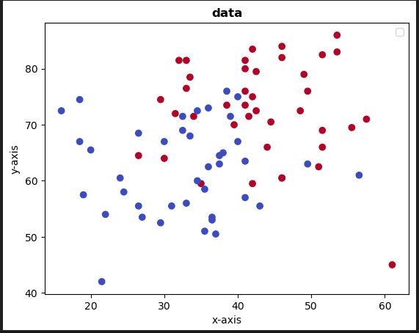

Slide 15
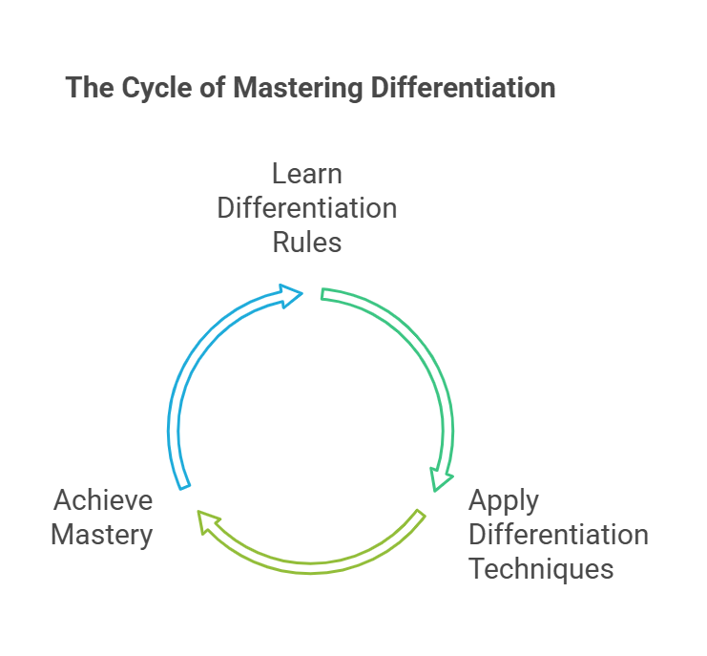
Conclusion and Summary
Differentiation is a central concept in calculus with wide-ranging applications.
Understanding the rules and techniques of differentiation is essential for advanced mathematics.
Mastery of differentiation lays the groundwork for further studies in calculus and its applications.
Notes:
Image source: https://www.smallbusinessdecisions.com

Slide 16


