Slide 1

Database Activity Monitoring
Imperva SecureSphere DAM — Deployment at
Directorate of Primary Education (DPE), Bangladesh
Presented by: Infosonik Systems Limited | 2026
Notes:
Welcome. This deck covers: what databases are, how they are secured natively, the risks, how Imperva DAM addresses them, our deployment at DPE, and all product features.

Slide 2
Agenda
01
What is a Database?
05
Deployment at DPE
Definition, types, stakeholders & real-world examples
5-phase installation: agent → gateway → MX verification
02
Database Security Fundamentals
06
Features & Functionalities
Native controls across Oracle, SQL Server, EDB, MySQL
All 95 operational components organised by category
03
Risks & Vulnerabilities
07
Conclusion
Why native controls alone are not enough
Summary, impact & production go-live roadmap
04
How Imperva DAM Fills the Gap
Architecture, zero-impact monitoring, real-time blocking

Slide 3
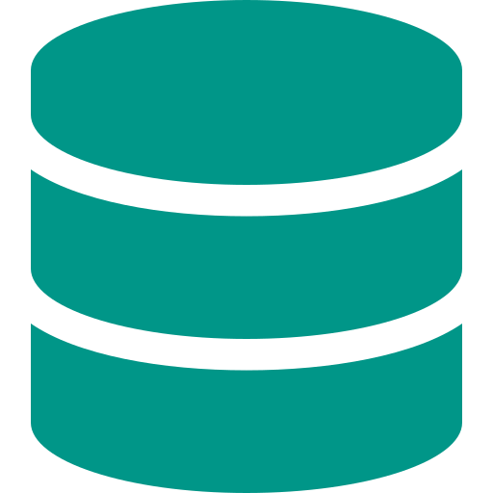
Section 1: What is a Database?
Foundations — Definition, Types, Stakeholders & Real-World Use

Slide 4

Database Fundamentals: Definition, Characteristics & Stakeholders
What is a Database?
Who Uses Databases?
An organised, electronic system for storing, retrieving, and managing structured data at scale. Unlike a spreadsheet, it handles massive data volumes while guaranteeing consistency, accuracy and concurrent multi-user access.
The DBMS (e.g., Oracle, SQL Server) is the software layer that interacts with users and enforces rules — the engine behind the database container.
→ End-Users: DPE officials, teachers, school staff (IPEMIS)
→ Database Admins (DBAs): manage health, backups, performance
→ Data Analysts: generate enrollment/resource reports
→ Decision Makers: long-term educational planning
→ IT Security: access controls and audit compliance
What is it For at DPE?
✔ Centralise millions of student & teacher records nationwide
Core Characteristics
✔ Automate payroll, textbook distribution & attendance
Data Integrity:
Prevents corruption; ensures data correctness
Concurrency:
All DPE teachers can update records simultaneously
✔ Historical archiving for decades of educational data
Persistence:
Data survives power failure or system crash
✔ Secure PII of millions of citizens — a national necessity

Slide 5
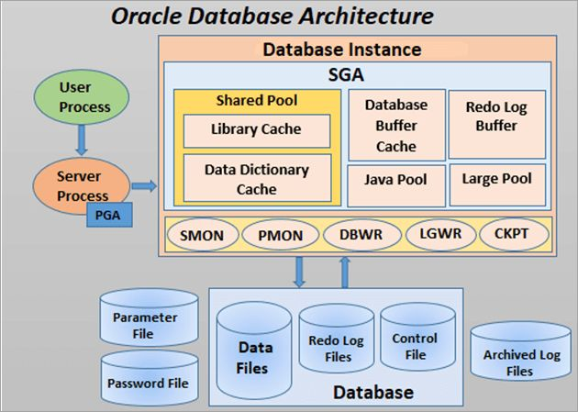

Slide 6
Common Database Types & Industry Standards
Relational (RDBMS)
Most common enterprise type
Non-Relational (NoSQL)
Flexible, unstructured data
Data in tables (rows & columns), linked by unique keys. Strong ACID compliance ensures integrity in critical systems. Uses SQL.
Schema-less storage for documents, key-value pairs, graphs, or wide-column data. Horizontally scalable for real-time workloads.
Examples: Oracle 19c · Microsoft SQL Server · EDB Postgres · MySQL
Examples: MongoDB · Redis · Cassandra · Couchbase
In-Memory Database
Microsecond response times
Distributed Database
High availability across sites
Stores data entirely in RAM. Used for caching, real-time analytics, and session management where disk I/O is too slow.
Spread across multiple physical locations or servers. If one site fails (e.g., DPE regional office), data remains available elsewhere.
Examples: Redis · Memcached · SAP HANA
Examples: AWS RDS · Azure SQL · Google Cloud Spanner

Slide 7
Section 2: Database Security Fundamentals
Native Controls — Four Pillars & Vendor Implementations

Slide 8




How Databases Secure Data Natively: 4 Pillars + Vendor Controls
Authentication
Authorisation
Encryption
Native Auditing
Who are you?
What can you do?
Can you read it?
Who did what?
Passwords, LDAP/AD integration, biometrics — verifying the identity of every user or application before granting any access.
Granular permission grants: READ for a teacher, UPDATE for an admin, EXECUTE for a stored procedure — no more, no less.
TDE for data at rest; SSL/TLS in transit. Even if storage media is stolen, data is unreadable without the decryption key.
Writes log files recording logins, timestamps, and executed queries — the internal trace that Imperva later supersedes.
Vendor-Specific Native Security Controls
Oracle
TDE encryption · Virtual Private Database (VPD) · Fine-Grained Auditing · Database Vault · Label Security · Audit Vault
EDB Postgres
Row-Level Security (RLS) · pg_audit extension · pgcrypto · LDAP/Kerberos auth · EDB Audit plugin
MySQL
Enterprise Firewall · Role-Based Access Control (RBAC) · InnoDB encryption · Enterprise Audit plugin
MS SQL Server
Always Encrypted · TDE · Dynamic Data Masking · Row-Level Security · SQL Server Audit · Extended Events

Slide 9

Section 3: Risks & Vulnerabilities
Why Native Security Alone Cannot Protect Your Data

Slide 10
Database Risks, Vulnerabilities & the Limits of Native Security
Active Threats
Limits of Native Security
⚠ SQL Injection (SQLi)
✕ Performance Penalty
Malicious SQL injected via web forms executes against the DB. Native databases cannot distinguish a legitimate app query from a SQLi attack.
Granular native auditing (logging every SELECT) consumes massive CPU & disk I/O, degrading application performance.
⚠ Privilege Abuse
✕ No Segregation of Duties
DBAs require high-level access. If credentials are stolen or a DBA goes rogue, native security cannot stop them — they are the gatekeeper.
DBAs manage both the database AND its audit logs. A malicious DBA can steal data then delete the evidence — a critical compliance failure.
⚠ Unpatched Vulnerabilities
✕ Reactive, Not Proactive
Zero-day CVEs in Oracle or SQL Server can be exploited before the vendor even releases a fix. Regular patching is critical.
Native logs record what happened after the fact. There is no real-time block when 10,000 student records are being extracted right now.
⚠ Misconfigurations
✕ Siloed Management
Default passwords left active, PUBLIC access granted to sensitive tables — complexity creates loopholes that attackers exploit.
Oracle, SQL Server, Postgres each use different audit systems. No single unified security view across the entire DPE infrastructure.

Slide 11
Section 4: How Imperva DAM Fills the Gap
Real-Time Monitoring · Blocking · Compliance · Unified Visibility

Slide 12
How Imperva DAM Completely Solves the Security Deficit
DAM continuously monitors 100% of database activity in real time, independent of the database, storing tamper-proof logs on a separate hardened server — eliminating every gap native security leaves open.
Problem: Performance Penalty
Problem: No Segregation of Duties
✔ DAM Solution: Zero-impact OS-level agent never uses the database's CPU or memory for analysis. DB runs at 100% efficiency.
✔ DAM Solution: Audit logs stored on MX Management Server. DBAs have zero access to Imperva — they cannot delete evidence of their own actions.
Problem: Reactive Logging
Problem: Siloed Management
✔ DAM Solution: Real-time blocking. If a SQL injection or bulk data extraction is detected, the Gateway severs the connection instantly — before data leaves.
✔ DAM Solution: Single pane of glass. One policy ('Alert on PII table access') applies across Oracle, Postgres, SQL Server, and MySQL simultaneously.

Slide 13
Imperva DAM: Three-Tier Decoupled Architecture
Tier 1
Tier 2
Tier 3
The Agent (Sensor)
The Gateway (Brain)
The MX Server (Command Centre)
→ Deployed on the database host OS — kernel level
→ Sits off the database — separate appliance or VM
→ Centralized Web UI console for all config
→ Zero analysis done locally; forwards traffic only
→ Receives all agent traffic over encrypted port 443
→ Tamper-proof immutable audit log vault
→
→
→ Captures LOCAL admin sessions (IPC/BEQ) — the most critical blind spot
→ Parses every SQL query in real time — full context
→ DBAs have NO access — absolute separation of duties
→ KABI integration for Linux/Oracle kernels
→ Checks against security policies: SQLi signatures, profile deviations
→ Advanced analytics, dashboards & compliance reports
→ Near-zero CPU/memory footprint on the DB server
→ Active mitigation: TCP reset issued BEFORE the DB executes malicious SQL
→ Triggers Action Sets: SMS, Email, SIEM forwarding
→ One Gateway can service multiple databases & agents

Slide 14
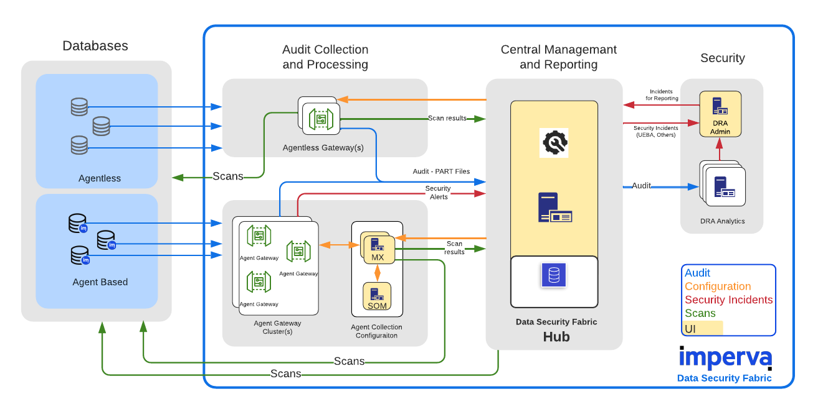

Slide 15

Section 5: Deployment at DPE
5-Phase Installation: Agent → Gateway → MX Console → Verification

Slide 16
Deployment Strategy: Test Environment First
Target: Designated Test Database Environment — not the live IPEMIS production servers
Zero-Risk Verification
Safe Policy Tuning
100% Traffic Capture Proof
Confirms agents communicate flawlessly with the Gateway and MX over port 443 without firewall interruptions — before any production change.
Observe normal DPE database behaviour, fine-tune security policies, and set baseline alert thresholds with zero risk to live IPEMIS applications.
Verify that both remote application queries AND local DBA terminal sessions (IPC/BEQ) are fully captured, parsed, and stored on the MX.

Slide 17
Phase 0: Agent Installation on Database Server
1
Download Reconnaissance Script
Access Imperva FTP → navigate to the misc directory → download which_ragent.sh
2
Environment Analysis
Run which_ragent.sh on the database server — it analyses the OS version and kernel footprint to identify the exact compatible agent package
3
Retrieve Agent Package
Return to Imperva FTP and download the recommended binary — install.sh or .bsx package, plus the KABI file if the Linux kernel requires it
4
Execute Installation
Run the installer as root. Provide the KABI file where required for deep OS-level kernel traffic interception on Linux/Oracle systems
5
Configure & Link to Gateway
Point the agent to the Imperva Gateway IP address — this establishes the secure SSL communication tunnel on port 443

Slide 18
Phases 1 – 3: Logical Hierarchy, Gateway Listener & Agent Mapping
Phase 1
→ Setup > Sites — create Site (e.g., 'DPE Datacenter')
Logical Infrastructure (Sites & Servers)
→ Create Server Group by OS/DB type: linux_oracle_db | windows_server_db
→ Add Server: exact IP address + Hostname of the agent host machine
→ Add Database Service: select type (Oracle / MS SQL) and listening port (1521 / 1433)
Phase 2
→ Navigate to Setup > Gateways → select the active Gateway
Gateway Listener Configuration
→ Confirm Agent Listener is active on Port 443 with SSL enabled
→ All agent-to-Gateway traffic is heavily encrypted in transit
Phase 3
→ Setup > Agents — the installed agent appears automatically (validates network path)
Agent Assignment & Database Service Mapping
→ Settings tab → assign agent to the Server Group created in Phase 1
→ Enable Agent Monitoring specifically for the newly created Database Service
→ This binds the agent's captured traffic to the correct audit policy scope

Slide 19
Phases 4 – 5: Data Interface Binding (Critical) & Live Verification
Phase 4: Data Interface Binding — Critical for Capturing Local Traffic
Agent selected → Data Interfaces tab:
View auto-discovered interfaces on the right side
Windows / MS SQL Server:
Un-ignore: MssQL IPC (local SSMS sessions) + TCP (remote app queries)
Linux / Oracle Database:
Un-ignore: Oracle BEQ + Oracle IPC (local DBA terminal) + TCP (remote)
Each un-ignored interface:
Set Service drop-down → match exact Database Service created in Phase 1
Why this matters:
Without IPC/BEQ, DBA terminal sessions are completely invisible — the most dangerous blind spot
Finalise:
Click Save in the top right corner to activate monitoring on all mapped interfaces
Phase 5: Live Verification — Confirming 100% Capture
✔ Navigate to Audit > DB Audit Data → select Data view
✔ Execute test queries directly on the database — both remote (app simulation) and local (as admin)
✔ Set Time Frame to 'Last Hour' → click Update
✔ Both query types now visible in logs: confirms successful capture, parsing, and tamper-proof storage on MX ✔

Slide 20

Section 6: Features & Functionalities
All 95 Operational Components — Organised by Category

Slide 21
Feature Group 1: UI Customisation, System Administration & Access Control
Custom Home Page
Workspace Hanging Tabs & Column Views
UI
Each role (Auditor, Security Ops, DBA) lands on their most relevant dashboard immediately after login. Configured via Preferences > Preferences.
UI
Hide/show Filter and Details panes to maximise screen real estate. Customise Alerts/Violations column grid via Action > Select Columns.
Password Strength Policy
Policy Change Comments & ADC Updates
SYS
Configure minimum length, character complexity (uppercase, numbers, special chars), and validity period for all local MX user accounts via Admin > System Definitions.
SYS
Force admins to log a reason for every security policy change — auto-creates an Activity Log. Schedule daily ADC vulnerability content updates.
Local Accounts & Custom Roles (RBAC)
External Auth (AD/LDAP) & Personal Info Masking
IAM
Create MX users with temporary passwords. Build custom roles with granular controls: which workspaces, tabs, and menus each role can access, with View/Edit/Create rights.
IAM
Integrate with Active Directory/LDAP for centralised login. PIM hashes usernames, hostnames, IPs with HMAC-SHA256 — authorised users unmask per session.

Slide 22
Feature Group 2: Infrastructure Setup, Discovery & Log Filtering
Global Objects
Sites Tree Hierarchy
INFRA
Centrally managed containers (IP Groups, Windows Domains, Stored Procedure Groups) applied globally — reduces repetitive configuration and false-positive alerts.
INFRA
Cascading structure: Site → Server Group → Service → Application. Supports load balancer forwarded-IP headers (X-Forwarded-For, True-Client-IP).
Service Discovery Scans
Reviewing & Protecting Discovered Servers
DISC
Actively scans subnets for rogue or unprotected databases. Auto-names new entities using $SITE, $IP, $SERVICE_TYPE placeholders. Can auto-add to Sites Tree.
DISC
Accept discovered servers to create Server Groups/Services. Click 'Add to Protected IPs' — verified by blue checkmark in the Protected column.
Basic & Advanced Log Filters
Quick Filter & Operation Modes
LOG
Checkbox-based quick filters (By Severity, By SubSystem) plus Advanced Filters using AND/OR logical operators with Enabled Fields and Predefined Values.
LOG
Literal text or attribute search (ip:, user:, session: syntax) above any log grid. Server Group modes: Simulation (log only) → Active (block) → Disabled.

Slide 23
Feature Group 3: Agent Tuning, Direct Access & Encryption Decryption
Agent CPU Restraining & Blocking
Data Interfaces & Exclusion Rules
AGENT
Set max CPU % limit to protect DB server performance. Enable Blocking checkbox for the agent to actively drop traffic when Server Group is in Active mode.
AGENT
Review and bind discovered TCP/IPC/BEQ interfaces. Create Agent Exclusion Rules at Global Objects level to drop high-volume trusted connections (e.g., nightly backups) before they reach the Gateway.
Direct Access Credentials
Stored Procedure Groups & Kerberos Keys
DB
Dedicated DB credentials on the MX for internal operations: reading stored procedures, classifying sensitive data, running assessments. Use a dedicated privileged account — not a shared DBA login.
DB
Map stored procedure groups to DB Applications so Imperva audits SQL inside precompiled procedures. Provide Kerberos domain\username keys to decrypt MS SQL Server network authentication.
Resolving 'Hashed User' (SSL Decryption)
Resolving 'Connected User' & Text Normalisation
FIX
When SSL encrypts DB logins, usernames appear as 'Hashed User'. Fix: upload the DB server SSL certificate (PKCS12/PFX) to Service Definitions → Encryption Support.
FIX
Match MX Connection Timeout to the DB server's session timeout. Use Text Replacement in the Service Operation tab to strip dynamic variables from queries and prevent profile bloat.

Slide 24
Feature Group 4: Behavioural Profiling & SQL Whitelist Engine
Profile Overview & Thresholds
Learned User Attributes
PROF
High-level stats across all sites: users, query groups, tables. Tune time-based thresholds (in hours) for graduating profiles from Learning → Static Protect → Dynamic Protect mode.
PROF
Automatically learns source IPs, OS hostnames, source applications per user. Padlock icon freezes a category — any new value triggers a policy violation.
Query Groups & Enforcement Modes
Blacklist Tables, Time Restrictions & Privileged Ops
PROF
Normalises SQL (variables → '?') into unique Query Groups. Each group set to Learning, Dynamic Protect, or Static Protect. Expand to read literal SQL statements recorded.
PROF
Forbid users from accessing sensitive table groups. Paint time grids to restrict DB access to business hours only. Whitelist DBA privileged operations (ALTER, DROP, GRANT) to prevent false positives.
User Group Profiles
Freeze / Revert Learning Engine
PROF
Cluster users with identical roles (DBA Group, App Service Account) to share learned attributes. Move individuals into groups — they inherit all shared profile settings automatically.
PROF
Disable Learning Engine (SQL Profile Policy → Advanced tab) to freeze a mature profile and save CPU. Or revert all Query Groups to Learning mode to completely suspend enforcement in erratic environments.

Slide 25
Feature Group 5: Data Masking, PIM & Sensitive Data Classification
Data Masking (Sensitive Dictionaries)
Personal Information Masking (PIM)
MASK
Masks credit cards, SSNs, National IDs with asterisks (***) before storage in the MX database. Applied to Requests and DB Audit Responses. Configurable per specific table groups.
MASK
Hashes usernames, hostnames, source IPs with HMAC-SHA256 in all UI views. Enabled via MX CLI (dam.properties). Authorised users unmask temporarily per session for investigations.
Data Types & Scan Profiles
Custom Classification Rules
CLASS
Predefined labels (Email, PCI, Account Number) or custom Data Types. Scan Profiles define which types to hunt for, sample accuracy (default 75%), and throttle settings.
CLASS
Column-name pattern matching OR Regex content-based patterns for proprietary data (e.g., columns named 'NID', 'TaxCode'). Assign to existing or new Data Types.
Run DB Classification Scans & Analyse Results
Accept Results & Generate Table Groups
CLASS
Executes against Protected IPs using Direct Access credentials. Summary View shows coloured distribution graphs of findings by database, schema, and table.
CLASS
Pending Tables workflow: Accept verified findings to auto-generate Global Database Table Groups — instantly linked to the DB Application and usable in security policies.

Slide 26
Feature Group 6: Security Policies, Blocking & Simulation Workflow
Default & Auto-Applied Policies
Rule Tuning: Severity, Enable/Block
POL
SQL Profile Policy, SQL Protocol Policy, SQL Correlation Policy — automatically applied to every new DB Service or Application. Provides immediate baseline protection out-of-the-box.
POL
Per-rule controls on any policy: toggle Enabled/Disabled, set Severity (Info/Low/Medium/High), set Action (None to alert only, or Block to drop traffic). Expand rules for advanced parameters.
Custom Security Policies
Active Mode + Rule-Level Blocking
POL
Build from scratch or clone existing policies. Define Match Criteria: specific DB user, event type, targeted column, or source IP. Apply at DB Service or DB Application level.
BLOCK
Two-lever requirement: (1) Server Group set to Active mode AND (2) individual rule Action set to Block. Both conditions must be true for traffic to actually be dropped.
Extended Blocking: Session, User & IP Block
Simulation-First Safe Deployment Workflow
BLOCK
Beyond dropping one packet: Terminate DB Session (sever the connection), User Block (lock the DB account), IP Block (drop ALL traffic from attacker IP for a set duration).
BLOCK
Run in Simulation → configure blocking rules → wait for all scheduled jobs to run → review Alert Report with DBAs to eliminate false positives → only then switch to Active mode.

Slide 27
Feature Group 7: Action Interfaces, Action Sets & Automated Archiving
Action Interfaces
Action Sets
ACT
Define external communication mechanisms: SMTP Email, Syslog (CEF), SCP/FTP Archive, SNMP Trap. Each interface stores technical parameters (SMTP server, port, auth) for reuse.
ACT
Group one or more Action Interfaces into a named set. Define scope: Security Violations, System Events, Audit, Archiving, or Assessments. Apply at Service, Application, or DB App level.
Followed Actions on Security Rules
Followed Actions on System Jobs
ACT
Attach an Action Set to a specific policy rule — when a violation fires, the Action Set automatically triggers (e.g., send Syslog to SIEM + email to DBA team simultaneously).
ARCH
Attach Action Sets to system maintenance jobs (MX Database Backup, Audit Archiving). Failed deliveries are stored in /var/tmp/failed_delivery on the MX for manual retrieval.
Audit Archiving Locations
Report Retention & Archive Job
ARCH
In Audit Policy → Archiving tab: assign an FTP/SCP/NFS Action Set with a daily schedule. Set Purge threshold — gateway only deletes records older than this AND already archived.
ARCH
Reports Archive job: auto-transfers old reports to external storage via FTP/SCP, then purges from MX. Enforces data retention policy and manages disk space automatically.

Slide 28
Feature Group 8: Audit Framework, Aggregation, SIEM & Health Statistics
DB Audit Data: Fast View vs. Live Fetch
Parsed Queries & Aggregation Tuning
AUD
Fast View pre-fetches recent data daily for instant loading. For data outside the cache window, click Update to force live query from Gateways. Configure Fast View days in Policy → Settings tab.
AUD
Queries are normalised (variables → '?') — identical structures increment a hit counter rather than creating duplicate rows. Set Event aggregation time window (e.g., 30 min) to control disk usage.
Custom Audit Policies
Extended Data Collection & DB Responses
AUD
Replace 'Default Rule – All Events' with targeted policies scoped to specific event types, DB users, or tables — saving significant CPU and gateway disk I/O.
AUD
Enable Extended Collection Events (unparsed queries, response sizes, timestamps). Enable DB Responses to capture actual data returned by the DB — specify Include/Exclude tables to control storage impact.
SIEM Integration & Analytics Views
Audit Stats Dashboard & Convert View to Report
SIEM
External Logger tab: forward logs to Splunk/QRadar in Syslog CEF format from the MX or directly from the Gateway. Use predefined views (Source Analysis, Privileged Ops) with persistent filters.
SIEM
Management Statistics: Gateway load, policy disk footprint, indexing status. Customise any Data View layout then click Save as Report to instantly create a scheduled, distributable report.

Slide 29
Feature Group 9: Monitoring, Alert Triage & Incident Response
Global Alert Dashboard
Violations vs. Aggregated Alerts
MON
Real-time single-pane view: Gateway CPU load, ThreatRadar status, Connections/sec, Throughput graphs, Alerts per Severity, and Latest Alerts — click any item to open full details.
MON
Violations = individual events (literal SQL, source IP, error codes visible in Details pane). Alerts = smart containers aggregating up to 30 identical violations over 12 hours — reduces alert fatigue.
Alert Triage Workflow (Flags)
Filter & Search Mechanics
MON
Right-click any alert: Mark as Important (!), Acknowledged (green ✓), Dismissed (×), or Unread (bold). Enables structured incident tracking without an external ticketing system.
MON
Basic (checkbox) filters, Advanced filters (AND/OR operators), and Quick Filter (ip:, user:, session: syntax). Filters are cross-view persistent — apply in Source Analysis, switch to Access Patterns view.
Applied Policies Review & Profile Blocking
Security Policy Configuration Reports
POL
Applied Policies tab on any DB Service/Application shows active baseline. For profile-based blocking, Query Groups must be in Static or Dynamic Protect mode — not Learning mode.
POL
Generate compliance docs listing all active policies, enabled rules, severity levels, and assets they protect. Schedule quarterly for audit requirements. Top 10 Attack pie charts for executive reporting.

Slide 30
Feature Group 10: Risk Assessments, URM & Reporting Engine
Assessment Policies: CIS, DISA-STIG, PCI-DSS
Assessment Scans & CVSS Risk Score
RISK
Built-in benchmarks with per-test Overview, Recommended Fix, and Technical Details. Filter by DB type (Oracle, MsSql). Tag policies (e.g., 'DPE-DB') for batch Tag-Based Scans.
RISK
Policy-Based Scan (single policy) or Tag-Based Scan (multiple policies by tag). Risk Calculator runs nightly; trigger 'Run Now' via Admin > Jobs Status after any ad-hoc scan.
Risk Console: Dashboards & Comparison View
DB User Rights Management (URM) Scans
RISK
Network View and Data View show at-risk Server Groups. Comparison View explicitly contrasts a recent scan vs. baseline — verifies whether vulnerabilities have been successfully remediated.
URM
Logs into the database and maps all granted roles and effective permissions. 'Ignore DBA Users' option off = reveals application accounts with improper DBA-level access.
Effective Permissions & Access Path Visualisation
Reporting Engine: Create, Schedule, Distribute
URM
Select any user row → click Show Paths → visual map shows the complete privilege chain from the account through nested AD groups to the specific database object.
RPT
Custom reports for Alerts, Audit Data, Configuration, Assessment, Profile, and URM. Configure charts and tables. Schedule daily/weekly/monthly. Auto-distribute via Email Action Interface.

Slide 31
Imperva DAM: Risk Elimination Summary at DPE
⚠ SQL Injection
✔ SQL Protocol & Profile policies detect malformed / excessively long queries; Gateway issues TCP reset before the DB executes the malicious statement
⚠ Privilege Abuse / Insider Threat
✔ Behavioural profiling flags any query or table access outside the user's learned whitelist; tamper-proof logs on MX — DBAs cannot delete their own audit trail
⚠ Encrypted Credentials (Hashed User)
✔ DB server SSL certificate upload + Kerberos key configuration reveals true usernames in every audit record — zero blind spots in the identity trail
⚠ Bulk Data Exfiltration
✔ Extended DB Response auditing + anomalous row-count SIEM alerts + real-time blocking stop data theft before it leaves the network perimeter
⚠ Compliance & Audit Gaps
✔ CIS / DISA-STIG / PCI-DSS built-in assessments with CVSS scoring; automated quarterly compliance reports distributed to DPE auditors
⚠ Rogue / Shadow Databases
✔ Service Discovery Scans actively probe all subnets; any unprotected database spun up by a DBA is detected and auto-added to the protection scope

Slide 32





Conclusion
Comprehensive Capability Verified
Fragmented Native Logs Replaced
All 95 operational components of Imperva DAM confirmed on DPE test environment — from UI management to full risk governance.
Tamper-proof external audit architecture permanently bridges the insider-threat and DBA blind spots native security leaves open.
Automated Governance Realised
Production Deployment Ready
Data classification, behavioural profiling, and User Rights Management give DPE full visibility over sensitive data and effective user permissions.
Technical steps proven, MX hierarchy mapped, and policy simulation workflow validated. Ready to scale to live IPEMIS production databases.
Infosonik Systems Limited · Imperva SecureSphere · DPE Bangladesh · 2025
Notes:
Close with Q&A. Next step: schedule production deployment planning session with DPE IT and DBA teams.

