Slide 1

Database Activity Monitoring
Imperva SecureSphere DAM — Deployment at
Directorate of Primary Education (DPE), Bangladesh
Presented by: Infosonik Systems Limited | 2026
Notes:
Welcome. This deck covers: what databases are, how they are secured natively, the risks, how Imperva DAM addresses them, our deployment at DPE, and all product features.

Slide 2
Agenda
01
What is a Database?
05
Deployment at DPE
Definition, types, stakeholders & real-world examples
5-phase installation: agent → gateway → MX verification
02
Database Security Fundamentals
06
Features & Functionalities
Native controls across Oracle, SQL Server, EDB, MySQL
All 95 operational components organised by category
03
Risks & Vulnerabilities
07
Conclusion
Why native controls alone are not enough
Summary, impact & production go-live roadmap
04
How Imperva DAM Fills the Gap
Architecture, zero-impact monitoring, real-time blocking

Slide 3

Section 1: What is a Database?
Foundations — Definition, Types, Stakeholders & Real-World Use

Slide 4

Database Fundamentals: Definition, Characteristics & Stakeholders
What is a Database?
Who Uses Databases?
An organised, electronic system for storing, retrieving, and managing structured data at scale. Unlike a spreadsheet, it handles massive data volumes while guaranteeing consistency, accuracy and concurrent multi-user access.
The DBMS (e.g., Oracle, SQL Server) is the software layer that interacts with users and enforces rules — the engine behind the database container.
→ Multiple Applications
→ Database Admins (DBAs): manage health, backups, performance
→ Data Analysts: generate enrollment/resource reports
→ Decision Makers: long-term educational planning
→ IT Security: access controls and audit compliance
What is it For at DPE?
✔ Centralise millions of student & teacher records nationwide
Core Characteristics
✔ Automate payroll, textbook distribution & attendance
Data Integrity:
Prevents corruption; ensures data correctness
Concurrency:
All DPE teachers can update records simultaneously
✔ Historical archiving for decades of educational data
Persistence:
Data survives power failure or system crash
✔ Secure PII of millions of citizens — a national necessity

Slide 5
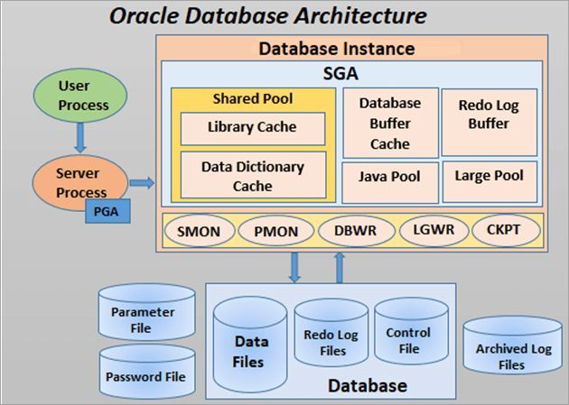

Slide 6
Common Database Types & Industry Standards
Relational (RDBMS)
Most common enterprise type
Non-Relational (NoSQL)
Flexible, unstructured data
Data in tables (rows & columns), linked by unique keys. Strong ACID compliance ensures integrity in critical systems. Uses SQL.
Schema-less storage for documents, key-value pairs, graphs, or wide-column data. Horizontally scalable for real-time workloads.
Examples: Oracle 19c · Microsoft SQL Server · EDB Postgres · MySQL
Examples: MongoDB · Redis · Cassandra · Couchbase
In-Memory Database
Microsecond response times
Distributed Database
High availability across sites
Stores data entirely in RAM. Used for caching, real-time analytics, and session management where disk I/O is too slow.
Spread across multiple physical locations or servers. If one site fails (e.g., DPE regional office), data remains available elsewhere.
Examples: Redis · Memcached · SAP HANA
Examples: AWS RDS · Azure SQL · Google Cloud Spanner

Slide 7
Section 2: Database Security Fundamentals
Native Controls — Four Pillars & Vendor Implementations

Slide 8




How Databases Secure Data Natively: 4 Pillars + Vendor Controls
Authentication
Authorisation
Encryption
Native Auditing
Who are you?
What can you do?
Can you read it?
Who did what?
Passwords, LDAP/AD integration, biometrics — verifying the identity of every user or application before granting any access.
Granular permission grants: READ for a teacher, UPDATE for an admin, EXECUTE for a stored procedure — no more, no less.
TDE for data at rest; SSL/TLS in transit. Even if storage media is stolen, data is unreadable without the decryption key.
Writes log files recording logins, timestamps, and executed queries — the internal trace that Imperva later supersedes.
Vendor-Specific Native Security Controls
Oracle
TDE encryption · Virtual Private Database (VPD) · Fine-Grained Auditing · Database Vault · Label Security · Audit Vault
EDB Postgres
Row-Level Security (RLS) · pg_audit extension · pgcrypto · LDAP/Kerberos auth · EDB Audit plugin
MySQL
Enterprise Firewall · Role-Based Access Control (RBAC) · InnoDB encryption · Enterprise Audit plugin
MS SQL Server
Always Encrypted · TDE · Dynamic Data Masking · Row-Level Security · SQL Server Audit · Extended Events

Slide 9

Section 3: Risks & Vulnerabilities
Why Native Security Alone Cannot Protect Your Data

Slide 10
Database Risks, Vulnerabilities & the Limits of Native Security
Active Threats
Limits of Native Security
⚠ SQL Injection (SQLi)
✕ Performance Penalty
Malicious SQL injected via web forms executes against the DB. Native databases cannot distinguish a legitimate app query from a SQLi attack.
Granular native auditing (logging every SELECT) consumes massive CPU & disk I/O, degrading application performance.
⚠ Privilege Abuse
✕ No Segregation of Duties
DBAs require high-level access. If credentials are stolen or a DBA goes rogue, native security cannot stop them — they are the gatekeeper.
DBAs manage both the database AND its audit logs. A malicious DBA can steal data then delete the evidence — a critical compliance failure.
⚠ Unpatched Vulnerabilities
✕ Reactive, Not Proactive
Zero-day CVEs in Oracle or SQL Server can be exploited before the vendor even releases a fix. Regular patching is critical.
Native logs record what happened after the fact. There is no real-time block when 10,000 student records are being extracted right now.
⚠ Misconfigurations
✕ Siloed Management
Default passwords left active, PUBLIC access granted to sensitive tables — complexity creates loopholes that attackers exploit.
Oracle, SQL Server, Postgres each use different audit systems. No single unified security view across the entire DPE infrastructure.

Slide 11
Section 4: How Imperva DAM Fills the Gap
Real-Time Monitoring · Blocking · Compliance · Unified Visibility

Slide 12
How Imperva DAM Completely Solves the Security Deficit
DAM continuously monitors 100% of database activity in real time, independent of the database, storing tamper-proof logs on a separate hardened server — eliminating every gap native security leaves open.
Problem: Performance Penalty
Problem: No Segregation of Duties
✔ DAM Solution: Zero-impact OS-level agent never uses the database's CPU or memory for analysis. DB runs at 100% efficiency.
✔ DAM Solution: Audit logs stored on MX Management Server. DBAs have zero access to Imperva — they cannot delete evidence of their own actions.
Problem: Reactive Logging
Problem: Siloed Management
✔ DAM Solution: Real-time blocking. If a SQL injection or bulk data extraction is detected, the Gateway severs the connection instantly — before data leaves.
✔ DAM Solution: Single pane of glass. One policy ('Alert on PII table access') applies across Oracle, Postgres, SQL Server, and MySQL simultaneously.

Slide 13
Imperva DAM: Three-Tier Decoupled Architecture
Tier 1
Tier 2
Tier 3
The Agent (Sensor)
The Gateway (Brain)
The MX Server (Command Centre)
→ Deployed on the database host OS — kernel level
→ Sits off the database — separate appliance or VM
→ Centralized Web UI console for all config
→ Zero analysis done locally; forwards traffic only
→ Receives all agent traffic over encrypted port 443
→ Tamper-proof immutable audit log vault
→
→
→ Captures LOCAL admin sessions (IPC/BEQ) — the most critical blind spot
→ Parses every SQL query in real time — full context
→ DBAs have NO access — absolute separation of duties
→ KABI integration for Linux/Oracle kernels
→ Checks against security policies: SQLi signatures, profile deviations
→ Advanced analytics, dashboards & compliance reports
→ Near-zero CPU/memory footprint on the DB server
→ Active mitigation: TCP reset issued BEFORE the DB executes malicious SQL
→ Triggers Action Sets: SMS, Email, SIEM forwarding
→ One Gateway can service multiple databases & agents

Slide 14
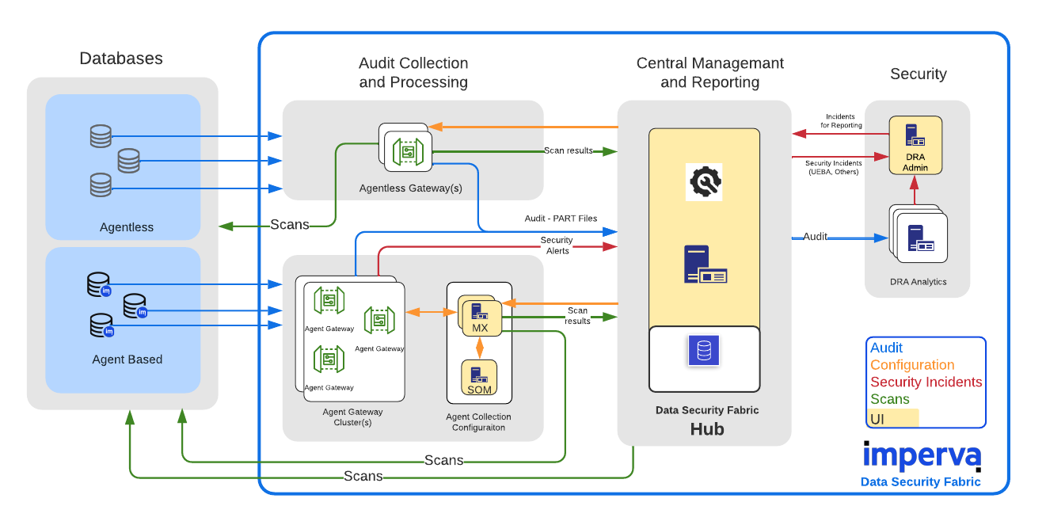

Slide 15

Section 5: Deployment at DPE
5-Phase Installation: Agent → Gateway → MX Console → Verification

Slide 16
Phase 0: Agent Installation on Database Server
1
Download Reconnaissance Script
Access Imperva FTP → navigate to the misc directory → download which_ragent.sh
2
Environment Analysis
Run which_ragent.sh on the database server — it analyses the OS version and kernel footprint to identify the exact compatible agent package
3
Retrieve Agent Package
Return to Imperva FTP and download the recommended binary — install.sh or .bsx package, plus the KABI file if the Linux kernel requires it
4
Execute Installation
Run the installer as root. Provide the KABI file where required for deep OS-level kernel traffic interception on Linux/Oracle systems
5
Configure & Link to Gateway
Point the agent to the Imperva Gateway IP address — this establishes the secure SSL communication tunnel on port 443

Slide 17
Phases 1 – 3: Logical Hierarchy, Gateway Listener & Agent Mapping
Phase 1
→ Setup > Sites — create Site (e.g., 'DPE Datacenter')
Logical Infrastructure (Sites & Servers)
→ Create Server Group by OS/DB type: linux_oracle_db | windows_server_db
→ Add Server: exact IP address + Hostname of the agent host machine
→ Add Database Service: select type (Oracle / MS SQL) and listening port (1521 / 1433)
Phase 2
→ Navigate to Setup > Gateways → select the active Gateway
Gateway Listener Configuration
→ Confirm Agent Listener is active on Port 443 with SSL enabled
→ All agent-to-Gateway traffic is heavily encrypted in transit
Phase 3
→ Setup > Agents — the installed agent appears automatically (validates network path)
Agent Assignment & Database Service Mapping
→ Settings tab → assign agent to the Server Group created in Phase 1
→ Enable Agent Monitoring specifically for the newly created Database Service
→ This binds the agent's captured traffic to the correct audit policy scope

Slide 18
Phases 4 – 5: Data Interface Binding (Critical) & Live Verification
Phase 4: Data Interface Binding — Critical for Capturing Local Traffic
Agent selected → Data Interfaces tab:
View auto-discovered interfaces on the right side
Windows / MS SQL Server:
Un-ignore: MssQL IPC (local SSMS sessions) + TCP (remote app queries)
Linux / Oracle Database:
Un-ignore: Oracle BEQ + Oracle IPC (local DBA terminal) + TCP (remote)
Each un-ignored interface:
Set Service drop-down → match exact Database Service created in Phase 1
Why this matters:
Without IPC/BEQ, DBA terminal sessions are completely invisible — the most dangerous blind spot
Finalise:
Click Save in the top right corner to activate monitoring on all mapped interfaces
Phase 5: Live Verification — Confirming 100% Capture
✔ Navigate to Audit > DB Audit Data → select Data view
✔ Execute test queries directly on the database — both remote (app simulation) and local (as admin)
✔ Set Time Frame to 'Last Hour' → click Update
✔ Both query types now visible in logs: confirms successful capture, parsing, and tamper-proof storage on MX ✔

Slide 19

Section 6: Features & Functionalities
All 95 Operational Components — Organised by Category

Slide 20
Reference Link:
https://github.com/ImranNoorEmon/Imperva_DAM_Deployment_Procedure

Slide 21
Imperva DAM: Risk Elimination Summary at DPE
⚠ SQL Injection
✔ SQL Protocol & Profile policies detect malformed / excessively long queries; Gateway issues TCP reset before the DB executes the malicious statement
⚠ Privilege Abuse / Insider Threat
✔ Behavioural profiling flags any query or table access outside the user's learned whitelist; tamper-proof logs on MX — DBAs cannot delete their own audit trail
⚠ Encrypted Credentials (Hashed User)
✔ DB server SSL certificate upload + Kerberos key configuration reveals true usernames in every audit record — zero blind spots in the identity trail
⚠ Bulk Data Exfiltration
✔ Extended DB Response auditing + anomalous row-count SIEM alerts + real-time blocking stop data theft before it leaves the network perimeter
⚠ Compliance & Audit Gaps
✔ CIS / DISA-STIG / PCI-DSS built-in assessments with CVSS scoring; automated quarterly compliance reports distributed to DPE auditors
⚠ Rogue / Shadow Databases
✔ Service Discovery Scans actively probe all subnets; any unprotected database spun up by a DBA is detected and auto-added to the protection scope

Slide 22





Conclusion
Comprehensive Capability Verified
Fragmented Native Logs Replaced
All 95 operational components of Imperva DAM confirmed on DPE test environment — from UI management to full risk governance.
Tamper-proof external audit architecture permanently bridges the insider-threat and DBA blind spots native security leaves open.
Automated Governance Realised
Production Deployment Ready
Data classification, behavioural profiling, and User Rights Management give DPE full visibility over sensitive data and effective user permissions.
Technical steps proven, MX hierarchy mapped, and policy simulation workflow validated. Ready to scale to live IPEMIS production databases.
Infosonik Systems Limited · Imperva SecureSphere · DPE Bangladesh · 2025
Notes:
Close with Q&A. Next step: schedule production deployment planning session with DPE IT and DBA teams.

