Slide 1
Virtual Environments in Python
By: Dr. Muhammad I. Qureshi
Associate Professor
FICT, BUITEMS, Quetta
Email: engr.imran@buitms.edu.pk

Slide 2
Table of Contents
Some Basics
Why We Need Virtual Environments at the First Place?
What is a Virtual Environment?
Using Virtual Environments
Creating Environments
Installing Packages
Managing Environments
Requirements Files
Duplicating Environments
Troubleshooting
References

Slide 3

Some Basics
Python is open-source software, and it needs different modules (or packages) to perform different tasks.
For instance, on Mac OS, we can easily find where sys.prefix points to using the Python shell:
>>> import sys
>>> sys.prefix
'D:\\ProgramData\\Anaconda3’
We can also find, where the site packages are installed by default
>>> import site
>>> site.getsitepackages()
['D:\\ProgramData\\Anaconda3', 'D:\\ProgramData\\Anaconda3\\lib\\site-packages']

Slide 4
Why We Need Virtual Environment?
It’s important to know this because, by default, every project on your system will use these same directories to store and retrieve site-packages.
This gets complicated and complex as you need to install multiple versions of the same package; therefore, it is best practice to create virtual environments for each project.
In addition, virtual environments provide us following advantages:
Resolve dependency issues by allowing you to use different versions of a package for different projects. For example, you could use Package A v2.7 for Project X and Package A v1.3 for Project Y.
Make your project self-contained and reproducible by capturing all package dependencies in a requirements file.
Install packages on a host on which you do not have admin privileges.
Keep your global site-packages/ directory tidy by removing the need to install packages system-wide which you might only need for one project.

Slide 5
What is a Virtual Environment?
A virtual environment is a Python tool for dependency management and project isolation. They allow Python site-packages (third-party libraries) to be installed locally in an isolated directory for a particular project instead of being installed globally (i.e. as part of a system-wide Python).
A virtual environment is just a directory with three important components:
A site-packages/ folder where third-party libraries are installed.
Symlinks to Python executables installed on your system.
Scripts that ensure executed Python code uses the Python interpreter and site packages installed inside the given virtual environment.

Slide 6
Using Virtual Environments: Creating Environments
Let’s say that we want to create a virtual environment for a project, called test-project/, which has the following directory tree
Where:
test-project is the main directory.
data: where the images are kept.
results: the details of the results is kept.
src: a folder where all the source files are stored.
tests: the details of tests is maintained in this folder.
utils: all the auxiliary and helping functions are
stored.
test-project
data
results
src
tests
utils

Slide 7
Using Virtual Environments: Creating Environments
Step 1: All we need to do is execute the venv module, which is part of the Python standard library.
cd .\Desktop\test-project\
Python -m venv venv/
The first line is used to navigate to the main folder ‘test-project’
The second line will create a folder called ‘venv’ inside the test-project directory. If you like, you can give another name to it.
Now the directory will look the one shown on right hand side.
test-project
data
results
src
tests
utils
venv
Reminder: A virtual environment is itself a directory.

Slide 8
Using Virtual Environments: Creating Environments
Step 2: The next step is to activate the environment by running the scripts below
venv/scripts/activate
We’re now inside an active virtual environment (indicated by the command prompt prefixed with the name of the active environment).
At this point we would work on our project as usual, safe in the knowledge that our project is completely isolated from the rest of our system. Inside our environment, we cannot access system-wide site-packages and any packages we install will not be accessible outside of our environment.
Please note that for Mac, we will use different commands to activate the virtual environment

Slide 9
Using Virtual Environments: Creating Environments
Step 3: When we’re done working on our project, we can exit the environment with
deactivate

Slide 10
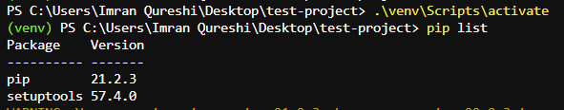
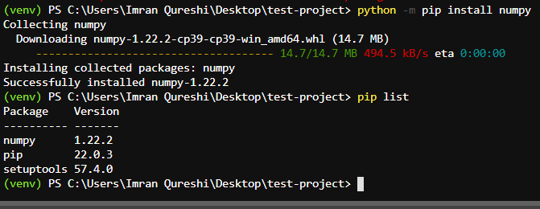
Using Virtual Environments: Installing Packages
By default, only pip and setuptools are installed inside a new environment.
If we want to install a specific version of a third-party library, say v1.15.3 of numpy, we can just use pip as usual.
python -m pip install numpy
pip list

Slide 11
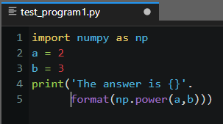
Using Virtual Environments: Installing Packages
Now we can import numpy in a script or active Python shell. For instance, say our project contains a script tests/test_program.py as shown in the figure.
When we run this script directly from the command-line, we get:

Slide 12
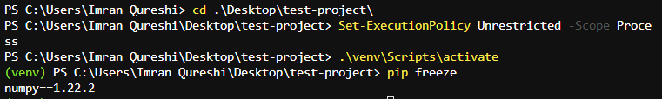
Managing Environments: Requirements Files
The easiest way to make our work reproducible by others is to include a requirements file in our project’s root directory (top directory). To do so, we’ll run pip freeze, which lists installed third party packages along with their version numbers,
pip freeze
numpy==1.22.2
And write the output to a file, which we’ll call requirements.txt.
pip freeze > requirements.txt
We can use this same command to rewrite our requirements file whenever we update a package or install a new one.
Now anyone we share our project with will be able to run our project on their system by duplicating our environment using our requirements.txt file.

Slide 13
Managing Environments: Duplicating Environments
Let’s say someone pulls down our test-project/ from our GitHub repository. On their system, the project’s directory tree looks like this:
There’s no venv/ folder. We’ve excluded it from our team’s GitHub repository.
This is one reason having a requirements.txt file is essential to reproducing your project’s code.
To run our test-project/ on their machine, all they need to do is to create a virtual environment inside the project’s root directory
cd test-project/
python3 -m venv venv/
And install the project’s dependencies inside an active virtual environment with the incantation pip install -r requirements.txt.
test-project
data
results
src
tests
utils
requirements.txt

Slide 14
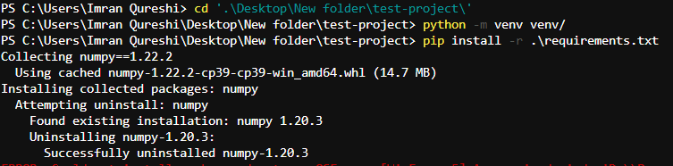
Managing Environments: Duplicating Environments
And install the project’s dependencies inside an active virtual environment with the incantation pip install -r requirements.txt.
pip install -r .\requirements.txt

Slide 15

Managing Environments: Troubleshooting
Sadly, things don’t always go according to plan. Eventually you will run into problems. Maybe you’ve updated a particular site package by mistake and now find yourself in the ninth level of Dependency Hell, unable to run a single line of your project’s code. Then again, maybe it’s not that bad. Maybe you only find yourself in the seventh level.
Whatever level you find yourself in, the easiest way to escape the flames and see the sun shine again is to re-create your project’s virtual environment.
That’s it. Thanks to your requirements.txt file you’re back in business. Yet another reason to always include a requirements file in your projects.

Slide 16
References
A Guide to Python’s Virtual Environments
Virtual Environments For Absolute Beginners
Python Virtual Environments: A Primer

