Slide 2
Welcome
Python

Slide 3
Python
Welcome

Slide 4
Welcome
Python

Slide 5
Python

Slide 6
Python

Slide 7
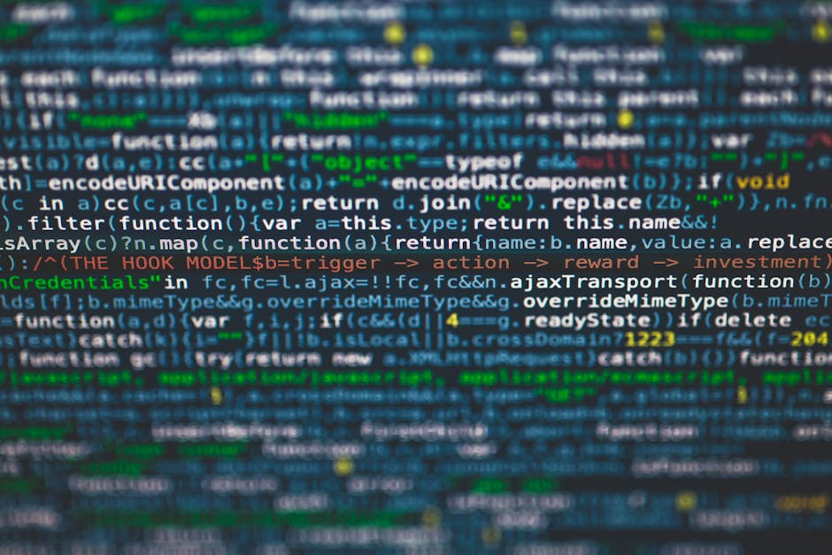
Python is a high-level, general-purpose programming language known for its emphasis on code readability, achieved through the use of significant indentation.
It is a versatile language used across various domains, including web development, data science, machine learning, and automation.
It supports multiple programming paradigms, including object-oriented, procedural, and functional programming.
Python

Slide 8
Comment
#This is a comment print("Hello, World!")
Python Syntax
print("Hello, World!") Hello, World!
Variables
x = 5 y = "John" print(x) print(y)
Data Types
Str, int, float, complex, list, tuple, range,, bytes, bytearray, memoryview

Slide 9
Python Syntax
print("Hello, World!")
Output : Hello, World!
Comment
#This is a comment print("Hello, World!")
Variables
x = 5 y = "John" print(x) print(y)
Data Types
Str, int, float, complex, list, tuple, range,, bytes, bytearray, memoryview

Slide 10
Comment
#This is a comment print("Hello, World!")
Python Syntax
print("Hello, World!") Hello, World!
Variables
x = 5 y = "John" print(x) print(y)
Data Types
Str, int, float, complex, list, tuple, range,, bytes, bytearray, memoryview

Slide 11
Comment
#This is a comment print("Hello, World!")
Python Syntax
print("Hello, World!") Hello, World!
Variables
x = 5 y = "John" print(x) print(y)
Data Types
Str, int, float, complex, list, tuple, range,, bytes, bytearray, memoryview

Slide 12
Comment
#This is a comment print("Hello, World!")
Python Syntax
print("Hello, World!") Hello, World!
Variables
x = 5 y = "John" print(x) print(y)
Data Types
Str, int, float, complex, list, tuple, range,, bytes, bytearray, memoryview

Slide 13
Variables
x = 5 y = "John" print(x) print(y)
Comment
#This is a comment print("Hello, World!")
Python Syntax
print("Hello, World!") Hello, World!
Data Types
Str, int, float, complex, list, tuple, range,, bytes, bytearray, memoryview

Slide 14
Comment
#This is a comment print("Hello, World!")
Python Syntax
print("Hello, World!") Hello, World!
Variables
x = 5 y = "John" print(x) print(y)
Data Types
Str, int, float, complex, list, tuple, range,, bytes, bytearray, memoryview

Slide 15
Comment
#This is a comment print("Hello, World!")
Python Syntax
print("Hello, World!") Hello, World!
Variables
x = 5 y = "John" print(x) print(y)
Data Types
Str, int, float, complex, list, tuple, range, bytes, bytearray,

