Slide 1
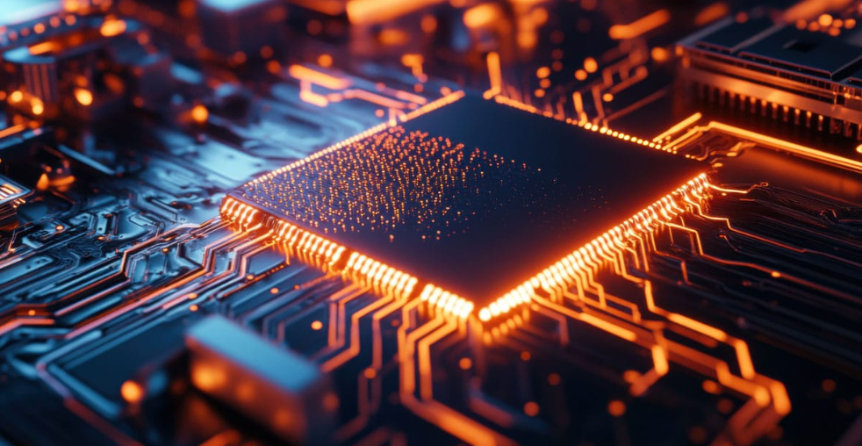
Welcome
IMRAN YEMON
ID : 746512
Student , GPI
Email : imranyemons24@gmail.com

Slide 2

Welcome
IMRAN YEMON
ID : 746512
Student , GPI
Email : imranyemons24@gmail.com

Slide 3
From Binary to Qubits
This document explores the fascinating evolution of computing technology, transitioning from traditional binary systems to the revolutionary realm of quantum computing. It delves into the fundamental differences between classical hardware and quantum chips, highlighting how quantum mechanics can redefine computational capabilities. The content is structured to provide a comprehensive overview of both traditional and quantum computing, emphasizing the implications for the future of technology and education.

Slide 4
From Binary to Qubits: The Evolution from Traditional Chips to Quantum Computing and the Future of Computing
This document explores the fascinating evolution of computing technology, transitioning from traditional binary systems to the revolutionary realm of quantum computing. It delves into the fundamental differences between classical hardware and quantum chips, highlighting how quantum mechanics can redefine computational capabilities. The content is structured to provide a comprehensive overview of both traditional and quantum computing, emphasizing the implications for the future of technology and education.

Slide 5
The evolution of computers is truly fascinating. We're all familiar with computers and the incredible power they hold, and the heart of any computer is its hardware—specifically the processor chip—which performs calculations using the fundamental building blocks of information: bits, represented by traditional simple electrical states of 0s and 1s, and manipulated by intricate logic circuits.
Yet, despite their immense capabilities, traditional chips are bound by the classical laws of physics, limiting information to a definite 0 or 1.
But there's a revolution brewing at the subatomic level!
What happens when we design computers around the mind-bending principles of quantum physics?
The result is a quantum chip: a piece of hardware that processes information using quantum bits, or qubits, which can exist in multiple states simultaneously.
Now, let's take a look at these two worlds—the foundational technology of classical chips and the paradigm-shifting potential of quantum chips—and see how they are redefining the future of computing.
Quantum Computing

Slide 6
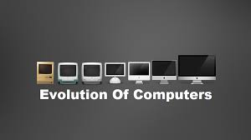
The evolution of computers is truly fascinating. We're all familiar with computers and the incredible power they hold, and the heart of any computer is its hardware—specifically the processor chip—which performs calculations using the fundamental building blocks of information: bits, represented by traditional simple electrical states of 0s and 1s, and manipulated by intricate logic circuits.
Yet, despite their immense capabilities, traditional chips are bound by the classical laws of physics, limiting information to a definite 0 or 1.
But there's a revolution brewing at the subatomic level!
What happens when we design computers around the mind-bending principles of quantum physics?
The result is a quantum chip: a piece of hardware that processes information using quantum bits, or qubits, which can exist in multiple states simultaneously.
Now, let's take a look at these two worlds—the foundational technology of classical chips and the paradigm-shifting potential of quantum chips—and see how they are redefining the future of computing.

Slide 7
The evolution of computers is truly fascinating. We're all familiar with computers and the incredible power they hold, and the heart of any computer is its hardware—specifically the processor chip—which performs calculations using the fundamental building blocks of information: bits, represented by traditional simple electrical states of 0s and 1s, and manipulated by intricate logic circuits.
Yet, despite their immense capabilities, traditional chips are bound by the classical laws of physics, limiting information to a definite 0 or 1.
But there's a revolution brewing at the subatomic level!
What happens when we design computers around the mind-bending principles of quantum physics?
The result is a quantum chip: a piece of hardware that processes information using quantum bits, or qubits, which can exist in multiple states simultaneously.
Now, let's take a look at these two worlds—the foundational technology of classical chips and the paradigm-shifting potential of quantum chips—and see how they are redefining the future of computing.
Introduction

Slide 8
But there's a revolution brewing at the subatomic level!
The evolution of computers is truly fascinating. We're all familiar with computers and the incredible power they hold, and the heart of any computer is its hardware—specifically the processor chip—which performs calculations using the fundamental building blocks of information: bits, represented by traditional simple electrical states of 0s and 1s, and manipulated by intricate logic circuits.
Yet, despite their immense capabilities, traditional chips are bound by the classical laws of physics, limiting information to a definite 0 or 1.
What happens when we design computers around the mind-bending principles of quantum physics?
The result is a quantum chip: a piece of hardware that processes information using quantum bits, or qubits, which can exist in multiple states simultaneously.
Now, let's take a look at these two worlds—the foundational technology of classical chips and the paradigm-shifting potential of quantum chips—and see how they are redefining the future of computing.
Introduction

Slide 9
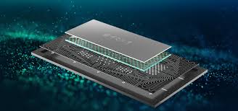
What happens when we design computers around the mind-bending principles of quantum physics?
But there's a revolution brewing at the subatomic level!
The evolution of computers is truly fascinating. We're all familiar with computers and the incredible power they hold, and the heart of any computer is its hardware—specifically the processor chip—which performs calculations using the fundamental building blocks of information: bits, represented by traditional simple electrical states of 0s and 1s, and manipulated by intricate logic circuits.
Yet, despite their immense capabilities, traditional chips are bound by the classical laws of physics, limiting information to a definite 0 or 1.
The result is a quantum chip: a piece of hardware that processes information using quantum bits, or qubits, which can exist in multiple states simultaneously.
Now, let's take a look at these two worlds—the foundational technology of classical chips and the paradigm-shifting potential of quantum chips—and see how they are redefining the future of computing.
Introduction

Slide 10
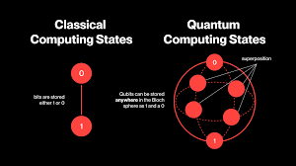
But there's a revolution brewing at the subatomic level!
The result is a quantum chip: a piece of hardware that processes information using quantum bits, or qubits, which can exist in multiple states simultaneously.
What happens when we design computers around the mind-bending principles of quantum physics?
The evolution of computers is truly fascinating. We're all familiar with computers and the incredible power they hold, and the heart of any computer is its hardware—specifically the processor chip—which performs calculations using the fundamental building blocks of information: bits, represented by traditional simple electrical states of 0s and 1s, and manipulated by intricate logic circuits.
Yet, despite their immense capabilities, traditional chips are bound by the classical laws of physics, limiting information to a definite 0 or 1.
Now, let's take a look at these two worlds—the foundational technology of classical chips and the paradigm-shifting potential of quantum chips—and see how they are redefining the future of computing.
Introduction

Slide 11
Traditional Computers: Mastering Classical Physics
Ubiquitous & Powerful
Traditional computers are everywhere – desktops, laptops, smartphones, and even supercomputers.
Incredible Capabilities
They manage complex tasks like browsing the web, running sophisticated software, processing large datasets, and rendering video games.
Rooted in Classical Physics
Their internal mechanisms follow the predictable laws of classical physics, mainly by controlling the flow of electricity through circuits.
Sequential Information Processing
Most classical computers perform operations step-by-step at extremely high speeds. Some modern architectures also allow limited parallel processing, but fundamentally, they rely on sequential logic.

Slide 12
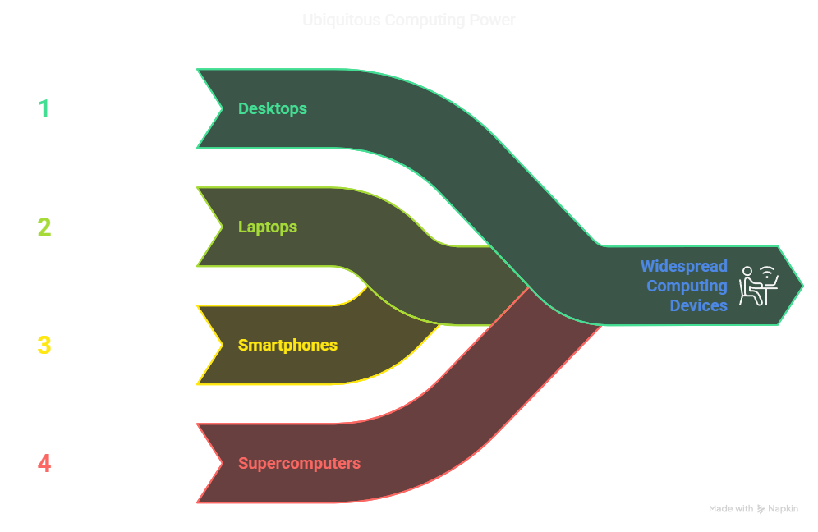
Traditional Computers: Mastering Classical Physics
Ubiquitous & Powerful
Traditional computers are everywhere – desktops, laptops, smartphones, and even supercomputers.
Incredible Capabilities
They manage complex tasks like browsing the web, running sophisticated software, processing large datasets, and rendering video games.
Rooted in Classical Physics
Their internal mechanisms follow the predictable laws of classical physics, mainly by controlling the flow of electricity through circuits.
Sequential Information Processing
Most classical computers perform operations step-by-step at extremely high speeds. Some modern architectures also allow limited parallel processing, but fundamentally, they rely on sequential logic.

Slide 13
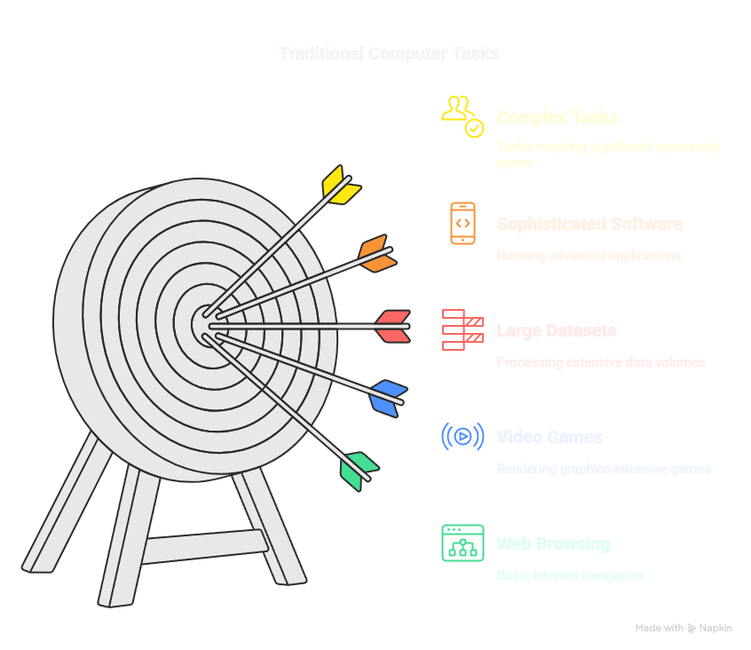
Ubiquitous & Powerful
Traditional computers are everywhere – desktops, laptops, smartphones, and even supercomputers.
Traditional Computers: Mastering Classical Physics
Incredible Capabilities
They manage complex tasks like browsing the web, running sophisticated software, processing large datasets, and rendering video games.
Rooted in Classical Physics
Their internal mechanisms follow the predictable laws of classical physics, mainly by controlling the flow of electricity through circuits.
Sequential Information Processing
Most classical computers perform operations step-by-step at extremely high speeds. Some modern architectures also allow limited parallel processing, but fundamentally, they rely on sequential logic.

Slide 14
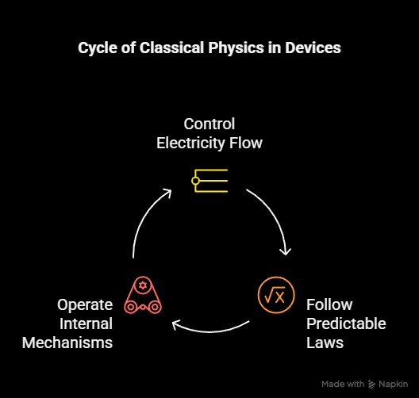
Incredible Capabilities
They manage complex tasks like browsing the web, running sophisticated software, processing large datasets, and rendering video games.
Ubiquitous & Powerful
Traditional computers are everywhere – desktops, laptops, smartphones, and even supercomputers.
Traditional Computers: Mastering Classical Physics
Rooted in Classical Physics
Their internal mechanisms follow the predictable laws of classical physics, mainly by controlling the flow of electricity through circuits.
Sequential Information Processing
Most classical computers perform operations step-by-step at extremely high speeds. Some modern architectures also allow limited parallel processing, but fundamentally, they rely on sequential logic.

Slide 15
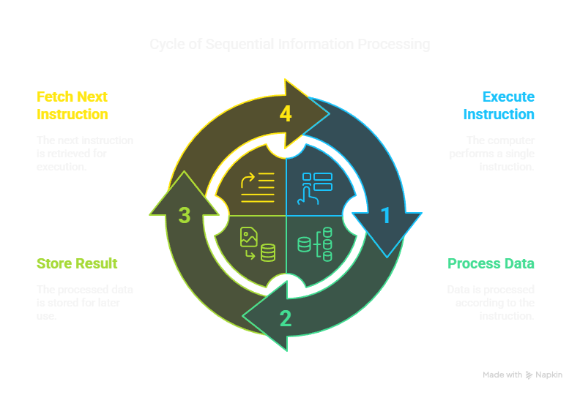
Rooted in Classical Physics
Their internal mechanisms follow the predictable laws of classical physics, mainly by controlling the flow of electricity through circuits.
Incredible Capabilities
They manage complex tasks like browsing the web, running sophisticated software, processing large datasets, and rendering video games.
Ubiquitous & Powerful
Traditional computers are everywhere – desktops, laptops, smartphones, and even supercomputers.
Traditional Computers: Mastering Classical Physics
Sequential Information Processing
Most classical computers perform operations step-by-step at extremely high speeds. Some modern architectures also allow limited parallel processing, but fundamentally, they rely on sequential logic.

Slide 16
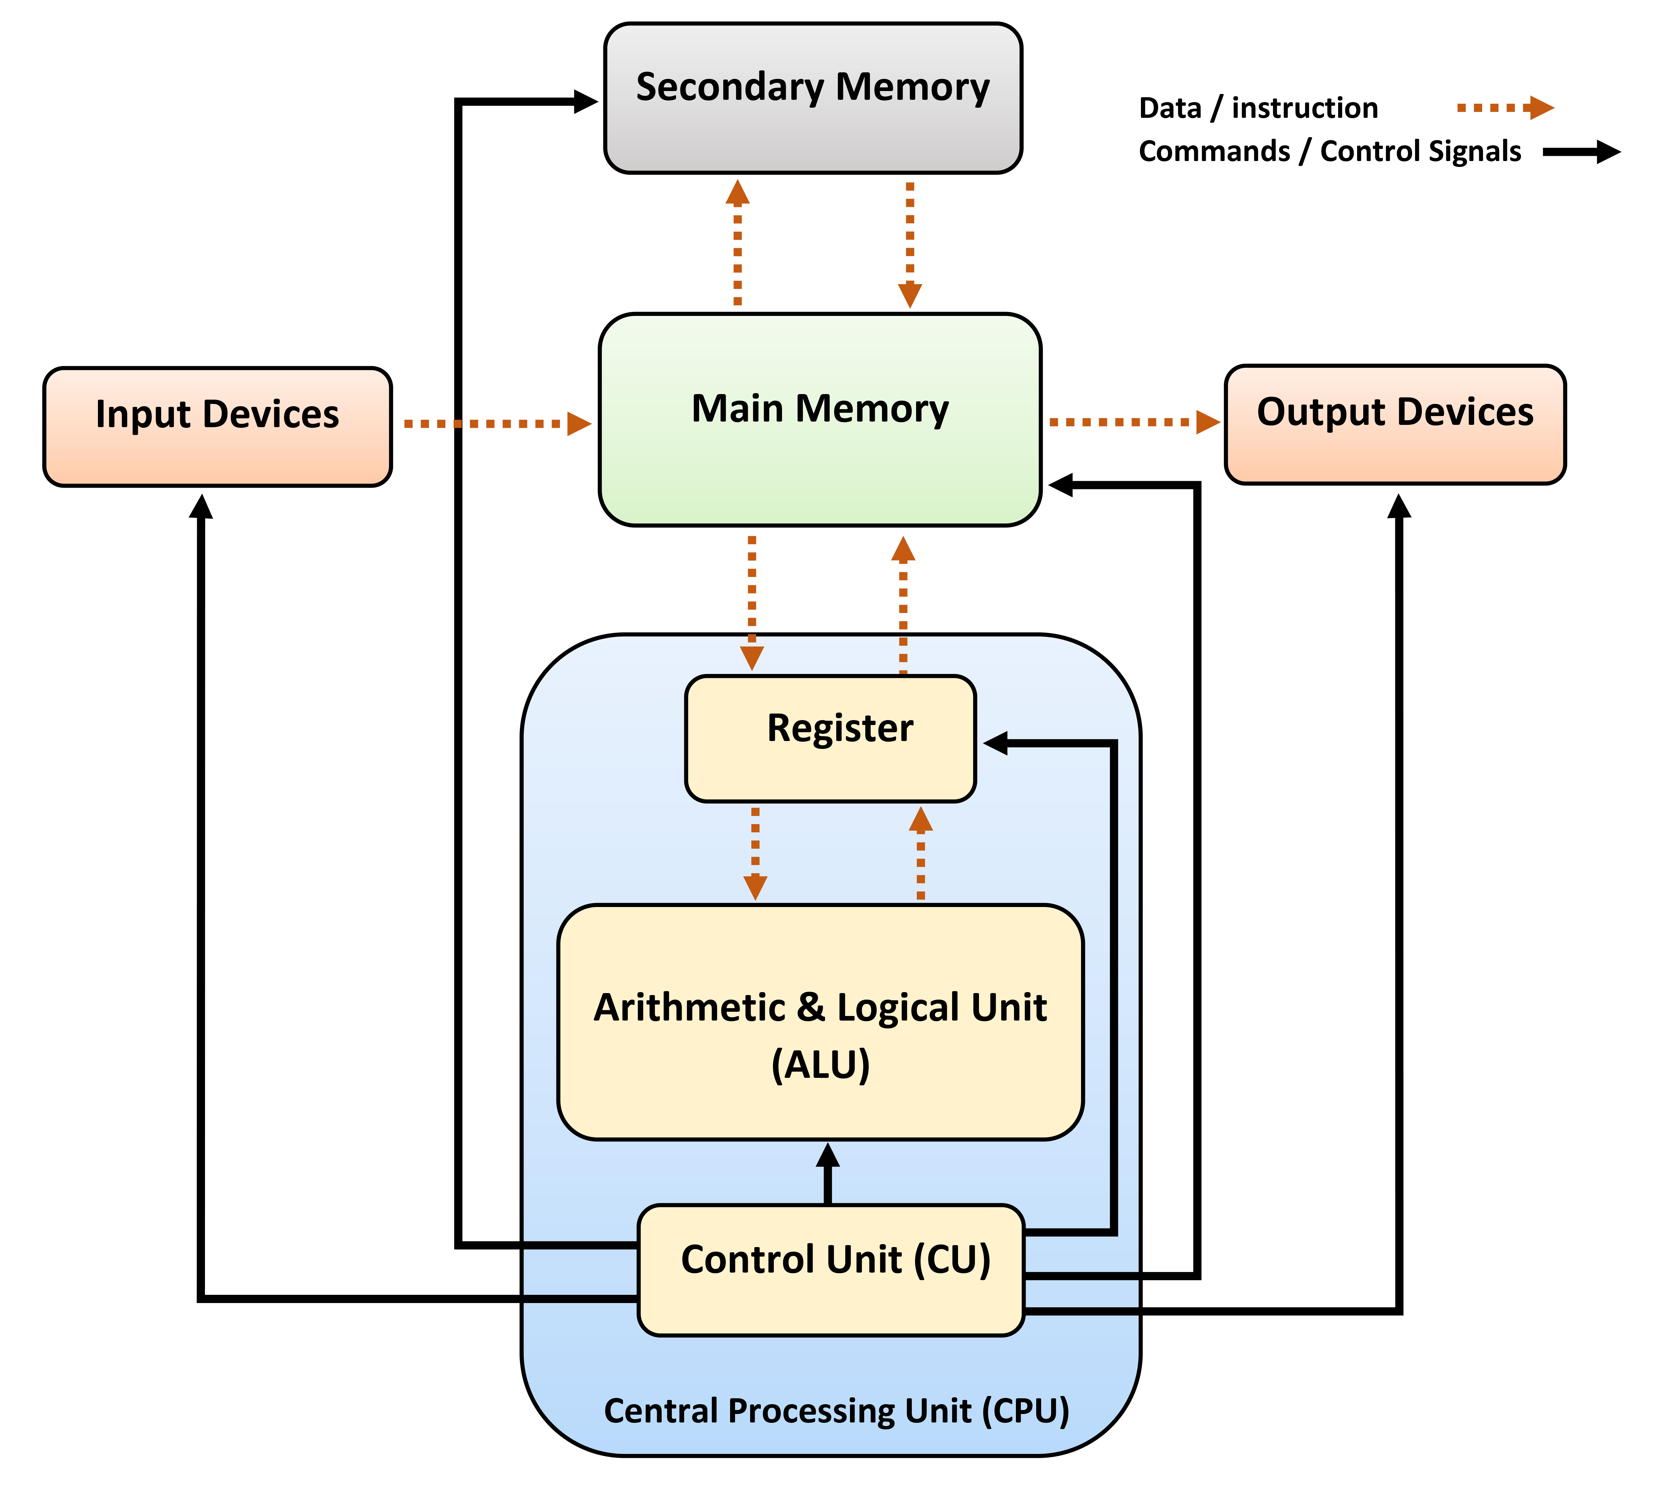
Traditional Chip Architecture

Slide 17
Traditional Chip Architecture
Bits: The Fundamental Unit of Information
Everything in a classical computer is built from bits, which represent two possible states.
Physical Representation
1 and 0 are encoded as different voltage levels. For example, a high voltage (around 5V or 3.3V) might represent a "1", while a low voltage (close to 0V) represents a "0".
Logic Gates: Building Blocks of Computing
Simple electronic circuits called logic gates (AND, OR, NOT, etc.) manipulate these bits. Logic gates take one or more binary inputs and produce a binary output following specific rules.
Combining Gates into Complex Circuits
Processor chips contain billions of transistors acting as tiny switches to form logic gates. These gates combine to create complex circuits that perform arithmetic, make decisions, and control data flow.
Boolean Logic
Classical computing strictly follows Boolean logic rules. For instance, in an AND gate, 1 AND 0 will always produce 0, just like in basic truth tables.

Slide 18
Quantum Mechanics
What is Quantum Physics?
Quantum physics is the study of the smallest particles in the universe, such as electrons and photons, and how they behave under strange, non-classical rules.
How Quantum Mechanics Works
Unlike classical physics, where objects exist in definite states, quantum mechanics allows particles to exist in multiple states at once through a phenomenon called superposition.
The State of an Electron
In the quantum world, an electron can be in two places at once, spin up and down simultaneously, or exist in a mix of states until it is measured.
Quantum Computer Architecture
Instead of billions of transistors, quantum computers use special components to create and control qubits. Qubits are housed in extremely controlled environments, often cooled close to absolute zero to prevent noise and instability.
How Quantum Computers Work
Quantum computers use superposition and entanglement to perform many calculations at once. Instead of working step-by-step like classical computers, quantum computers explore multiple possibilities simultaneously.
Introducing Qubits
A qubit can represent a 0, a 1, or both at the same time. For example, a qubit might be 60% "1" and 40% "0" simultaneously, allowing quantum computers to perform complex computations with fewer resources.
The Power of Quantum Computing
By harnessing superposition and entanglement, quantum computers have the potential to solve problems that are practically impossible for classical computers — such as simulating molecules, optimizing massive systems, and breaking current encryption methods.

Slide 19
Quantum Mechanics
What is Quantum Physics?
Quantum physics is the study of the smallest particles in the universe, such as electrons and photons, and how they behave under strange, non-classical rules.
How Quantum Mechanics Works
Unlike classical physics, where objects exist in definite states, quantum mechanics allows particles to exist in multiple states at once through a phenomenon called superposition.
The State of an Electron
In the quantum world, an electron can be in two places at once, spin up and down simultaneously, or exist in a mix of states until it is measured.
Quantum Computer Architecture
Instead of billions of transistors, quantum computers use special components to create and control qubits. Qubits are housed in extremely controlled environments, often cooled close to absolute zero to prevent noise and instability.
How Quantum Computers Work
Quantum computers use superposition and entanglement to perform many calculations at once. Instead of working step-by-step like classical computers, quantum computers explore multiple possibilities simultaneously.
Introducing Qubits
A qubit can represent a 0, a 1, or both at the same time. For example, a qubit might be 60% "1" and 40% "0" simultaneously, allowing quantum computers to perform complex computations with fewer resources.
The Power of Quantum Computing
By harnessing superposition and entanglement, quantum computers have the potential to solve problems that are practically impossible for classical computers — such as simulating molecules, optimizing massive systems, and breaking current encryption methods.

Slide 20
Quantum Mechanics
How Quantum Mechanics Works
Unlike classical physics, where objects exist in definite states, quantum mechanics allows particles to exist in multiple states at once through a phenomenon called superposition.
What is Quantum Physics?
Quantum physics is the study of the smallest particles in the universe, such as electrons and photons, and how they behave under strange, non-classical rules.
The State of an Electron
In the quantum world, an electron can be in two places at once, spin up and down simultaneously, or exist in a mix of states until it is measured.
Quantum Computer Architecture
Instead of billions of transistors, quantum computers use special components to create and control qubits. Qubits are housed in extremely controlled environments, often cooled close to absolute zero to prevent noise and instability.
How Quantum Computers Work
Quantum computers use superposition and entanglement to perform many calculations at once. Instead of working step-by-step like classical computers, quantum computers explore multiple possibilities simultaneously.
Introducing Qubits
A qubit can represent a 0, a 1, or both at the same time. For example, a qubit might be 60% "1" and 40% "0" simultaneously, allowing quantum computers to perform complex computations with fewer resources.
The Power of Quantum Computing
By harnessing superposition and entanglement, quantum computers have the potential to solve problems that are practically impossible for classical computers — such as simulating molecules, optimizing massive systems, and breaking current encryption methods.

Slide 21
Quantum Mechanics
The State of an Electron
In the quantum world, an electron can be in two places at once, spin up and down simultaneously, or exist in a mix of states until it is measured.
How Quantum Mechanics Works
Unlike classical physics, where objects exist in definite states, quantum mechanics allows particles to exist in multiple states at once through a phenomenon called superposition.
What is Quantum Physics?
Quantum physics is the study of the smallest particles in the universe, such as electrons and photons, and how they behave under strange, non-classical rules.
Quantum Computer Architecture
Instead of billions of transistors, quantum computers use special components to create and control qubits. Qubits are housed in extremely controlled environments, often cooled close to absolute zero to prevent noise and instability.
How Quantum Computers Work
Quantum computers use superposition and entanglement to perform many calculations at once. Instead of working step-by-step like classical computers, quantum computers explore multiple possibilities simultaneously.
Introducing Qubits
A qubit can represent a 0, a 1, or both at the same time. For example, a qubit might be 60% "1" and 40% "0" simultaneously, allowing quantum computers to perform complex computations with fewer resources.
The Power of Quantum Computing
By harnessing superposition and entanglement, quantum computers have the potential to solve problems that are practically impossible for classical computers — such as simulating molecules, optimizing massive systems, and breaking current encryption methods.

Slide 22
Quantum Mechanics
The State of an Electron
In the quantum world, an electron can be in two places at once, spin up and down simultaneously, or exist in a mix of states until it is measured.
How Quantum Mechanics Works
Unlike classical physics, where objects exist in definite states, quantum mechanics allows particles to exist in multiple states at once through a phenomenon called superposition.
Quantum Computer Architecture
Instead of billions of transistors, quantum computers use special components to create and control qubits. Qubits are housed in extremely controlled environments, often cooled close to absolute zero to prevent noise and instability.
What is Quantum Physics?
Quantum physics is the study of the smallest particles in the universe, such as electrons and photons, and how they behave under strange, non-classical rules.
How Quantum Computers Work
Quantum computers use superposition and entanglement to perform many calculations at once. Instead of working step-by-step like classical computers, quantum computers explore multiple possibilities simultaneously.
Introducing Qubits
A qubit can represent a 0, a 1, or both at the same time. For example, a qubit might be 60% "1" and 40% "0" simultaneously, allowing quantum computers to perform complex computations with fewer resources.
The Power of Quantum Computing
By harnessing superposition and entanglement, quantum computers have the potential to solve problems that are practically impossible for classical computers — such as simulating molecules, optimizing massive systems, and breaking current encryption methods.

Slide 23
Quantum Mechanics
How Quantum Computers Work
Quantum computers use superposition and entanglement to perform many calculations at once. Instead of working step-by-step like classical computers, quantum computers explore multiple possibilities simultaneously.
The State of an Electron
In the quantum world, an electron can be in two places at once, spin up and down simultaneously, or exist in a mix of states until it is measured.
How Quantum Mechanics Works
Unlike classical physics, where objects exist in definite states, quantum mechanics allows particles to exist in multiple states at once through a phenomenon called superposition.
Quantum Computer Architecture
Instead of billions of transistors, quantum computers use special components to create and control qubits. Qubits are housed in extremely controlled environments, often cooled close to absolute zero to prevent noise and instability.
What is Quantum Physics?
Quantum physics is the study of the smallest particles in the universe, such as electrons and photons, and how they behave under strange, non-classical rules.
Introducing Qubits
A qubit can represent a 0, a 1, or both at the same time. For example, a qubit might be 60% "1" and 40% "0" simultaneously, allowing quantum computers to perform complex computations with fewer resources.
The Power of Quantum Computing
By harnessing superposition and entanglement, quantum computers have the potential to solve problems that are practically impossible for classical computers — such as simulating molecules, optimizing massive systems, and breaking current encryption methods.

Slide 24
Quantum Mechanics
How Quantum Computers Work
Quantum computers use superposition and entanglement to perform many calculations at once. Instead of working step-by-step like classical computers, quantum computers explore multiple possibilities simultaneously.
The State of an Electron
In the quantum world, an electron can be in two places at once, spin up and down simultaneously, or exist in a mix of states until it is measured.
How Quantum Mechanics Works
Unlike classical physics, where objects exist in definite states, quantum mechanics allows particles to exist in multiple states at once through a phenomenon called superposition.
Quantum Computer Architecture
Instead of billions of transistors, quantum computers use special components to create and control qubits. Qubits are housed in extremely controlled environments, often cooled close to absolute zero to prevent noise and instability.
Introducing Qubits
A qubit can represent a 0, a 1, or both at the same time. For example, a qubit might be 60% "1" and 40% "0" simultaneously, allowing quantum computers to perform complex computations with fewer resources.
What is Quantum Physics?
Quantum physics is the study of the smallest particles in the universe, such as electrons and photons, and how they behave under strange, non-classical rules.
The Power of Quantum Computing
By harnessing superposition and entanglement, quantum computers have the potential to solve problems that are practically impossible for classical computers — such as simulating molecules, optimizing massive systems, and breaking current encryption methods.

Slide 25
Quantum Mechanics
The Power of Quantum Computing
By harnessing superposition and entanglement, quantum computers have the potential to solve problems that are practically impossible for classical computers — such as simulating molecules, optimizing massive systems, and breaking current encryption methods.

Slide 26
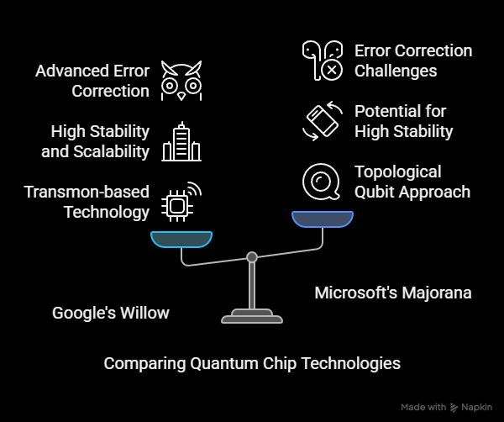
Quantum Chips in Action: Google's Willow vs Microsoft's Majorana
Google's Willow Quantum Chip
Google's Willow chip is an advancement based on their Sycamore processor. Willow uses superconducting qubits and focuses on achieving quantum supremacy—performing tasks faster than the most powerful supercomputers. Willow shows improvements in qubit coherence time, error correction, and gate fidelity.
Microsoft's Majorana-Based Chip
Microsoft is exploring a different path using "Majorana particles," which are exotic particles acting as their own antiparticle. Majorana-based qubits are more stable and resistant to errors compared to traditional superconducting qubits. This stability could mean fewer errors and better scaling to larger quantum systems.

Slide 27
Who is Ahead?
While Google achieved early quantum supremacy milestones, Microsoft's approach is considered one step ahead because it targets a more scalable and fault-tolerant quantum system in the long term. Microsoft's use of topological qubits (based on Majorana) promises a future where quantum computers are easier to build and maintain.
Quantum Computers Overall
Quantum computers could solve problems in seconds that would take thousands of years for classical computers. They will revolutionize fields like cryptography, materials science, and artificial intelligence.
Quantum Programming Languages
New languages like Microsoft's Q# (Q-sharp) and Google's are designed specifically for developing quantum algorithms. These languages allow programmers to harness quantum properties such as entanglement and superposition in their code.
Quantum Chips in Action

Slide 28
Quantum Chips in Action
Who is Ahead?
While Google achieved early quantum supremacy milestones, Microsoft's approach is considered one step ahead because it targets a more scalable and fault-tolerant quantum system in the long term. Microsoft's use of topological qubits (based on Majorana) promises a future where quantum computers are easier to build and maintain.
Quantum Computers Overall
Quantum computers could solve problems in seconds that would take thousands of years for classical computers. They will revolutionize fields like cryptography, materials science, and artificial intelligence.
Quantum Programming Languages
New languages like Microsoft's Q# (Q-sharp) and Google's are designed specifically for developing quantum algorithms. These languages allow programmers to harness quantum properties such as entanglement and superposition in their code.

Slide 29
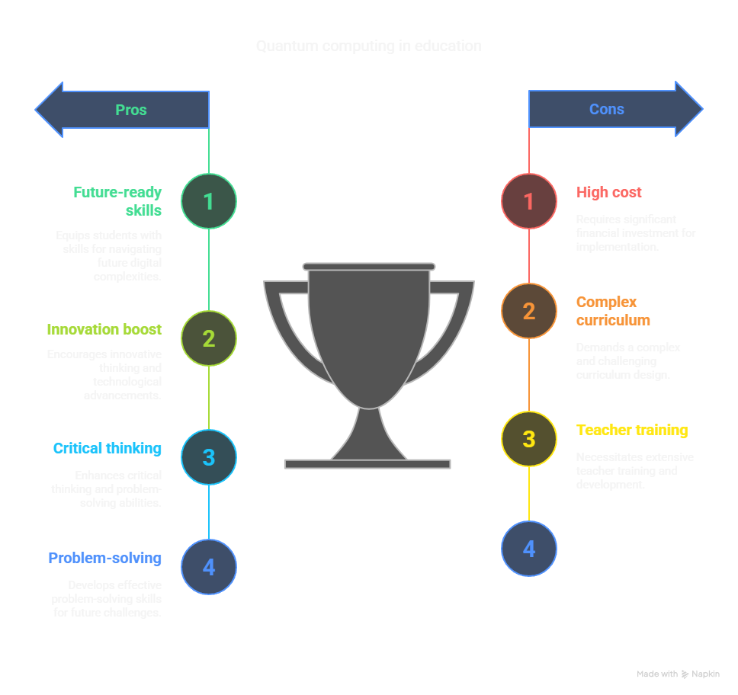
Conclusion: Embracing Quantum Computing in Education
Quantum computing is emerging as a groundbreaking technology that will transform the future of computation. As it rapidly evolves, our education system must keep pace with these advancements. It is essential that universities introduce quantum computing into their curricula alongside traditional computer science and engineering courses.
Students should learn not only the principles of quantum physics behind quantum computing but also the architecture of quantum systems and how to work with quantum programming languages. By integrating this knowledge into computer science and engineering education, we can ensure that the next generation of professionals is ready for the quantum revolution.

Slide 30
Conclusion: Embracing Quantum Computing in Education
Quantum computing is emerging as a groundbreaking technology that will transform the future of computation. As it rapidly evolves, our education system must keep pace with these advancements. It is essential that universities introduce quantum computing into their curricula alongside traditional computer science and engineering courses.
Students should learn not only the principles of quantum physics behind quantum computing but also the architecture of quantum systems and how to work with quantum programming languages. By integrating this knowledge into computer science and engineering education, we can ensure that the next generation of professionals is ready for the quantum revolution.

Slide 31
Thank You
Computer has lot’s for memory but no imagination.
IMRAN YEMON

