Slide 1
Point Cloud Library (PCL)

Slide 2
What you Will Learn...
What is Point Cloud
Basic Structure
Point Type
Create and Build PCL Project
PCD file format
Reading PCD File
Writing PCD File
Getting Point Cloud From OpenNI
Normal Estimation
Computing 3D Features
Filtering
Down Sampling
What are Key Points and How Compute
Kd Tree
OcTree
Iterative Closest Point

Slide 3
What is Point Clouds
Definition: A point clouds is a data structure and used to represent a collection of multi-dimensional points , and commonly used to represent three dimensional points
When color present it becomes 4D

Slide 4
Basic Structure
PointCloud
  Template C++ Class
  Basic Data Type in Point Cloud
  Data Fields In PointCloud

Slide 5
Basic Structure → Data Fields
Width(int)
Height (int)
Points -(std::vector〈PointT〉
is_dense-(bool)
sensor_origin-(Eigen::Vector4f)
sensor_orientation(Eigen::Quaternionf)

Slide 6
Basic Structure → Data Fields
Width
  specifies the width of the point cloud datasets in the number of points
  the total number of points in the cloud (equal with the number of elements in points) for unorganized datasets
  the width (total number of points in a row) of an organized point cloud dataset

Slide 7
Basic Structure → Data Fields
Height (int)
  Specifies the height of the point cloud dataset in the number of points.
  set to 1 for unorganized point clouds
  the height (total number of rows) of an organized point cloud dataset

Slide 8
Basic Structure → Data Fields
Points (std::vector〈PointT〉)
  Contains the data array where all the points of type PointT are stored
is_dense (bool)
  True: if all the data in points is finite
  False: XYZ values of certain points contain Inf/NaN values

Slide 9
Basic Structure → Data Fields
sensor_origin(Eigen::Vector4f)
  Specifies the sensor acquisition pose (origin/translation).
  This member is usually optional, and not used by the majority of the algorithms in PCL

Slide 10
Basic Structure → Data Fields
sensor_orientation(Eigen::Quaternionf)
  Specifies the sensor acquisition pose (orientation)
  This member is usually optional, and not used by the majority of the algorithms in PCL

Slide 11
Point Types
PointXYZ- float x, y, z
PointXYZI- float x, y, z, intensity
PointXYZRGB- float x, y, z, rgb
PointXYZRGBA- float x, y, z, uint32t rgba
Normal- float normal[3], curvature
PointNormal- float x, y, z, normal[3], curvature
Histogram- float histogram[N]
Many more and Define yourself

Slide 12
Create and Build PCL Project
Create a project directory
Create CmakeLists.txt file in that directory (Basic CmakeLists.txt is given)
Create a build directory in your project directory
In build directory run cmake ..
Then run make
Done

Slide 13
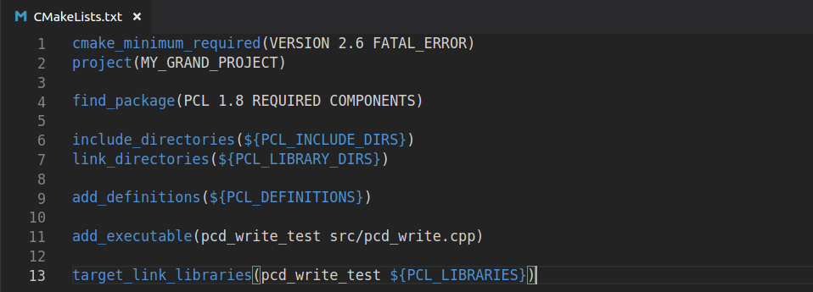
Create and Build PCL Project
CMakeLists.txt

Slide 14
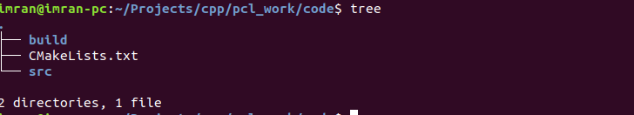
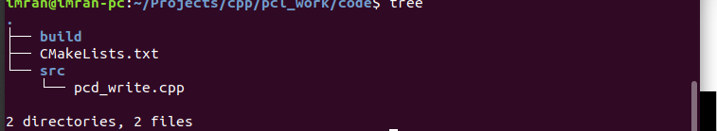
Create and Build PCL Project
Project Directory Structure

Slide 15
Create and Build PCL Project
Building Project

Slide 16
PCD File Format
Header(Text)
Data(ASCII/Binary)

Slide 17
PCD File Format→ Header
Header – contains following fields
  Version – Specifies version of PCD file normaly 7
  Fields – name of dimension that point can have (x, y, z)
  Size – size of each dimension in bytes (float 4)
  Type – Type Of Each Dimension as char (float , unsigned, signed)
  Count – the number of elements in each dimension (x, y ,z have 1)
  Width – the width of point cloud
  Height – the height of point cloud
  Viewpoint – an acquisition viewpoint for point (translation + quaternion)
  Data

