Slide 1


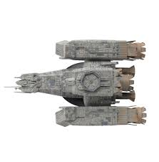
DIE!
WEW THAT WAS CLOSE.
UH OH
IS YOUR HOME
UH OH
PLANET EARTH
LET’S PREPARE IN CASE THAT HAPPENS AGAIN
WEW THAT WAS CLOSE.

Slide 2


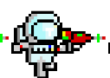



VIEW GRID

