Slide 1
Key Insights
There were total 292k+ total signup count.(2070 internal players)
167k+ total active players.
March had max. active players 44k+ and June had min. active players 20k+.
December had max. profit rate i.e. 81%.
Parlor makes highest benefit from e-gaming category.(Non Table contributes almost 92%)
Lottery Six was made 91.75% of the total amount in lottery category.
January and April admitted max. bonus amount of 2.79 million.

Slide 2
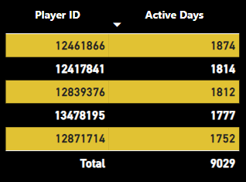
Top 5 active players

Slide 3
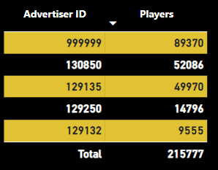
Top 5 Advertisor

Slide 4
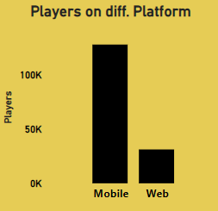
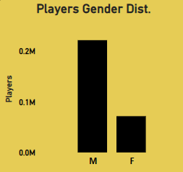
Mobile/Web Players
Male/Female Players

Slide 5
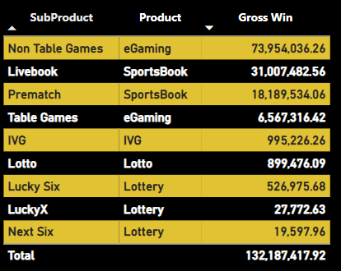
Product wise Gross winning

Slide 6
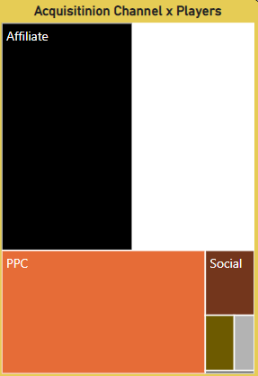
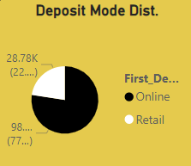
Acquisition mode dist.
Deposit Channel wise dist.

Slide 7
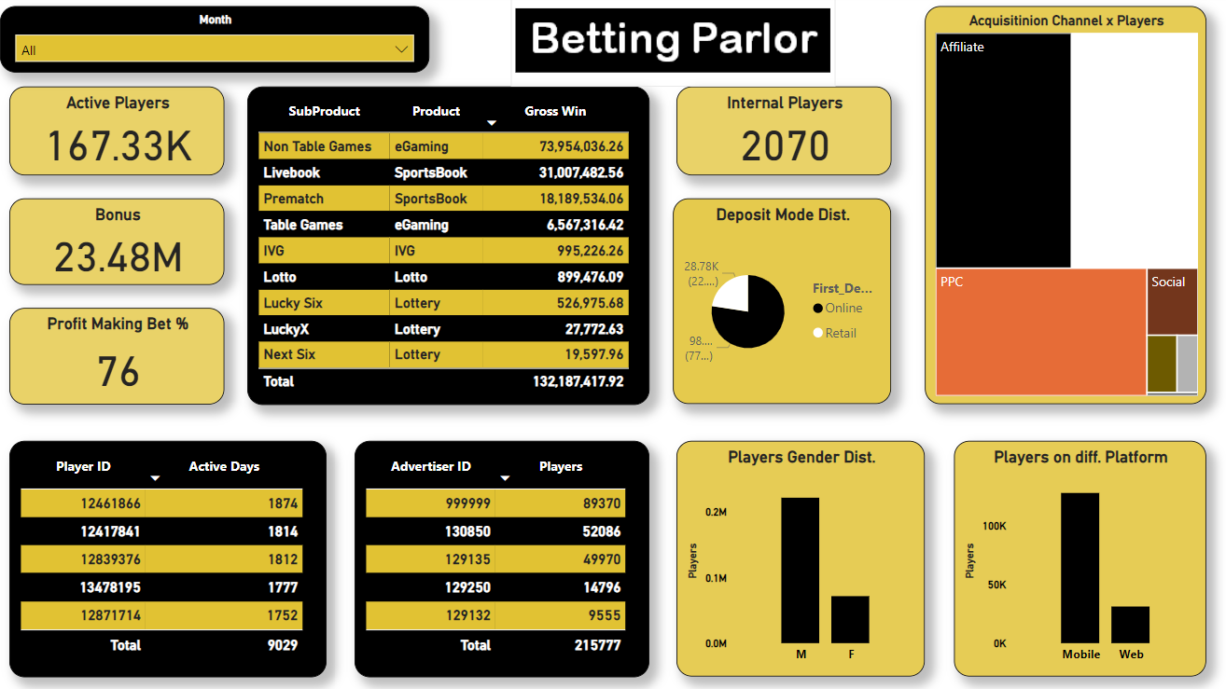
All the mentioned fields can be filter by month and nature of the values can be recorder for more deeper insights.

