Slide 1
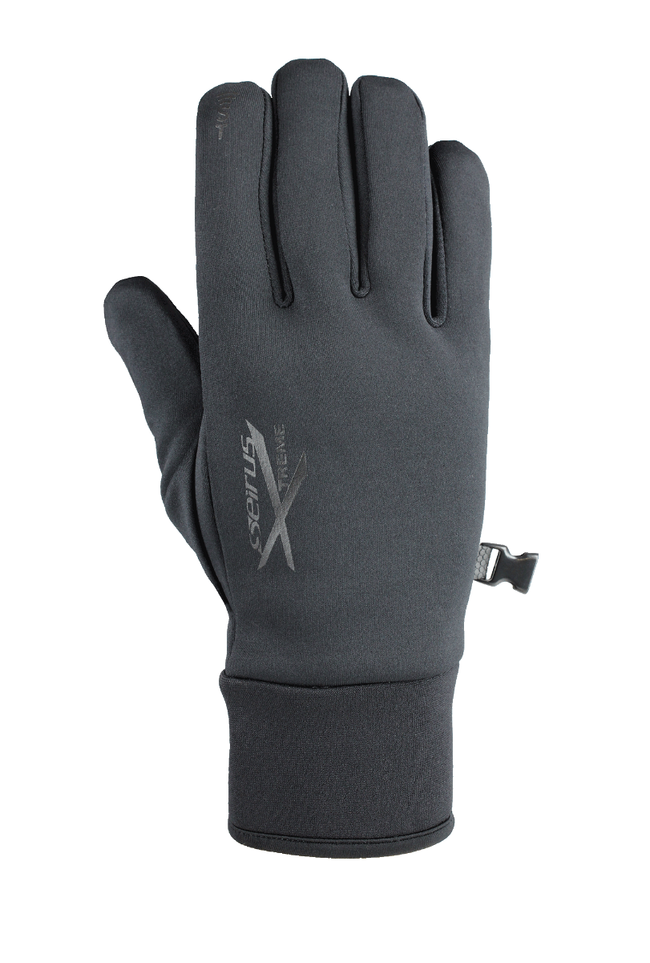
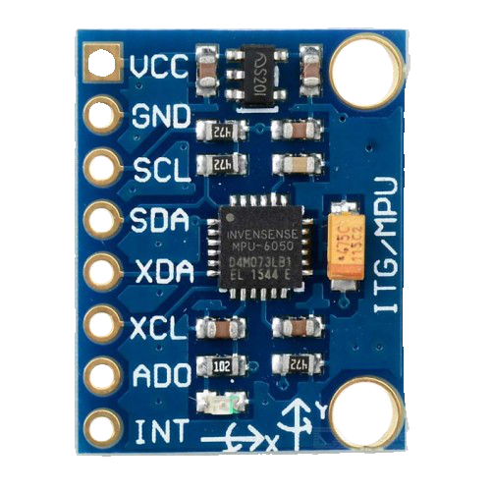
MPU data
Rotate down y=-5
Rotate left x=5
Rotate right x=-5
Rotate dup y=8

