Slide 1


Here's your outline to get started
Key facts about your topic
The International Space Station is a space station in low Earth orbit. The ISS programme is a joint project between five participating space agencies: NASA, Roscosmos, JAXA, ESA, and CSA. The ownership and use of the space station is established by intergovernmental treaties and agreements.
Orbital height: 205 miles (330 km)
Launched: Nov 20, 1998
Mission sent there: Expedition 45, Expedition 44, Soyuz TMA-13M
Orbital speed: 4.79 miles/s (7.71 km/s)
See more: Open the Notes below for more information.
Notes:
QuickStarter has created an outline to help you get started on your presentation. Some slides include information here in the notes to provide additional topics for you to research.

Slide 2
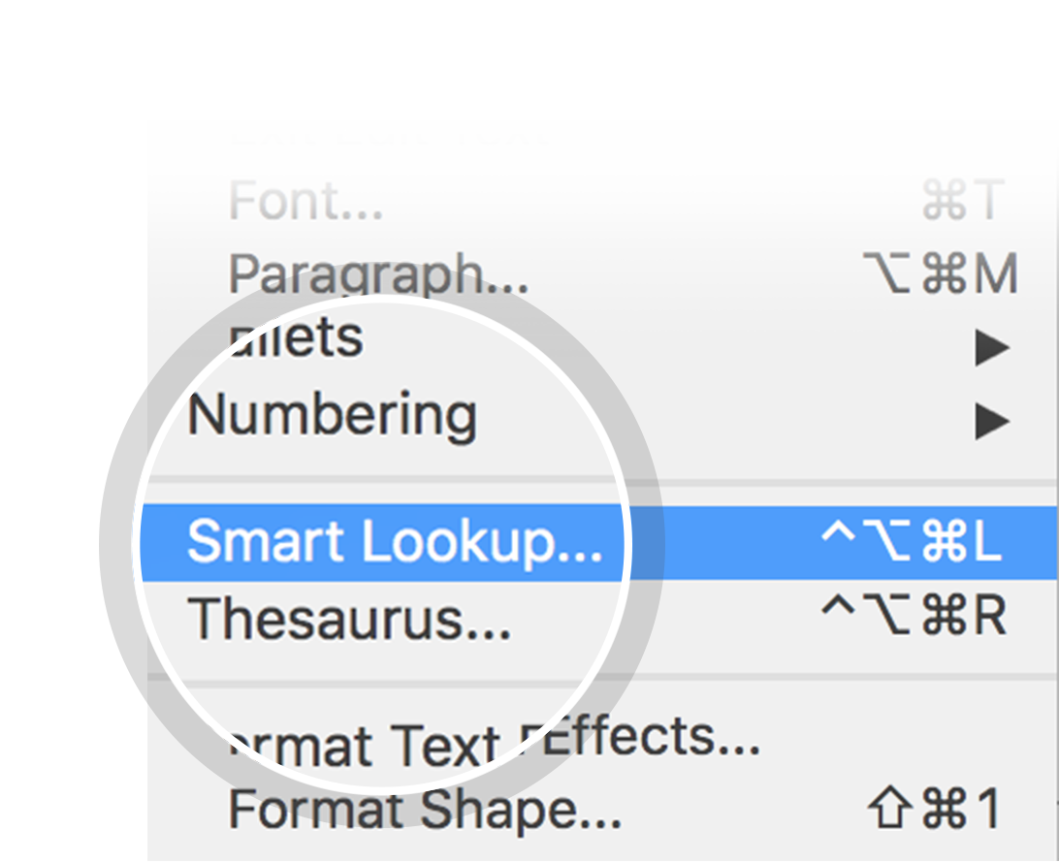
Related topics to research
Space station
NASA
Low Earth orbit
Assembly of the International Space Station
Space tourism
Space Shuttle program
Zvezda
Apollo 11
European Space Agency
Satellite
Use Smart Lookup to learn more
1
Highlight one of the related topics
Right-click on the topic
Choose "Smart Lookup"
2
3

Slide 3
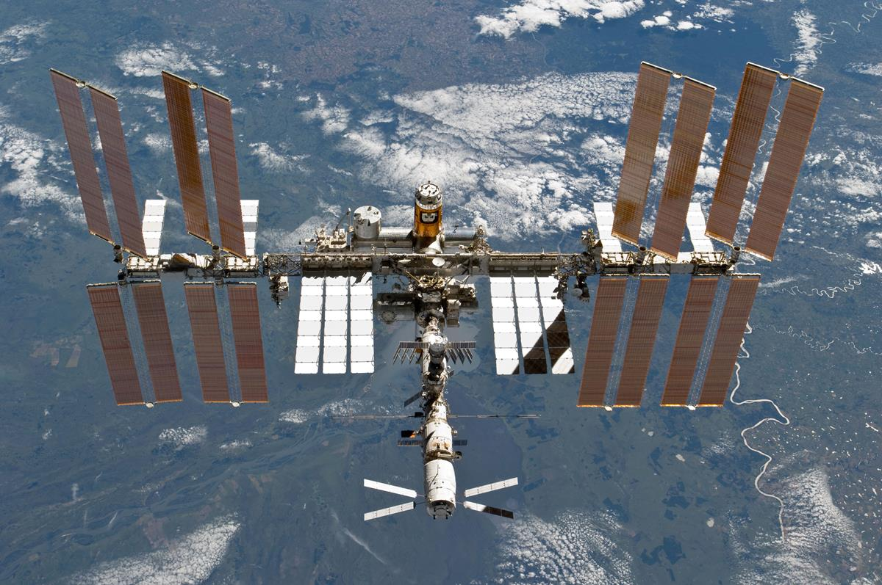
International Space Station

Slide 4
Contents
Purpose
Manufacturing
Assembly
Structure
Systems
Operations
Mission controls
Fleet operations
Life aboard
Crew health and safety
Orbital debris threats
End of mission
Cost
Sightings from Earth

Slide 5
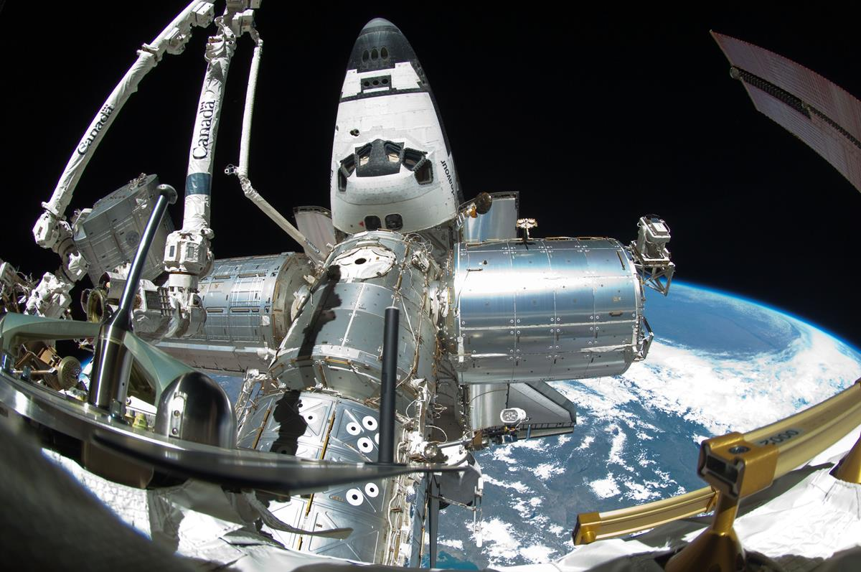
Purpose
Look in the slide notes below for topics to consider talking about
Notes:
Consider talking about:
Scientific research
Exploration
Education and cultural outreach

Slide 6
Manufacturing

Slide 7
Assembly

Slide 8
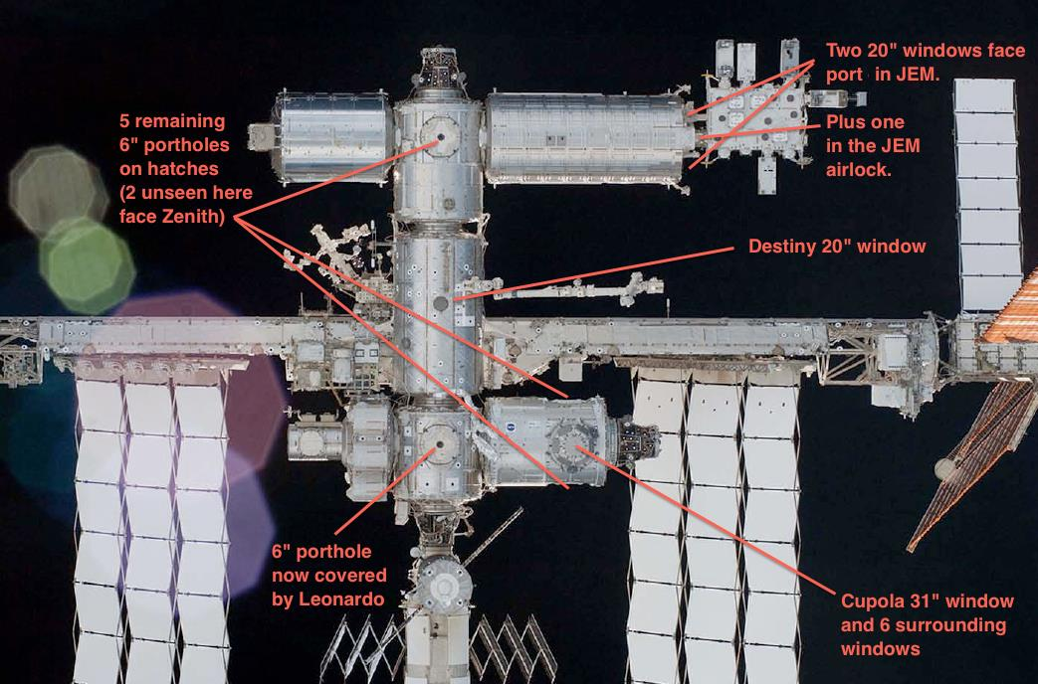
Structure
Look in the slide notes below for topics to consider talking about
Notes:
Consider talking about:
Pressurised modules
Unpressurised elements
Planned componments
Cancelled components

Slide 9
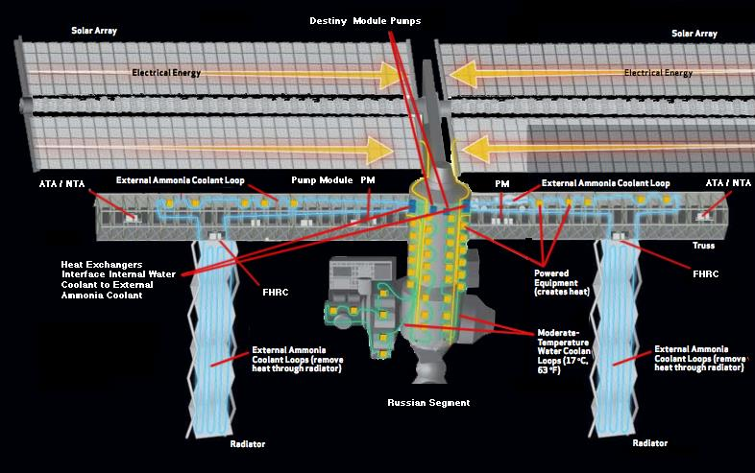
Systems
Look in the slide notes below for topics to consider talking about
Notes:
Consider talking about:
Life support
Power and thermal control
Communications and computers

Slide 10
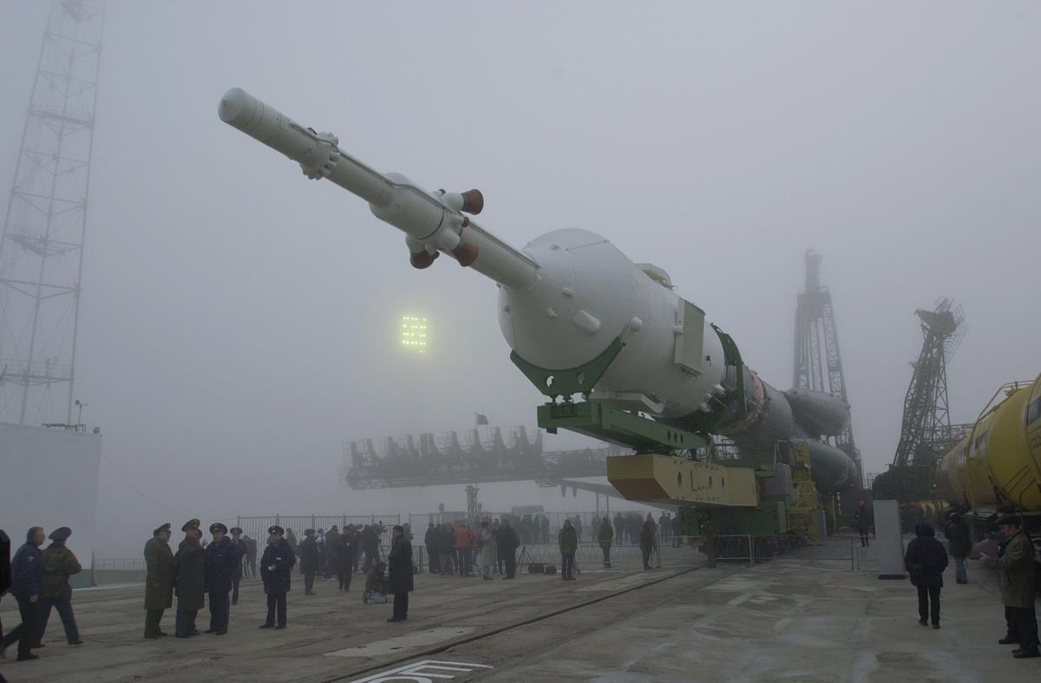
Operations
Look in the slide notes below for topics to consider talking about
Notes:
Consider talking about:
Expeditions and private flights
Orbit

Slide 11
Mission controls
Look in the slide notes below for topics to consider talking about
Notes:
Consider talking about:
Repairs

Slide 12
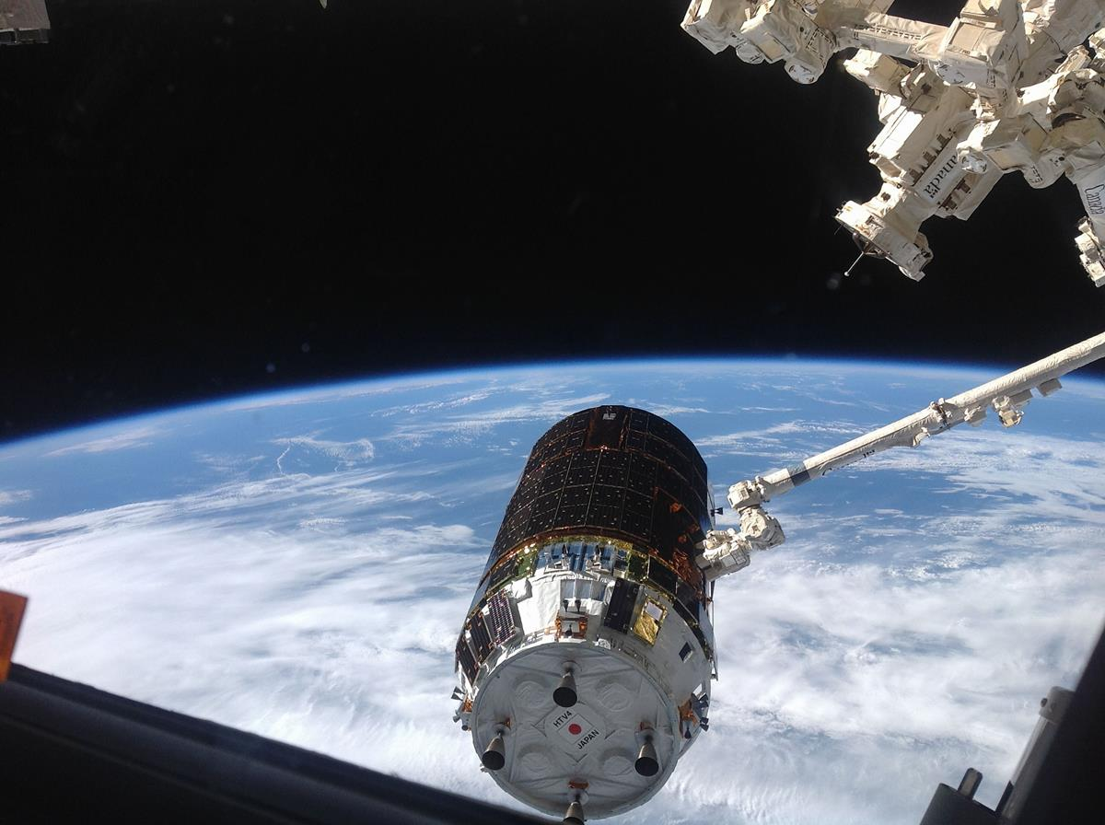
Fleet operations
Look in the slide notes below for topics to consider talking about
Notes:
Consider talking about:
Currently docked/berthed
Scheduled missions
Docking
Launch and docking windows

Slide 13
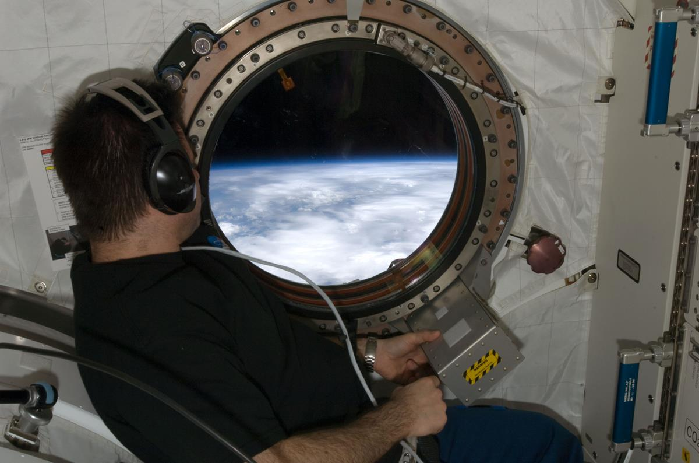
Life aboard
Look in the slide notes below for topics to consider talking about
Notes:
Consider talking about:
Crew activities
Food
Hygiene

Slide 14
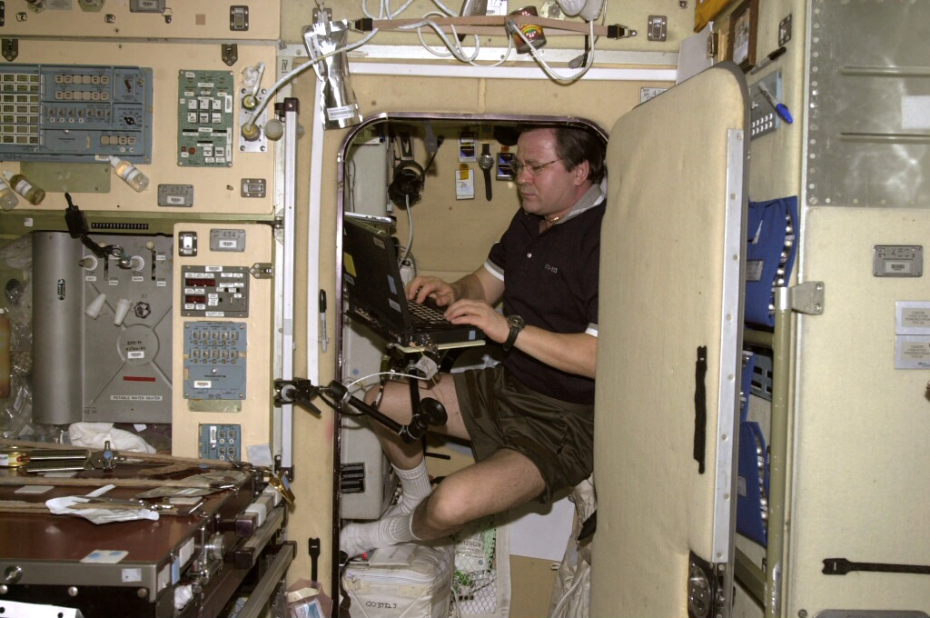
Crew health and safety
Look in the slide notes below for topics to consider talking about
Notes:
Consider talking about:
Overall
Radiation
Stress
Medical
Microbiological environmental hazards
Fire and toxic gases

Slide 15
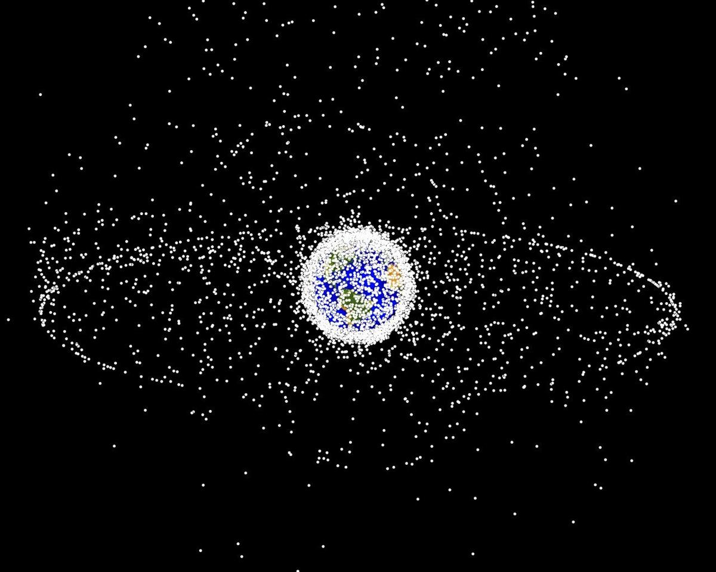
Orbital debris threats

Slide 16
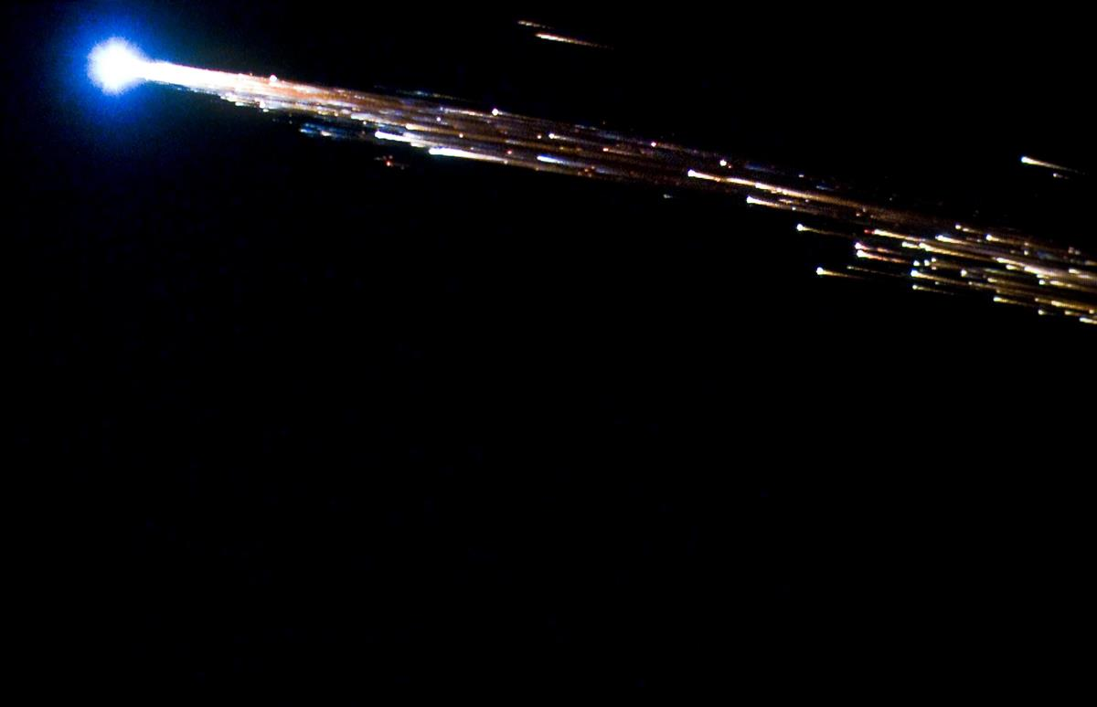
End of mission

Slide 17
Cost

Slide 18
Sightings from Earth
Look in the slide notes below for topics to consider talking about
Notes:
Consider talking about:
Naked-eye visibility
Astrophotography

Slide 19
Works cited

