Slide 1


St Joseph Engineering College – Mangaluru.
An Autonomous Institution
IOT Enabled Prototyping
Subject Code: 22IEP38
Waste Segregator
Guided by
JAYASHREE M
CLASS- 3rd SEM
SECTION: I BRANCH:CSBS

Slide 2
TEAM INFO
TEAM LEADER : STIAN SEQUEIRA
S.NO | NAME | USN
1 | Stian Sequeira | 4SO23CB056
2 | Preethesh Carvalho | 4SO23CB037
3 | Winston Dsouza | 4SO23CB061
4 | Imran Yousuf Kazia | 4SO23CB022
5 | Prithesh Fernandes | 4SO23CB039

Slide 3
Introduction :
The improper management of waste has severe environmental consequences, including pollution, health hazards, and climate change. Effective waste segregation is crucial to address these issues, but it remains a significant challenge. To tackle this problem, we propose an IoT-based object segregation and monitoring system that utilizes sensors and automation to detect and separate wet and dry waste.
This system aims to promote eco-friendly waste management practices by providing real-time monitoring and data analysis, enabling cities and communities to adopt sustainable waste management practices and reduce their environmental footprint

Slide 4
Objectives :
1.Effective Waste Segregation
2. Automation and Efficiency
3. Environmental Impact
4. Ease of Use and Maintenance
5. Data Collection and Monitoring
6. Public Awareness and Education

Slide 5
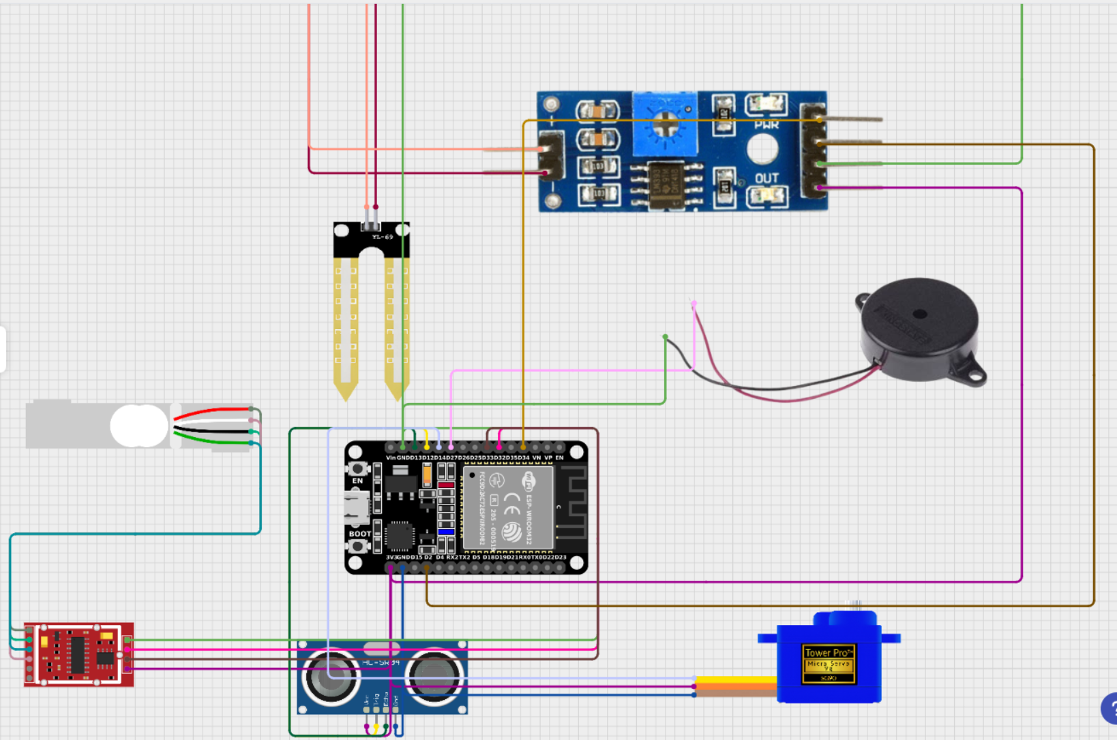
Figurative Representation of the project model :

Slide 6
Operation of the project :
Waste Collection: Waste is collected from various sources, such as households, offices, and public spaces, and placed in designated waste collection bins.
Real-time Monitoring: The system provides real-time monitoring of the segregation process, enabling operators to track the efficiency and accuracy of the system.
Data Analytics: The system analyzes the data collected to provide insights on waste generation patterns, material composition, and recycling rates.
Sensing and Segregation: The sensors detect the properties of the waste, and the microcontroller makes decisions based on the input. The automation system separates the waste into different bins based on the decisions made by the microcontroller.

Slide 7
Program :
#include <Wire.h>
#include <LiquidCrystal_I2C.h>
#include <ESP32Servo.h>
#include <HX711.h>
// Pin definitions
#define TRIG_PIN 12
#define ECHO_PIN 13
#define SERVO_PIN 14
#define BUZZER_PIN 27
#define SOIL_MOISTURE_PIN 34
#define LOADCELL_DOUT_PIN 32
#define LOADCELL_SCK_PIN 33

Slide 8
// Initialize components
LiquidCrystal_I2C lcd(0x27, 16, 2);
Servo servo;
HX711 loadCell;
void setup() {
// Initialize serial communication
Serial.begin(9600);
// Initialize LCD
lcd.init();
lcd.backlight();
lcd.setCursor(0, 0);
lcd.print("Detecting Waste");
// Initialize servo
servo.attach(SERVO_PIN);
servo.write(90); // Initial position
// Initialize load cell
loadCell.begin(LOADCELL_DOUT_PIN, LOADCELL_SCK_PIN);
loadCell.set_scale();
loadCell.tare();

Slide 9
// Initialize pins
pinMode(TRIG_PIN, OUTPUT);
pinMode(ECHO_PIN, INPUT);
pinMode(BUZZER_PIN, OUTPUT);
pinMode(SOIL_MOISTURE_PIN, INPUT);
}
void loop() {
// Detect waste using ultrasonic sensor
digitalWrite(TRIG_PIN, LOW);
delayMicroseconds(2);
digitalWrite(TRIG_PIN, HIGH);
delayMicroseconds(10);
digitalWrite(TRIG_PIN, LOW);
long duration = pulseIn(ECHO_PIN, HIGH);
long distance = duration * 0.034 / 2;
if (distance < 15) { // Waste detected within 30 cm
// Sound the buzzer
digitalWrite(BUZZER_PIN, HIGH);
delay(1000);
digitalWrite(BUZZER_PIN, LOW);

Slide 10
// Check moisture level
int moistureValue = analogRead(SOIL_MOISTURE_PIN);
lcd.clear();
lcd.setCursor(0, 0);
if (moistureValue <4000) { // Wet waste
servo.write(160); // Turn left for wet waste
lcd.print("WET");
Serial.println(" ==> Wet Waste");
Serial.println(moistureValue);
// Turn left for wet waste
} else { // Dry waste
servo.write(20);
lcd.print("DRY");
Serial.println(" ==> Dry Waste");
Serial.println(moistureValue);
// Turn right for dry waste
}
delay(3000); // Hold servo position
servo.write(90); // Reset servo position

Slide 11
// Measure weight
float weight = loadCell.get_units(10);
//it is showing an error value of 200grams in weight sensor so i have added this condition to avoid that
weight = weight - 300;
if(weight < 0) {
weight = 0;
}
lcd.clear();
lcd.setCursor(0, 0);
lcd.print("Weight: ");
lcd.print(weight);
lcd.print(" g");
//print moisture value on serial monitor
Serial.print("Moisture Value: ");
Serial.println(moistureValue);
Serial.print("Weight Value");
Serial.println(weight);
}
delay(2000); // General delay between operations
}

Slide 12
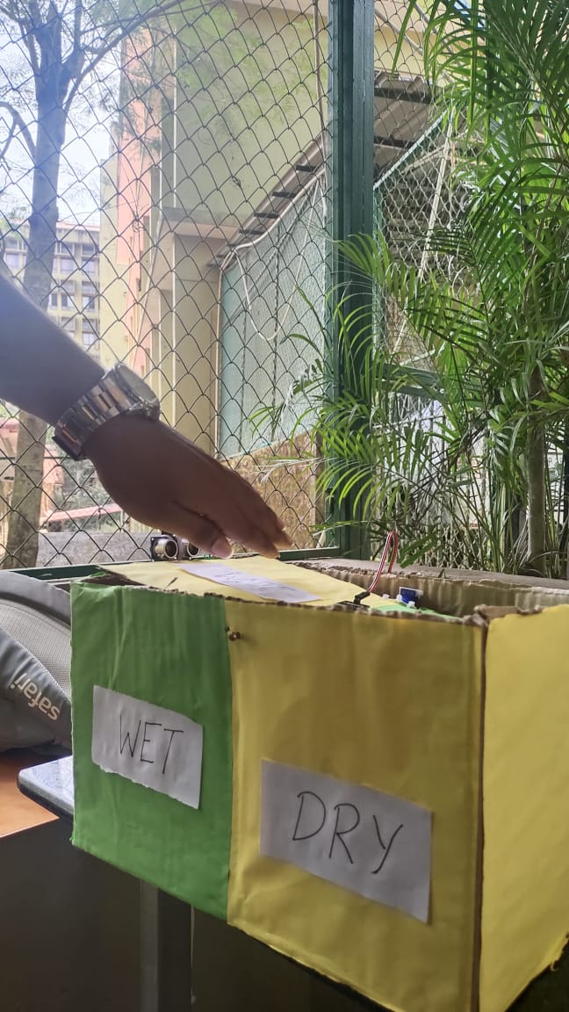
Final Project Model

Slide 13
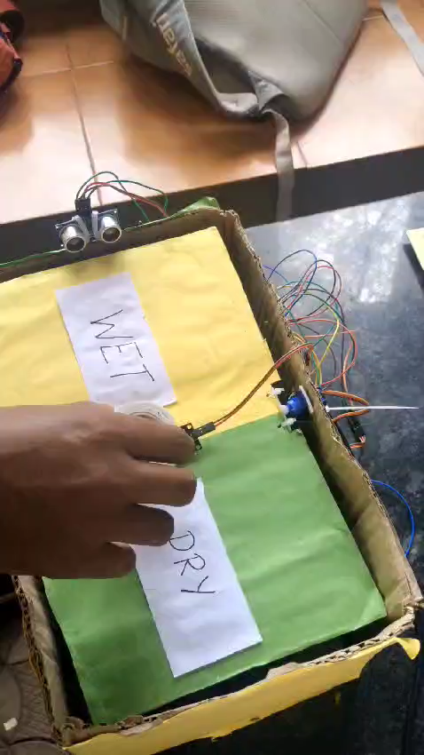
Results and Discussion

Slide 14
Future Scope
Data Collection: Record waste data in a database for analysis and waste management optimization.
Full Bin Alerts: Sensors notify staff when bins are full, ensuring timely emptying.
Automated Cleaning Bots: Bots clear waste from segregators and transport it to disposal points.
Networked Collection System: Connect segregators to coordinate efficient waste collection schedules.

Slide 15


