Slide 1


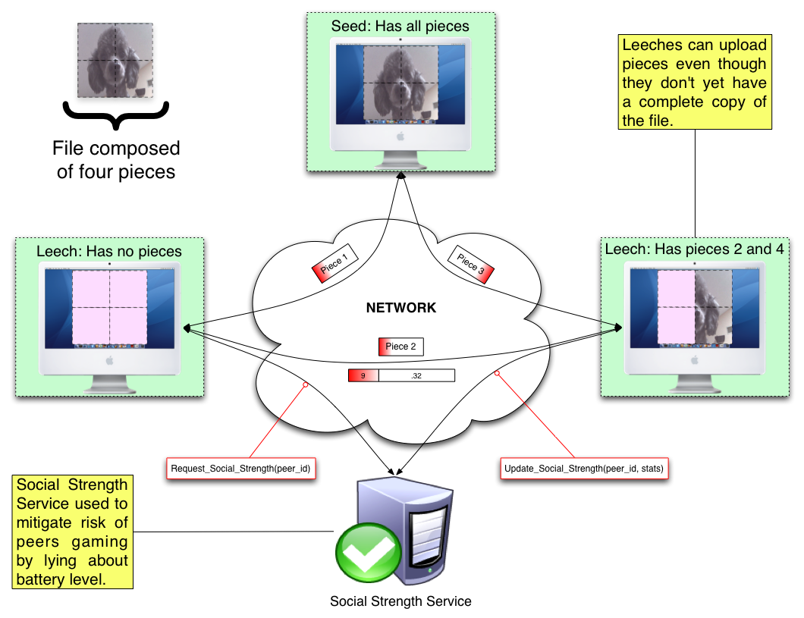
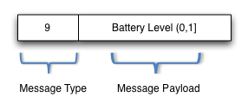
BatTorrent: A Battery-Aware BitTorrent for Mobile Devices
Zach King, Jeremy Blackburn, Adriana Iamnitchi
Computer Science and Engineering, University of South Florida
MOTIVATION
Introducing BitTorrent to mobile devices (i.e., mobile phones) dramatically increases both the concern and consequences for power loss. BitTorrent's tit-for-tat mechanism ensures that all peers, including mobile peers, must upload content in order to download content. As transmission of data necessarily consumes more energy than reception of data, a mobile BitTorrent peer is faced with a conundrum: maximize upload bandwidth to receive the reciprocal download bandwidth and drain battery or limit the rate of data upload and suffer the consequences of the tit-for-tat enforcement.
BITTORRENT MODIFICATIONS
1) Introduce a new message type, BATT
2) Allow peers to scale upload based on battery level
PROPOSED SOLUTION
Scaling the upload rate of peers as a function of remaining battery life, while also inversely scaling the rate measures, will allow a battery proportionate contribution to the swarm without suffering the penalties associated with scaled upload rates. BatTorrent is integrated with a social strength service to mitigate the risk of peers lying about their battery level to gain an unfair advantage.
3) Modify the choking algorithm to manage the scaled uploads
4) Social strength service
def choking_algorithm(peers)
# determine regular unchokes
peers.sort(R) # R = Ordering Function
Num_unchokes.times do |peer_index|
peers[peer_index].unchoke
end
# choke everyone else
choked_peers = peers[Num_unchokes, peers.length]
choked_peers.each do |peer_to_choke|
peer_to_choke.choke
end
# perform optimistic unchokes
choked_peers[rand(choked_peers.length)].unchoke
end
Rely on a social strength service to infer social-based trust to help mitigate gaming and provide incentives for resource sharing
Rate Ordering Function R:
BitTorrent: Strictly based on upload rate, r.
BatTorrent: Compensates for scaled uploads based on f(r, batt, socs)
Num_unchokes:
Represents the number of unchoke slots available. While the BitTorrent specification indicates four slots, this can vary per client.
Optimistic Unchokes:
Per BitTorrent spec one slot is reserved for a random peer to be unchoked, which allows new peer discovery.
PRELIMINARY RESULTS
BatTorrent is implemented on Android G1 phone and preliminary experiments at scale on PlanetLab
FUTURE WORK
We are currently investigating other scaling functions. In addition, we are examining a battery level threshold approach to BatTorrent bandwidth scaling. While we have a proof of concept of BatTorrent running on the Android emulator and a G1 dev phone, experiments composed primarily of mobile devices will come soon.
Acknowledgements: This material is based upon work supported by the National Science Foundation under Grant No. CNS-0831785

