Slide 1
Tracking User Attention in Collaborative Tagging Communities
Elizeu Santos-Neto
Matei Ripeanu
Univesity of British Columbia
Adriana Iamnitchi
University of South Florida

Slide 2
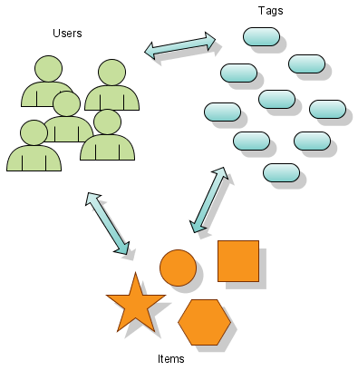
Collaborative Tagging - Introduction
Users collect items and mark them with tags
Items can be URLs, photos, books, paintings, blog posts, etc…
All tagging events are visible in this study

Slide 3
The Problem
Ability to find relevant content.
Growth reduces navigability
  Lack of collaborative tagging behavior models
How to improve scalability in these commuities?
  Improve user experience via personalization
Notes:
Define navigability

Slide 4
Goals
Contributions
How is the activity distributed among users?
  User activity level is highly heterogeneous
Does the interest sharing has any structure?
  Several disjoint sub-communities
  Large amount of singleton users
Can the tracked behavior help navigation?
  Interest sharing graph helps improve navigability

Slide 5
Data Sets
 | CiteULike | Bibsonomy
Users | ~6K | ~600
Items | ~200K | ~67K
Tags | ~51K | ~21K
Assignements | ~452K | ~257K
Data Cleaning
  Robot users: tagged ~3K items within 5min
  Automated Tags: bibtex-import, no-tag

Slide 6
Contributions – Part I
How is the activity distributed among users?
  User activity level is highly heterogeneous
Does the interest sharing has any structure?
  Several disjoint sub-communities
  Large amount of singleton users
Can the tracked behavior help navigation?
  Interest sharing graph helps improve navigability

Slide 7

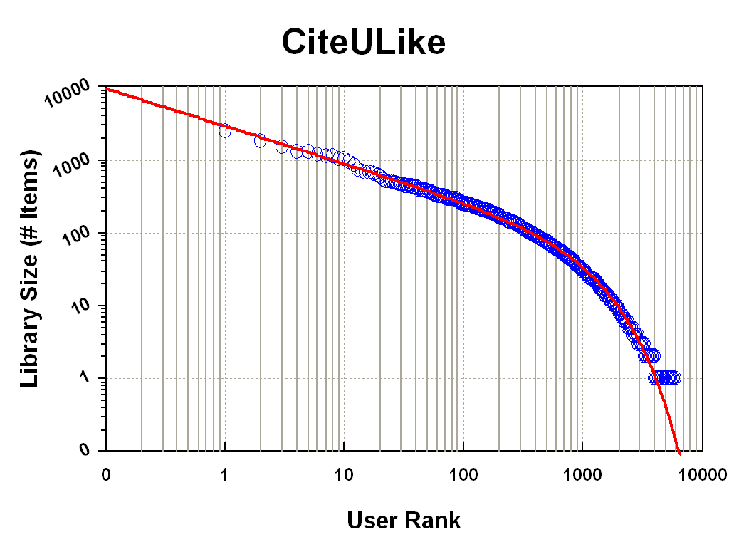
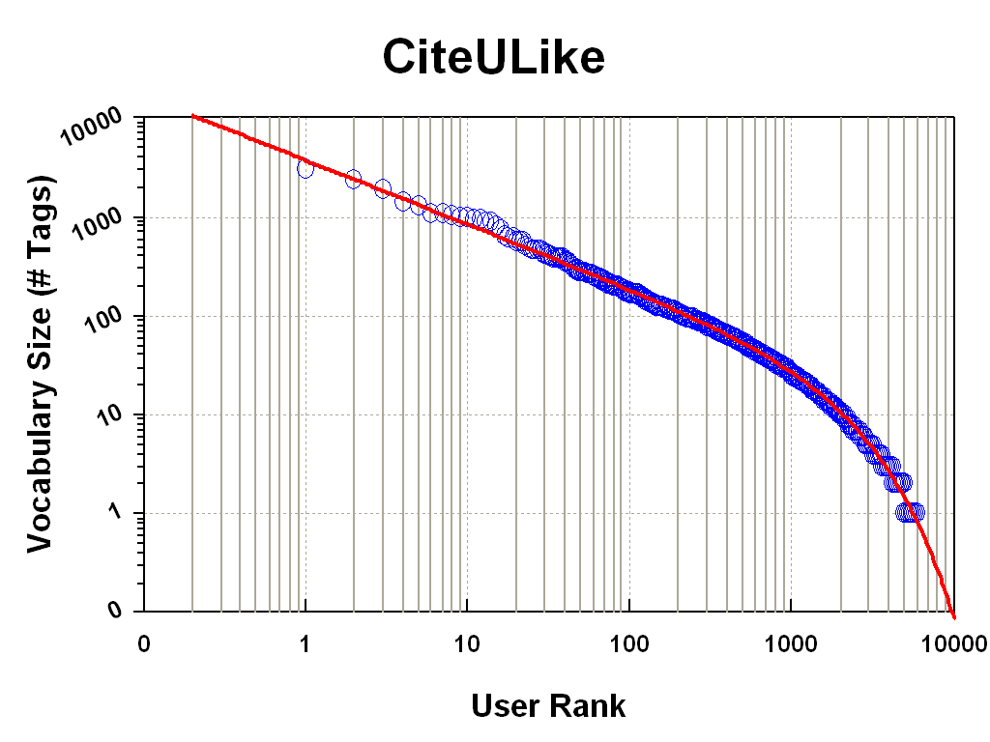
Tagging Activity
Item Set Size Distribution
Tag Set Size Distribution
User activity level is highly heterogeneous
Item and Tag set sizes - strong correlation

Slide 8
Contributions – Part II
How is the activity distributed among users?
  User activity level is highly heterogeneous
Does the interest sharing has any structure?
  Several disjoint sub-communities
  Large amount of singleton users
Can the tracked behavior help navigation?
  Interest sharing graph helps improve navigability

Slide 9

An Interest Sharing Graph
George
Tony
Items
Tags
Castro

Slide 10
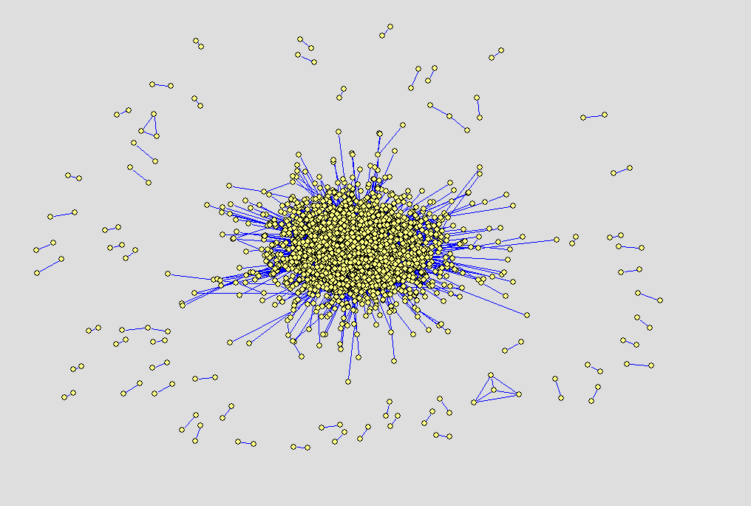
Interest Sharing – Structure
At least one
shared item!
Users are nodes!
Zero-degree nodes
are removed!

Slide 11
Scalable Interest Sharing Definition
George
Tony
50%
Items
Tags
Castro
20%
For example:
At least 30% items
are shared!
Several similarity
metrics are possible

Slide 12
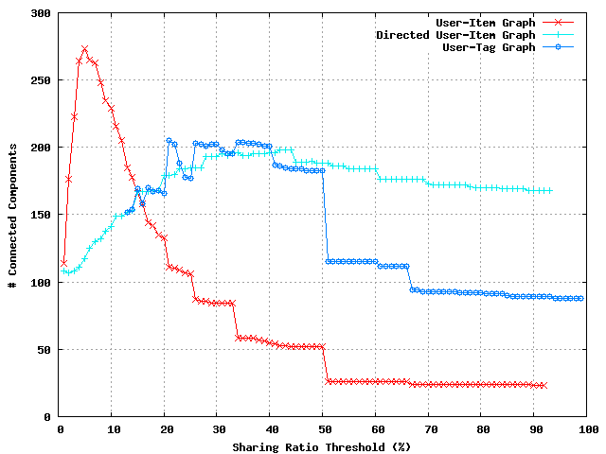
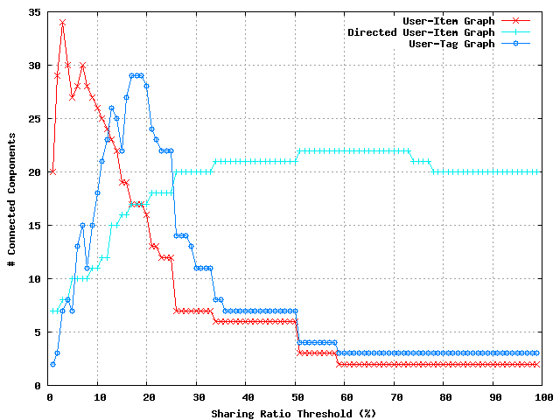
Finding sub-communities
CiteULike
Bibsonomy
Several disjoint sub-communities
Large amount of singleton users

Slide 13
Contributions – Part III
How is the activity distributed among users?
  User activity level is highly heterogeneous
Does the interest sharing has any structure?
  Several disjoint sub-communities
  Large amount of singleton users
Can the tracked behavior help navigation?
  Interest sharing graph helps improve navigability

Slide 14
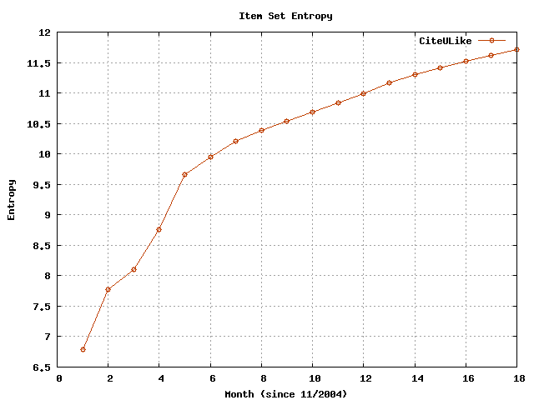
Growth reduces navigability
Intuition:
1. the higher is the entropy
2. more randomness 3. the harder is to find relevant content
Global Entropy: ~11.75

Slide 15
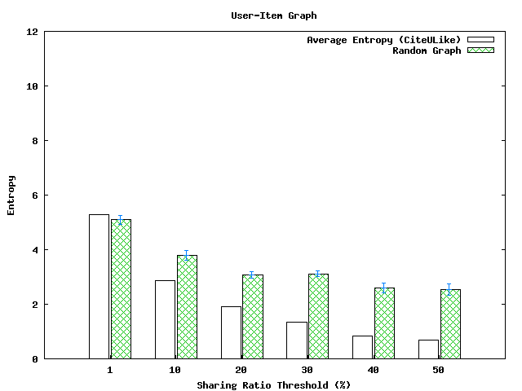
Interest Sharing to Reduce Entropy
Random Graph
Each user owns a library!
Average Entropy
Global Entropy:
~ 11.75

Slide 16
How useful is the reduction of entropy?
Hit Rate Evaluation
  Let G(t) be a graph at time t
  Compare the user libraries in the graphs G(t) and G(t+1)
  Time unit can be month, day or hour.
Preliminary results
  Predicted about 20%(hour) to 5% (month)
Is the data inherently hard to predict ?
  Current work: comparison against other prediction techniques

Slide 17
Summary
User activity level is highly heterogeneous…
  … and the Hoerl function is a good model.
Users do share interest…
  … but they form disjoint sub-communities.
The entropy can be reduced…
  …thus, more relevant content can be presented
Future actions can be predicted...
  …a sys admin was impressed by the results.

Slide 18
Thanks! Obrigado!
Questions?

Slide 19
Related Studies
How this paper relates to the other papers presented here?

Slide 20
Current Work
Recommendation techniques
  e.g., Top-k most pop, clustering-based similarity, reputation based
Are there other structural patterns?
  e.g., small-world
Application of the interest-sharing graph
  BitTorrent communities
  Scientific Collaborations

Slide 21
Hoerl Model parameters
CiteULike | a | b | c
Tag Assignments | 9,767.13 | 0.9979 | -0.4754
Library Size | 2,609.77 | 0.9988 | -0.4772
Vocabulary Size | 3,338.55 | 0.9992 | -0.5964
Bibsonomy
Tag Assignments | 28,969.29 | 0.9864 | -0.6888
Library Size | 6,137.49 | 0.9850 | -0.5461
Vocabulary Size | 2,608.45 | 0.9907 | -0.5126

Slide 22
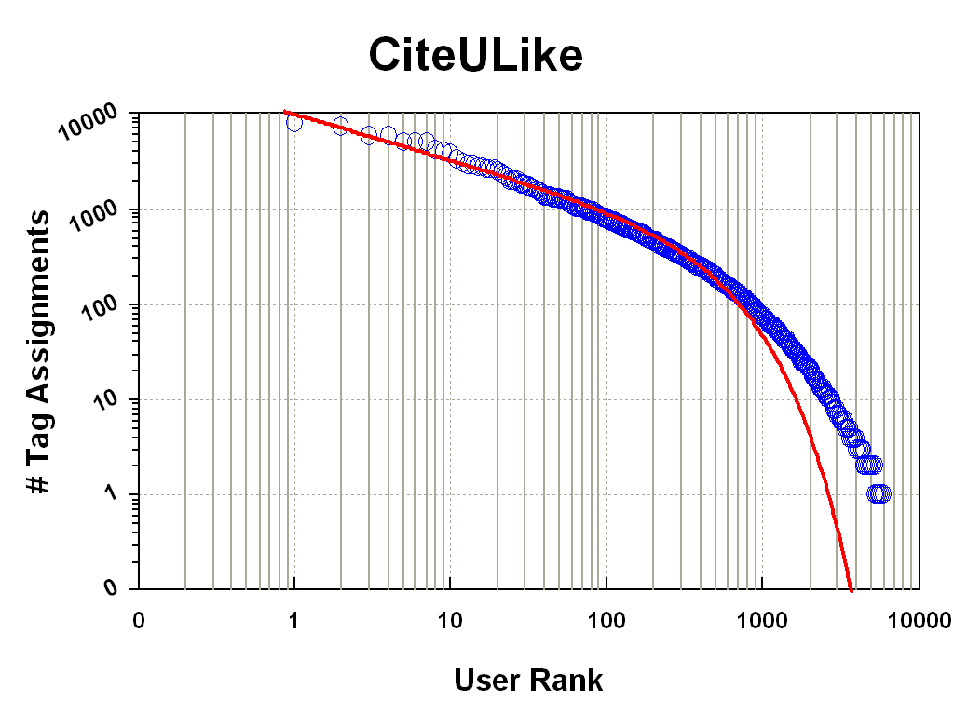
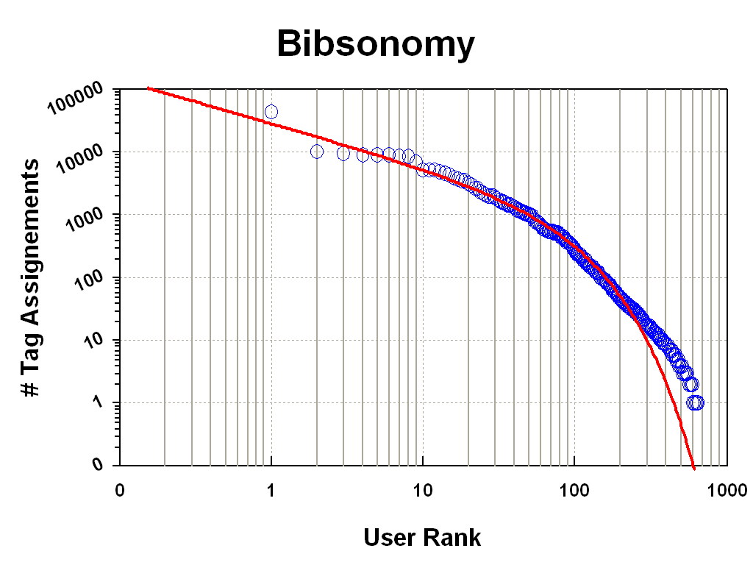
Tagging Activity - assignements

Slide 23
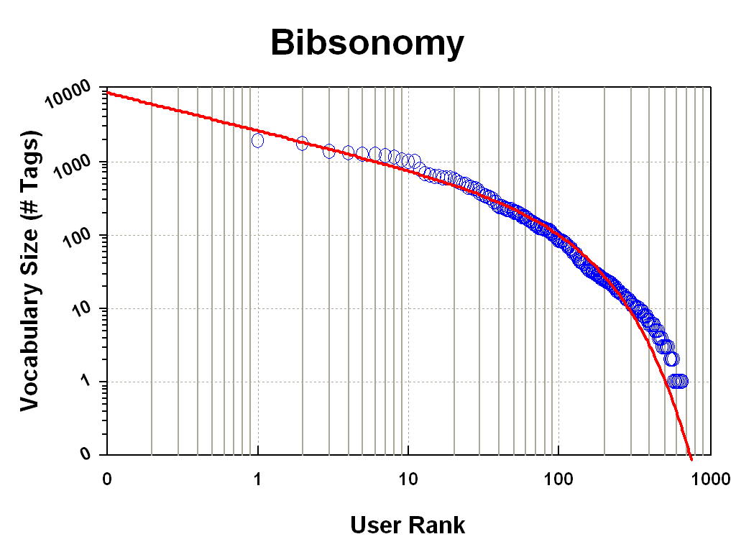
Tagging Activity – vocabulary size

Slide 24
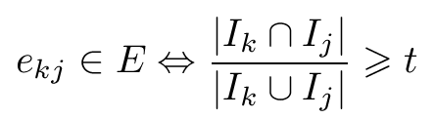
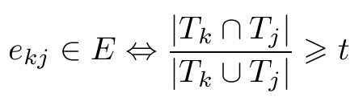
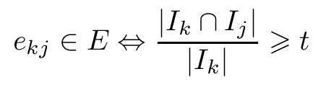
Interest Sharing - Definitions
A graph definition: G=(U,E)
  U is the set of users and E is the set of edges
Interest-Sharing Graph definition
  User-Item
  User-Tag
  Directed-User-Item

Slide 25
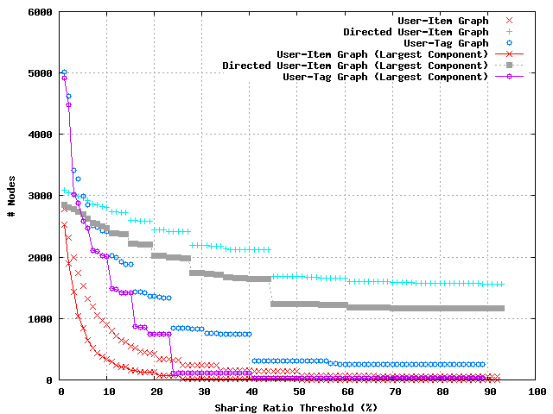
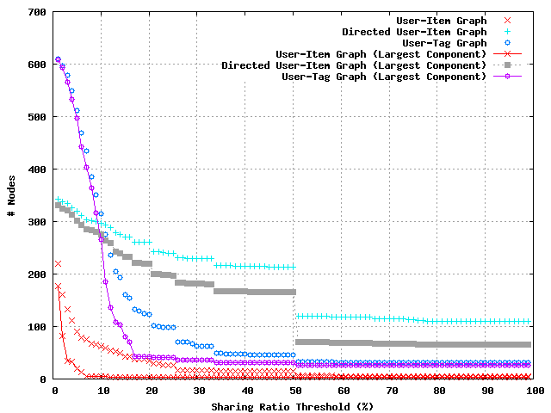
Interest Sharing – # nodes

Slide 26
Interest Sharing – Structure

Slide 27
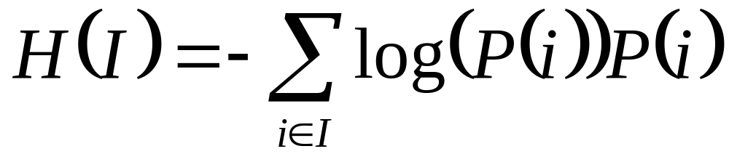
Entropy
I is the set of items
P(i) is the popularity of item i

Slide 28
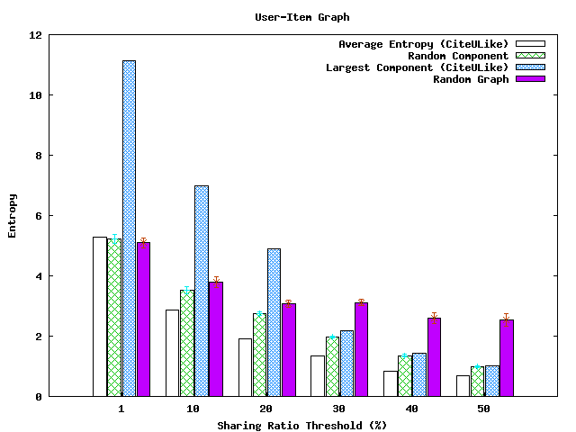
Entropy
This is due to the effect of the neighborhood library size.
Global Entropy:
~ 11.75

