Slide 1
Data Transfers in the Grid:
Workload Analysis of Globus GridFTP
Nicolas Kourtellis, Lydia Prieto, Gustavo Zarrate, Adriana Iamnitchi
University of South Florida
Dan Fraser
Argonne National Laboratory

Slide 2
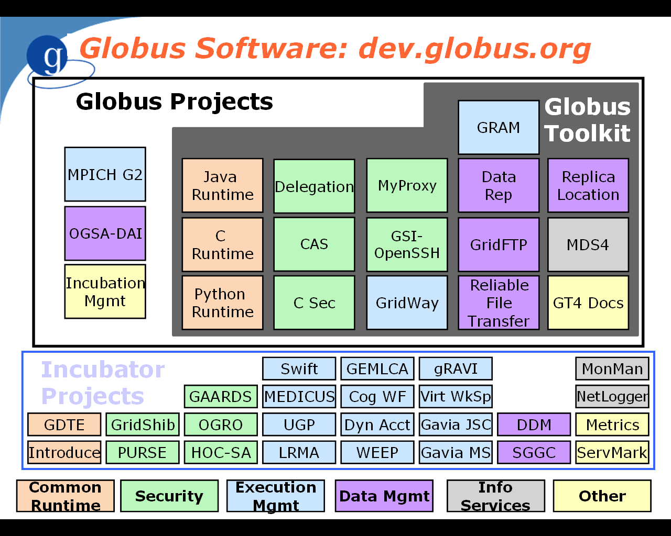
Notes:
What Globus is
What GridFTP is
What Metrics is

Slide 3

  Objective 1: Quantify volume of transfers
    What is the transfer size distribution?
    What is the volume of activity for the most active hosts?
  Objective 2: Understand how tuning capabilities are used
    What are the buffer sizes used during the transfers?
    What is the average bandwidth?
    What is the utilization of functionalities like streams and stripes?
  Objective 3: Quantify user base and predict usage trends
    How does the user base evolve over time?
    What are the geographical characteristics of the GridFTP data transfers?

Slide 4

Outline
Metrics dataset
Surprises and …
… zoom in (TeraGrid)
Lessons and discussions

Slide 5
GridFTP Metrics Dataset
Field | Range of Values | Comment
Source hostname/host IP | String/IPnet | Anonymized
Start time of the transfer | Timestamp | Accuracy: ms
End time of the transfer | Timestamp | Accuracy: ms
TCP Buffer Size | Integer (Bytes) | ≥0
Total Number of Bytes | Integer (Bytes) | ≥0
Number of Streams | Integer | ≥1
Number of Stripes | Integer | ≥1
Store or Retrieve | Integer (0, 1,2) | STOR, RETR, LIST

Slide 6
Metrics Dataset
Started with ~137.5 million records (Jul’05 - Mar’07)
Cleaning:
  transfer size ≤0: ~22.8 million records
  buffer size <0: ~1000 records
  directory listings: ~3.9 million records
  invalid hostnames (e.g., /[B@89712e): ~4,600 records
  ANL-TeraGrid testing: ~11.4 million records
  duplicate reports: ~16.8 million records
  self transfers (source=destination): ~5.75 million records
Clean database: ~77.2 million records (~56.2%)
Notes:
Server to server transfers
=> Duplicate Report of the same transfer
Criteria to identify duplicates:
Window of 5 records
Complementary stor_or_retr code (0 or 1)
Number of bytes, buffer size, block size same
Transfer time (end-start) within 1sec difference
Start (or end) time within 60sec difference
For more than one matching records, pick the smallest difference in transfer time.
=> 16.8 million server-to-server transfers identified
~5.75 million records: self transfers (same hostname for source/destination)

Slide 7
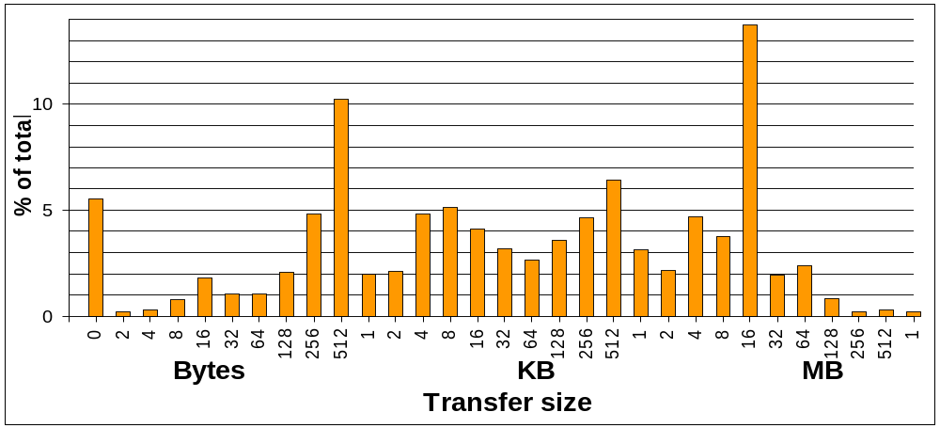
Surprise #1: Transfer Size Distribution
Objective 1: Quantify volume of transfers
Notes:
1st Peak: 16MB - 32MB, ~13 million records.
2nd Peak: 512B - 1KB (low transfer size), ~7.4 million records.
3rd Peak: 0-2B, ~5,2 million records.
Maximum bucket: 1TB-16TB, 45 records.
GB region buckets: ~255,000 records.
CMS community uses PhEDEX: median size transfer=1.55GB (>1.7 million transfers), average size transfer=1.69GB, maximum size transfer=20.33GB.

Slide 8
Zoom-in: TeraGrid
Are these results representative for production grids?
  GridFTP testing for deployment and learning
Identify transfers from TeraGRid and analyze dataset.

Slide 9
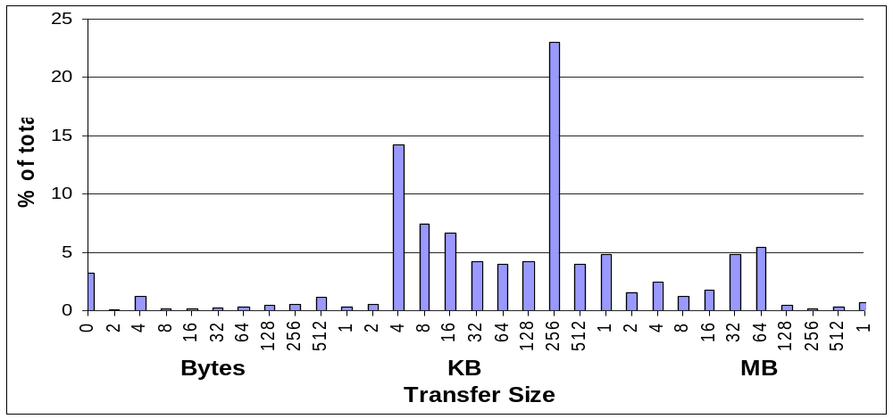
Transfer Size Distribution (TG)
Objective 1: Quantify volume of transfers
Notes:
Many small transfers in the range of a few hundreds of KB
Peak in the range of 256-512KB
Few in the range of MB or even GB.
We can conclude that the set of TeraGrid transfers is a representative sample over the whole population of reported GridFTP transfers.

Slide 10
All
TG

Slide 11
Why So Small Transfers?
There are still many old versions (i.e., before v3.9.5) of GridFTP in use. These versions do not include trace reporting capabilities.
Other data transfer protocols and implementations are used
Users have turned off the reporting capability
Some of the logs are inevitably lost due to the UDP-based reporting mechanism
The low transfer volumes could suggest a shift towards data-aware job scheduling (?)

Slide 12
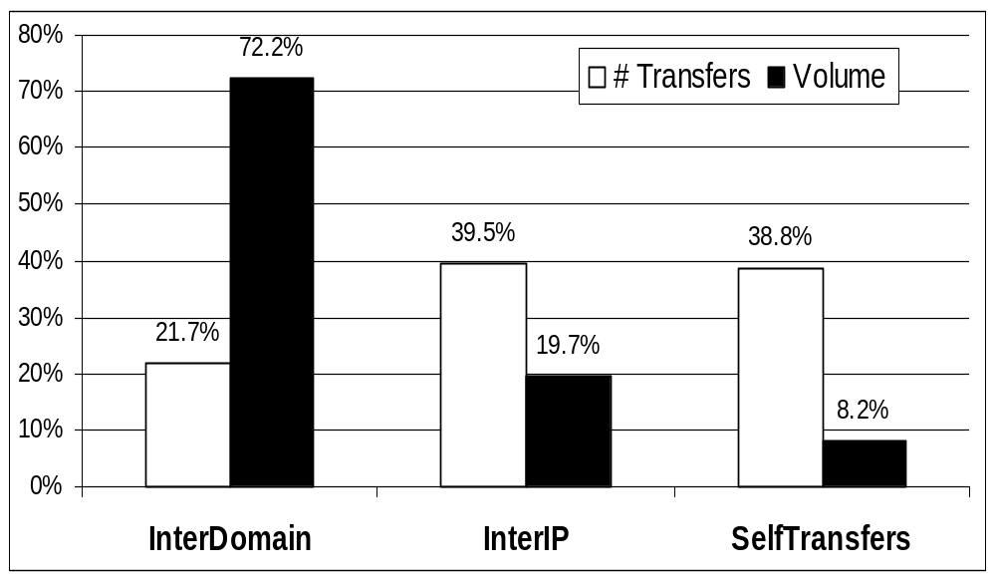
Server to Server Transfers
  High reporting of Self Transfers (more than 1/3)
Objective 1: Quantify volume of transfers
Notes:
Small % of Inter-Domain transfers but respective high % in Volume
The opposite for Intra-Domain (InterIP) transfers

Slide 13
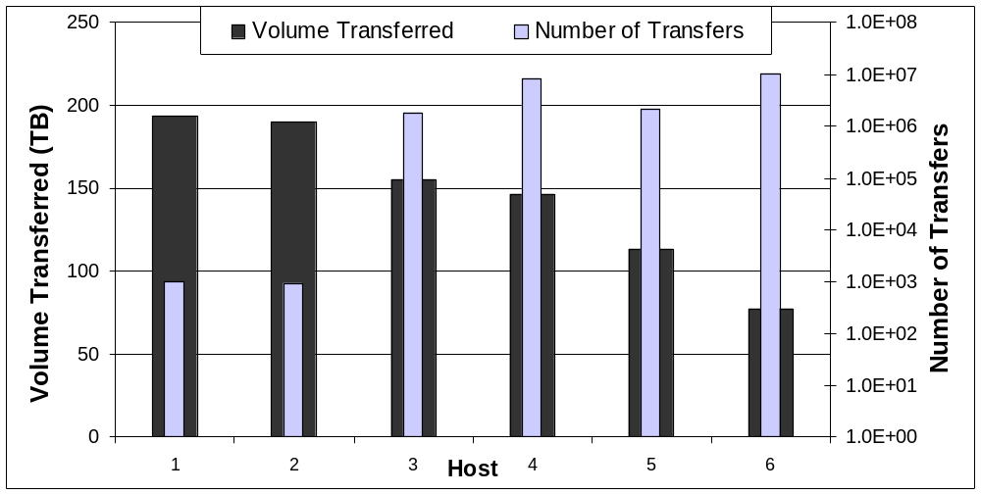
Top 6 Active Hosts (all)
Top 6 hosts traffic adds up to ~28% of total volume
Next 48 hosts (IPs) transferred 10s of TB
Objective 1: Quantify volume of transfers
Notes:
Note the log scale in the transfers axis.

Slide 14
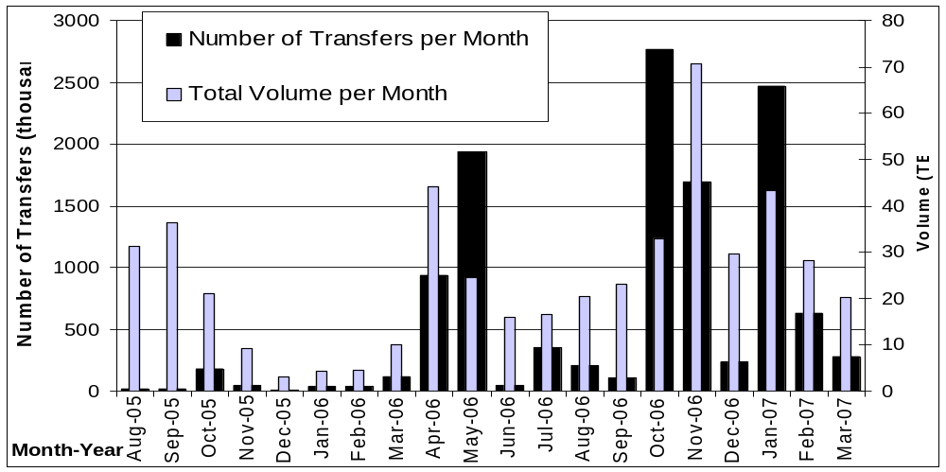
Number of Transfers & Volume (TG)
Objective 1: Quantify volume of transfers

Slide 15
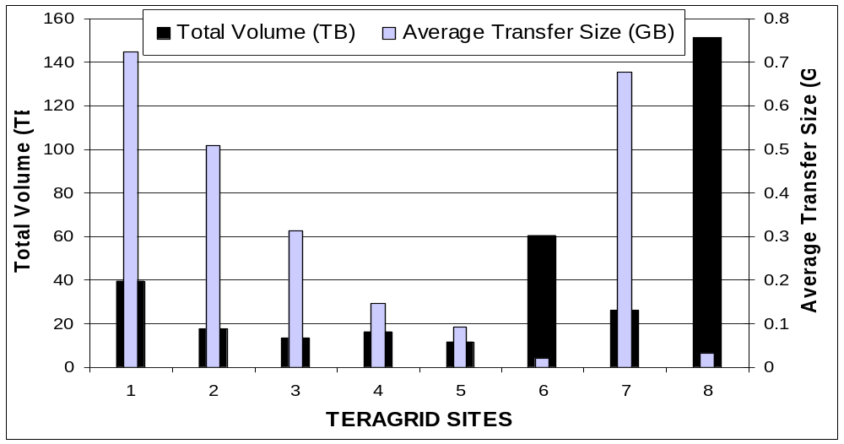
Average Transfer Size
& Total Volume (TG)
Objective 1: Quantify volume of transfers
Notes:
Most sites with a high average transfer size have moved only a few TB of data
Sites that moved a high volume of data have a fairly low average transfer size

Slide 16
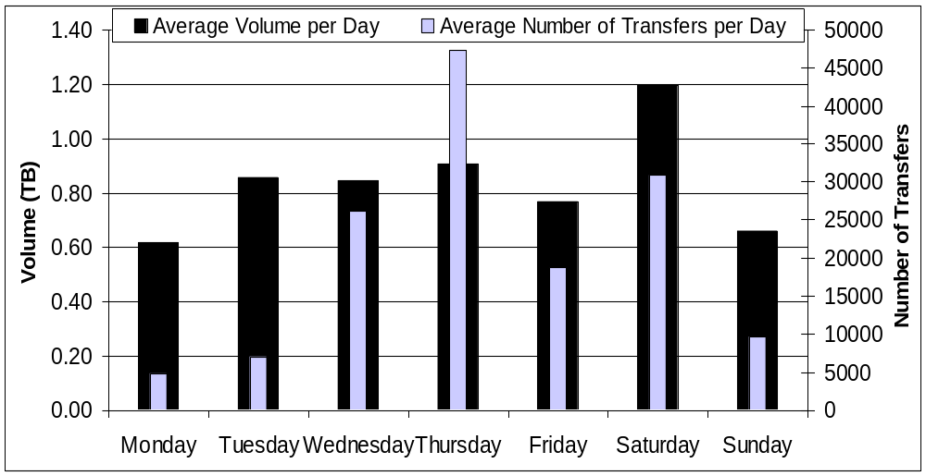
Daily Workload (TG)
Average volume transferred per day: ~ 0.6TB
GridFTP doesn’t get weekends free!
Objective 1: Quantify volume of transfers

Slide 17
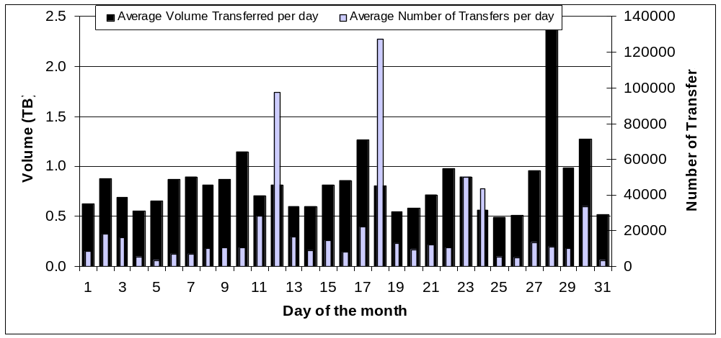
Monthly Workload (TG)
~50,000 transfers per day
~1TB per day of total volume
Lowest around 0.5TB per day
Peaks due to particular days
Objective 1: Quantify volume of transfers
Notes:
Many transfers during the days 05/12/05 and 10/18/06)
The peak: 28th of the month is due to a large total volume transferred on 04/28/06.

Slide 18
  Objective 1: Quantify volume of transfers
    What is the transfer size distribution?
    What is the volume of activity for the most active hosts?
  Objective 2: Understand how tuning capabilities are used
    What are the buffer sizes used during the transfers?
    What is the average bandwidth?
    What is the utilization of functionalities like streams and stripes?
  Objective 3: Quantify user base and predict usage trends
    How does the user base evolve over time?
    What are the geographical characteristics of the GridFTP data transfers?

Slide 19
Surprise #2: Usage of Streams and Stripes
Unreliably reported (from Globus team).
Reliable observations:
  At least ~20% of the transfers used 4 streams (suggested number by ANL’s website)
  At least ~10% of the transfers used a different value, larger than one.
  Maximum number of streams reported: 1010 (!!)
Objective 2: Understand how tuning capabilities are used

Slide 20
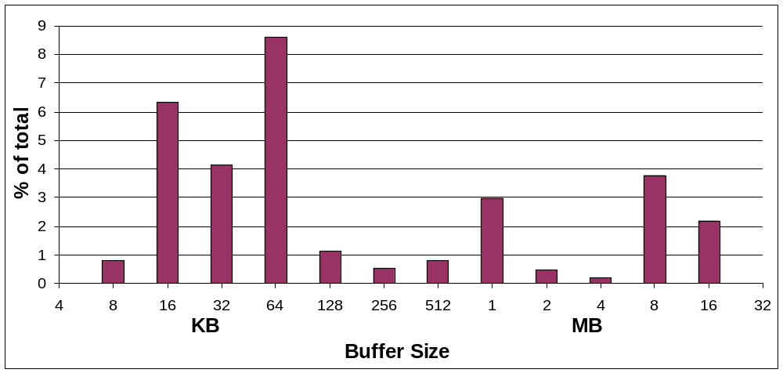
Buffer Size Distribution
    60% from the original table: OS-controlled (0 bytes)
    Most commonly used: 16–128KB
    Largest buffer size: 1-2GB (92 records)
Objective 2: Understand how tuning capabilities are used

Slide 21
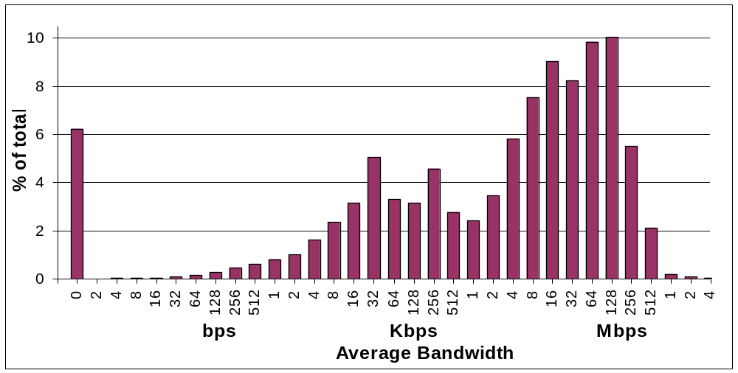
Average Bandwidth Distribution
  Peak: 128-256Mbps, ~7.7 million records
  Most common (58%): 4Mbps—1Gbps

Slide 22
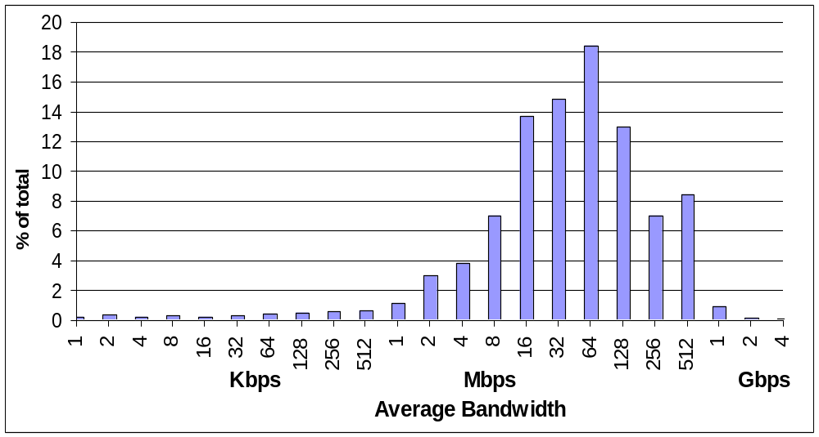
Average Bandwidth Distribution (TG)
Compared to the total dataset:
  => The region of 4Mbps to 1Gbps includes more than 85% of the transfers (58% for the whole dataset)

Slide 23
  Objective 1: Quantify volume of transfers
    What is the transfer size distribution?
    What is the volume of activity for the most active hosts?
  Objective 2: Understand how tuning capabilities are used
    What are the buffer sizes used during the transfers?
    What is the average bandwidth?
    What is the utilization of functionalities like streams and stripes?
  Objective 3: Quantify user base and predict usage trends
    How does the user base evolve over time?
    What are the geographical characteristics of the GridFTP data transfers?

Slide 24
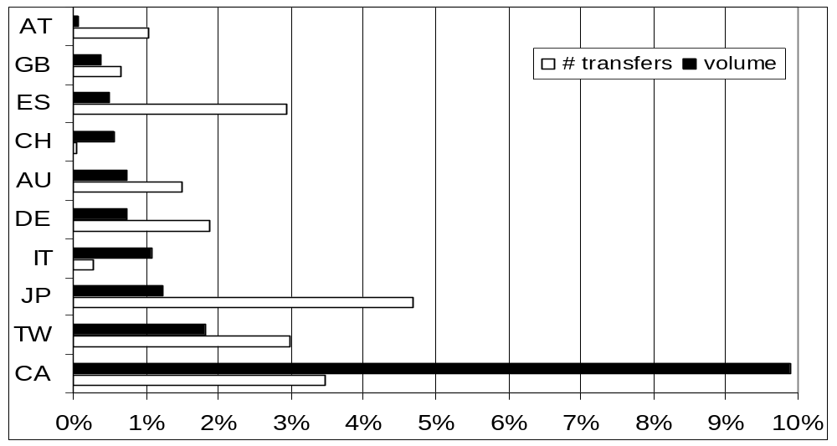
Surprise #3: Geographic Distribution
USA: 78.4% or ~50.8 million transfers and 82.9% or ~1.7 PB
Canada+Taiwan+Japan+Spain:~14M transfers and 346TB
49 different countries and 446 different cities (178 cities from USA)
Objective 3: Quantify user base and predict usage trends
Notes:
The most relevant activity was concentrated in 20 countries

Slide 25
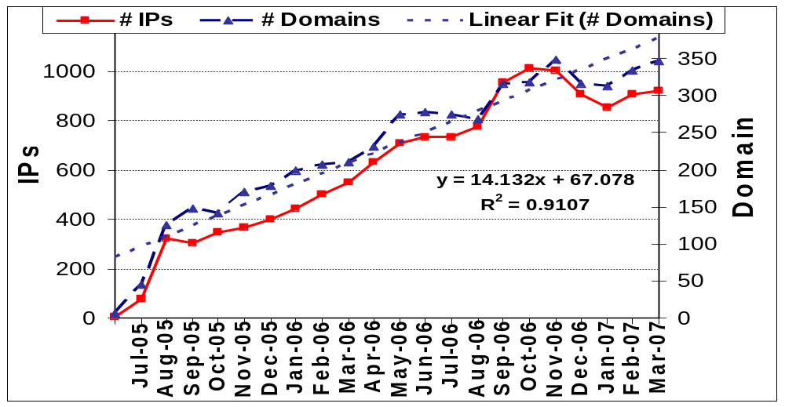
User and Domain Evolution (all)
Continuing increase of user and organization population
Forecasts: 67 new IPs and 14 new domains per month
Objective 3: Quantify user base and predict usage trends

Slide 26
Summary of Results
Many transfers in the range of KBs to 10s MB (peak in 16MB-32MB).
  relevant for setting up realistic simulations.
  previous work assume different, larger file sizes.
Bandwidth measured in previous work is confirmed by our workload analysis.
Tuning parameters:
  Users tend not to set the buffer size explicitly (60%), leaving it to the OS
  The unexpectedly small transfers do not justify tuning GridFTP parameters (stripes and streams)
The usage of Globus GridFTP is growing over time in terms of IPs (users), domains (organizations), and volume transferred.
Missing some of the big players

Slide 27
?

