Slide 1

Are P2P Data-Dissemination Techniques Viable in Today's Data-Intensive Scientific Collaborations?
Samer Al-Kiswany – University of British Columbia
joint work with
Matei Ripeanu – University of British Columbia
Adriana Iamnitchi - University of South Florida
Sudharshan Vazhkudai - Oak Ridge National Laboratory

Slide 2
Introduction
Data-intensive science: large-scale simulations and new scientific instruments generate huge volumes of data (PetaBytes).
User communities: large, geographically dispersed
Requirement : Efficient data dissemination tools
Samer Al-Kiswany
/26
EuroPar ‘07

Slide 3
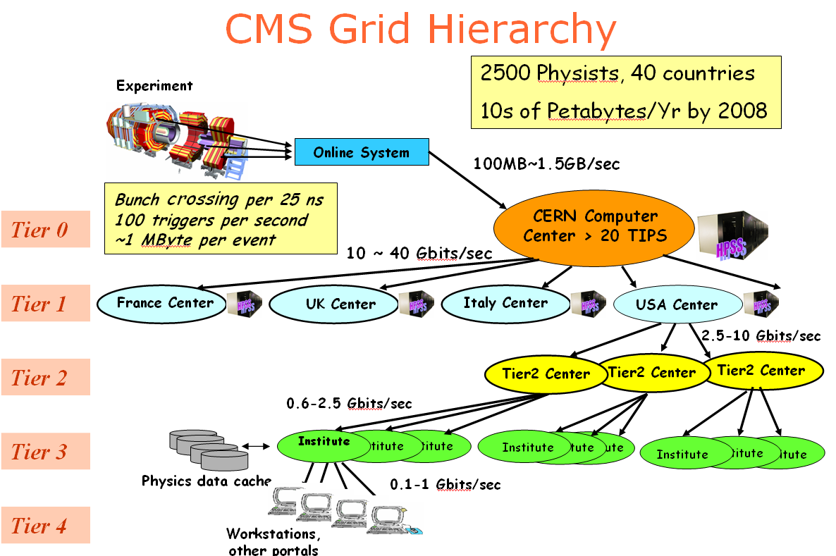
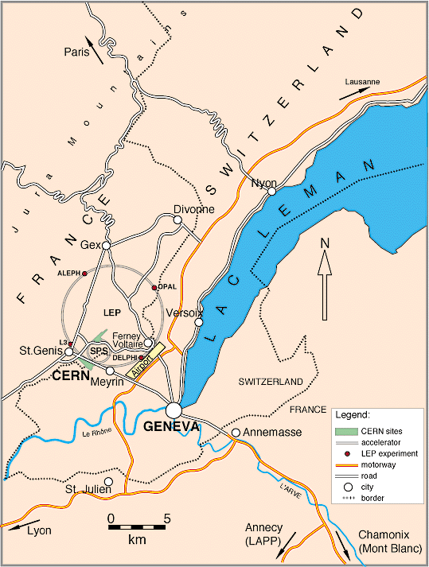
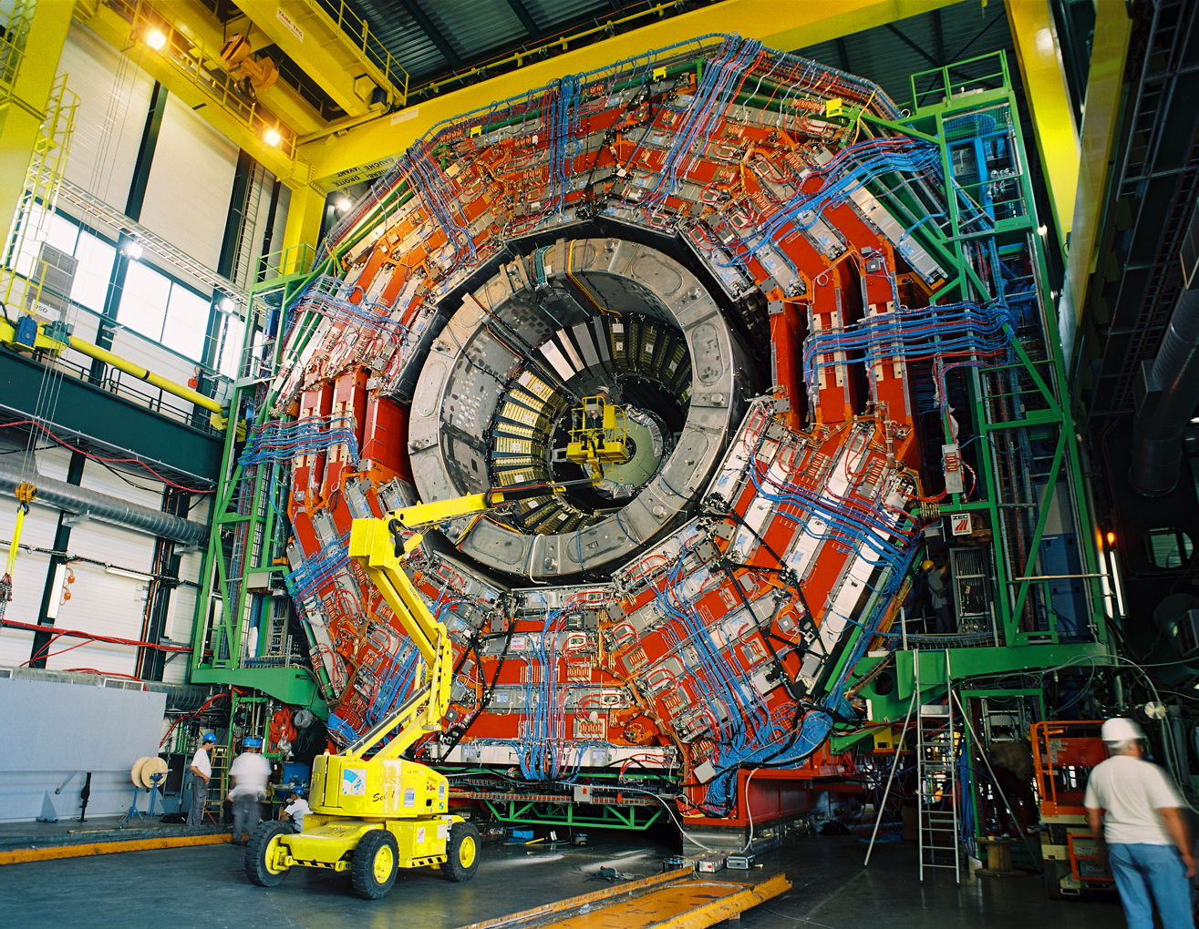
Introduction - Example
Samer Al-Kiswany
/26
EuroPar ‘07

Slide 4
Question ?
Data dissemination solutions: IP-Multicast, Bullet, BitTorrent, SPIDER, OMNI, ALMI, Logistical-Multicast, Narada, Scribe, Grido, FastReplica… and many others.
What data dissemination strategies perform best in today's Grids deployments?
Samer Al-Kiswany
/26
EuroPar ‘07

Slide 5
Roadmap
What data dissemination strategies perform best in today's Grids deployments?
Workload characteristics
Evaluation
Recommendations
Deployment platform characteristics
Data dissemination proposed solutions
Samer Al-Kiswany
/26
EuroPar ‘07

Slide 6
Workload and Deployment Platform
Data-intensive scientific collaboration characteristics:
Scale of data: massive data collections (TeraBytes)
Data usage: Uniform popularity distributions, and co‑usage
Deployment platform characteristics:
Resource availability: low churn rate, high node availability,
well-provisioned networks.
Collaborative environments: no freeriding,
thus less effort is needed to control fair resource sharing
Samer Al-Kiswany
/26
EuroPar ‘07

Slide 7
Roadmap
What data dissemination strategies perform best in today's Grids deployments?
Workload characteristics
Evaluation
Recommendations
Deployment platform characteristics
Data dissemination proposed solutions
Samer Al-Kiswany
/26
EuroPar ‘07

Slide 8
Classification of Approaches
Technique | Protocol
Tree based techniques | ALM and SPIDER
Swarming | Bullet and BitTorrent
Techniques employing intermediate storage capabilities | Logistical Multicasting
Base Cases:
IP-Multicast.
Parallel transfers: separate data channels from the source to each destination.
Samer Al-Kiswany
/26
EuroPar ‘07

Slide 9


Separate Transfer from the Source to every Destination
Drawbacks:
Overwhelms the source – does not scale
Generates high duplicate traffic at the links around the source
Does not exploit all available transport capacity.
/26

Slide 10
IP Multicasting
10
10
10
10
5
5
10
10
10
10
10
10
10
10
10
10
10
10
10
10
10
10
10
10
/26

Slide 11
IP Multicast
Drawbacks:
Limited deployment
Vulnerability to nodes failures
Does not exploit all available transport capacity.
Throughput limited by bottleneck link
10
10
5
10
10
10
10
10
10
10
10
10
/26

Slide 12
Tree Based Techniques: Application Level Multicast (ALM)
Source
Source
1
5
6
6
4
3
2
ALM Tree
1
5
2
4
3
/26

Slide 13
Tree Based Techniques: Application Level Multicast (ALM)
Source
Source
Drawbacks:
1
5
Vulnerability to nodes failures
Does not exploit all possible routes in the network.
6
6
4
3
2
ALM Tree
1
5
2
4
3
/26

Slide 14
Swarming Techniques: BitTorrent and Bullet
Complete file
1
2
3
4
4
1
2
3
/26

Slide 15
Swarming Techniques: BitTorrent and Bullet
Complete file
1
2
3
4
4
4
1
2
1
2
1
3
3
/26

Slide 16
Swarming Techniques: BitTorrent and Bullet
Complete file
1
2
3
4
Drawbacks:
Generates high duplicate traffic.
3
4
1
2
1
2
1
3
4
/26

Slide 17

Logistical Multicasting
/26

Slide 18
Roadmap
Question: What data dissemination strategies perform best in today's Grids deployments?
Workload characteristics
Evaluation Approaches:
Evaluation
Recommendations
Analytical Modeling
Deployment platform characteristics
Implementation
Simulation
Data dissemination proposed solutions
Samer Al-Kiswany
/26
EuroPar ‘07

Slide 19
Methodology
Simulator Design:
Block-level simulation.
Simulates physical layer link-contention
Inputs:
Real topologies of three deployed Grid testbeds: LCG, GridPP, EGEE.
Generated topologies: ∼100 (using BRITE)
Samer Al-Kiswany
/26
EuroPar ‘07
Notes:
You can make the graph appear when you talk about real topologies

Slide 20
Methodology
Success criteria | Metrics
Dissemination time | Transfer time.
Overhead | MB x hop
Load balancing | Volume of in/out data.
Fairness | Link stress
Samer Al-Kiswany
/26
EuroPar ‘07

Slide 21
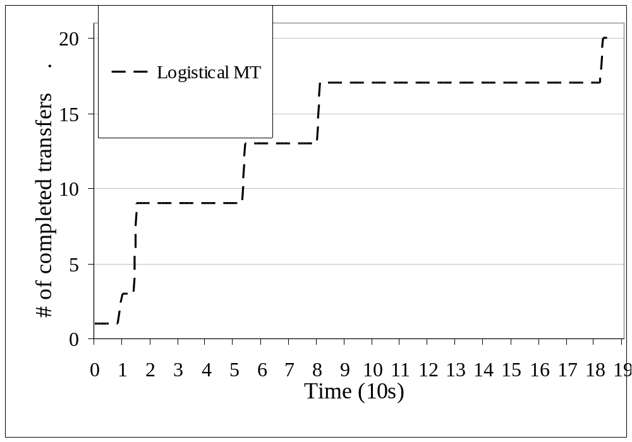
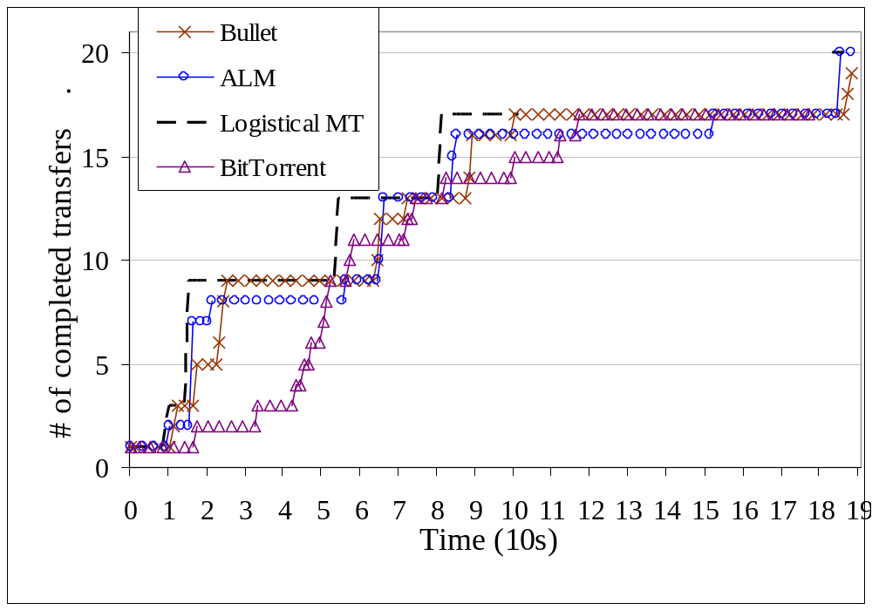
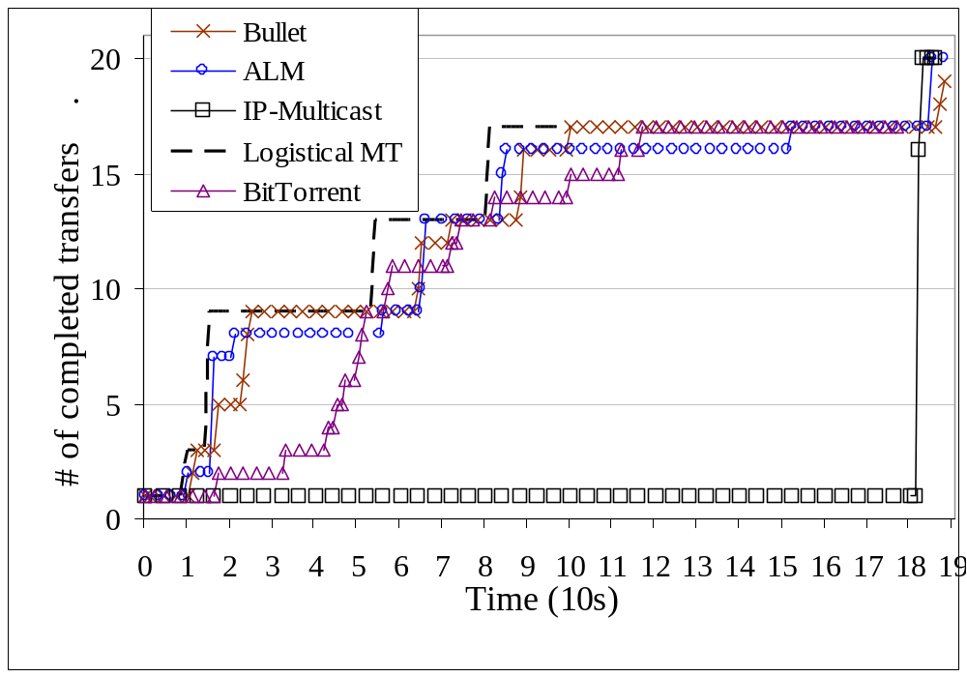
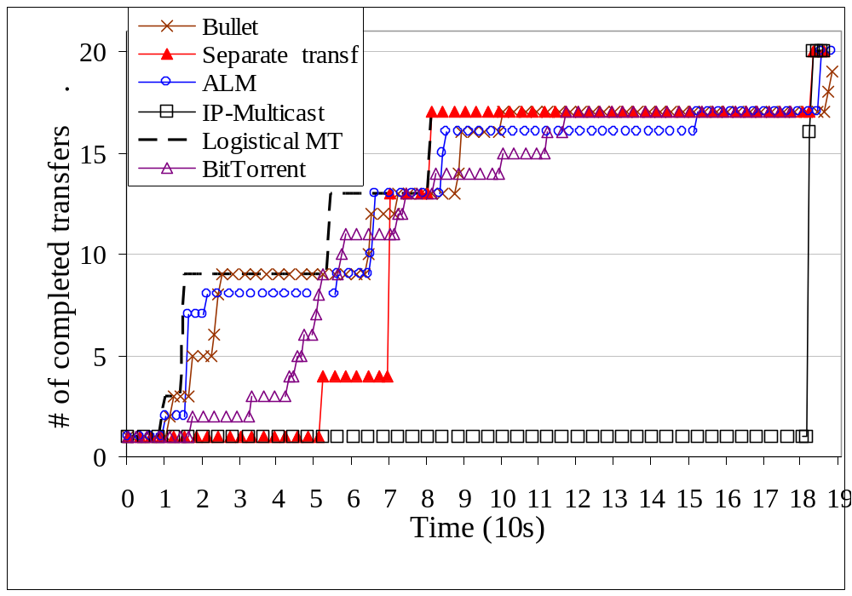
Transfer Time
Number of destinations that have completed the file transfer for the original EGEE topology.
Samer Al-Kiswany
/26
EuroPar ‘07

Slide 22
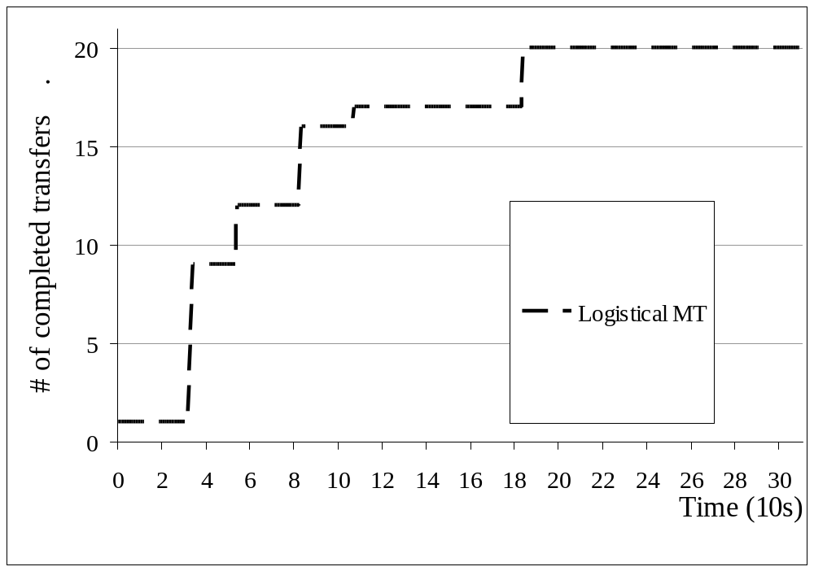
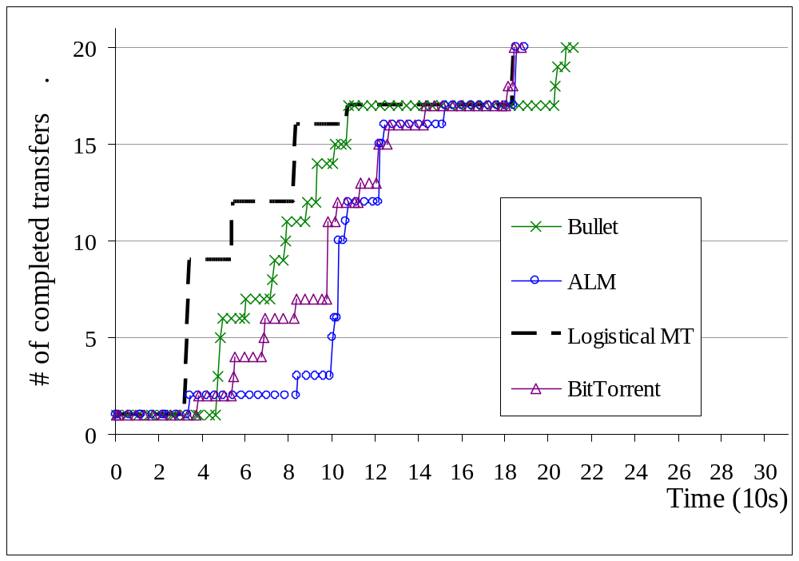
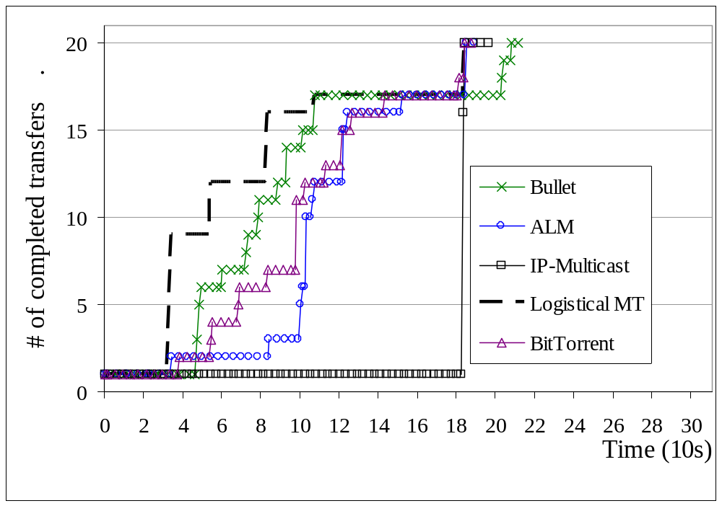
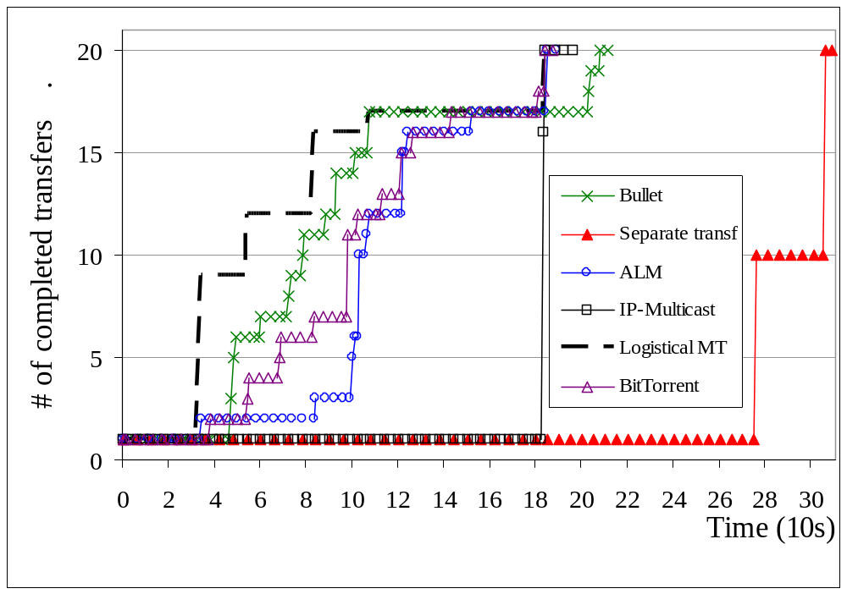
Transfer Time – With reduced core-link bandwidth
Conclusions:
On well-provisioned topologies even naïve algorithms perform well.
On constrained topologies application‑level techniques perform uniformly well: are among the first to finish the transfer with good intermediate progress,
Number of destinations that have completed the file transfer – EGEE topology with core bandwidth reduced to ¹/₈ of the original one.
Samer Al-Kiswany
/26
EuroPar ‘07

Slide 23
Protocol Overhead – Metric Definition
Useful
1
1
Duplicate
Useful
Samer Al-Kiswany
/26
EuroPar ‘07

Slide 24
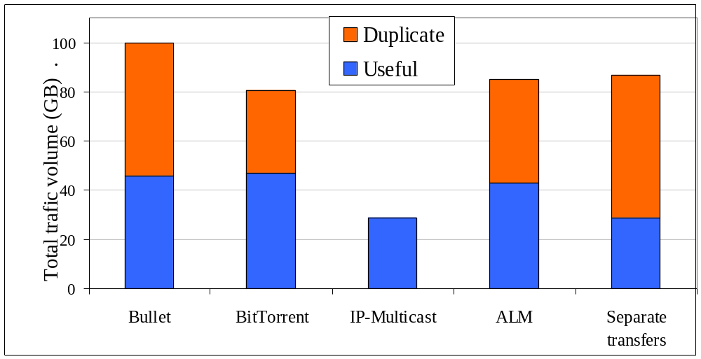
Protocol Overhead
Conclusion:
Application-level techniques generates significant overheads. Up to 4 times more than IP layer solutions.
Reasons:
The dissemination decisions is based on application level metrics.
Ignore node topology location.
Overhead of each protocol on EGEE Topology.
Samer Al-Kiswany
/26
EuroPar ‘07

Slide 25
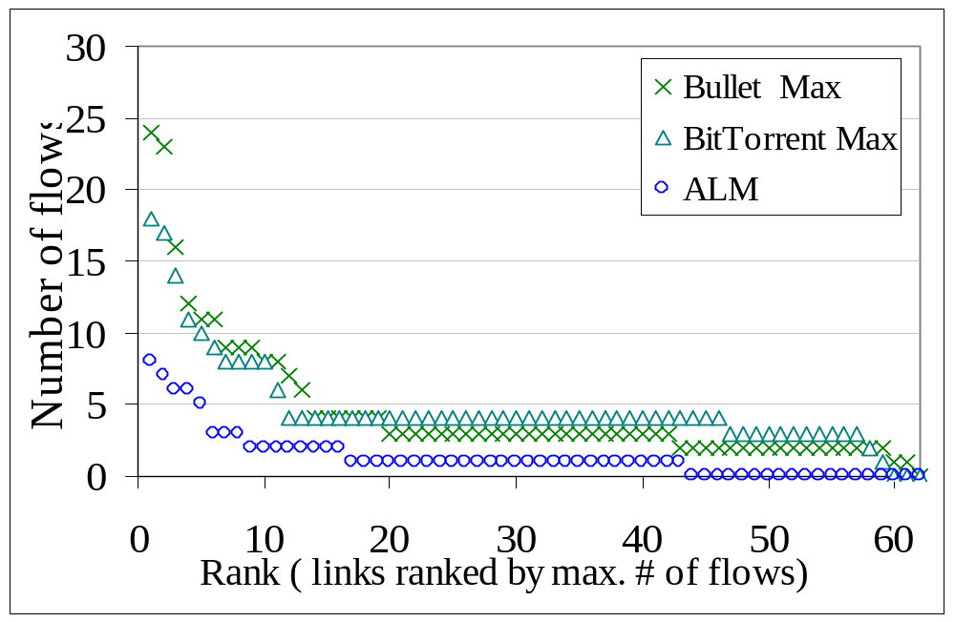
Fairness
Conclusion:
Application‑level solutions have a considerable impact on competing traffic.
Link stress distribution for the EGEE topology. For BitTorrent and Bullet the plot presents maximum link stress.
Samer Al-Kiswany
/26
EuroPar ‘07

Slide 26
Summary
Motivating question: What data dissemination strategies perform best in today's Grids deployments?
In this project, we:
Simulated representative solutions.
  Considering the characteristics of the workload and deployed platforms
Our results provide guidelines for selecting the data dissemination technique, depending on the:
  Target environment.
  Overall system workload characteristics.
  Success Criteria.
Samer Al-Kiswany
/26
EuroPar ‘07

Slide 27

Thank you
www.ece.ubc.ca/~samera

