Slide 1
Content Reuse and Interest Sharing in Tagging Communities
Elizeu Santos-Neto
Matei Ripeanu
Univesity of British Columbia
Adriana Iamnitchi
University of South Florida

Slide 2
Motivation
There is a growing interest in leveraging collective behavior in tagging communities
  e.g., recommendation, spam detection
To date, no quantitative study available that…
  estimates collaboration levels in tagging communities
  evaluates the impact of observed levels on applications
Our finding: collaboration levels are low!

Slide 3
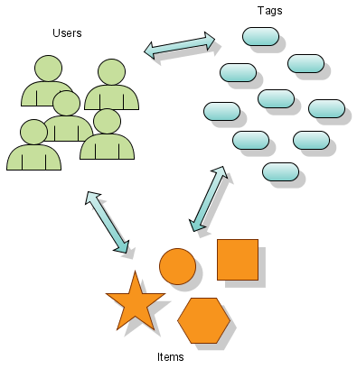
Tagging Communities
Users collect items and annotate them with tags
Items can be URLs, photos, citation records, blog posts, etc…

Slide 4
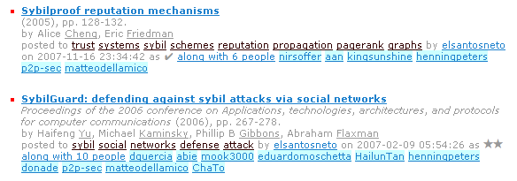
Example - CiteULike
Tags
Item
User
Other Users

Slide 5
Goals
Assess the levels of collaboration
  Define metrics
  Analyze real communities (CiteULike and Connotea)
Discuss the impact of collaboration levels on
  Recommendation systems
  Detection of malicious behavior (e.g. tag spam)

Slide 6
Metrics to assess collaboration
Content Reuse
  Percentage of activity that refer to existing items (or tags)
Interest Sharing
  The level of overlapping between the set of items (or tags) of two users

Slide 7
Data Sets
 | CiteULike | Connotea
Users | ~21K | ~10K
Items (unique) | ~625K | ~267K
Tags (unique) | ~188K | ~110K
Tag Assignments | ~3.3M | ~890K
Activity trace since communities conception
  Traces represent more than 2 years of activity
  Explicit activity only (no browsing histories or click traces)
Data collection
  CiteULike: publicly available trace
  Connotea: our own crawler

Slide 8
Item Reuse
CiteULike
Connotea
Notes:
Add a plot with the # of tagging assignments

Slide 9
User Activity

Slide 10
Tag Reuse

Slide 11

Interest Sharing
Ana
Eve
Items
Tags
Otto

Slide 12
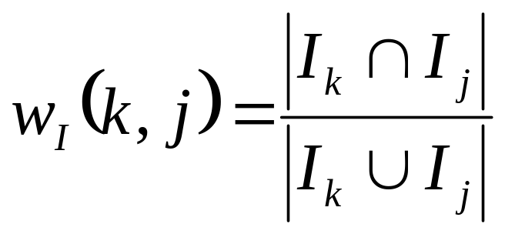
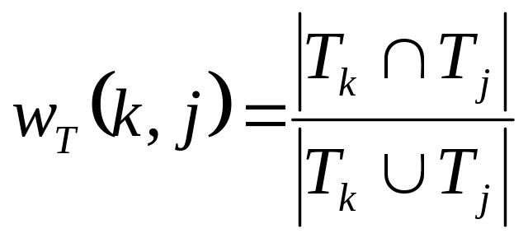
Interest Sharing - Definition
Intuition
  User similarity based on their activity
Metric: Jaccard Index
Definitions
  Item-based
  Tag-based

Slide 13
Interest Sharing - Results
 | CiteULike |  | Connotea
 | Item-based | Tag-based | Item-based | Tag-based
No Interest Sharing | 99% | 98% | 98% | 98%
Average | 7.6% | 13.1% | 4.5% | 2.5%
Median | 2.3% | 2.2% | 0.9% | 1.4%
Standard Deviation | 16.7% | 27.2% | 11.2% | 4.7%
Interest sharing level is low for both communities
Observed interest sharing values are dispersed
Notes:
- Percentage of ZERO INTEREST SHARING in the table above

Slide 14
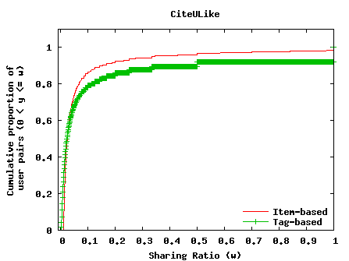
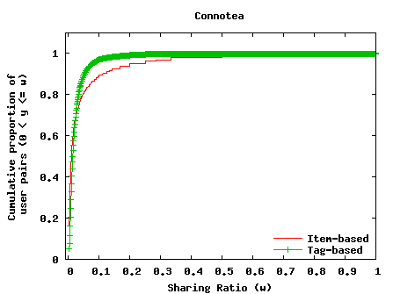
Interest Sharing – Results (2)
The interest sharing levels are concentrated around low values
Notes:
Larger labels…

Slide 15
Impact on System Design
Collaboration levels are low
  What is the impact on systems design?
Recommendation systems
  New item problem
  Data set sparsity
Misbehavior detection
  It is harder to detect legitimate behavior

Slide 16
Summary
Assess collaboration levels
  Content Reuse and Interest Sharing
Collaboration levels: lower than expected
Impact on recommendation and spam detection
Future Work
Other formulations of similarity
  E.g., rare items = stronger similarity: Adamic-Adar Index
Does the content type influence collaboration?
Evaluate the impact on anti-spam techniques
What is the role of different relationship types?

Slide 17
Questions
http://netsyslab.ece.ubc.ca

Slide 18
Interest Sharing Structure
Interest sharing graph
  Users are nodes
  Connected if their pair wise interest sharing is not zero
 | CiteULike (21,980 nodes) |  | Connotea (10,667 nodes)
 | Item-based | Tag-based | Item-based | Tag-based
Singleton nodes | 9,737 | 599 | 5,695 | 859
Connected components (excluding singletons) | 767 | 8 | 226 | 14
Nodes in the largest component | 8,636 | 21,369 | 4,205 | 9,782
Largest component density | 0.0121 | 0.1703 | 0.0131 | 0.0995

Slide 19
Interest Sharing Dynamics - Results
Connotea

Slide 20
Interest Sharing Over Time

