Slide 1
To Blog or Not to Blog: Characterizing and Predicting Retention in Community Blogs
Imrul Kayes¹, Xiang Zuo¹, Da Wang², Jacob Chakareski³
¹University of South Florida
²Hubei University of Technology
³University of Alabama

Slide 2
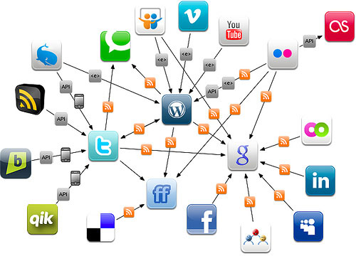
What is a blog?
A blog is a personal journal published on the Web.
Blogs are usually the work of a single individual, occasionally of a small group and often themed on a focused topic.
Blogging platform allow the creation of online profiles to link to other bloggers.
  This blogger to blogger declared social ties create a social network.

Slide 3
The Impacts of Blogs
Blogging has become immensely popular and been widely used.
e.g., WordPress alone is used by over 14.7% out of “top 1 million” websites according to Alexa.
Citizen journalism had high impacts in major events.
e.g., South Asia tsunami, London terrorist bombings and New Orleans Hurricane Katrina.
Blogosphere provides a platform for different aspects of virtual and real life.
e.g., viral marketing, sales prediction and counter terrorism efforts.

Slide 4
Retention Problems in Blog Community
Participation is often sparse and uneven
  One-third of listed users had no interactions during a three-month observation period.
  Contribution churn is high
  Only 11.5% of the users who posted in one month returned to post in the second month.
Cummings et al., 2002
Jones et al., 2004

Slide 5
Research Questions
  What motivates a user to join a blogging community? (well studied in literature)
  What motivates the blogger to continue participating (retention) in the blog community? (our focus)

Slide 6

BlogSter Community
  BlogSter is a blogging community that features specific-interests blogs.
  It is a combination of blogging and social networking.
  Spam-free blogs.

Slide 7
BlogSter Community Data Set
91% of total posts
Type | Nodes | Edges | Connected Components | Posts
Bloggers’ profiles are public | 17,436 | 72,907 | 17 | 329,114
Data collected by using Metropolis-Hastings Random Walk algorithm.
The largest connected component has 14,323 nodes and 64,888 edges, which includes 82% of nodes in the network.
Gjoka et al., 2011

Slide 8
Research Questions on Retention
  Question 1: What variables predict high retention?
  Question 2: How well do these variables predict user retention?

Slide 9
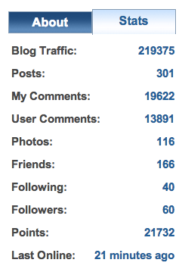
Analyzing Variables Affect Users’ retention in BlogSter
  Predictor Variables (Five categories)
  Network metrics specific variables: centralities, clustering coefficient.
  User activity oriented variables: posts, comments, photos, network age.
  User physiology oriented variables: age, gender.
  Interactional variables: blog traffic, other users’ comments.
  Relational variables: social tie strength, friends retention.
  Output Variable
  Retention = Points

Slide 10
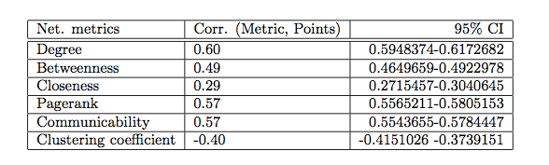
Network metrics and retention
Correlation between network metrics and blog points
Observations:
  The majority of centralities are positively correlated with points
  Degree centrality has the highest correlation with points
  Closeness centrality has the weakest correlation with points
  Clustering coefficient is negatively correlated with points

Slide 11

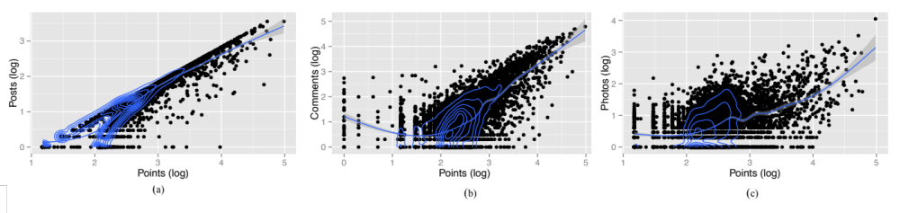
Activities and Retention
Correlation and distribution of users’ activities and points
Observations
  Higher number of posts, comments or photos mean higher blogger points
  The more active a user is, the more point she has.

Slide 12

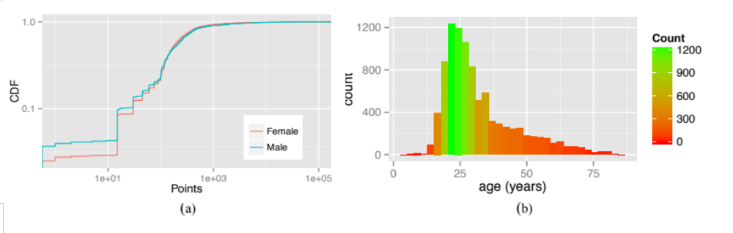
Physiology and retention
Correlation and distribution of physiology and points
  Corr.(age, point) = 0.21, p < 0.05.
Observations
  Male bloggers have higher retention than female bloggers
  Bloggers’ age also has correlation with their retention.

Slide 13
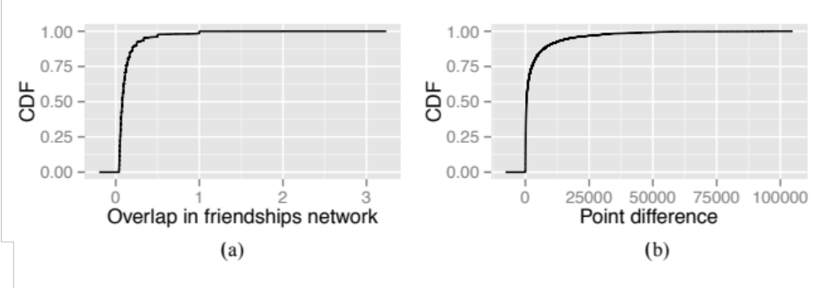

Social Tie and Retention
Distribution of users’ social ties and points
Observations
  Users who are socially close have higher retention similarity

Slide 14
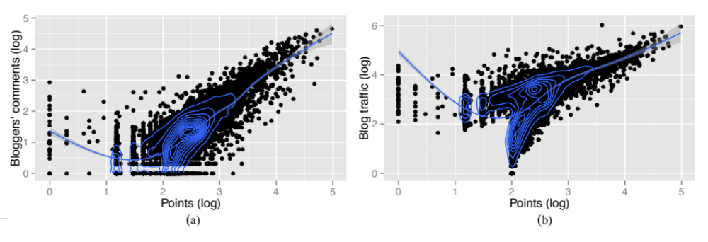
Interaction and Retention
Distribution of users’ interactions and points
Observations
  The more retention a user has, the higher number of comments she gets on her blogs.

Slide 15
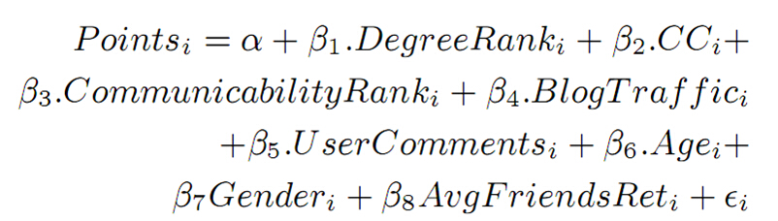
Predicting users’ retention in BlogSter
  Question: Can we use these different types of variables (network metrics, activity metrics, physiological, interactional and relational) to predict user retention?
  A multiple linear regression model:

Slide 16
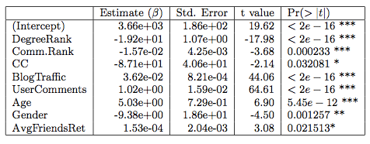
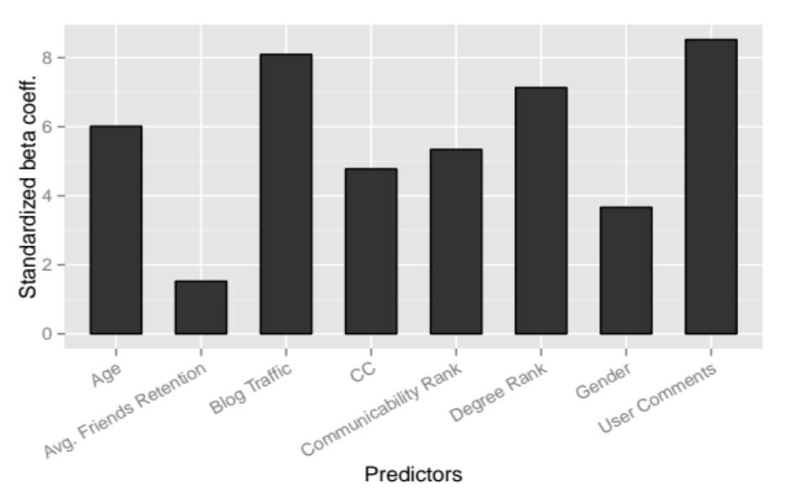
Prediction Results
Adjusted R is 0.837, which implies the model can explain 83.7% of variation around points.
Blog traffic, degree rank and user comments are the most influential predictors.

Slide 17
Summary
Retention in the blog community
Analyzing factors affect users’ retention in blogs
  e.g., users’ network topology attributes, users’ social behaviors, social ties and physiological factors, etc.
Predicting users’ retention with different types of factors
  Build a multiple linear regression model to predict user’s retention
Conclusion
  Male and senior bloggers who have friends with higher retention are more retained in the blog community and also get higher attention from others (reflected by interaction intensity)

Slide 18


