Slide 1
AMAZON S3 FOR SCIENCE GRIDS:
A VIABLE SOLUTION?
Mayur Palankar and Adriana Iamnitchi
University of South Florida
Matei Ripeanu
University of British Columbia
Simson Garfinkel
Harvard University

Slide 2
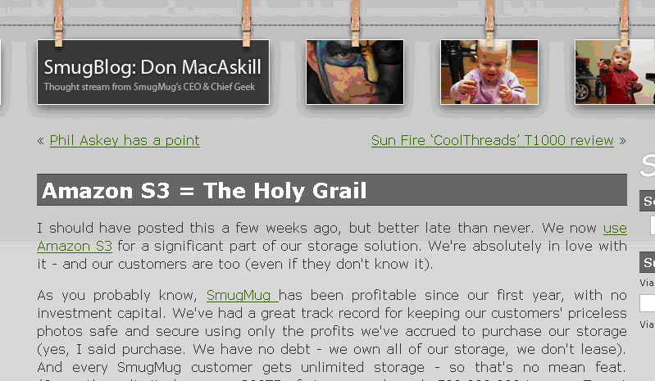



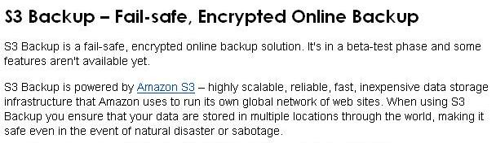

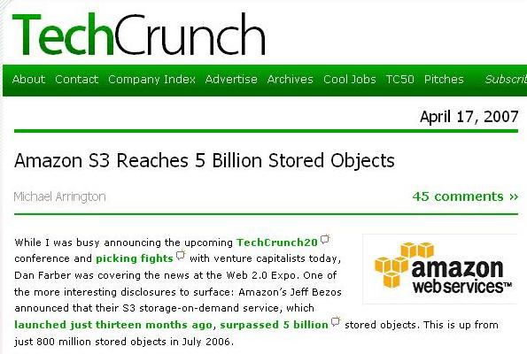
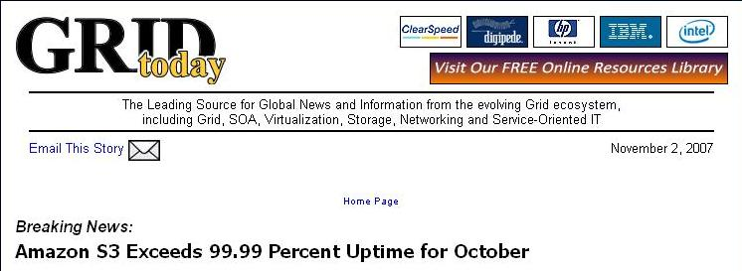


Slide 3
Science Grids
Data-intensive scientific collaborations
Produce, analyze, and archive huge volumes of data (PetaBytes)
  High data management and maintenance costs
  Files are often used by groups of users and not individually
Amazon Simple Storage Service (S3)
Novel storage ‘utility’:
  Direct access to storage
Self-defined performance targets:
  scalable, infinite data durability, 99.99% availability, fast data access
Pay-as-you go pricing:
  $0.15/month/GB stored and $0.10-$0.17/GB transferred
Is offloading data storage from an in-house mass storage system to S3 feasible and cost-effective?
Keeps decreasing

Slide 4
Approach
Characterize S3
  Does it live up to its own expectations?
Toy scenario: evaluate a representative scientific application (DZero) in this context
  Estimate performance and costs
  Is the functionality provided adequate?
Outline
S3 architecture
S3 performance evaluation
Toy scenario: S3-supported DZero: cost and functionality requirements
Lessons/suggested improvements

Slide 5
S3 Architecture
Two-level namespace
  Buckets (think directories)
    Global names
    Two goals: data organization and charging
  Data objects
    Opaque object (max 5GB)
    Metadata (attribute-value, up to 4KB)
Functionality
  Simple put/get functionality
  Limited search functionality
  Objects are immutable, cannot be renamed
Data access protocols
  SOAP
  REST
  BitTorrent

Slide 6
S3 Architecture (…cont)
Security
  Identities
    Assigned by S3 when initial contract is ‘signed’
  Authentication
    Public/private key scheme
    But private key is generated by Amazon!
  Access control
    Access control lists (limited to 100 principals)
    ACL attributes
      FullControl
      Read & Write (objects cannot be written)
      ReadACL & WriteACL (for buckets or objects)
  Auditing (pseudo)
    S3 can provide a log record

Slide 7
Storage Service Requirements for Science Grids
Data durability
Data availability
Access performance
Usability
Support for access control and privacy policies
Low cost
Approach
Characterize S3
  Does it live up to its own expectations?
Toy scenario: evaluate a representative scientific application (DZero) in this context
  Estimate performance and costs
  Is the functionality provided adequate?

Slide 8
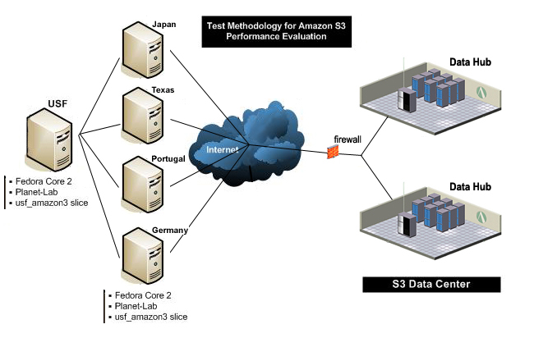
S3 Characterization Methodology
Black-box approach using PlanetLab nodes to estimate:
    durability
    availability
    access performance
    the effect of BitTorrent on cost savings

Slide 9
Evaluating Amazon S3
Durability: perfect
  But limited scale experiment (1 year)
  More than 137,000 requests for 10,000 files
Availability
  From EC2: higher than declared 99.99%
  From over the Internet: 23 weeks of testing
    About 15,456 access requests (every 15 mins)
    Retry protocol, exponential back-off
      95.89% availability after the original access
      98.06% availability after the 1st retry
      99.01% availability after the 2nd retry
      99.76% availability after the 3rd retry
      99.94% availability after the 4th retry
      100% availability after the 5th retry

Slide 10
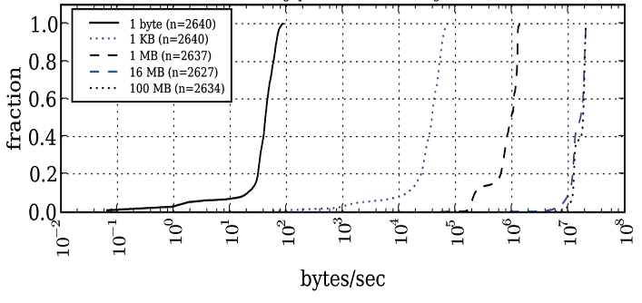
S3 Access Performance:
Single Thread

Slide 11
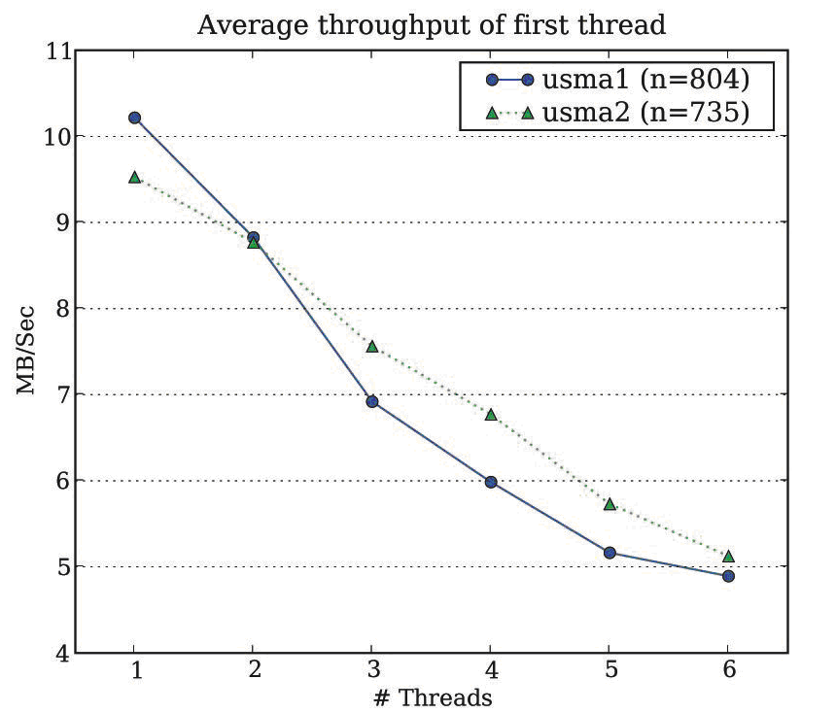
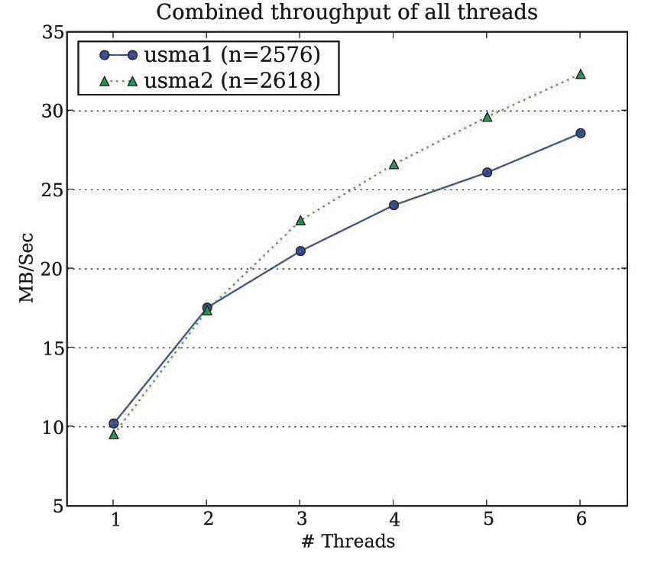
S3 Access Performance:
Multi-Thread

Slide 12
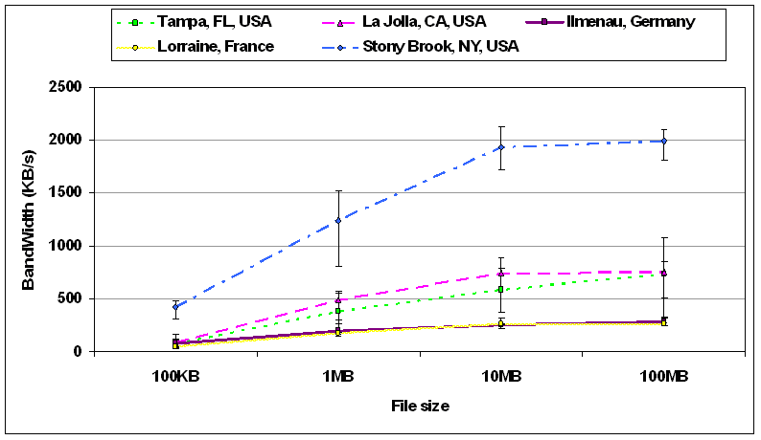
Remote Access Performance

Slide 13
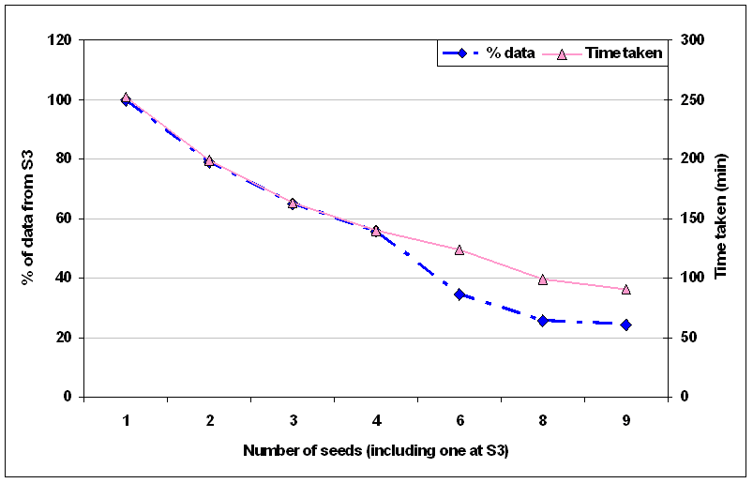
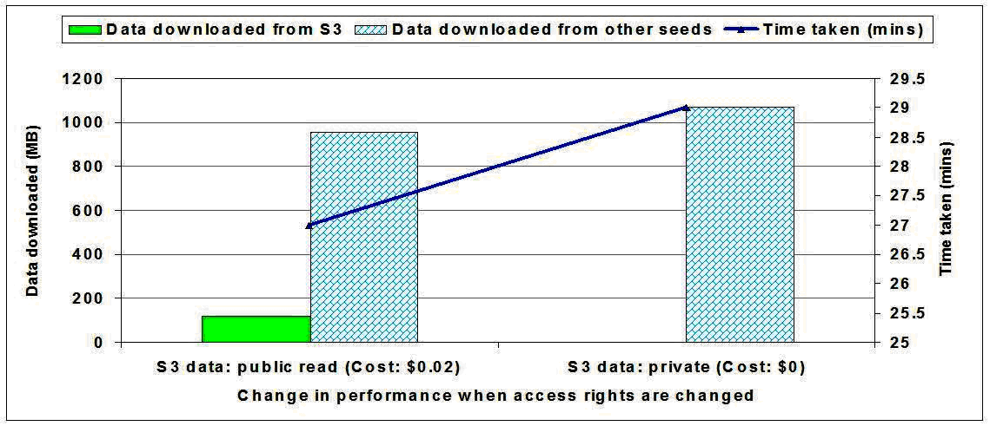
Access Performance via BitTorrent

Slide 14
Approach
Characterize S3
  Does it live up to its own expectations?
Toy scenario: evaluate a representative scientific application (DZero) in this context
  Estimate performance and costs
  Is the functionality provided adequate?

Slide 15
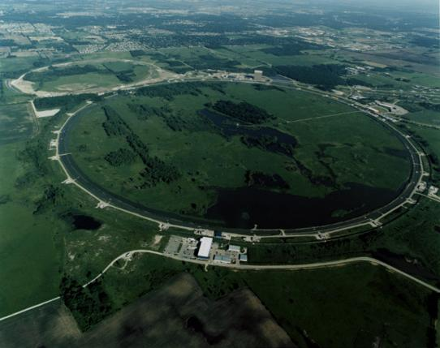

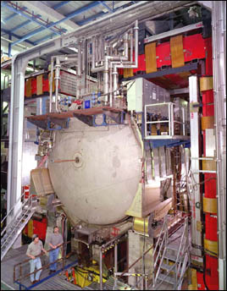
The DØ Experiment
High-energy physics collaboration
Traces from January ‘03 to March ’05 (27 months)
375 TB data, 5.2 PB transferred
Shared data usage: no access control
561 users from 70+ institutions in 18 countries
High intensity data usage: ~550Mbps sustained access rate in DZero
113,062 jobs running for 973,892 hours over the period of 27 months
Trace recording interval | 01/2003 – 03/2005
Number of jobs | 113,062
Hours of computation | 973,892
Total storage volume | 375 TB
Total data processed | 5.2 PB
Average data access rate | 273 GB/hour

Slide 16
S3 Evaluation: Cost
All data stored at S3 and processed by DZero
  Storage cost: $691,000/year ($829,440 for S3-Europe)
  Transfer: $335,012/year
  → $85,500/month
Reducing transfer costs:
  Caching:
    50TB cooperative cache: $43,888 per year in transfer costs (~10 times lower)
  BitTorrent and distributed replicas
  Use EC2: Replace transfer costs with $43,284/year
Reducing storage costs:
  Archive cold data
    lifetime of 30% files < 24 hours, 40% < a week, 50% < a month
  Throw away derived data
    Distinguish between raw and derived data
Notes:
Hypothetical scenario:
S3 used by a high-performance application – DZero

Slide 17
Key Idea: Unbundling performance characteristics
High availability, high durability, high performance are bundled at a single pricing point.
Some applications need only one or two of them
  A cache: availability and access performance
  A backup solution (for DZero): durability and availability
Solution: SLAs that allow the user to specify their requirements and chose pricing point.

Slide 18
Unbundling Performance Characteristics
Application class | Durability | Availability | High performance data access
Cache | No | Depends | Yes
Long-term archival | Yes | No | No
Online production | No | Yes | Yes
Batch production | No | No | Yes
The resources needed to provide high performance data access, high data availability and long data durability are different

Slide 19
S3 Evaluation: Security
Risks
  Traditional risks with distributed storage are still a concern:
    Permanent data loss,
    Temporary data unavailability (DoS),
    Loss of confidentiality
    Malicious or erroneous data modifications
  New risk: direct monetary loss
    Magnified as there is no built-in solution to limit loss
Security scheme’s big advantage: it’s simple
… but has limitations
  Access control
    Hard to use ACLs in large systems – needs at least groups (now available)
    ACLs limited to 100 principals
  No support for fine grained delegation
  Implicit trust between users and the service S3
    No support for un-repudiabiliy
  No tools to limit risk

Slide 20
Lessons: Suggested Improvements
To lower costs: unbundle performance characteristics
  High availability, High durability, High performance are bundled at a single pricing point.
  Some applications need only one or two of them
  Solution: SLAs that allow the user to specify their requirements and chose pricing point.
To provide specific support for science collaborations
  Better security support for complex collaborations
  Additional functionality for better usability:
    Metadata based searches
    Renaming and mutating objects
  Relax hard-coded limitations: 100 buckets, 100 users in ACL, etc.
Lesson for application integrators: Use application-level information to reduce costs
  Raw vs. derived data
  Exploit usage patterns: e.g., data gets cold.
The answer: not yet.

Slide 21
Thank you

