Slide 1
File Grouping for
Scientific Data Management:
Lessons from Experimenting with Real Traces
Shyamala Doraimani* and Adriana Iamnitchi
University of South Florida
anda@cse.usf.edu
*Now at Siemens

Slide 2
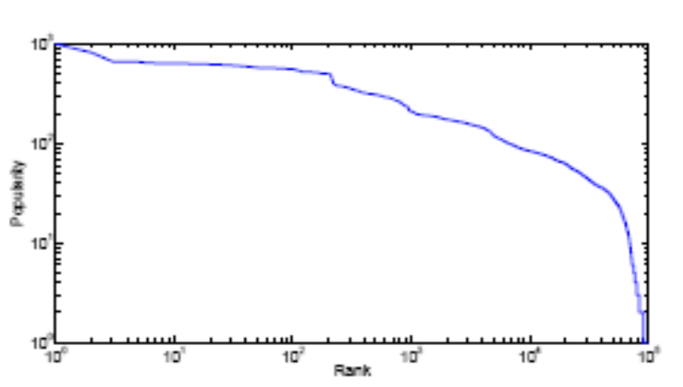
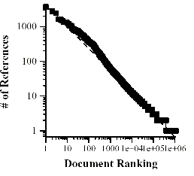
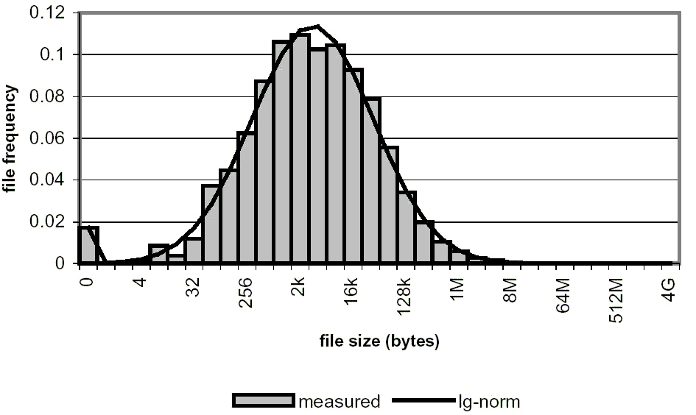
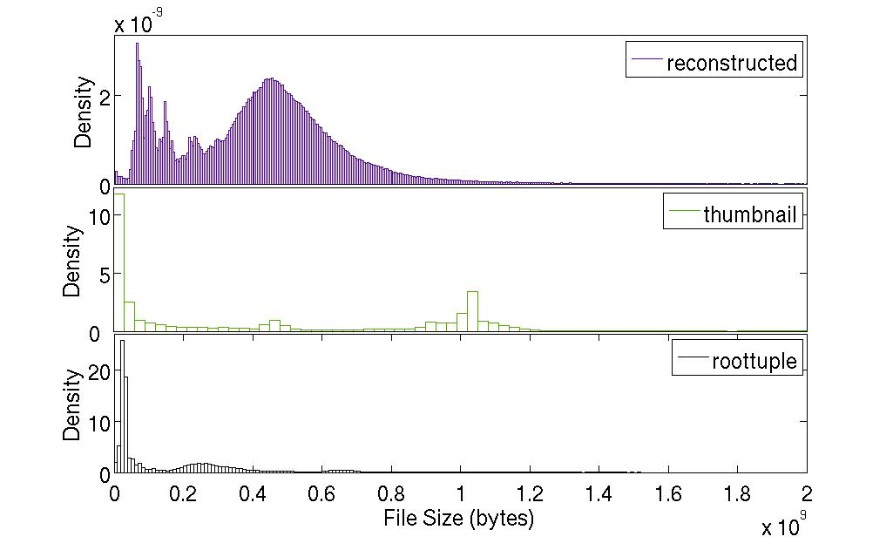
Real Traces or
Lesson 0: Revisit Accepted Models
File popularity distributions
Expected: Zipf.
Why not:
  Scientific data is uniformly interesting
File size distribution
Expected: log-normal. Why not?
  Deployment decisions
  Domain specific
  Data transformation

Slide 3
Objective: analyze data management (caching and prefetching) techniques using workloads:
  Identify and exploit usage patterns
  Compare solutions using realistic and the same workloads
Outline:
Workloads from the DZero Experiment
Workload characteristics
Data management: prefetching, caching and job reordering
Lessons from experimental evaluations
Conclusions
Notes:
Contributions:
A set of recommendations for workload modeling for data management in science grids based on our experiments with real traces. We acknowledge that one set of real traces cannot provide a workload model general enough to fit other domains and diverse applications. However, it is enough to prove that generalizing previously accepted patterns (such as file size and popularity distribution) from systems such as the Web or filesystems is not appropriate.
A set of design recommendations for data staging for distributed collaborations, such as preserving time locality and enforcing the role of job reordering.
Our previous analysis of the DZero traces showed the existence of filecules [fil’-eh-kyul’], that are groups of files always used together in data processing jobs. We show that a simple and well-understood caching algorithm (i.e., least recently used) that uses filecules has significant advantages over more sophisticated caching techniques. We identify the property of the traces that leads to this performance difference and make a set of recommendations for accurate workload modeling.
An implementation and comparison of previously proposed caching mechanisms to quantify the relative benefit of each solution on real traces. We took the trouble of implementing previously proposed solutions to better understand them and accurately compare them with other approaches on the set of real traces available for our study.

Slide 4
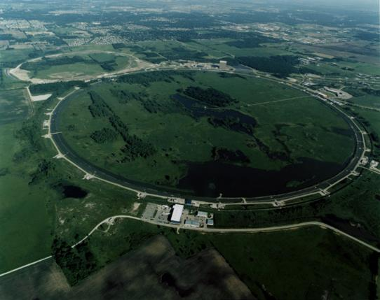

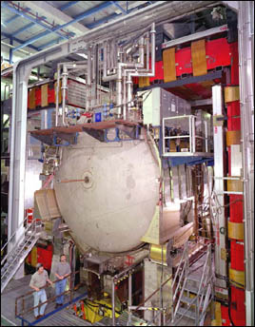
The DØ Experiment
High-energy physics data grid
72 institutions, 18 countries, 500+ physicists
Detector Data
  1,000,000 Channels
  Event rate ~50 Hz
Data Processing
  Signals: physics events
  Events about 250 KB, stored in files of ~1GB
  Every bit of raw data is accessed for processing/filtering
DØ:
  … processes PBs/year
  … processes 10s TB/day
  … uses 25% – 50% remote computing

Slide 5
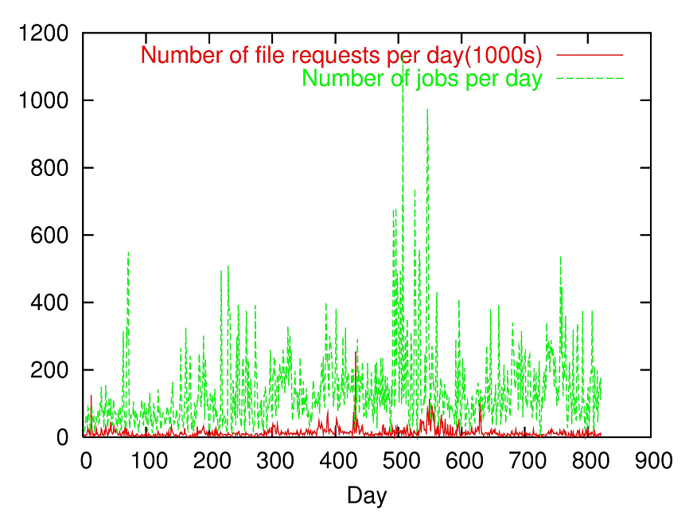
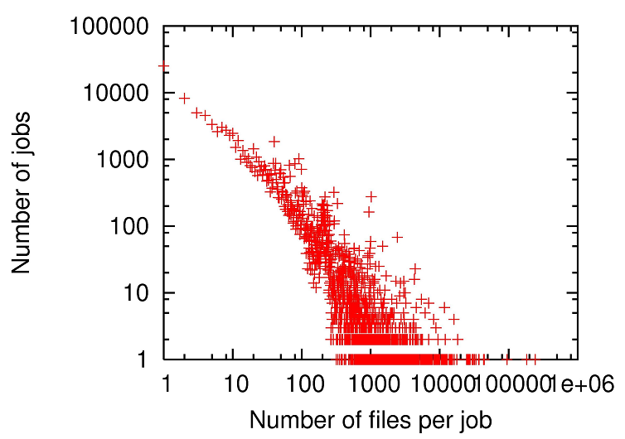
DØ Traces
Traces from January 2003 to May 2005
Job, input files, job running time, input file sizes
113,062 jobs
499 users in 34 DNS domains
996,227 files
102/files per job on average

Slide 6
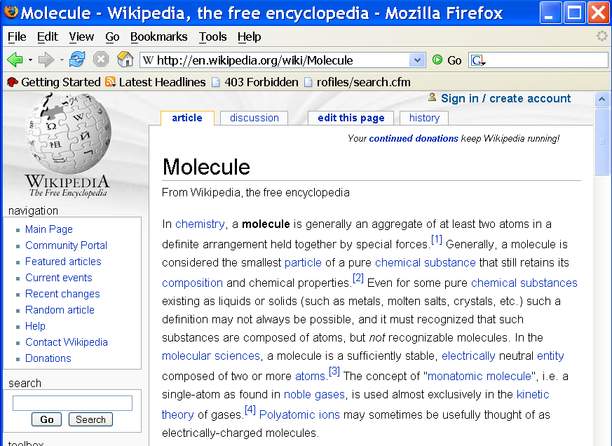
Filecules: Intuition
“Filecules in High-Energy Physics: …”, Iamnitchi, Doraimani, Garzoglio, HPDC 2006
Notes:
Filecule: an aggregate of one or more files in a definite arrangement held together by special forces related to their usage.
The smallest unit of data that still retains its usage properties.
One-file filecules as the equivalent of a monatomic molecule, (i.e., a single-atom as found in noble gases) in order to maintain a single unit of data.
Properties:
Any two filecules are disjoint
A filecule contains at least one file
The popularity of a filecule is equal to the popularity of its files

Slide 7
Filecules: Intuition and Definition
Filecule: an aggregate of one or more files in a definite arrangement held together by special forces related to their usage.
  The smallest unit of data that still retains its usage properties.
  One-file filecules as the equivalent of a monatomic molecule, (i.e., a single-atom as found in noble gases) in order to maintain a single unit of data.
Properties:
  Any two filecules are disjoint
  A filecule contains at least one file
  The popularity of a filecule is equal to the popularity of its files

Slide 8
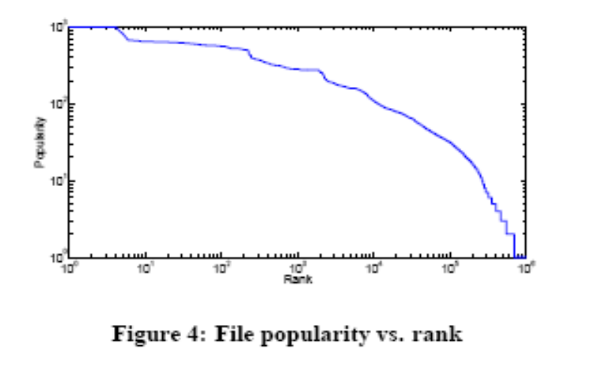
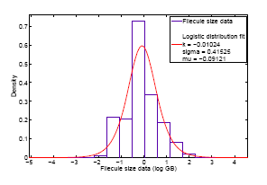
Workload Characteristics
Popularity Distributions
Size Distributions

Slide 9
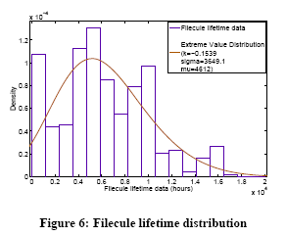
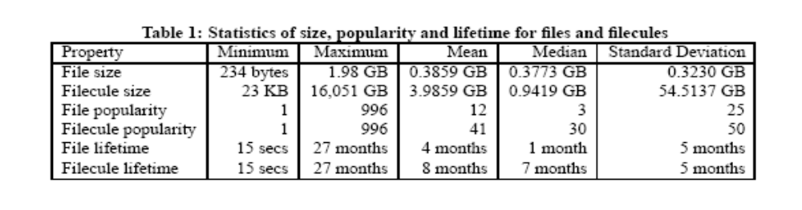
Characteristics
Lifetime of:
30% files < 24 hours;
40% < a week;
50% < a month

Slide 10
Data Management Algorithms
Algorithm | Caching | Scheduling | File grouping/ prefetching
File LRU | LRU | FCFS | None
Filecule LRU | LRU | FCFS | Filecule
GRV | GRV | GRV | GRV
LRU-GRU (a.k.a. LRU-Bundle) | LRU | GRV | None
Performance metrics:
  Byte hit rate
  Percentage of cache change
  Job waiting time
  Scheduling overhead

Slide 11
Greedy Request Value (GRV)
Introduced in “Optimal file-bundle caching algorithms for data-grids”, Otoo, Rotem and Romosan, Supercomputing 2004
Job reordering technique that gives preference to jobs with data already in the cache:
  Input files receive a value = f(size, popularity)
      α(f_{i}) = size(f_{i})/popularity(f_{i})
  Jobs receive a value based on their input files
      β(r(f₁…f_{m})) = popularity((f₁…f_{m}))/Σ(α(f_{i}))
  Jobs with highest values scheduled first

Slide 12
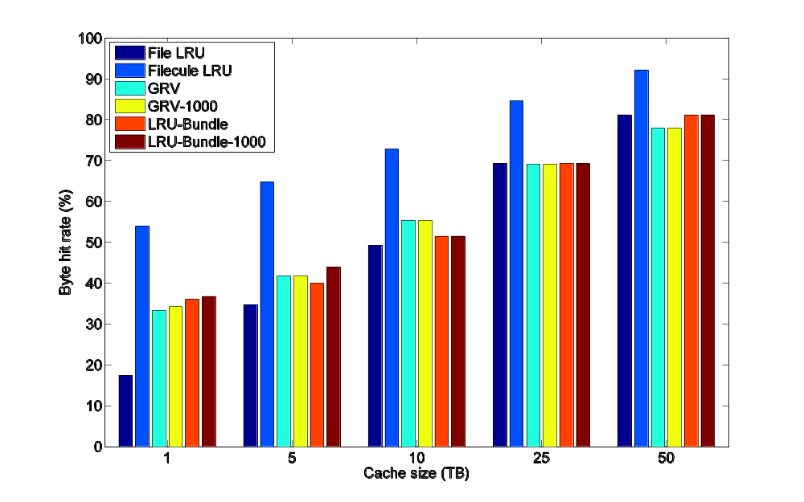
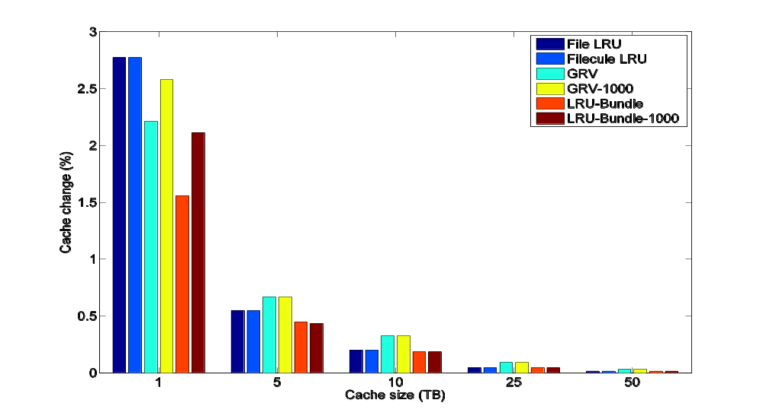
Experimental evaluations
Percentage of Cache Change
Average Byte Hit Rate
1 TB ~ 0.3%, 5 TB ~ 1.3%, 50TB ~ 13% of total data

Slide 13
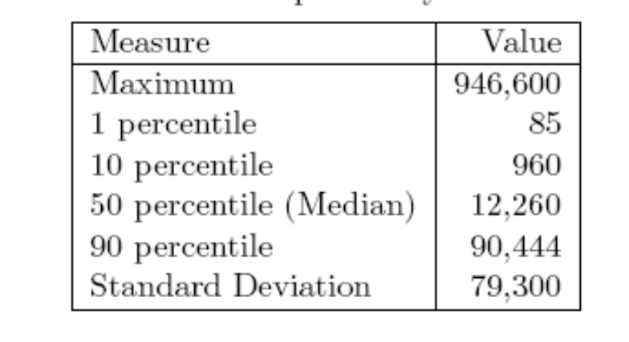
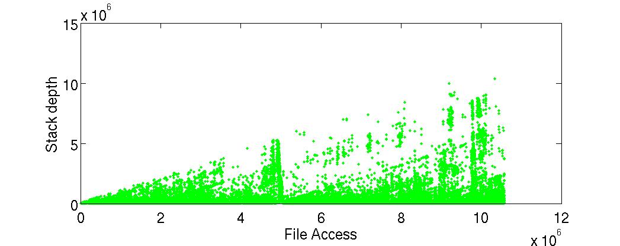
Lesson 1: Time Locality
All stack depths smaller than 10% of files

Slide 14
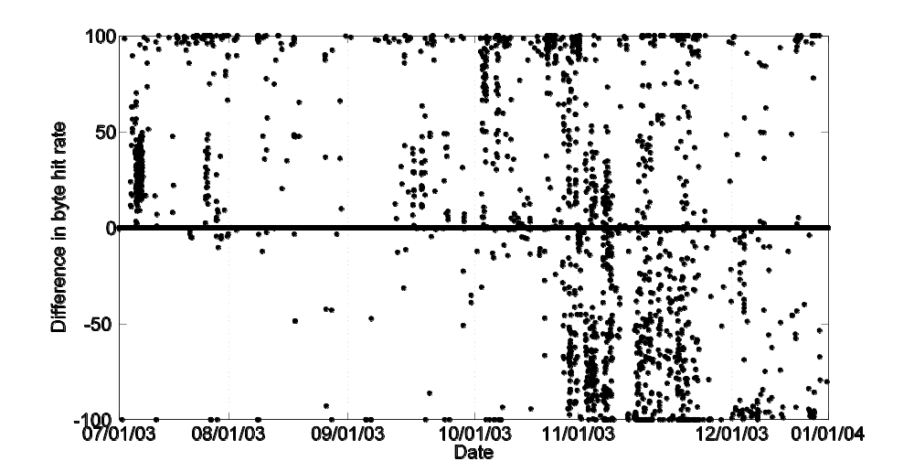
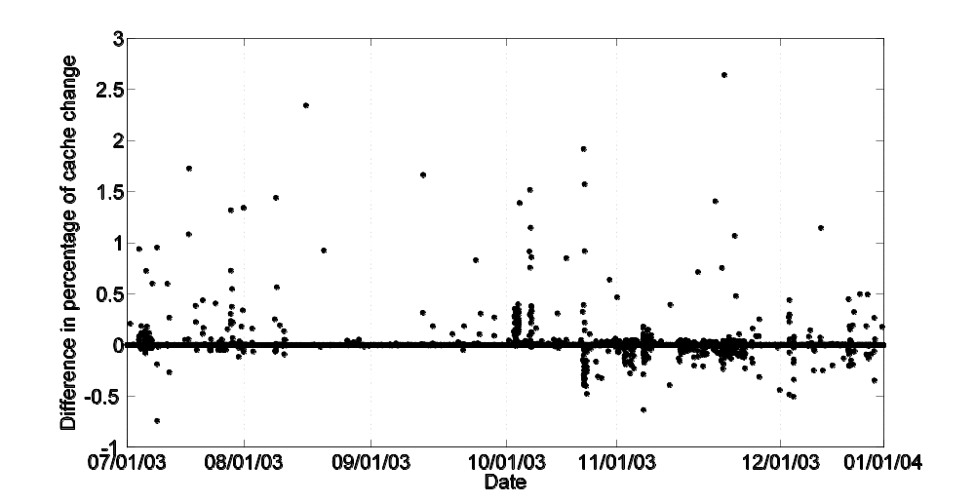
Lesson 2: Impact of History Window for Filecule Identification
Byte hit rate:
92% jobs have same
- equal relative impact for the rest
1 month vs. 6-month history
Cache change: < 2.6%

Slide 15
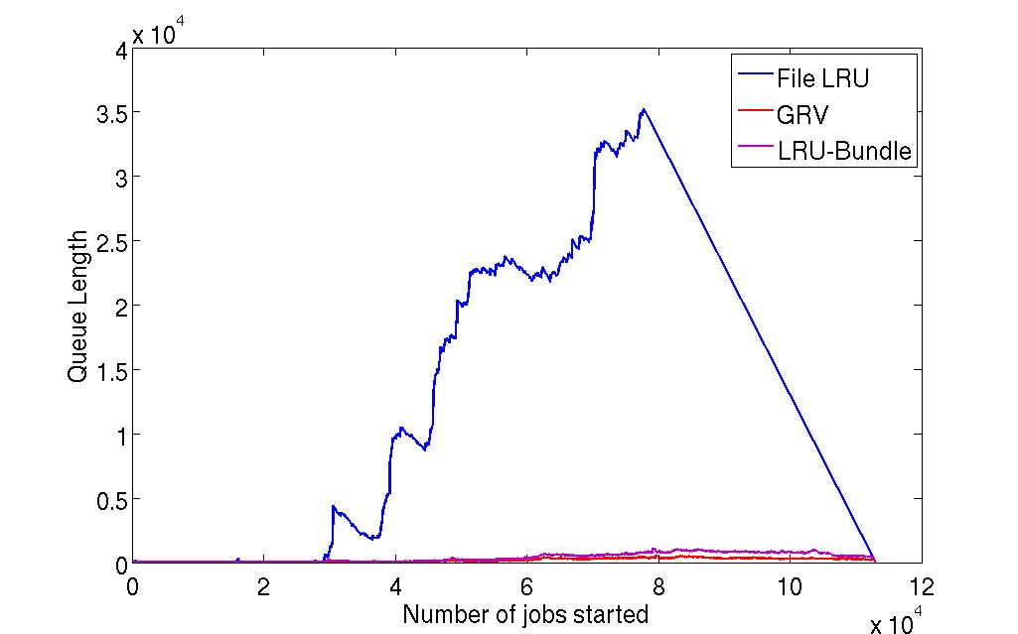
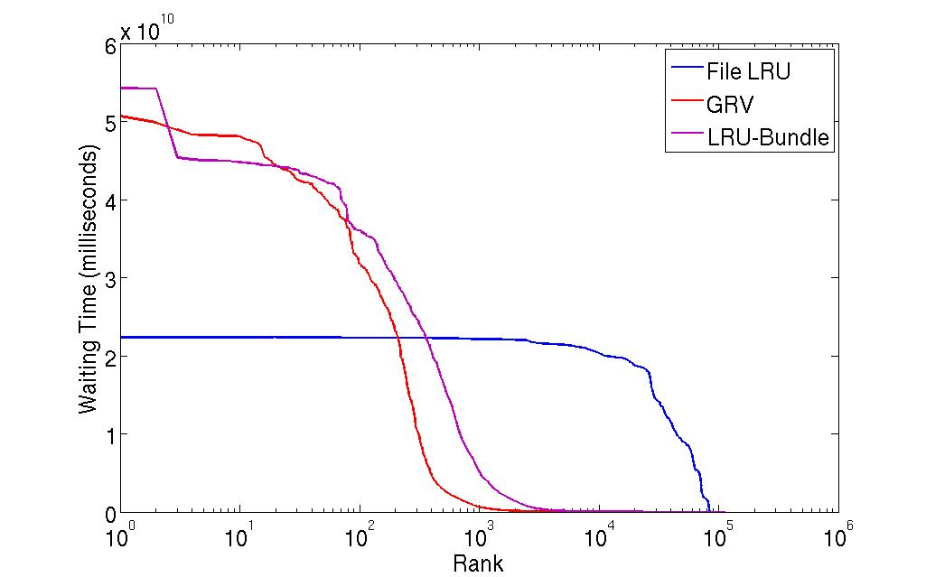
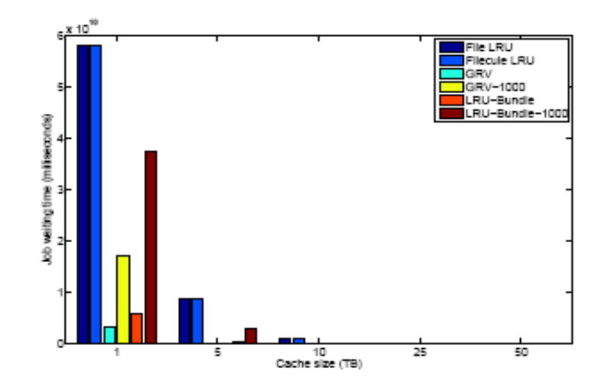
Lesson 3: the Power of Job Reordering

Slide 16
Summary
Revisited traditional workload models
  Generalized from file systems, the web, etc.
  Some confirmed (temporal locality), some infirmed (file size distribution and popularity)
Compared caching algorithms on D0 data:
  Temporal locality is relevant
  Filecules guide prefetching
  Job reordering matters (and GRV is a good solution)
Metric | Best Algorithm
Byte hit rate | Filecule LRU
% Cache change | LRU-Bundle
Job Waiting time | GRV
Scheduling overhead | File and Filecule LRU (FCFS)

Slide 17
Thank you anda@cse.usf.edu

