Slide 1
P2P Systems Meet Mobile Computing
A Community-Oriented Software Infrastructure for Mobile Social Applications
Cristian Borcea*, Adriana Iamnitchi⁺
*New Jersey Institute of Technology
⁺University of South Florida

Slide 2
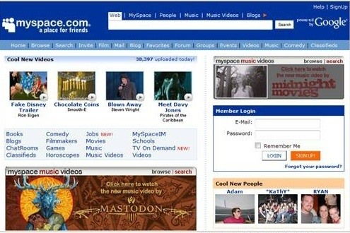
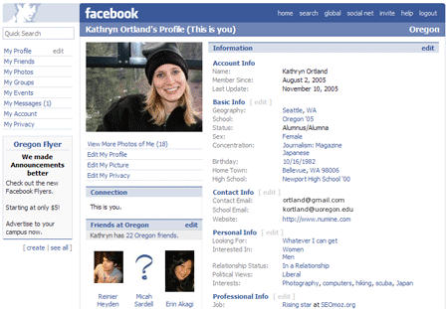
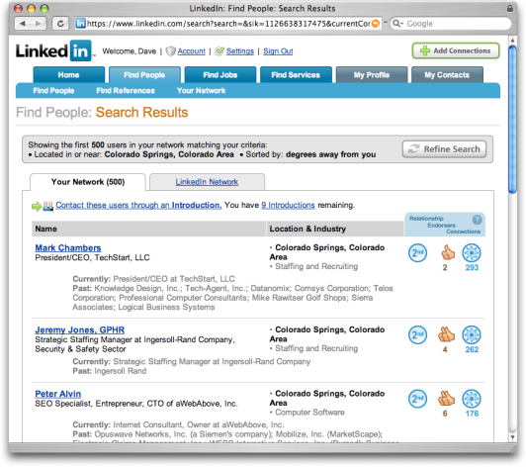
Social Computing in the Internet
Myspace
Facebook
LinkedIn
Social networking applications improve social connectivity
  Share news, photos, etc
  Find out information about events and places
  Create and/or maintain communities

Slide 3
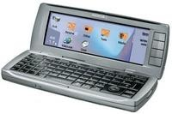
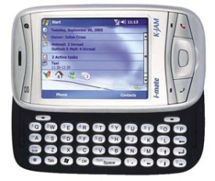
Mobile Social Computing
More than just social computing anytime, anywhere
New applications will benefit from real-time location and place information
Smart phones are the ideal devices
  Always with us
  Internet-enabled
  Locatable (GPS or other systems)
200-400 MHz processors
64-128 MB RAM
GSM, WiFi, Bluetooth
Camera, keyboard
Symbian, Windows Mobile, Linux
Java, C++, C#

Slide 4
Application Examples
People-centric
  Are any of my friends in the cafeteria now?
  Recommend interesting groups based on common geo-social patterns
Place-centric
  Which are the places where CS students hang out?
  Geo-tagged multimedia content associated to nearby places
System-centric
  Smart phones understand social context and silence themselves during important meetings
  Safely and automatically exchange data among mobile devices by inferring trust from social relations
What software infrastructure is required to support such applications?

Slide 5
Desired Infrastructure Features
Capture, manage, and share community geo-social data and state
  History of social relations
  Associations between people and places
  Emergent community patterns
  Real-time community information
  Sharing done according to user-specified privacy constraints
Scale to very large user populations and amounts of data
Provide high service and data availability
Adapt to application/user dynamics
Save battery power on mobile devices

Slide 6
Existing Solutions
Mobile devices interact via one-hop spontaneous ad hoc communication
  Limited functionality
  Lack of trust
Mobile devices interact with centralized services
  Not scalable
  Lack of flexibility in service provisioning
  Big brother scenarios
How about a potential scenario where mobile devices interact directly over the Internet?
  Difficult to provide persistent services due to limited resources (especially battery power, but also CPU and bandwidth)

Slide 7
Mobius
Decentralized 2-tier infrastructure
  Users put together their PCs and mobile devices to create a community infrastructure
P2P tier: provides support for mobile applications
  Offer persistent services (core or user-deployed)
  Manage social state and data
  Adapt to geo-social context to improve performance and enable energy efficiency in the Mobile tier
Mobile tier: runs mobile applications
  Interact with services provided by the P2P tier
  Collect geo-social information using ad hoc communication and share it with the P2P tier

Slide 8

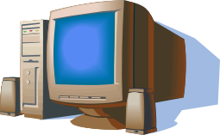
Application Scenario: Community Multimedia Sharing (1)
Mike
Jane
Alice, Mike &
Jane friends
Alice
Download mobile
application for Bob’s service
Mobile tier
P2P tier
Register
service
Bob’s service enable mobile users to upload & share multimedia content
Sharing community is specified according to type and strength of social ties
Bob’s service
Service discovery
service

Slide 9
Application Scenario: Community Multimedia Sharing (2)
Ad Hoc Collection of Jane’s
Social Context Data
Jane
Alice
Mike
Upload
Photo
Mobile tier
Event
Notification
P2P tier
Notify Alice’s
Friends
Download
Photo
Service
discovery
Event notification
service
Bob’s service
Store
Photo
Service discovery
service
Jane’s PC

Slide 10
P2P Tier Architecture
Service 1
Service 2
Service n
Service API
Privacy/Security Policy Enforcement
Event
Manager
Service
Discovery
Offloading
Admission
Context
Provider
Core Services for Mobile Tier
Geo-Social Data
Collection
Emergent Geo-Social Pattern Learning
Overlay
Data
Service
Social State
Geo-Socially Aware P2P Management
Geo-Social P2P Services
Network

Slide 11
Geo-socially Aware P2P Adaptability
Storing and replicating (when necessary) user generated content
  Examples: Store my data only on my friends’ PCs. Replicate content “closer” to the community that accesses it
Creating and terminating service instances
  Example: Dynamically replicate overloaded community services on other community PCs
Offloading applications from mobile tier to P2P tier
  Example: To save energy on my smart phone, run a computationally intensive application either on my PC or on my friends’ PCs
Decisions based on individual, community, or system-wide policies (e.g., privacy, security, performance optimizations)

Slide 12
Mobile Node Architecture
Application 1
Application 2
Application n
Mobile API
Event
Dispatcher
Resource
Monitor
Ad Hoc
Social Context
Location
Engine
Offloading
Manager
Operating System
Why ad hoc social context?
  Could be more reliable than user-declared social context
  No need for user’s explicit context sharing
  Merged with on-line social context for better results

Slide 13
Social State vs. Privacy/Trust
Centralized alternative
  Social state maintained centralized, easy to infer emergent patterns across all users
  “Big brother” issue
Mobius alternatives
  Share everything – same with centralized for inferring patterns (but slower) & worse for privacy
  Don’t share anything (social data stored only on user’s PC) - identify individual patterns & best privacy
  Share within community – identify patterns for community & could be better than centralized for privacy

Slide 14
Conclusions
Mobile social computing applications can be deployed in real-life today
Mobius provides a flexible, scalable, and efficient approach to program such applications
Main novelty
  P2P infrastructure for a new class of applications (mobile social computing)
  Geo-social knowledge used in P2P infrastructure for self-adaptive management techniques

Slide 15
Thank you!
http://www.cs.njit.edu/~borcea
Acknowledgment: Work sponsored by NSF grants CNS-0831753, CNS-0454081

