Slide 1

Individual and Social Behavior in Tagging Systems
Elizeu Santos-Neto
David Condon, Nazareno Andrade
Adriana Iamnitchi, Matei Ripeanu
20th ACM International Conference in Hypermedia and Hypertext, 2009

Slide 2
Online Peer Production Systems
“Systems where production is radically decentralized, collaborative and non-proprietary” [1]
Wikipedia, CiteULike, Connotea, YouTube, del.icio.us, Flickr, …
[1] Y. Benkler. “The Wealth of Networks”, Yale Press, 2006

Slide 3



Tagging Systems
Social applications where users annotate shared content with free-form words
Notes:
+ Expressly mention what is ITEM TAG TAS USER….

Slide 4
Motivation
Patterns of production/consumption of information are relatively unexplored
Usage patterns could inform system design
  Recommendation
  Content pre-fetching
  Spam detection
Notes:
+ 2nd should clearly say that we do design a mechanism

Slide 5
Q1. To which degree items are repeatedly tagged and tags reused?
Q2. What are the characteristics of users’ activity similarity in the system?
Q3. Does activity similarity relate to other indicators of collaboration?
Questions
Notes:
+ data set information after this slide

Slide 6
Q1. What are the levels of item re-tagging and tag reuse?
Prediction of future content consumption
Item re-tagging: captures the interest of users over content already present in the system
Tag reuse: the degree users repeat tags

Slide 7
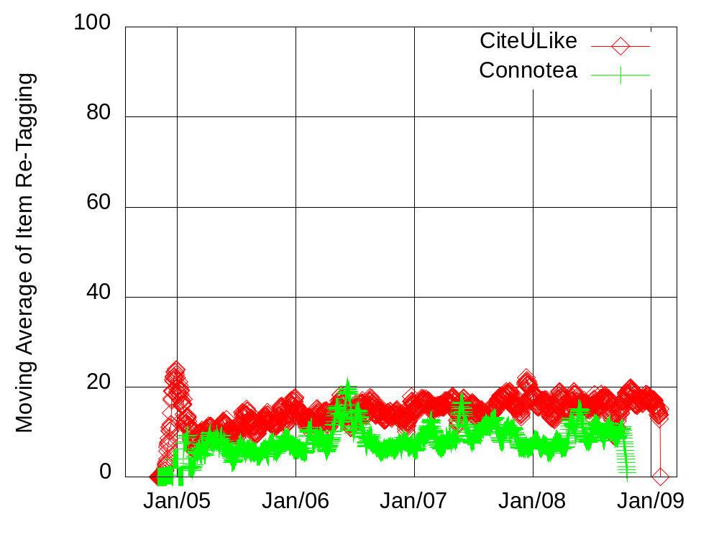
Repeated Item Tagging
Conclusion: Users constantly add new items.
Notes:
% on Y-axis

Slide 8
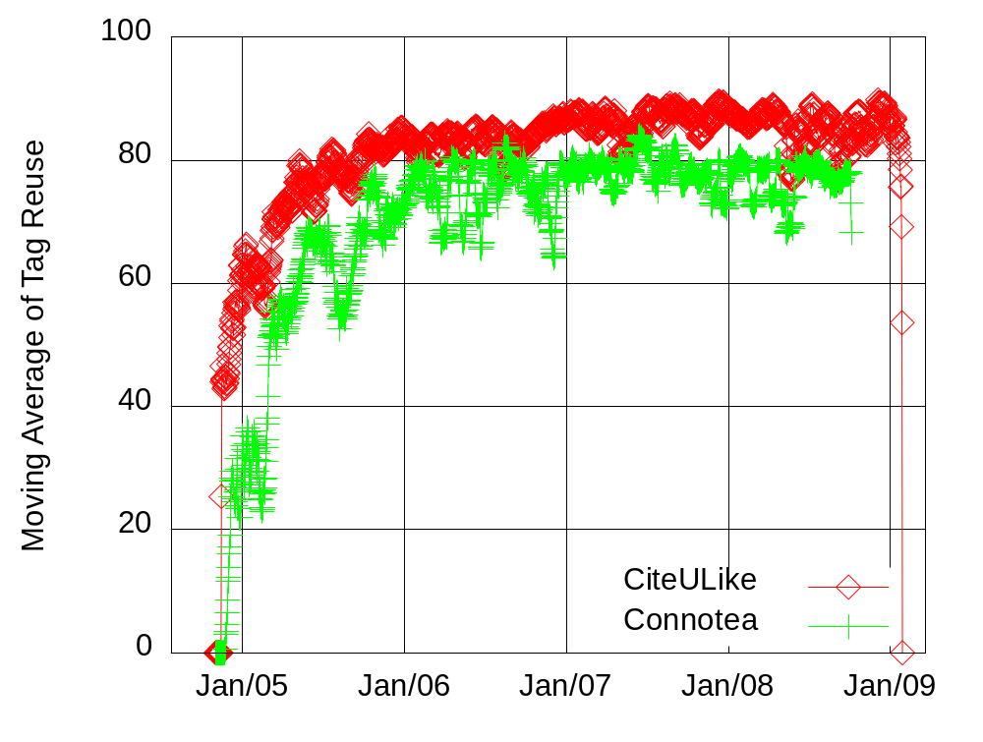
Repeated use of tags
Conclusion: Together low item re-tagging and high tag reuse support the intuition of content categorization.
Notes:
Yellowise…

Slide 9
Q2. What are the characteristics of users’ activity similarity?
Patterns of user’s social behavior
Define an implicit pairwise relationship
  Define interest-sharing
  Determine its empirical distribution
Baseline comparison - Random Null Model
Notes:
+ Be clear on the switch ACT SIM <-> IS

Slide 10

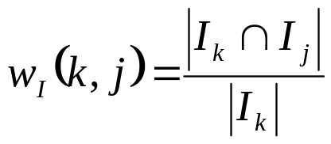


Interest Sharing
Items
Tags
k
j
Notes:
+ define item-based / tag-based metric flavors

Slide 11
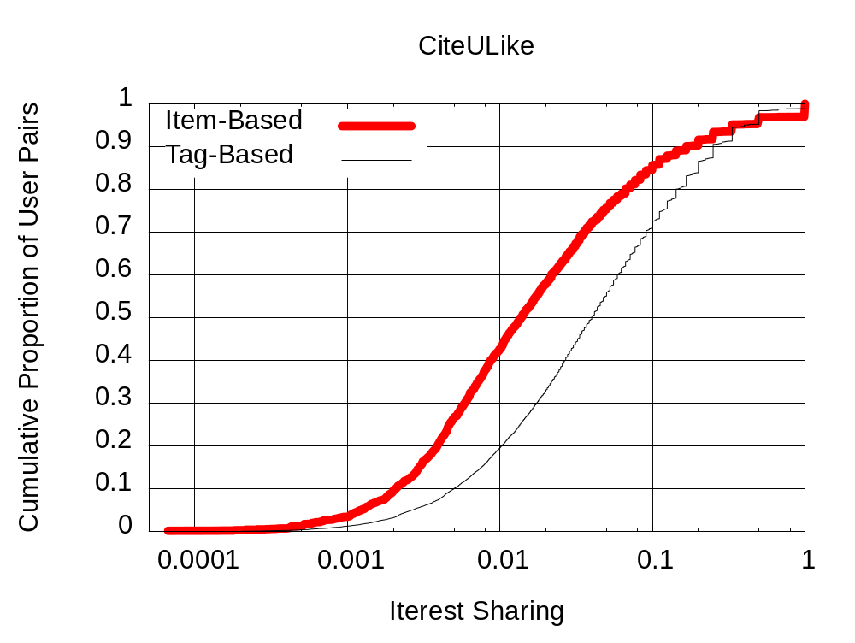
Interest Sharing Characteristics
Few user pairs share any interest
  99.9% of user pairs have no items in common
  83.8% of user pairs use no tags in common
How is the intensity of interest sharing distributed?
Conclusion: High interest sharing is concentrated on few user pairs.
Notes:
+ Ask whether is relevant or not?
+ Random Null model is the answer for all your problems!!!

Slide 12
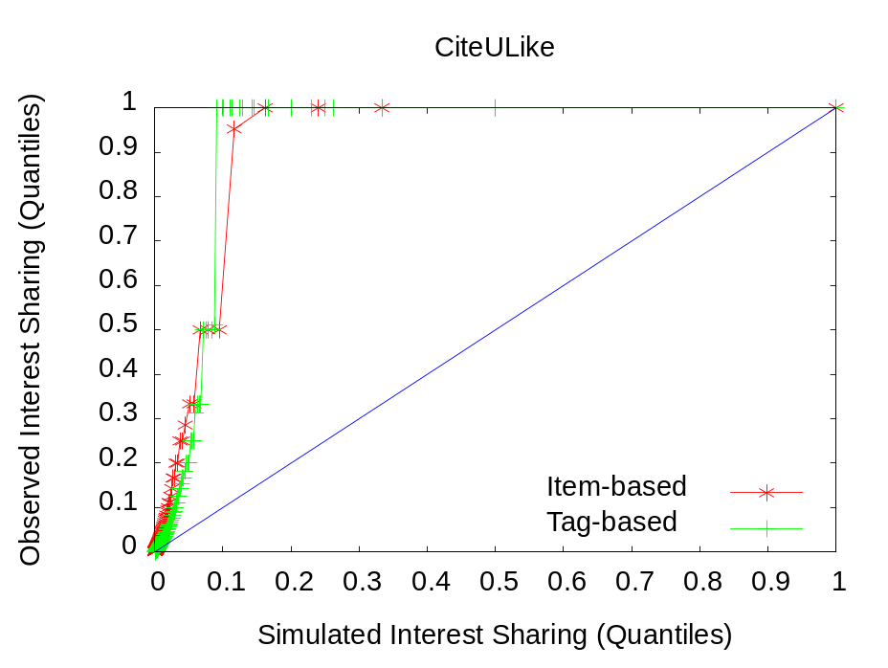
Baseline comparison
Random Null Model
  Keep same activity volume and distribution
  Shuffle user-item and user-tag association
Compare interest sharing distributions
Conclusion: Interest sharing embeds information about user social behavior
Notes:
+ Maybe an animatio for the reshuffling step
+ Add a summary on the right hand side

Slide 13
Q3. Does interest sharing relate to collaboration?
First steps towards relating interest sharing and collaboration
Indicators of collaboration
  Membership in the same discussion group (only 0.6% of user pairs with no interest sharing are in the same group)
  Semantic similarity of tag vocabulary
User pairs with shared interest
have more similar vocabularies.
Conclusion: Users that have interest sharing tend to have higher levels of collaboration
Notes:
+ Say Semantic similarity only
+ This is a first step towards…
+ unconnected > no-interest sharing
+ ask david for the CCDF

Slide 14
Summary

Slide 15
Q1. To which degree items are repeatedly tagged and tags reused?
  Tag reuse is higher than item re-tagging
  Predicting items still needs more sophisticated techniques
  Tag reuse provides an opportunity for alleviating item sparsity
Q2. What are the characteristics of users’ activity similarity in the system?
  Interest sharing exhibits a non-random pattern
Q3. Does activity similarity relate to other indicators of collaboration?
  Users who share interests show moderately higher collaboration levels
Notes:
+ data set information after this slide

Slide 16

Questions http://netsyslab.ece.ubc.ca
Individual and Social Behavior in Tagging Systems
Elizeu Santos-Neto, David Condon, Nazareno Andrade
Adriana Iamnitchi, Matei Ripeanu

Slide 17
Next Steps
Design systems that exploit these observations
  e.g., social search
  e.g., distributed resource annotation
Refine the models of interest-sharing
Assess the value of peer-produced information

Slide 18
Item-based interest sharing vs. Semantic similarity of tag vocabulary
Conclusion: Users that have interest sharing tend to have more semantically similar tags
Notes:
+ Say Semantic similarity only
+ This is a first towards…
+ unconnected > no-interest sharing
+ ask david for the CCDF

Slide 19
Interest Sharing
What is the intensity of user similarity?
CiteULike
1
0.9
Item-Based
Tag-Based
0.8
0.7
0.6
0.5
Cumulative Proportion of User Pairs
0.4
0.3
0.2
0.1
0
0.0001
0.001
0.01
0.1
1
Interest Sharing

Slide 20
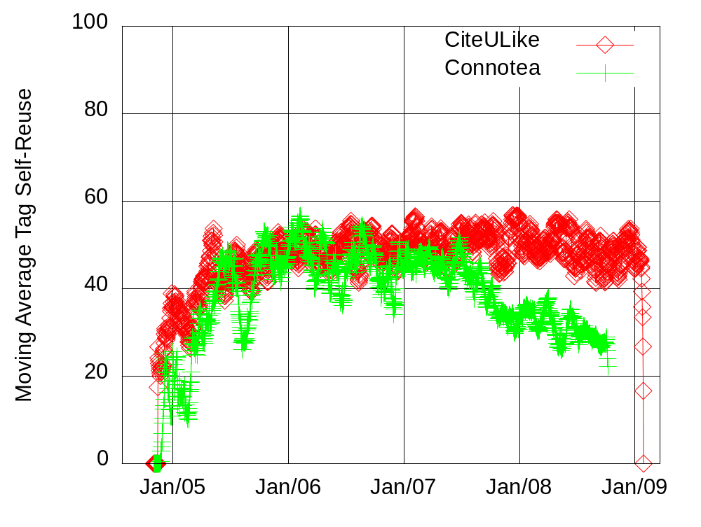
Self-Reuse
What is the fraction of self-reuse?

Slide 21
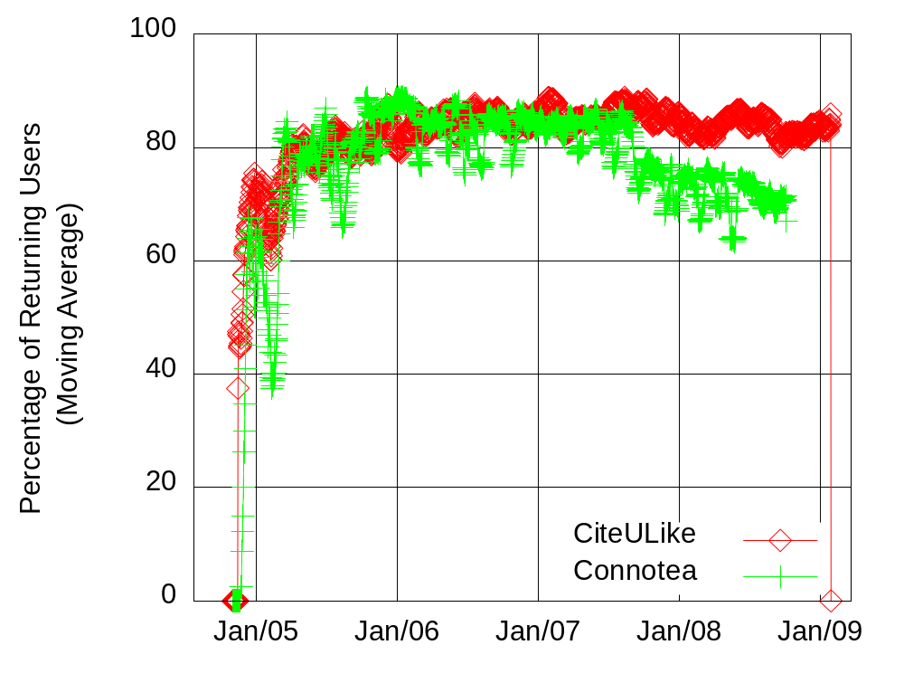
Returning users
Are these reuse levels due to new users?

Slide 22
Interest Sharing
First observations - Connotea
  99.8% of user pairs tag no items in common
  95.8% of user pairs use no tags in common
What is the distribution of interest sharing?

Slide 23
Group membership
What is the relation between item-based interest sharing and group membership?

Slide 24
Tag semantic similarity
What is the relation between item-based interest sharing and semantic similarity of vocabularies?

Slide 25
Implicit Social Structure
Sara
Lucy
Items
Tags
Ana

Slide 26
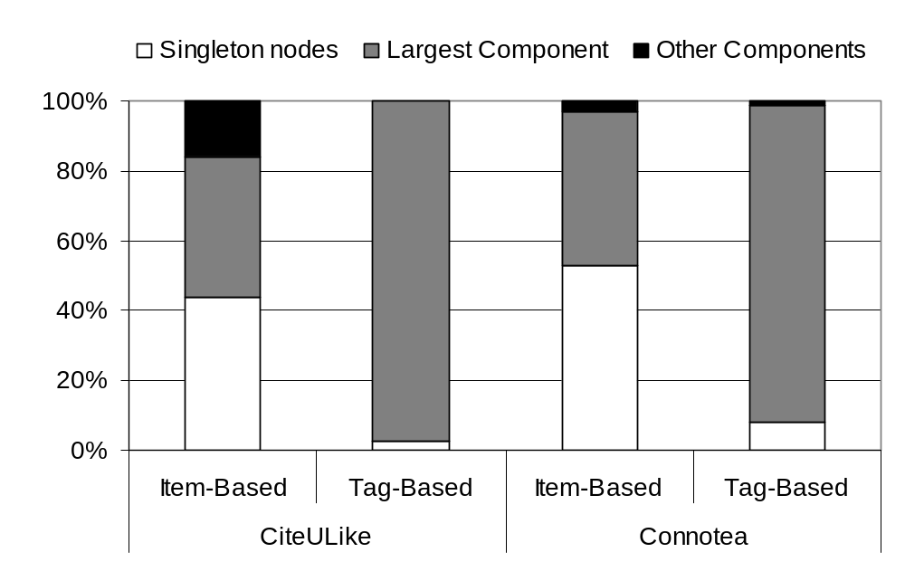
Q1. What are the implicit social structure characteristics?
Sara
Lucy
Items
Tags
Ana
Notes:
Summary, graph structure,

Slide 27
Findings and Implications
Structure is similar to explicit online social networks [2]
Natural user clustering
  Social search
  Content distribution
[2] R. Kumar et al., "Structure and evolution of online social networks,“
in KDD '06, pp. 611-617, 2006.

