Slide 1

BANSAL INSTITUTE OF RESEARCH & TECHNOLOGY, BHOPAL
DEPARTMENT OF COMPUTER SCIENCE & ENGINEERING
Major Project –I (CS706)
Presentation
On
“Image To Text Extractor”
Under the Guidance of:
Prof. Ankur Mishra
(Professor)
CSE, Department
Presented By:
Gaurav Singh Bhandari (0506CS211024)
Abhijeet Sen (0506CS211004)
Rajdeep Namdev (0506CS211045)

Slide 2
OUTLINES
Introduction
Feasibility Study
Problem Statement
Objective
Scope of Project
Work Distribution table of Team Members
Description of Software Life Cycle Model
Methodology like E-R Diagram , Flow Diagram, Use case diagram
etc.
Software & Hardware requirement
Project Description
Result
Limitation
Future Scope
References

Slide 3
Introduction
A process that converts text from images into editable, machine-readable text using Optical Character Recognition (OCR) technology.
Automate the conversion of images containing text into digital text format for easy editing and processing.
The project aims to create a user-friendly tool that can easily convert images into text across different formats (e.g., JPG, PNG, PDF).

Slide 4
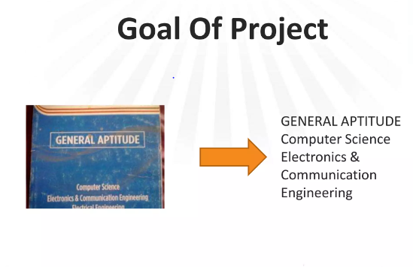

Slide 5
Image preprocessing
Text Detection
Character Recognition
Post Processing
Result - output

Slide 6
Feasibility Study
Technical Feasibility
Technology: Leverage OCR (e.g., Tesseract, Easy OCR), Python, machine learning.
Data Needs: Diverse datasets for various fonts, languages.
Challenges: Handling low-quality images, custom fonts.

Slide 7
Problem Statement
In many industries, large volumes of data are present in image formats (e.g., scanned documents, photos of whiteboards, receipts, etc.).
Extracting useful data manually from images is time-consuming, error-prone, and inefficient.

Slide 8
Objective
Automate the process of extracting text from images to save time and improve efficiency in document digitization.
Enable users to easily retrieve and manipulate information from images for various purposes (e.g., document processing, data entry, accessibility).

Slide 9
Scope of Project
Develop a user-friendly tool or application that can take image files as input and output editable text.
Improve accuracy through preprocessing and optimization techniques, especially in the case of low-quality images or varied fonts.

Slide 10
Work Distribution table of Team Members
No. | Members | Roles
1. | Abhijeet Sen | Design & Frontend development
2. | Gaurav Singh Bhandari | Documentation & Backend development
3. | Rajdeep Namdev | Testing & Backend development

Slide 11
Description of Software Life Cycle Model
Define user needs, formats, accuracy, and architecture (e.g., OCR engine selection).
Develop core modules, integrate OCR, and perform unit, integration, and user tests.
Deploy on target platforms, ensure compatibility, update OCR, and enhance based on feedback.

Slide 12
ER- diagram
USER
Platform
Image uploader
Text -output

Slide 13
Flow Diagram
Start
Image input
File format
Process
Outut text
End

Slide 14
Software & Hardware Requirement
Software Requirements:
OS: Windows 10/11, Linux (Ubuntu), macOS
Programming Language: Python, html, CSS
Libraries:
Tesseract OCR
OpenCV
Development Environment: Visual Studio Code, PyCharm
Hardware Requirements:
Processor: Intel i3 (minimum), Intel i5 (recommended)
RAM: 4 GB (minimum), 8 GB (recommended)
Graphics Card: Optional (for large image datasets)
Camera/Scanner: Optional (for capturing images)

Slide 15
Project Description
Objective: Convert text from images into machine-readable text using OCR.
Key Features:
Extracts text from image files (JPG, PNG, etc.).
Pre-processes images for clarity (OpenCV).
Outputs text in editable formats (.txt, .docx).
Technology:
OCR Engine: Tesseract
Image Processing: OpenCV, PIL/Pillow
Programming Language: Python 3.x
Target Audience: Individuals and businesses needing text extraction from images.
Use Cases: Scanning documents, converting photos of text,
assisting visually impaired users.

Slide 16
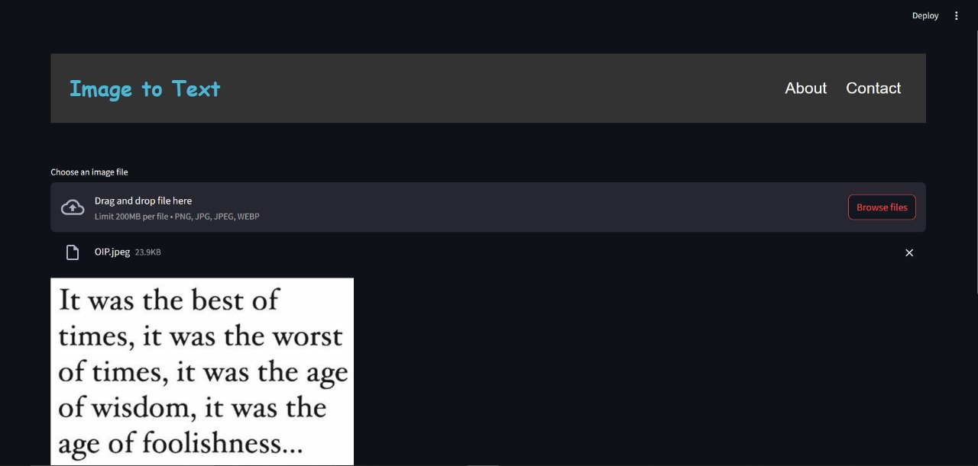
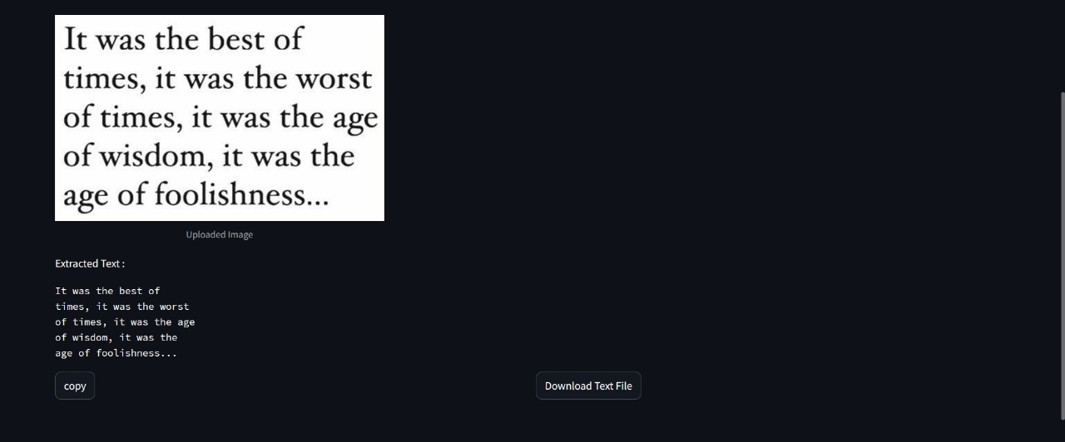
Result

Slide 17
Limitation
Accuracy: Reduced with poor image quality or complex fonts.
Language Support: Limited to Tesseract-supported languages.
Text Formatting: Complex formats (e.g., tables) may not be preserved.
Image Quality: Requires clear, high-resolution images.
Noise: Struggles with noisy or distorted images.
Performance: Slower processing with large/bulk images.

Slide 18
Future Scope
Multilingual Support: Add more languages for improved OCR.
AI/ML Integration: Enhance accuracy with AI models.
Cloud Processing: Enable scalable, faster cloud-based OCR.
Real-time Processing: Implement live text extraction via camera.
Advanced Formatting: Better handle complex document layouts.
User Customization: Allow training for specific fonts/handwriting.
Cross-Platform: Develop mobile and web versions.

Slide 19
References
Google – python library
Tessract – python library
Stack overflow
GfG concepts

Slide 20
THANK YOU

