Slide 1
Habilis Project
Gianluigi Caldiera Anish George Sri Vidhya Prasanth Rajasekaran Shubham Kumar

Slide 2
LLM-Based Chatbot Using Amazon Bedrock
The Need: In our organization, we frequently deal with repetitive queries, manual data lookups, and knowledge sharing. This slows down productivity and increases dependency on experienced individuals for routine answers.
Our Objective: To develop a scalable, intelligent chatbot that enhances internal efficiency, empowers employees with self-service capabilities, and reduces time for common queries.
Innovation Backing: This project was selected and funded through the Innovation Funnel, recognizing its potential as a high-impact digital solution for operational improvement.
Why Amazon Bedrock? Amazon Bedrock is a fully managed AWS service
Access foundation models without building or managing infrastructure
We can integrate LLMs via simple API calls

Slide 3
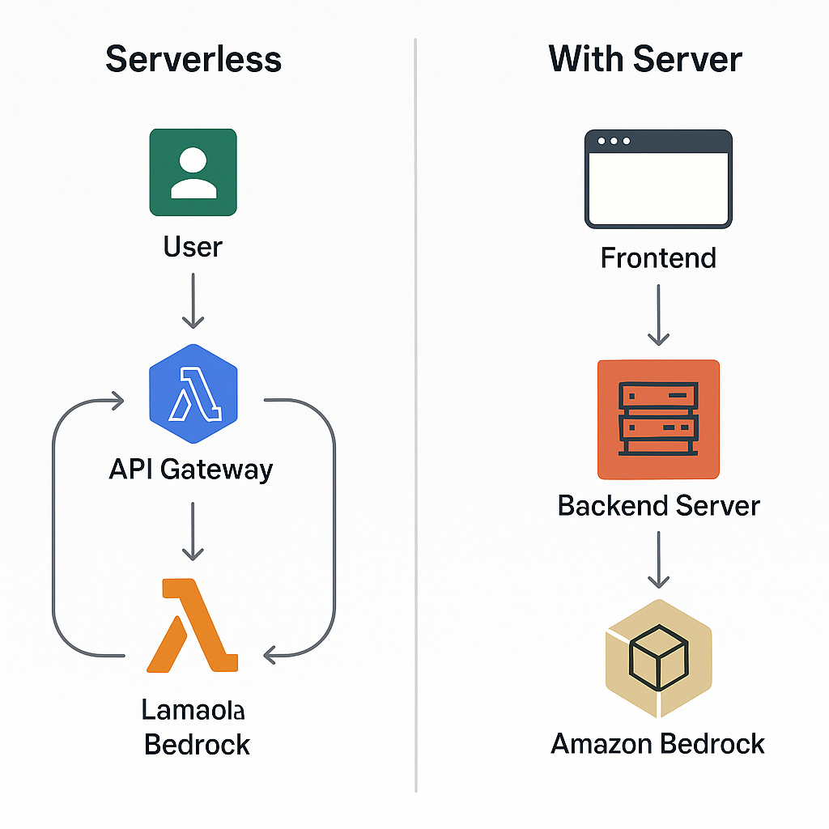
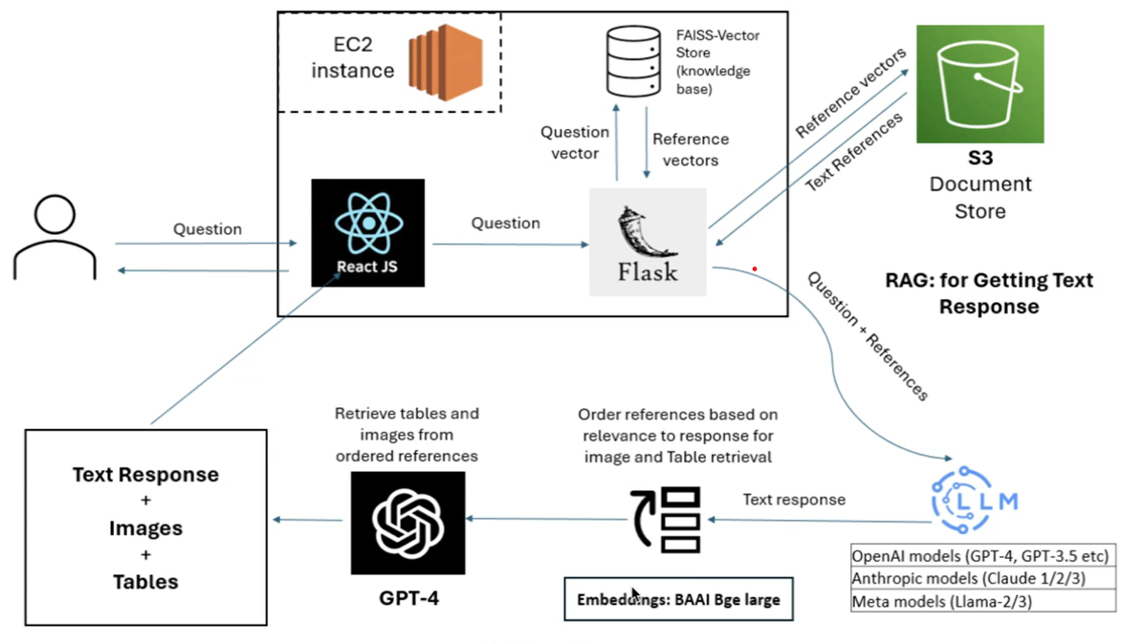
Server-Based Architecture (using EC2 + Amazon Bedrock)

Slide 4
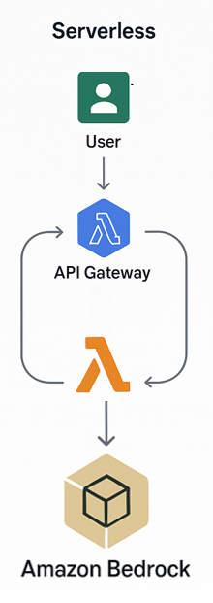
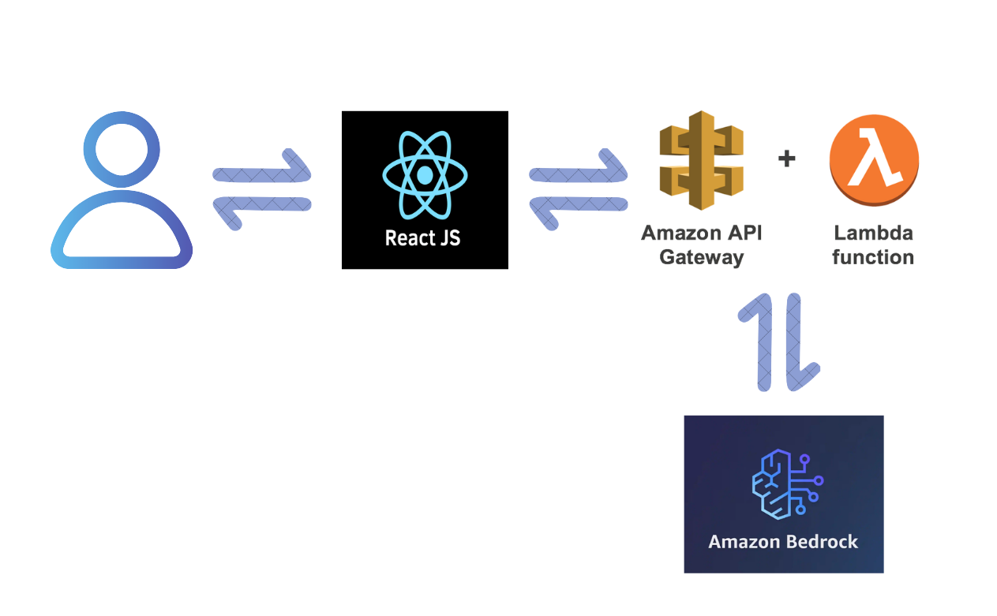
Serverless Architecture (using AWS Lambda + Amazon Bedrock)

Slide 5
Thank You

