Slide 1
INSITE – Value Proposition
Jan 22, 2025
Sustainable Technology Solutions

Slide 2
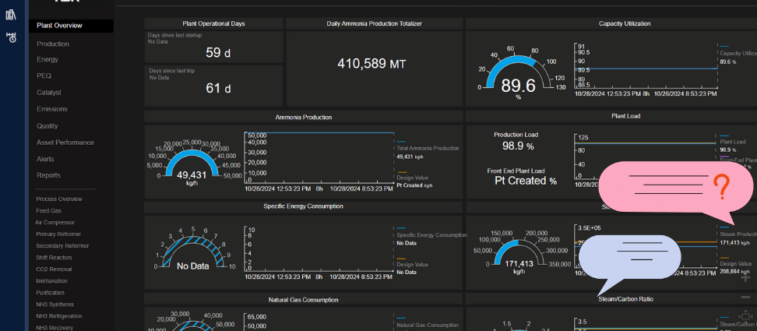
Building a Chatbot Using HABILIS
Chatbot

Slide 3
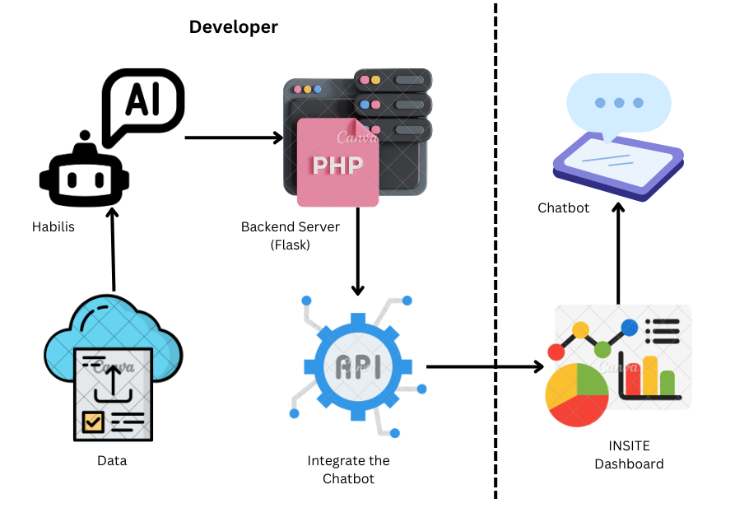
Integrating a Chatbot into the Dashboard

Slide 4
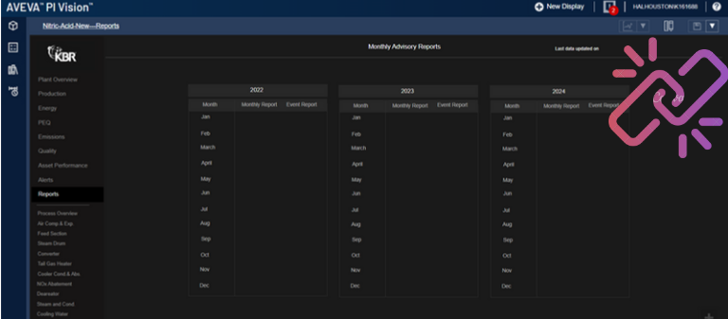
Hyperlink to Habilis project environment
Redirect to Habilis project environment

Slide 5
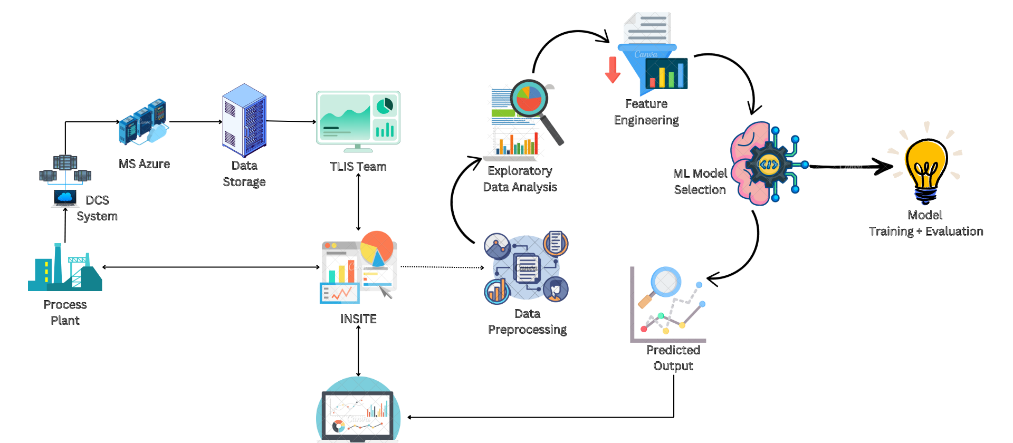

Integrating AI/ML in INSITE
INSITE System
Tools required VS Code

Slide 6

Discussion / Path Forward

Slide 7
Thank You

Slide 8
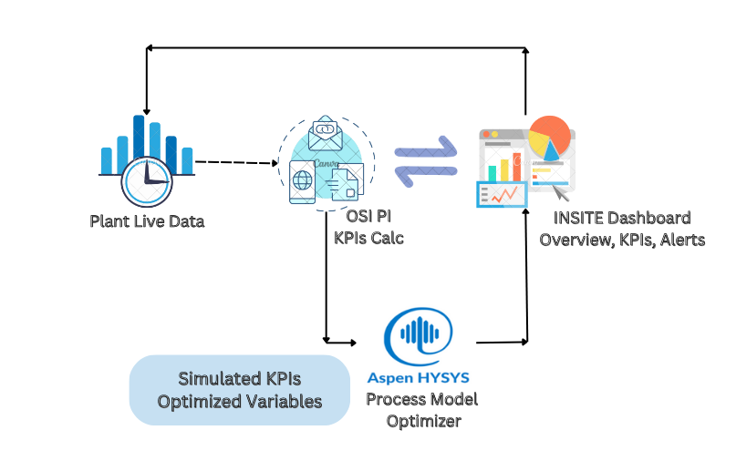
INSITE Architecture

Slide 9

Integrating New Technologies
Hybrid Model-Based Solution: Started working on a hybrid model-based solution combining first principle-based calculations and machine learning.
Predictive Analytics: Implementing predictive analytics to enhance decision-making processes.
Chatbot Integration: Planning to integrate chatbots for our Dashboard for our team and customers to improve communication and support.
Efficient Use of Aspen HYSYS: Exploring ways to use Aspen HYSYS more efficiently, ensuring no optimization restrictions due to model limitations.

