Slide 1
MACHINE LEARNING AND OPTIMIZATION FOR TESTING
Final project tutorial
Prediction: Predict CO2 Emissions in Rwanda
Student: Mayowa Adeyemi
Date: 31.01.2025

Slide 2
1. CHALLENGE OVERVIEW
Predicting CO2 Emissions in Rwanda

Slide 3
Description
Problem Description:
The challenge focuses on predicting CO2 emissions in Rwanda using satellite data from Sentinel-5P.
Accurate monitoring of carbon emissions is crucial for understanding climate change patterns, especially in regions like Rwanda, where ground-based monitoring systems are limited.
The goal is to develop machine learning models to predict future carbon emissions, enabling governments and organizations to estimate emissions in areas without ground monitoring.

Slide 4
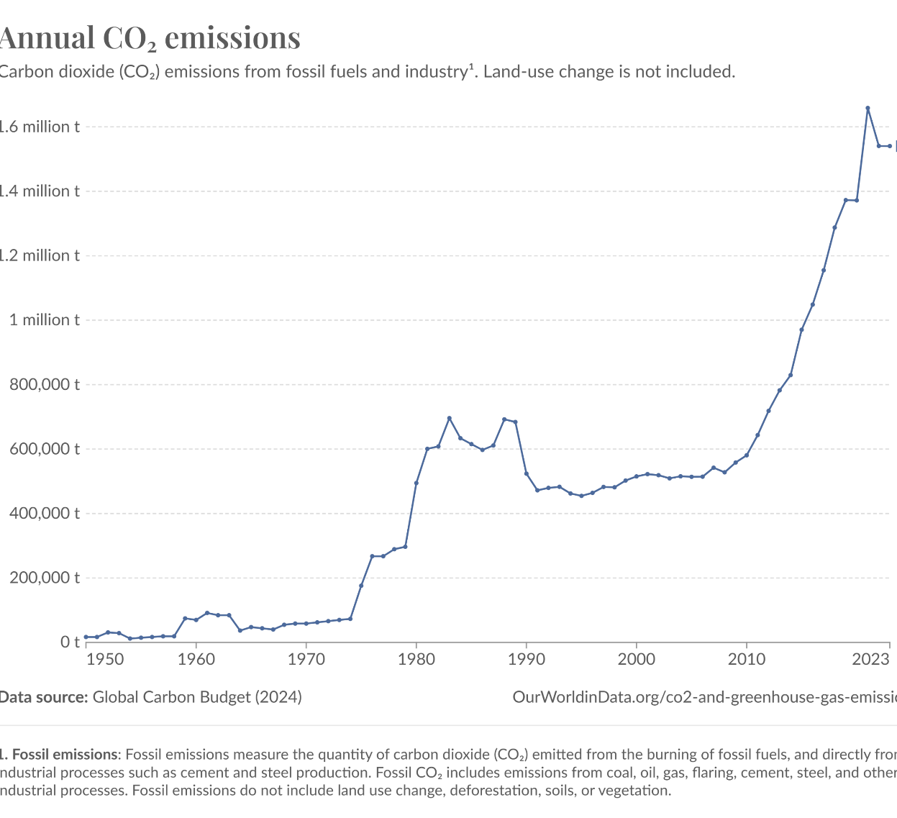
Description
This interactive chart shows how much carbon dioxide (CO₂) is produced in a given year.
These figures look specifically at CO₂ emissions – not total greenhouse gas emissions.
Reason for the Problem:
Climate change is a global issue, and accurate CO2 emission data is essential for mitigation strategies.

Slide 5
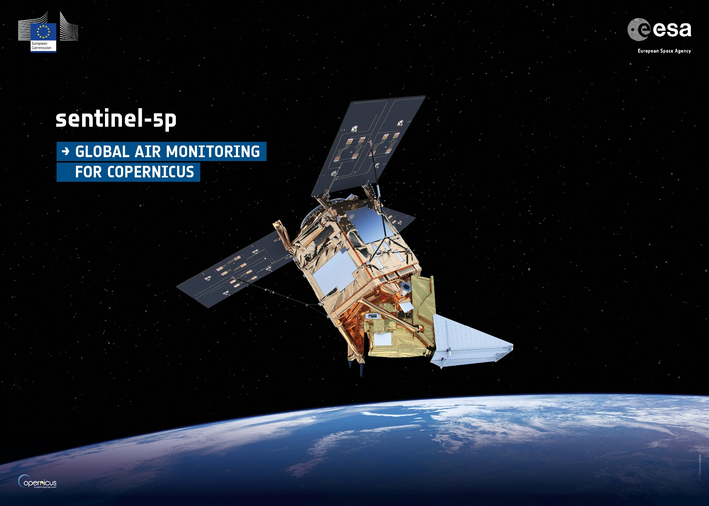
Description
Objective:
Predict CO2 emissions in Rwanda using Sentinel-5P satellite data.
Enable governments and other actors to estimate carbon emissions in areas with limited ground monitoring.

Slide 6
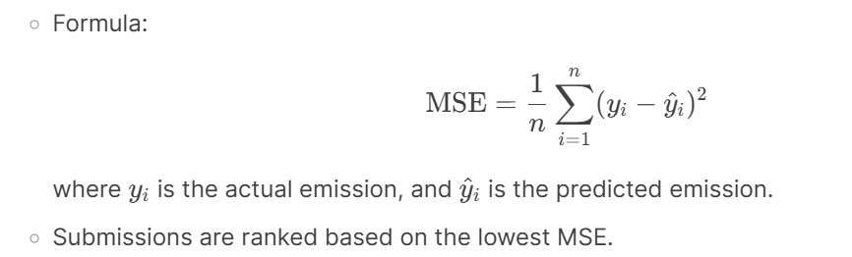
Evaluation
Evaluation Methodology:
The evaluation is based on Mean Squared Error (MSE) between predicted and actual CO2 emissions. …

Slide 7
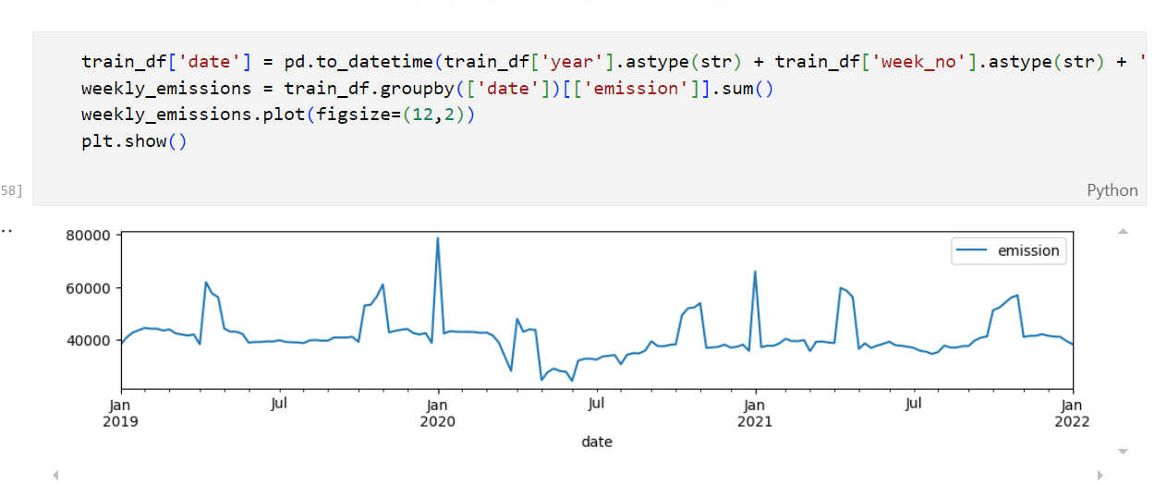
Evaluation
Evaluation Methodology:
The evaluation is based on Mean Squared Error (MSE) between predicted and actual CO2 emissions. …

Slide 8
2. DATA
Purpose:
The dataset is used to predict CO2 emissions in Rwanda using satellite observations.

Slide 9
Dataset description
Contents Overview:
Contains 76 features (train) and 75 features (test), including latitude, longitude, year, week number, and various satellite-derived measurements (e.g., SO2, CO, NO2, O3).
Target variable: emission (CO2 emission levels).
Creator:
Dataset provided by Carbon Monitor and prepared by Darius Moruri from Zindi.
Features:
Examples: latitude, longitude, year, week_no, SulphurDioxide_SO2_column_number_density, CarbonMonoxide_CO_column_number_density, etc.

Slide 10
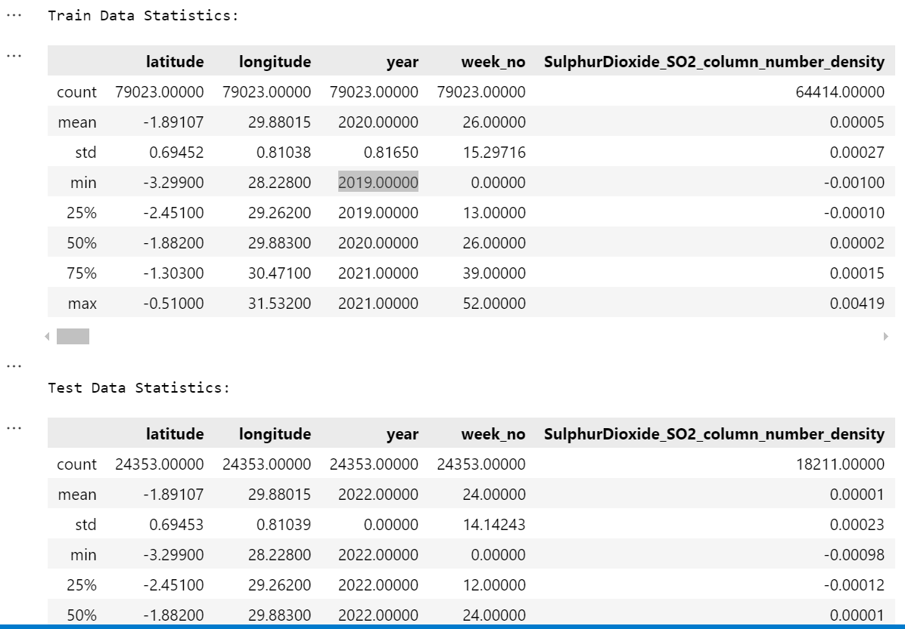
Dataset statistics
First Few Samples:

Slide 11
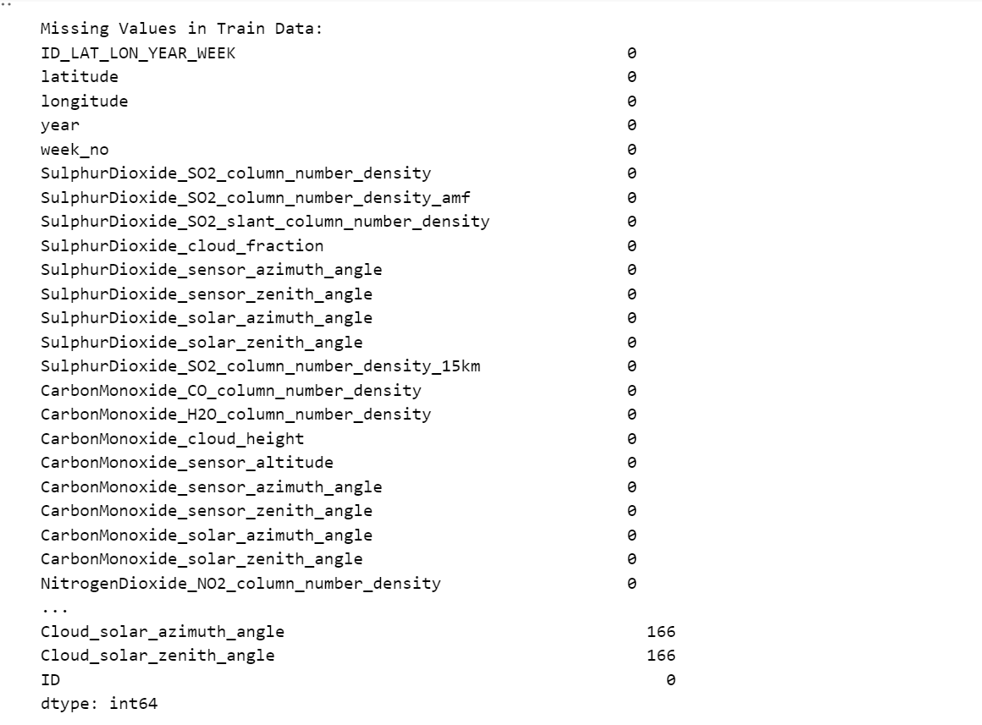
Dataset statistics
Missing Values:

Slide 12
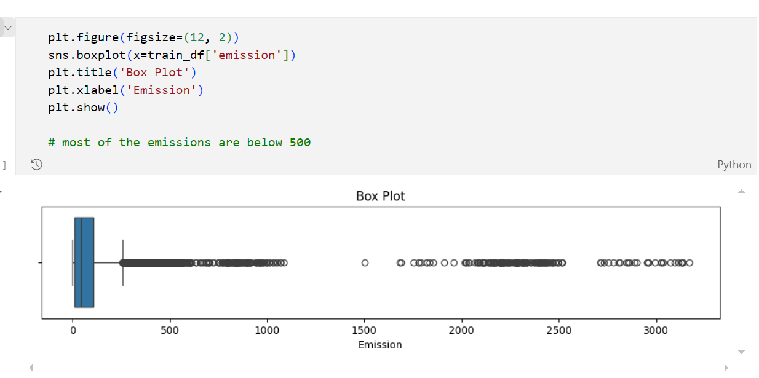
Dataset statistics
Box plot showing the data range

Slide 13
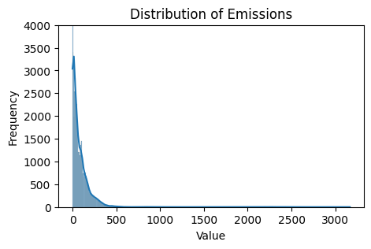
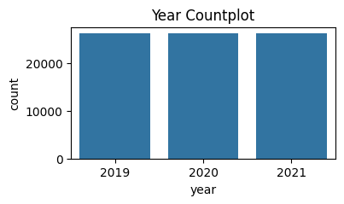
Dataset statistics
Statistical Summary:

Slide 14
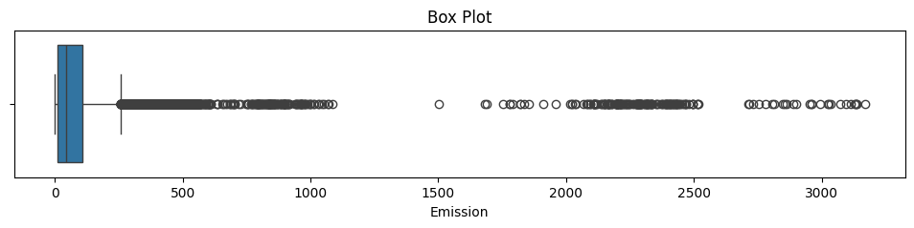
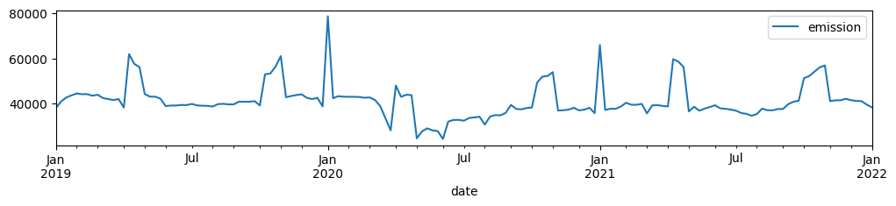
Dataset statistics
boxplot of the emission variable
Plot of CO2 emissions over time (year/month) to identify trends

Slide 15
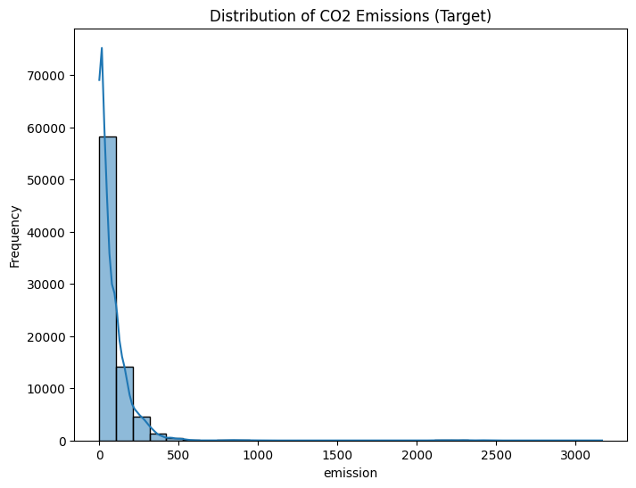
Dataset statistics

Slide 16
Data engineering
Methods Used:
Missing Values: Imputed the missing values for numerical columns using mean strategy.(so that the computation can be properly done )
Data Cleaning: Removed irrelevant columns and handled outliers by dropping those columns.
Data Standardization: Normalized features using StandardScaler.
Data Transformation: Encode categorical columns using Label Encoding (for simplicity).
Reason for Methods:
Missing values can bias model predictions; standardization ensures features are on the same scale.
Key Observations:
Some columns in the test dataset have a significant number of missing values.
Train dataset has no missing values in the target variable (emission).

Slide 17
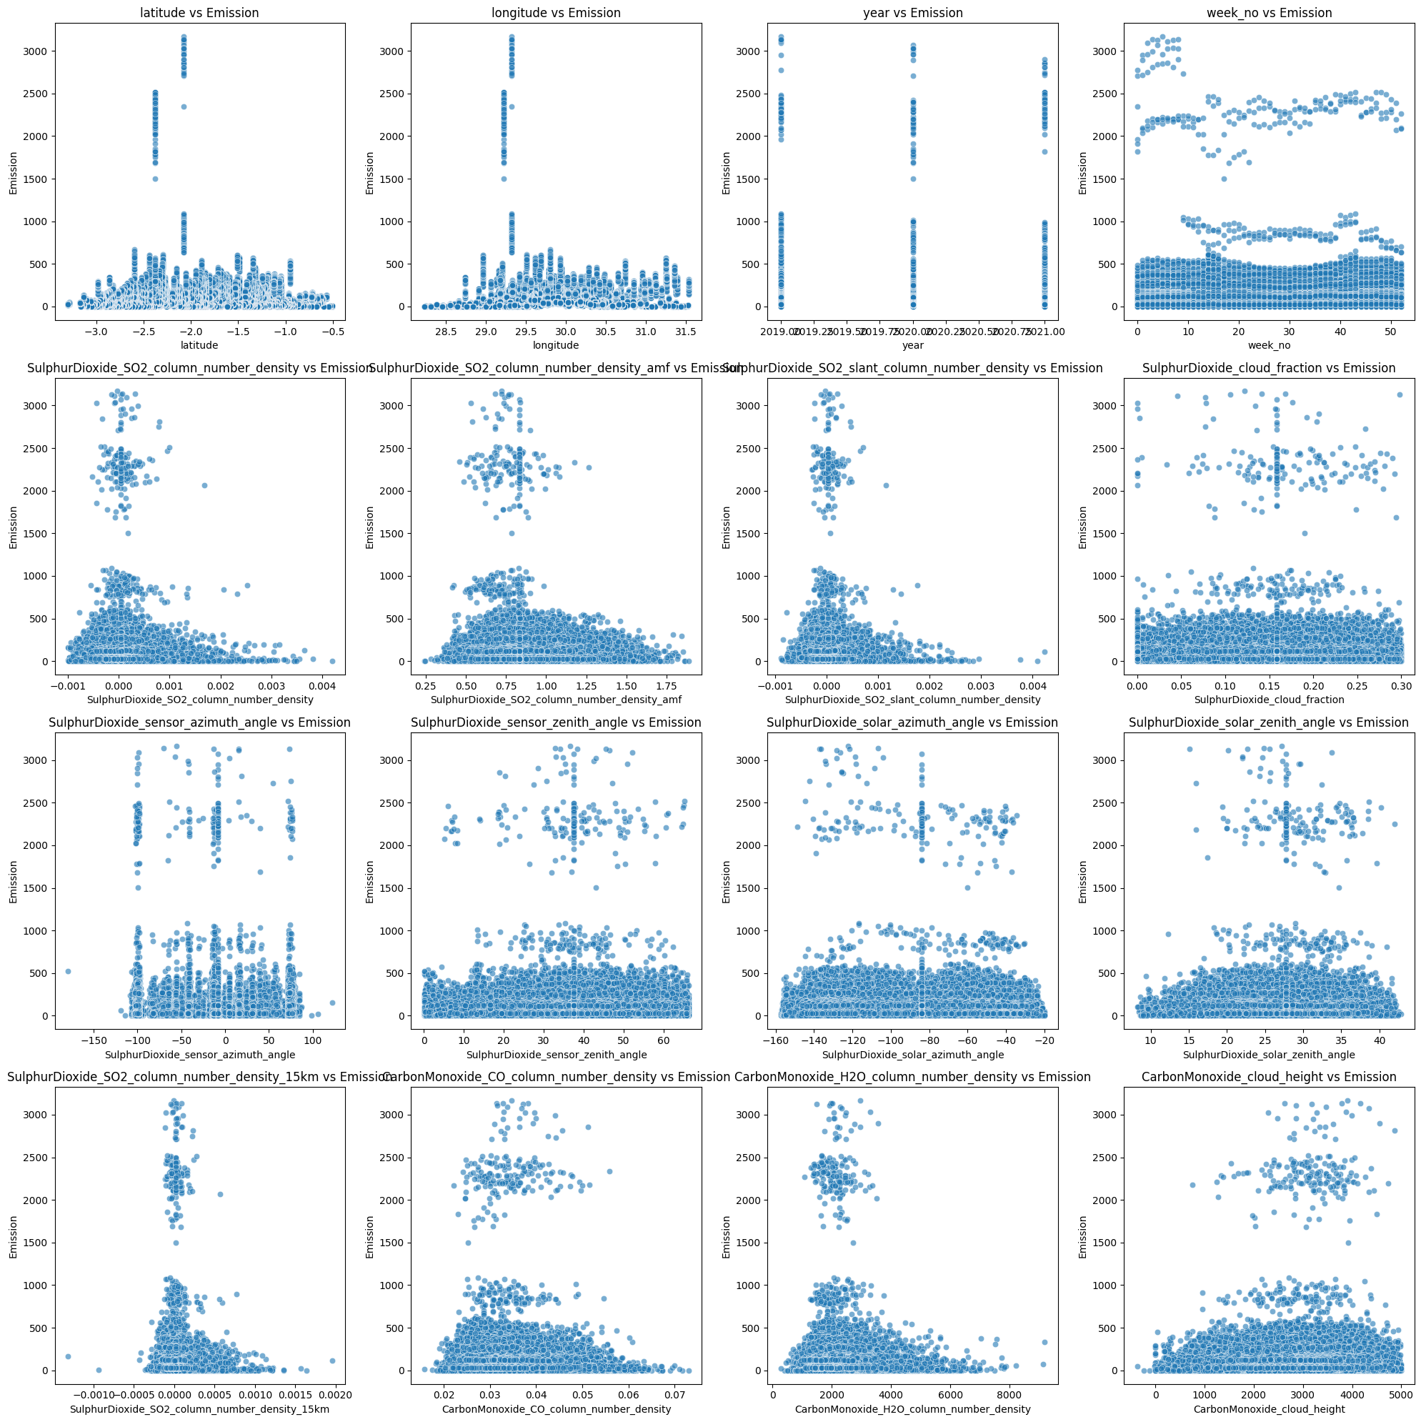
Data engineering
Effects of Data Engineering the effect of standardization on feature distributions.

Slide 18
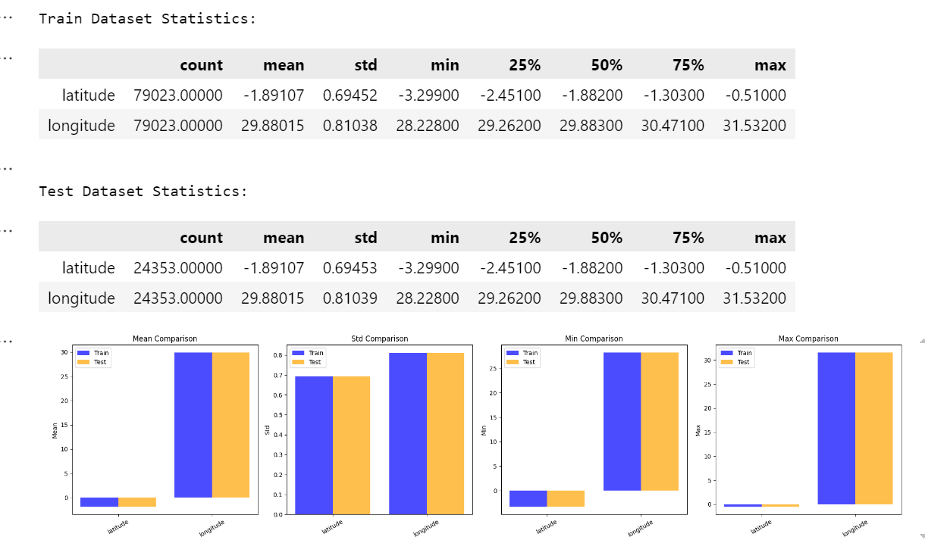
Data engineering

Slide 19
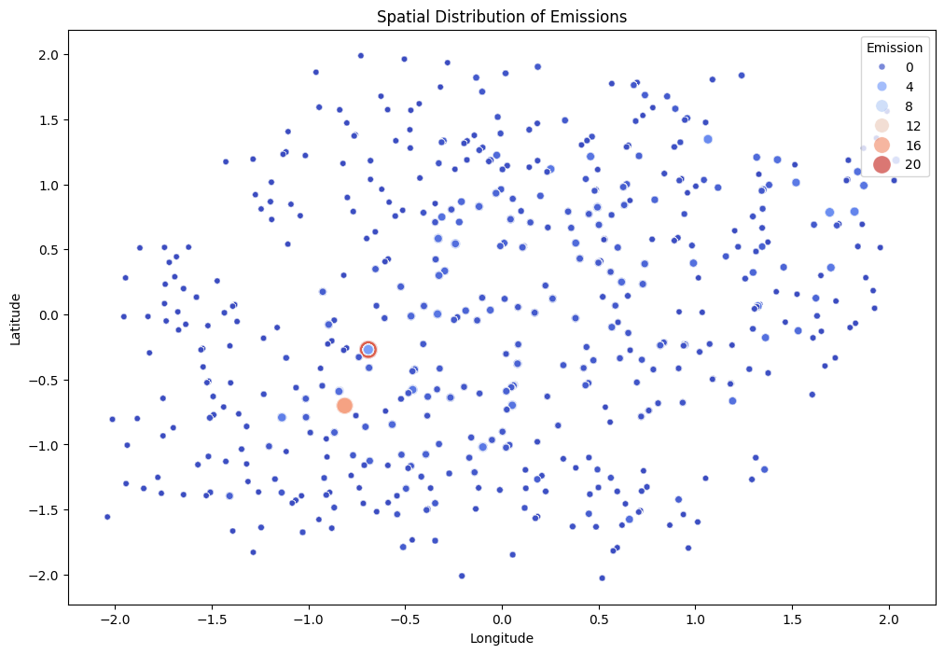
Data engineering
Impact on Model Performance:
The distribution of emission based
on location after the data cleaning and
transformation

Slide 20
Data engineering
Exploratory Data Analysis (EDA)
Statistical Summary:
Descriptive statistics for numerical features in both train and test datasets.
Mean, standard deviation, min, max, and quartile values for key features.
Visualizations:
Histograms, box plots, and correlation matrices (not shown in the notebook but implied).
Key Insights:
Emission values range from 0 to 3167.77, with a mean of 81.94.
Most features have a wide range of values, indicating variability in the data.

Slide 21
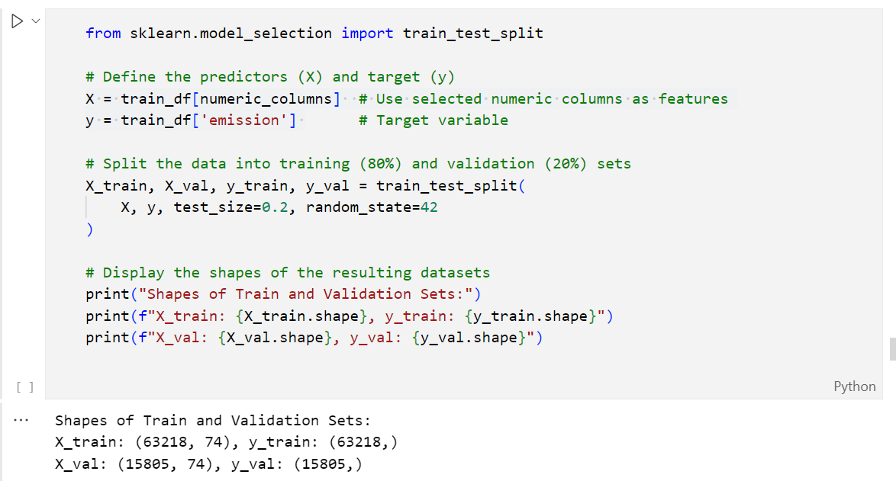
Data engineering

Slide 22
3. APPLIED ML/DL METHOD/S
The Machine learning models applied on the data.

Slide 23
Selected ML/DL method description
Models Considered:
Random Forest Regressor.
Gradient Boosting Regressor.
AdaBoost Regressor.
Decision Tree Regressor.
Evaluation Metric:
Mean Squared Error (MSE) to evaluate model performance.
Model Selection Criteria:
Ability to handle missing data.
Robustness to overfitting.
Interpretability of results.

Slide 24
Selected ML/DL method description
Training Process:
Split the dataset into training and validation sets. By using 80 by 20 rule
Trained models on the training set.
Evaluated models on the validation set using MSE.
Results:
Random Forest Regressor performed very well with the lowest MSE, but I chose the cat boost model to avoid overfitting
Gradient Boosting Regressor also showed good performance.
Key Observations:
Models were able to capture the relationship between satellite data and CO2 emissions.

Slide 25
Selected ML/DL method description
Linear Regression
A statistical method modeling the linear relationship between the target and features using the Ordinary Least Squares (OLS) method.
Logic: Finds the best-fitting line by minimizing the sum of squared errors between predicted and actual values.
Advantages:
Simple, interpretable, and efficient.
Effective for linear relationships.
Disadvantages:
Assumes linearity, limiting flexibility.
Sensitive to outliers.
Use Cases: Ideal for datasets with linear relationships and when interpretability is key.

Slide 26
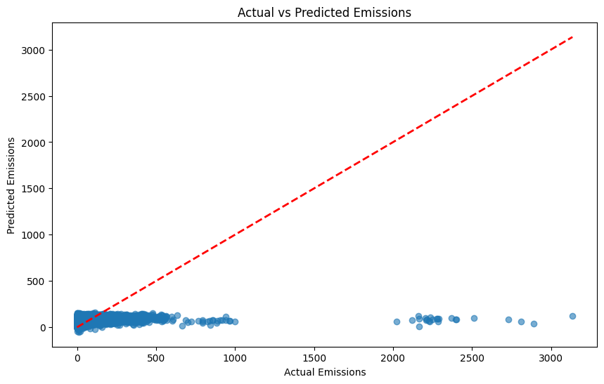
Selected ML/DL method description
Baseline Model: Linear Regression Mean Squared
Error (MSE): 15886.8861 R² Score: 0.0344

Slide 27
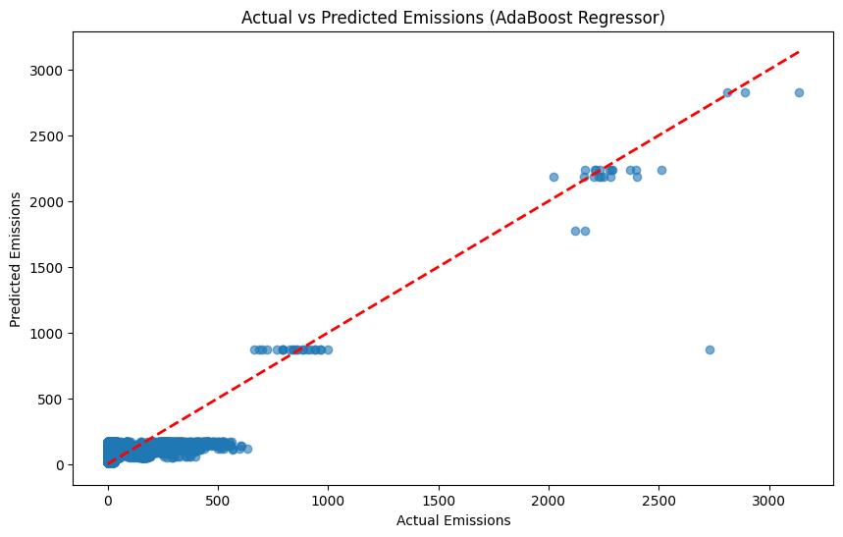
Selected ML/DL method description
AdaBoost Regressor Mean Squared Error (MSE): 7423.9037 R² Score: 0.5488

Slide 28
ML/DL method specification
CatBoostRegressor
Handles Categorical Features: Automatically processes categorical data without extensive preprocessing.
Efficient with Large Datasets: Optimized for performance, suitable for large datasets.
Robust to Overfitting: Uses ordered boosting to prevent overfitting.
High Accuracy: Advanced handling of categorical features and robust boosting techniques.
Fast Training: Efficient implementation and GPU support for faster training times.
Ideal for CO2 Emission Prediction: Scalable, accurate, and robust, making it perfect for enormous data.

Slide 29
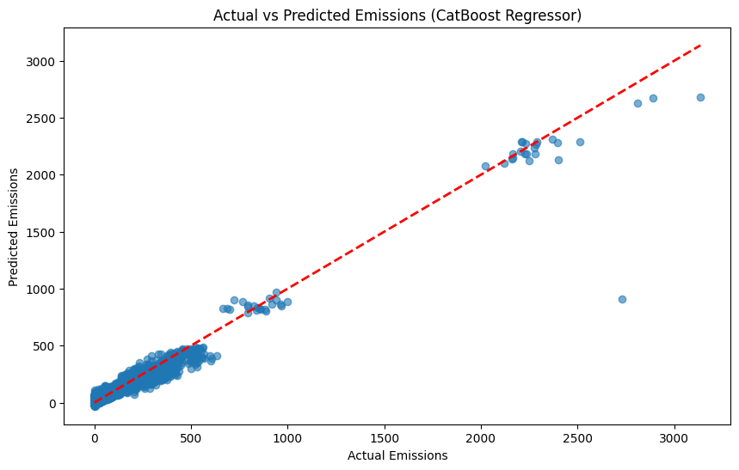
ML/DL method specification
CatBoostRegressor

Slide 30
ML/DL method specification
Framework:
Implemented using Scikit-learn in Python.
Key libraries: RandomForestRegressor, train_test_split, mean_squared_error.
Accuracy of the Regression Model:
Mean Absolute Error (MAE): 9.7131
Mean Squared Error (MSE): 909.5607
Root Mean Squared Error (RMSE): 30.1589R²
Score: 0.9447

Slide 31
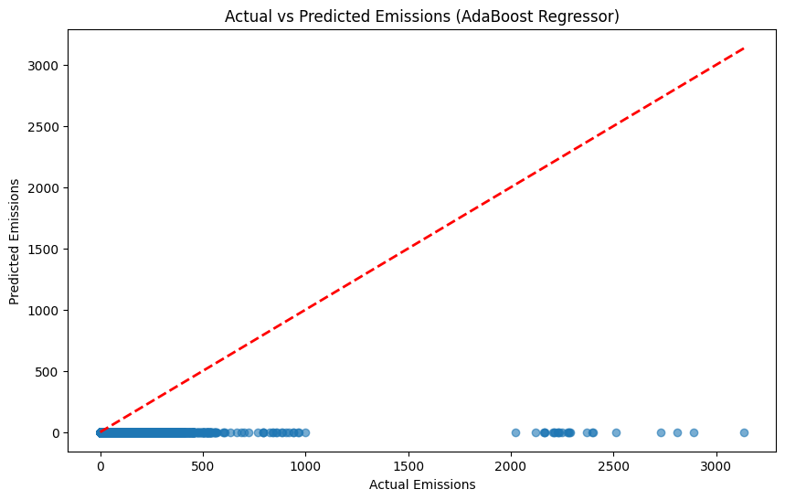
ML/DL method specification
AdaBoost Regressor

Slide 32
4. RESULTS AND DISCUSSION

Slide 33
Final results
MSE Score:
The final MSE score is achieved by the CatBoost Regressor Mean Squared Error (MSE): 758.7854
Additional Metrics:
R² Score: 0.9539
Key Insights:
Predictions were consistent with the training data trends.
Model was able to generalize well to unseen data.

Slide 34
Final results

Slide 35
Comparison
Model Comparison
Regression Model:
MAE: 9.7131
MSE: 909.5607
RMSE: 30.1589
R² Score: 0.9447
Decision Tree Regressor (Binary Classification):
Accuracy: 0.9943
AdaBoost Regressor:
MSE: 7423.9037
R² Score: 0.5488
CatBoost Regressor:
MSE: 758.7854
R² Score: 0.9539

Slide 36
5. CONCLUSIONS

Slide 37
Conclusion and future work
Challenges:
Handling missing data in the test dataset.
High dimensionality of the dataset.
Ensuring model interpretability.
Limited computation power
Limitations:
Model performance may be affected by the quality of satellite data.
Limited ground truth data for validation.

Slide 38
Conclusion and future work
Concluding Remarks:
The Catboot model performed well in predicting CO2 emissions, but there is room for improvement.
Future Work:
Explore deep learning models (e.g., LSTM) for time-series data.
Incorporate additional data sources (e.g., weather data, land use data).
Experiment with more advanced models (e.g., Neural Networks, XGBoost).
Perform hyperparameter tuning to optimize model performance.

Slide 39
Possible application in the testing domain
Idea 1:
Use similar ML methods to predict software defects based on historical data.
Idea 2:
Apply CO2 emission prediction techniques to monitor energy consumption in software testing environments.
Constraints:
Data availability and quality are critical for accurate predictions.

