Slide 1
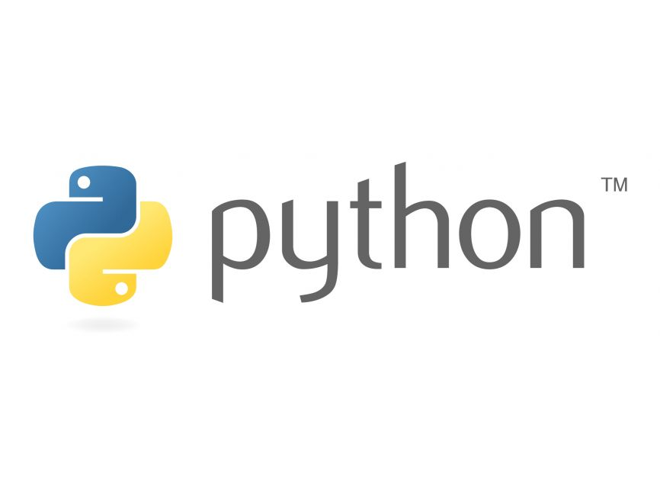
Python OOP
Presentation on Basics and Sudo Examples of Python OOP
Course: Software Environment & Programming
Georg & Mayowa
WS 2022/23

Slide 2
Background Information
Audience Expectation:
Assumes basic familiarity with Python and Object-Oriented Programming (OOP) concepts as a foundation for the discussion.
Python Special Methods:
Introduces Python's special methods to implement class definition, inheritance, multiple inheritance, accessibility, polymorphism, and encapsulation within OOP.
Methodological Contrast:
Highlights distinctions in OOP implementation in Python, emphasizing differences in approach compared to other languages.
Comprehensive Coverage:
Covers key OOP aspects such as class definition, inheritance, multiple inheritance, accessibility, polymorphism, and encapsulation, providing a holistic understanding tailored for Python developers.

Slide 3
What Is Object Oriented Programming
In the context of C++, 'object-oriented' refers to a programming paradigm, emphasizing modularity, encapsulation, and inheritance.
Object-Oriented Programming (OOP) organizes code around objects, promoting code reusability and abstraction.
OOP employs encapsulation to bundle data and methods, enhancing code clarity, and utilizes inheritance for code extensibility.
Polymorphism allows objects to take on multiple forms, enhancing flexibility.
[1,3]

Slide 4
Difference between Object-Oriented and
Procedural Oriented Programming
Aspect | Object-Oriented Programming (OOP) | Procedural Programming (POP)
Paradigm | Organizes code around objects with attributes and methods. | Focuses on procedures and routines; data and methods are separate.
Data Handling | Encourages encapsulation, bundling data and methods. | Data and functions are distinct; no inherent encapsulation.
Code Reusability | Promotes code reusability through classes and inheritance. | Code reuse is achieved through functions and procedures.
Modularity | Emphasizes modularity by encapsulating related functionality within objects. | Modules and functions provide modularity, but less intrinsic than OOP.
[2]

Slide 5
What are Classes and Objects?
A class is a collection of objects or you can say it is a blueprint of objects defining the common attributes and behavior. Now the question arises, how do you do that?
Class is defined under a “class” Keyword.
Example:
class class1: # class1 is the name of the class
The example below include class definition, constructor function, destructor function, attributes and methods definition and object definition.
These definitions and uses will be introduced specifically in the following.
[2]

Slide 6
What are Classes and Objects?
• Class definition syntax:
class subclass[(superclass)]:
[attributes and methods]
• Object instantiation syntax:
object = class()
• Attributes and methods invoke:
object.attribute
object.method()
[6]

Slide 7
What are Classes and Objects?
# Pseudocode for creating a class in Python
class Car:
# Constructor method to initialize object properties
def __init__(self, make, model, year):
self.make = make
self.model = model
self.year = year
self.is_running = False # Additional property for demonstration purposes
# Method to start the car
def start(self):
if not self.is_running:
print(f"The {self.year} {self.make} {self.model} is now running.")
self.is_running = True
else:
print("The car is already running.")
[8]

Slide 8
Constructor: __init__()
Initializer method in Python classes; automatically called when an object is created, initializing its attributes and performing setup tasks.
# Define a class with a constructor
class Person:
def __init__(self, name, age):
self.name = name
self.age = age
# Create an object using the constructor
person1 = Person(name="Alice", age=25)
# Access initialized attributes
print(f"{person1.name} is {person1.age} years old.")
From the code , we can see that
after instantiate object, it
automatically invokes __init__()
[6]

Slide 9
Special Class Attributes in Python
Except for self-defined class attributes in Python, class has some special attributes. They are provided by object module.
Attributes Name | Description
__dict__ | Dict variable of class name space
__doc__ | Document reference string of class
__name__ | Class name
__module__ | Module name consisting of class
__bases__ | The tuple including all the superclasses
[6]

Slide 10
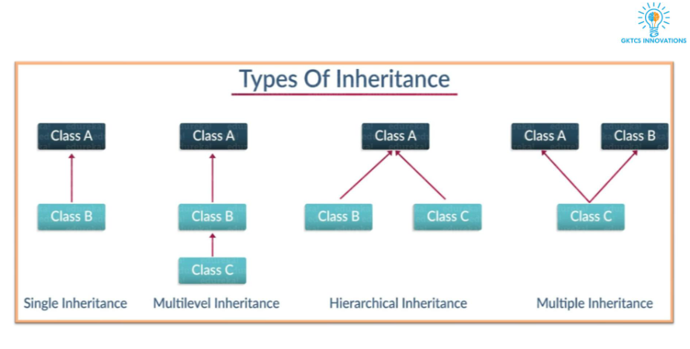
Inheritance:
Ever heard of this dialogue from relatives “you look exactly like your father/mother” the reason behind this is called ‘inheritance’.
Inheritance in Python OOP enables a class to inherit attributes and methods from another class, fostering code reuse and hierarchy.
The new class is called the derived/child class and the one from which it is derived is called a parent/base class.
[2]

Slide 11
Single Inheritance, Multilevel Inheritance, Hierarchical Inheritance, :
# Single Inheritance
class Animal:
def speak(self):
print("Animal speaks")
class Dog(Animal): # Single Inheritance
def bark(self):
print("Dog barks")
# Multilevel Inheritance
class Mammal(Animal): # First level
pass
class Cat(Mammal): # Second level (Multilevel)
def meow(self):
print("Cat meows")
# Hierarchical Inheritance
class Shape:
def draw(self):
print("Drawing shape")
In Python OOP:
- Single Inheritance inherits from one parent, forming a linear hierarchy for code reuse.
- Multilevel Inheritance creates a chain of inheritance, enabling reuse and extension.
- Hierarchical Inheritance has multiple classes inheriting from a common base, sharing functionalities while maintaining individual characteristics.
[1]

Slide 12
Encapsulation and Abstraction:
Encapsulation:
In OOP, encapsulation bundles data and methods within a class, ensuring data integrity and security by restricting direct access.
Abstraction:
Abstraction simplifies complex systems by hiding unnecessary details, offering a clear, high-level representation for effective understanding and implementation.
[3]

Slide 13
Encapsulation and Abstraction:
Python Accessibility:
In Python, there are no keywords like 'public,' 'protected,' or 'private.' All attributes are considered public. To define private attributes, add "__" before the variable or function name.
Private Accessibility Method:
Although Python lacks true private access, adding "__" is a convention. It changes names to `_ClassName__variable` to restrict access. Special syntax allows access.

Slide 14
Encapsulation and Abstraction:
# Define a class with a public attribute and method
class PublicExample:
public_variable = 10
def public_method(self):
return "This is a public method."
# Create an instance and access public members
obj = PublicExample()
print(obj.public_variable)
print(obj.public_method())
# Define a class with a protected attribute and method
class ProtectedExample:
_protected_variable = 20
def _protected_method(self):
return "This is a protected method."
# Create an instance and access protected members
obj = ProtectedExample()
print(obj._protected_variable)
print(obj._protected_method())
# Define a class with a protected attribute and method
class ProtectedExample:
_protected_variable = 20
def _protected_method(self):
return "This is a protected method."
# Create an instance and access protected members
obj = ProtectedExample()
print(obj._protected_variable)
print(obj._protected_method())

Slide 15
Encapsulation and Abstraction:
Suppose you booked a hotel room ticket from booking.com or any other process. You don’t know the procedure of how the pin is generated or how the verification is done.

Slide 16
Encapsulation and Abstraction:
Abstraction simplifies complex systems, as seen in a remote control abstracting the intricacies of a TV.
In programming, it hides unnecessary details for a simplified, user-friendly interface. It basically means you only show the implementation details of a particular process and hide the details from the user.

Slide 17
Polymorphism:
You all must have used GPS for navigating the route, Isn’t it amazing how many different routes you come across for the same destination depending on the traffic.
Polymorphism in Python OOP enables objects to have multiple forms, offering flexibility through method overloading and overriding.
Two types: compile-time (method overloading) and runtime (method overriding).
[3]

Slide 18
Compile-time (Static) Polymorphism and Runtime (Dynamic) Polymorphism:
Compile-time (Static) Polymorphism:
Compile-time polymorphism, also known as static polymorphism, occurs when the method that needs to be executed is determined at compile time. It is achieved through method overloading.
class MathOperations:
def add(self, a, b):
return a + b
def add(self, a, b, c):
return a + b + c
# Create an instance
calculator = MathOperations()
# Compile-time polymorphism
result1 = calculator.add(2, 3) # Calls the first add method
result2 = calculator.add(2, 3, 4) # Calls the second add method

Slide 19
Compile-time (Static) Polymorphism and Runtime (Dynamic) Polymorphism:
Runtime (Dynamic) Polymorphism:
Runtime polymorphism, also known as dynamic polymorphism, occurs when the method that needs to be executed is determined at runtime. It is achieved through method overriding.
class Animal:
def make_sound(self):
pass
class Dog(Animal):
def make_sound(self):
return "Woof!"
class Cat(Animal):
def make_sound(self):
return "Meow!"
# Create instances
dog_instance = Dog()
cat_instance = Cat()
# Runtime polymorphism
sound1 = dog_instance.make_sound() # Calls Dog's make_sound method
sound2 = cat_instance.make_sound() # Calls Cat's make_sound method

Slide 20
Take Away / Learnings
OOP Fundamentals:
Understanding Object-Oriented Programming (OOP) is crucial, encompassing principles like encapsulation, inheritance, and polymorphism.
Abstraction Simplifies:
Abstraction simplifies complex systems, providing a clear, high-level representation while hiding unnecessary details.
Polymorphism Flexibility:
Polymorphism enables flexibility; compile-time polymorphism uses method overloading, and runtime polymorphism uses method overriding.
Encapsulation Security:
Encapsulation ensures data security by bundling data and methods within a class, restricting direct access.
Inheritance Hierarchy:
Inheritance establishes hierarchies, promoting code reuse; types include single, multilevel, and hierarchical inheritance in Python.
Python OOP Implementation:
Python's OOP features include public, protected, and private access levels, enhancing code organization and security.

Slide 21

Questions

Slide 22
References
[1] Python objects and classes. Programiz. (n.d.). https://www.programiz.com/python-programming/class
[2] Object Oriented Programming using python - GKTCS. (n.d.). https://gktcs.com/media/PPT/Sanket%20Lolge/Python-Django/9-_Object_Oriented_Programming_Using_Python.pdf Python objects and classes. Programiz. (n.d.). https://www.programiz.com/python-programming/class
[3] B. Stroustrup, "What is object-oriented programming?," in IEEE Software, vol. 5, no. 3, pp. 10-20, May 1988, doi: 10.1109/52.2020.
[4]Prabhakaran, S. (2022, March 8). Object Oriented Programming (OOPS) in Python. Machine Learning Plus. https://www.machinelearningplus.com/python/object-oriented-programming-oops-in-python/
[5]R. Klump, "Understanding object-oriented programming concepts," 2001 Power Engineering Society Summer Meeting. Conference Proceedings (Cat. No.01CH37262), Vancouver, BC, Canada, 2001, pp. 1070-1074 vol.2, doi: 10.1109/PESS.2001.970207.
[6]Object-oriented design with Python - University of Colorado Boulder ... (n.d.-b). https://home.cs.colorado.edu/~kena/classes/5448/f12/presentation-materials/li.pdf
[7] K&uuml;&ccedil;&uuml;k, Z. (2023, September 22). Overview of the python programming language. Medium. https://zynpkucuk.medium.com/overview-of-the-python-programming-language-fb76a1dab200#:~:text=Python%3A%20A%20Brief%20Introduction&text=Its%20initial%20goal%20was%20to,%2C%20scientific%20computing%2C%20and%20more.
[8] T, S. (2023a, August 29). Init python: Learn how to use __init__ to initialize objects in Python. Copahost. https://www.copahost.com/blog/init-python/

