Slide 1


Slide 2

NLP Chatbot Development Using dialogflow

Slide 3
My Introduction
Assalam o alaikum !
I am Imtanan Ahnaf , student of BSSE and presenting you here my Final Year Project.
Group ID: F24PROJECT9A4A9
Student ID: BC200401263

Slide 4

INTRODUCTION OF PROJECT
This project aims to develop an intelligent chatbot using Dialogflow that automates and enhances customer support for a training company. The chatbot will handle tasks like answering course-related queries, managing student registrations, and providing timely information about schedules and services. By integrating Natural Language Processing (NLP), the system offers human-like interaction, improves user experience, and reduces the manual workload of administrative staff.

Slide 5
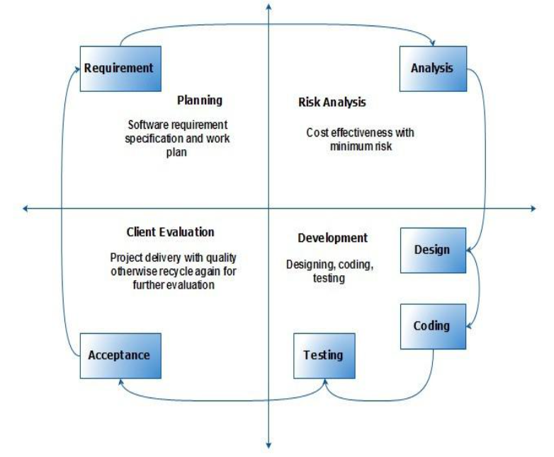
VU Process Model

Slide 6
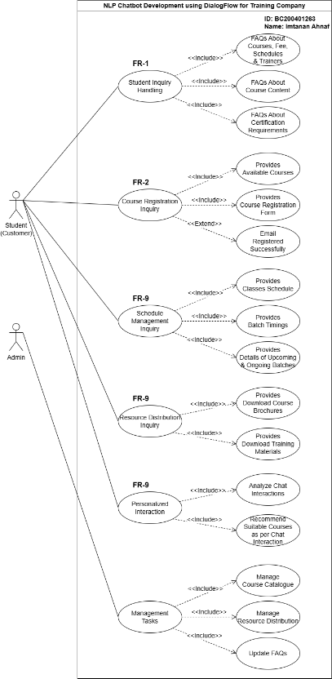
Use Case Diagram

Slide 7
Business Rules Catalog
1.Student Inquiry Handling
2.Course Registration
3.Schedule Management
4.Resource Distribution
5.Personalized Interaction
6.Management Tasks

Slide 8
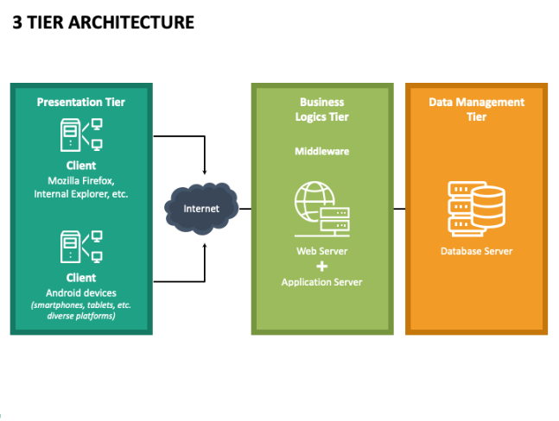
Architectural Design

Slide 9
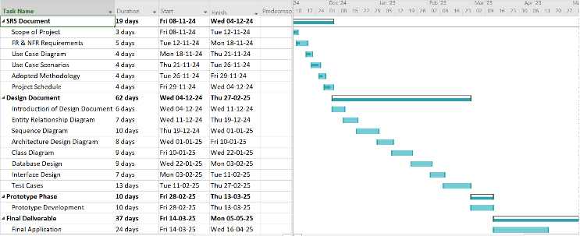
Project Schedule

Slide 10
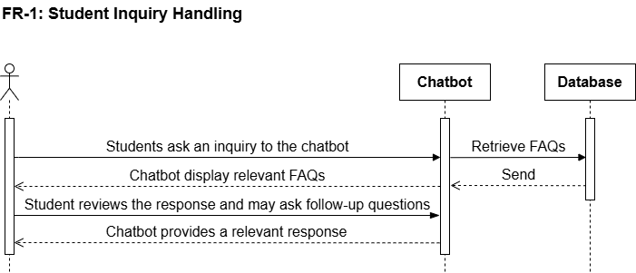
Sequence Diagrams

Slide 11
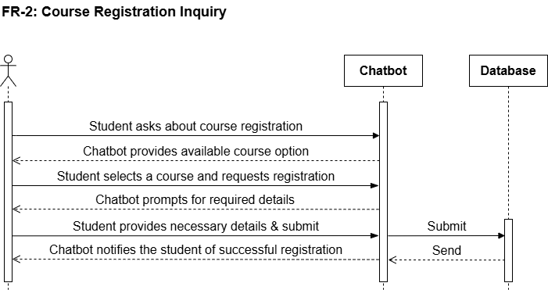
Sequence Diagrams

Slide 12
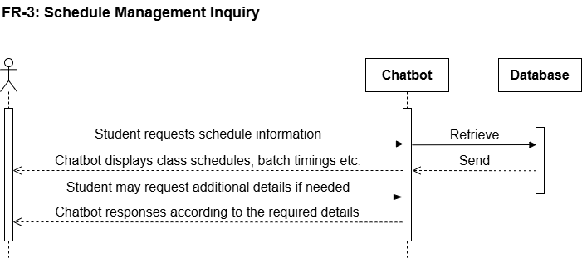
Sequence Diagrams

Slide 13
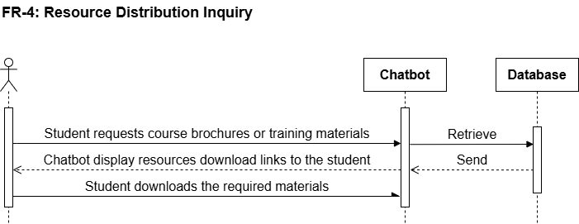
Sequence Diagrams

Slide 14
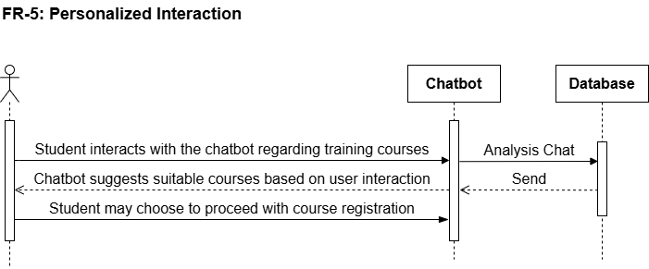
Sequence Diagrams

Slide 15
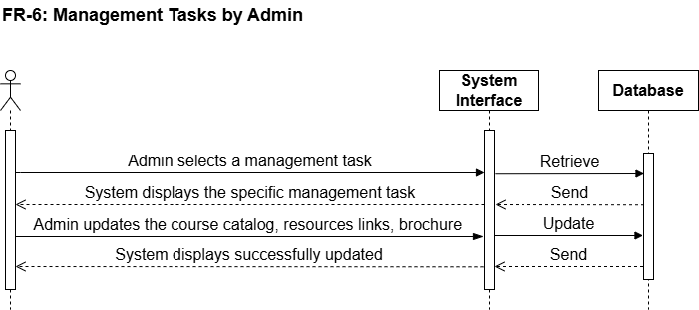
Sequence Diagrams

Slide 16
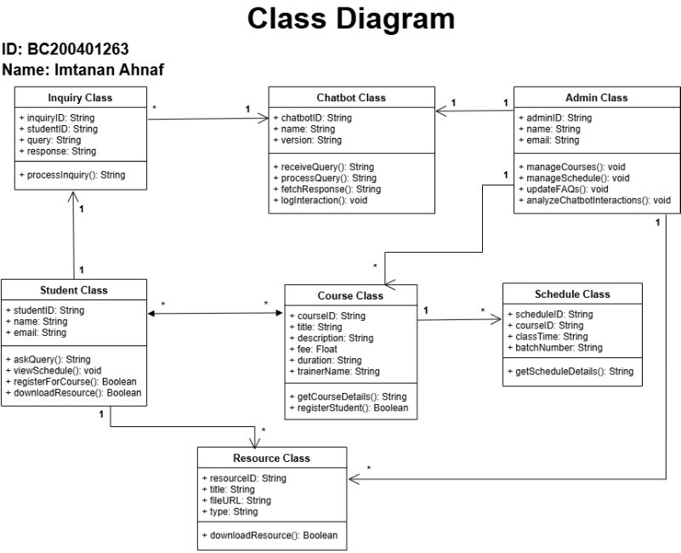
Logical Model/Class Diagram

Slide 17
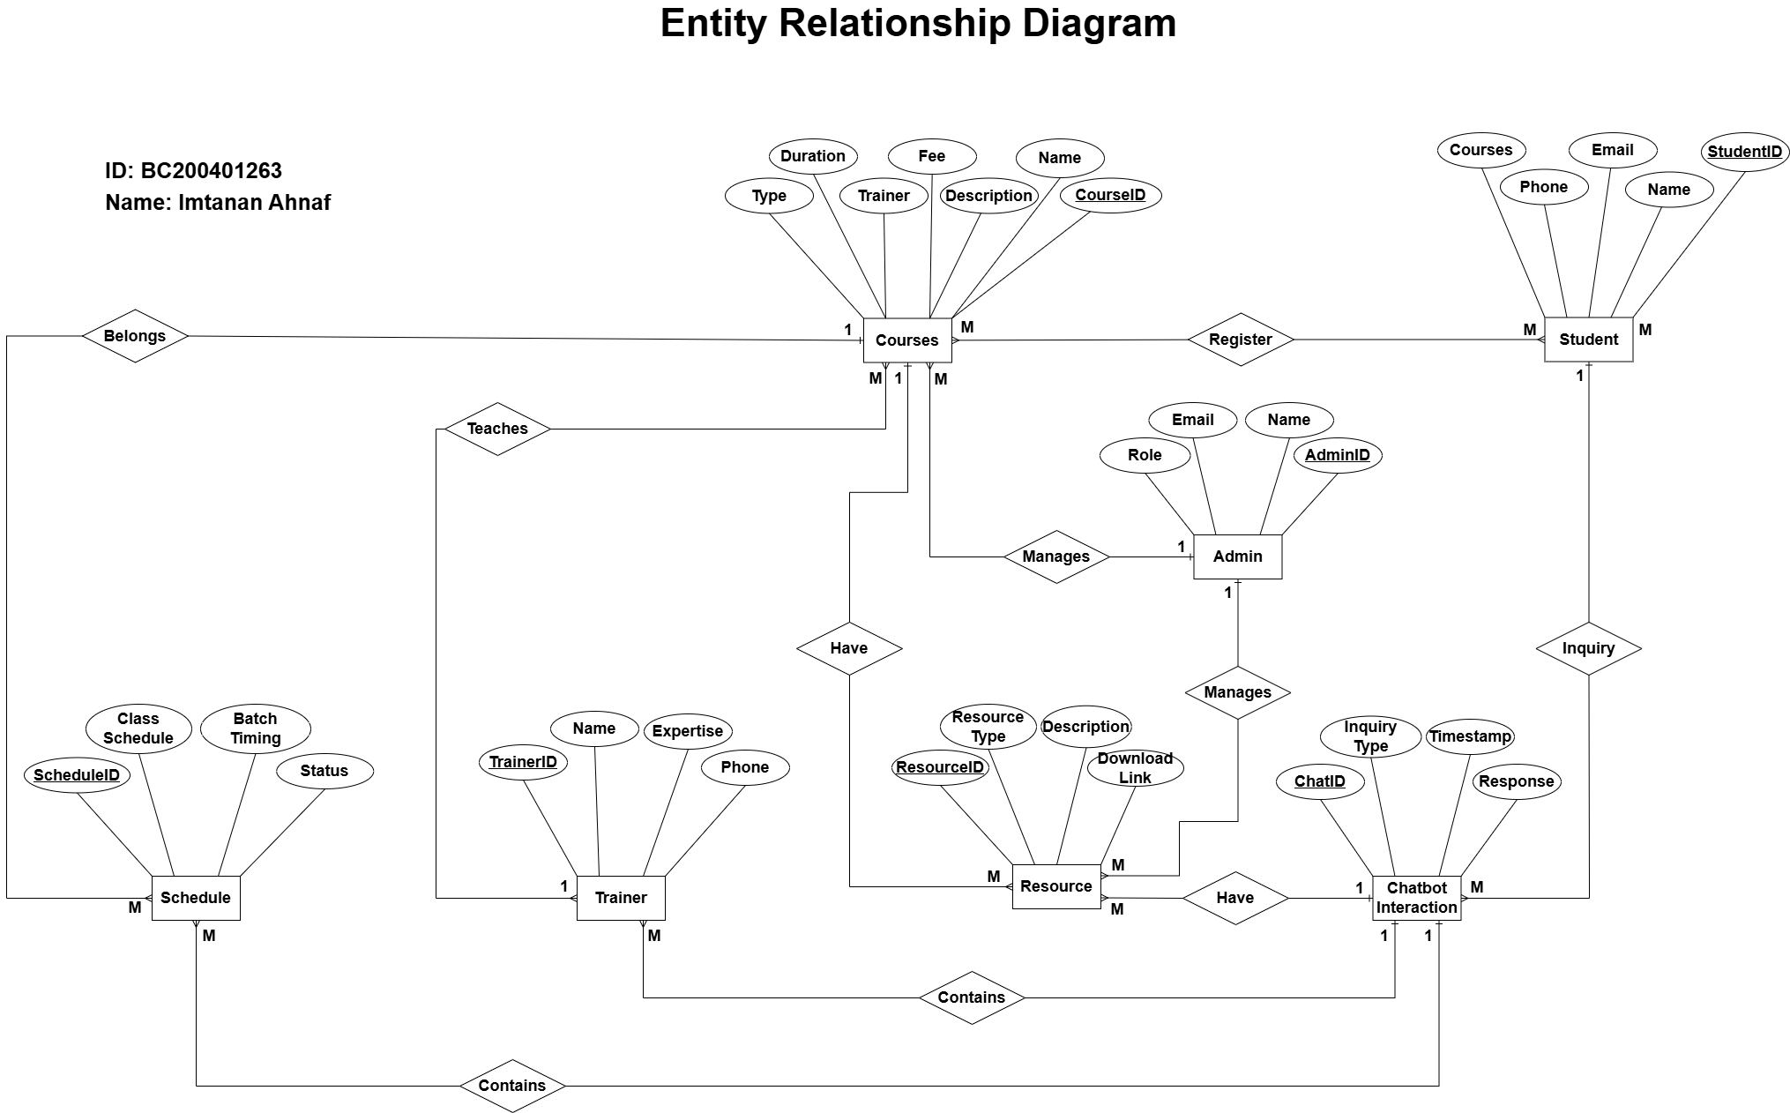
Entity-Relationship Diagram

Slide 18
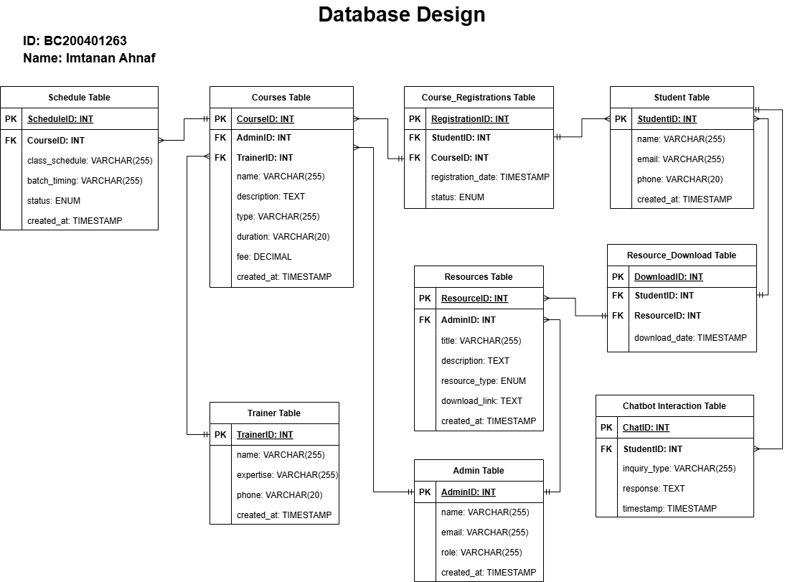
Database Diagram

Slide 19
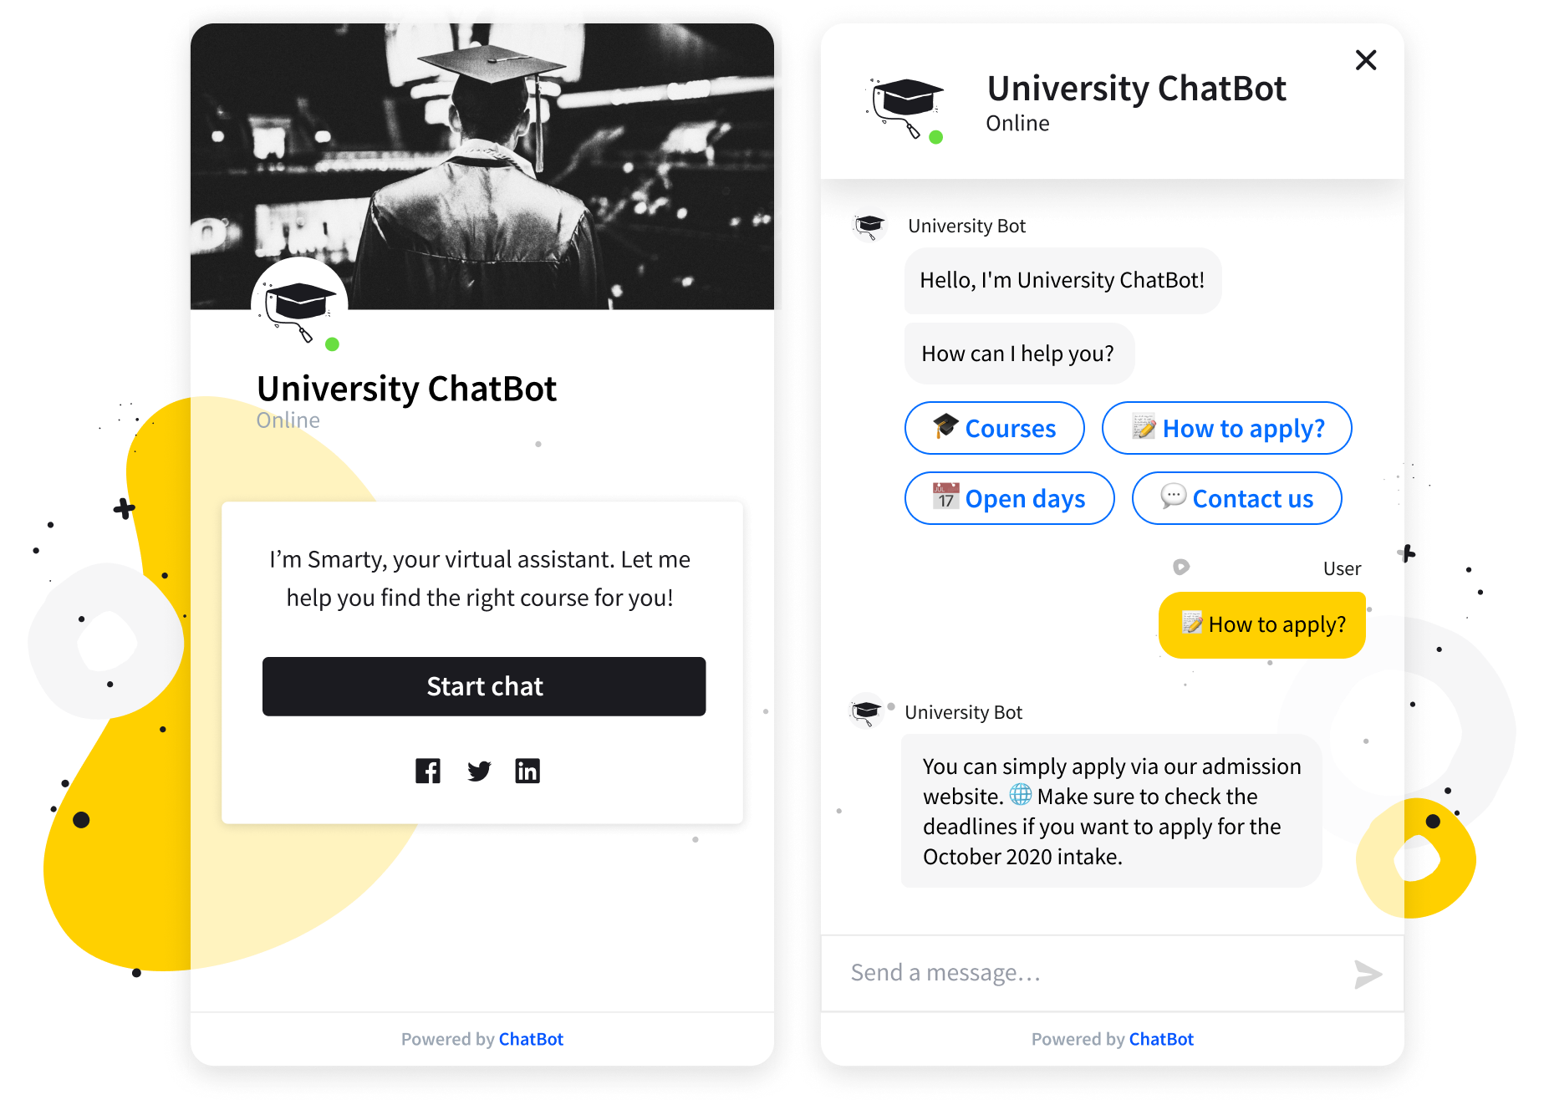
User Interfaces

Slide 20
Tools
Development & NLP Tools:
Dialogflow – For designing and training the NLP chatbot
PHP – Backend scripting and server-side logic
HTML/CSS/JavaScript – Frontend development
MySQL – Database management
VS Code – Code editor/IDE
XAMPP – Local server environment for PHP and MySQL
Testing & Debugging:
Postman – For testing APIs (if used)
Dialogflow Testing Console – To simulate and test user interactions

