Slide 1


Slide 2

NLP Chatbot Development Using dialogflow

Slide 3
My Introduction
Assalam o alaikum !
I am Imtanan Ahnaf, full-time student of BSSE and presenting you here my Final Year Project.
Group ID: F24PROJECT9A4A9
Student ID: BC200401263

Slide 4

INTRODUCTION OF PROJECT
This project aims to develop an intelligent chatbot using Dialogflow that automates and enhances customer support for a training company. The chatbot will handle tasks like answering course-related queries, managing student registrations, and providing timely information about schedules and services. By integrating Natural Language Processing (NLP), the system offers human-like interaction, improves user experience, and reduces the manual workload of administrative staff.

Slide 5
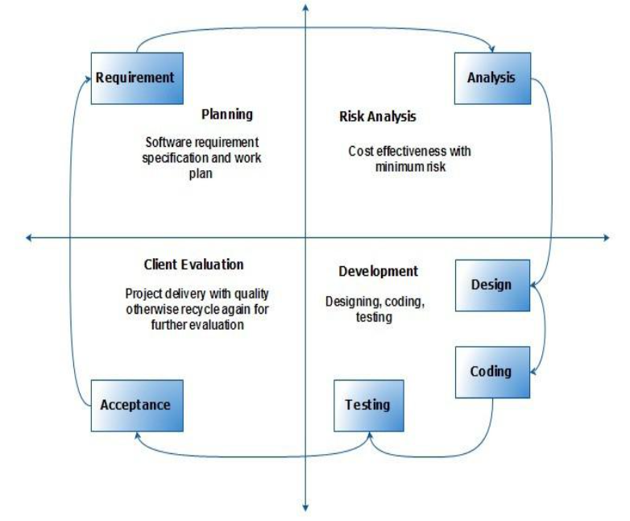
VU Process Model

Slide 6
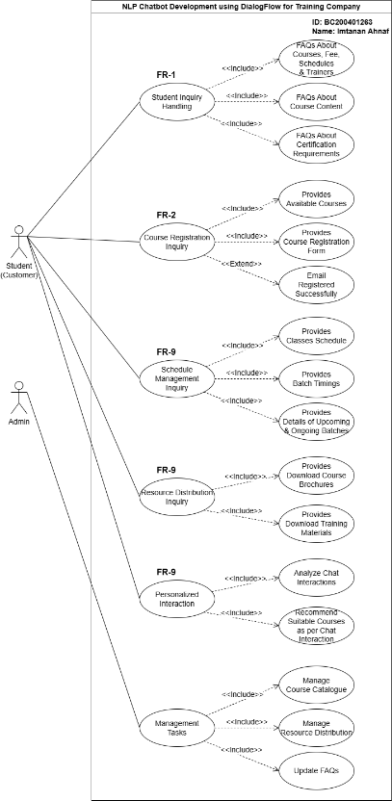
Use Case Diagram

Slide 7
Business Rules Catalog
1.Student Inquiry Handling
2.Course Registration
3.Schedule Management
4.Resource Distribution
5.Personalized Interaction
6.Management Tasks

Slide 8
DETAILED REQUIREMENTS(FR)
1. Student Inquiry Handling
Answers FAQs about courses, fees, schedules, and trainers
Provides details on course content & certifications
2. Course Registration
Displays available courses for easy registration
Sends confirmation messages upon successful signup
3. Schedule Management
Provides class schedules & batch timings
Allows users to check upcoming & ongoing classes
4. Resource Distribution
Enables students to download brochures & training materials
5. Personalized Interaction
Recommends courses based on user interests & history
6. Management Tasks (Admin Panel)
Manage Course Catalog – Add, update, or remove course details

Slide 9
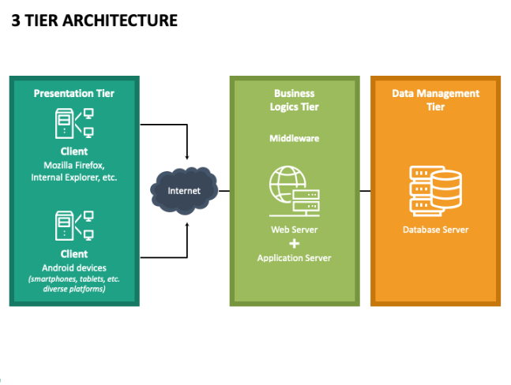
Architectural Design

Slide 10
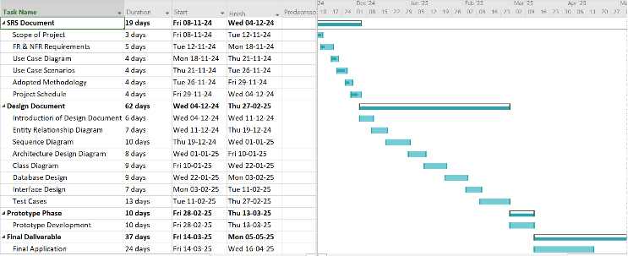
Project Schedule

Slide 11
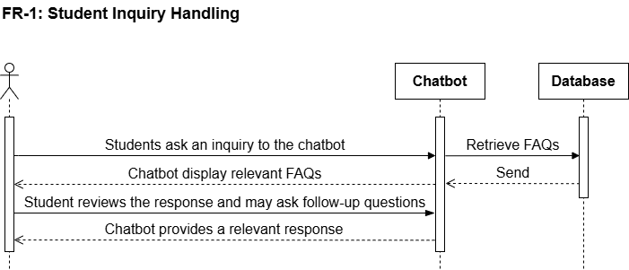
Sequence Diagrams

Slide 12
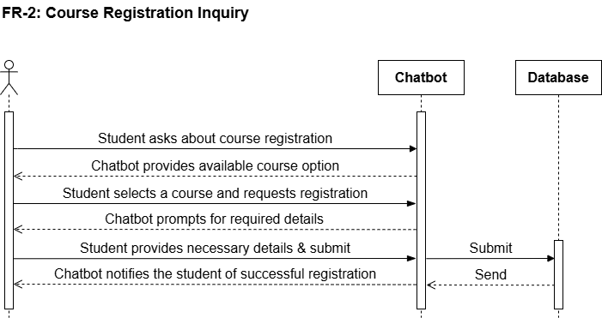
Sequence Diagrams

Slide 13
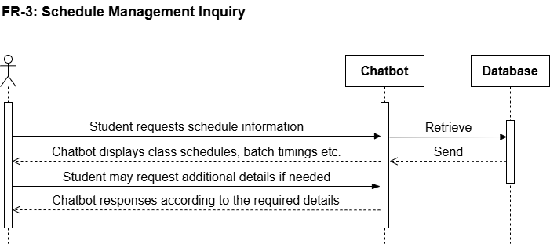
Sequence Diagrams

Slide 14
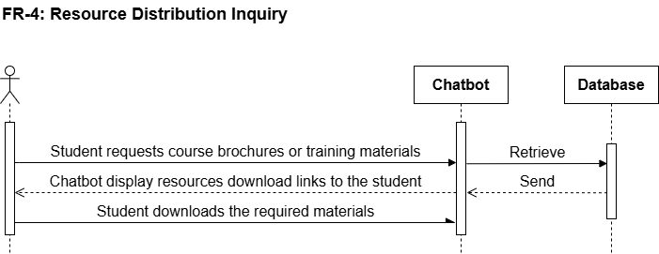
Sequence Diagrams

Slide 15
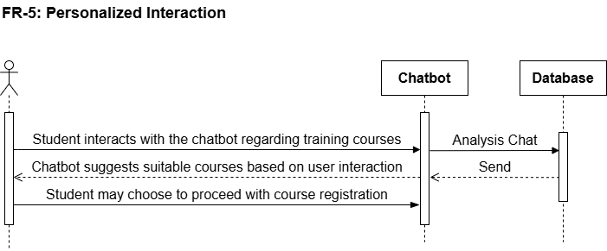
Sequence Diagrams

Slide 16
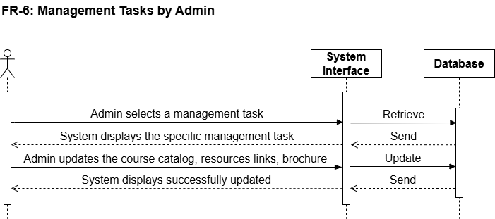
Sequence Diagrams

Slide 17
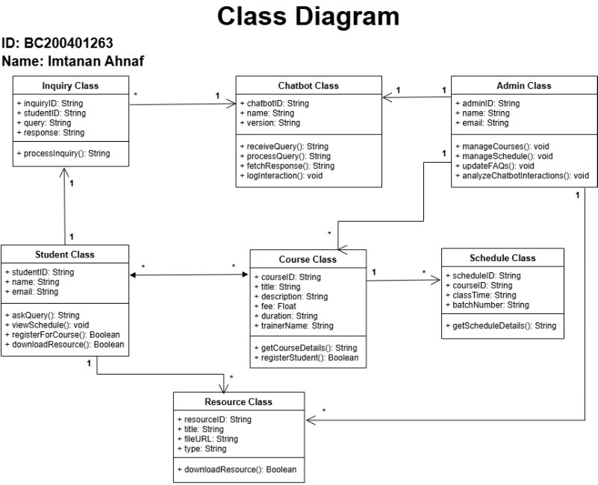
Logical Model/Class Diagram

Slide 18
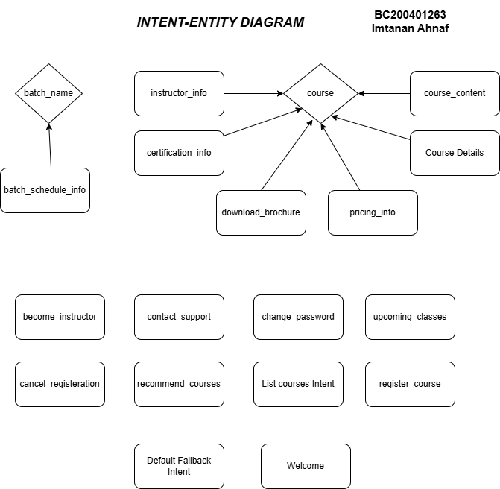

Slide 19
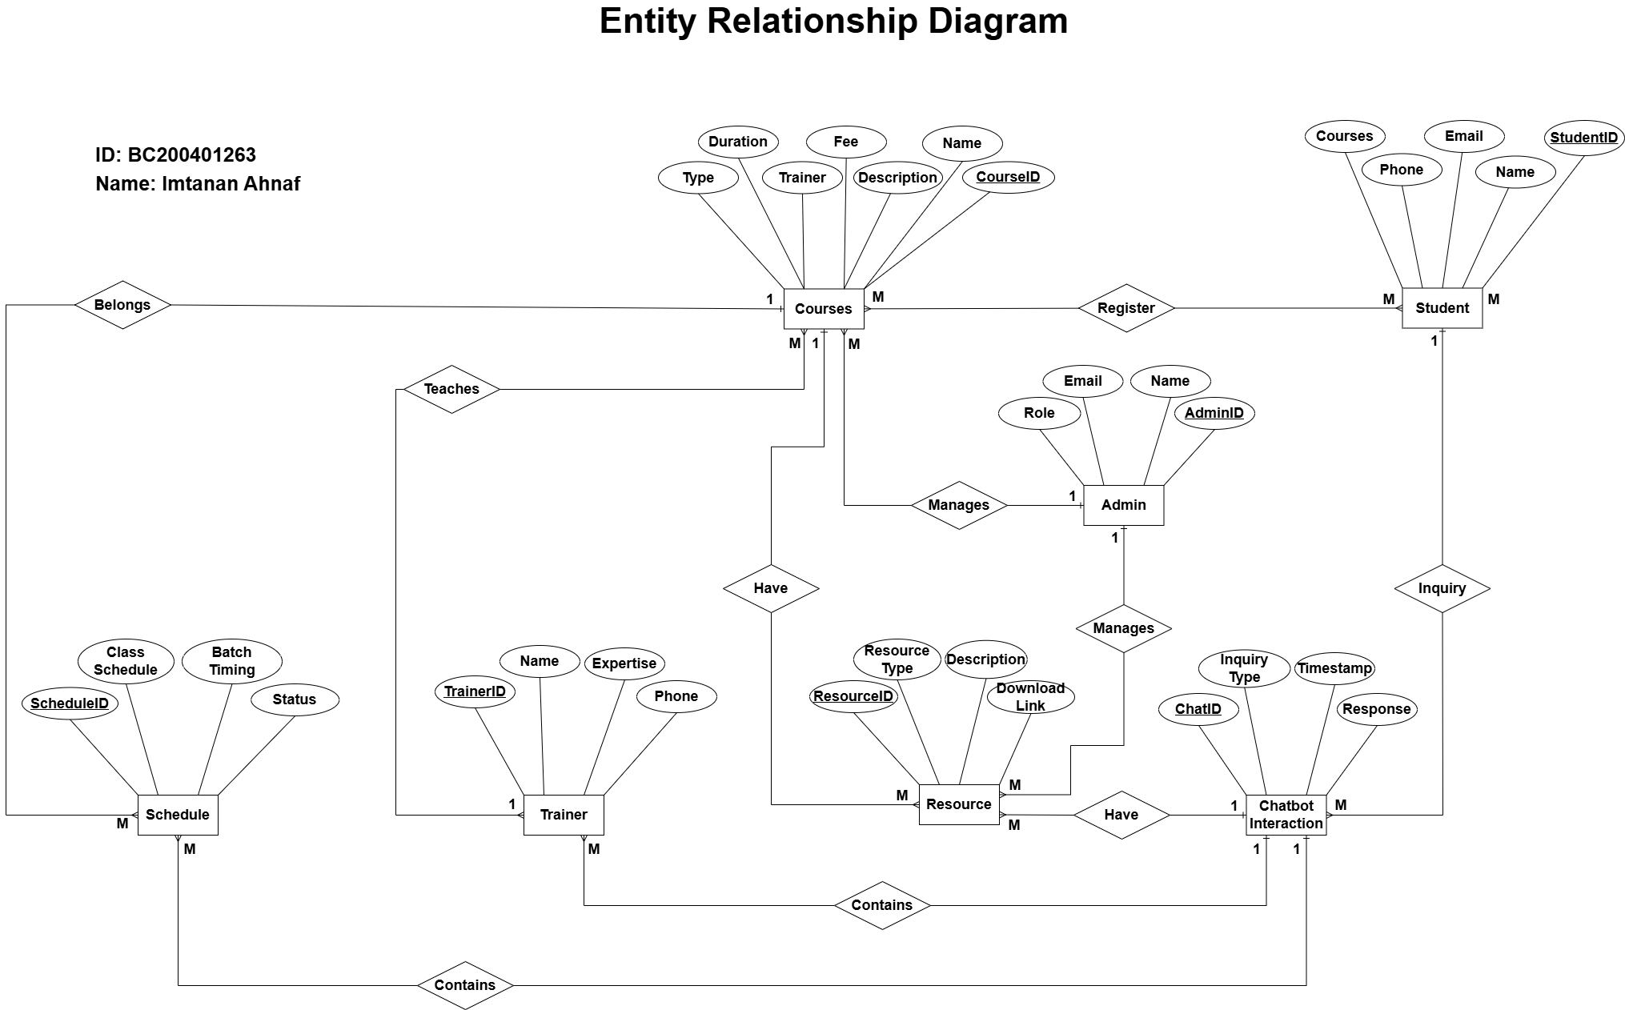
Entity-Relationship Diagram

Slide 20
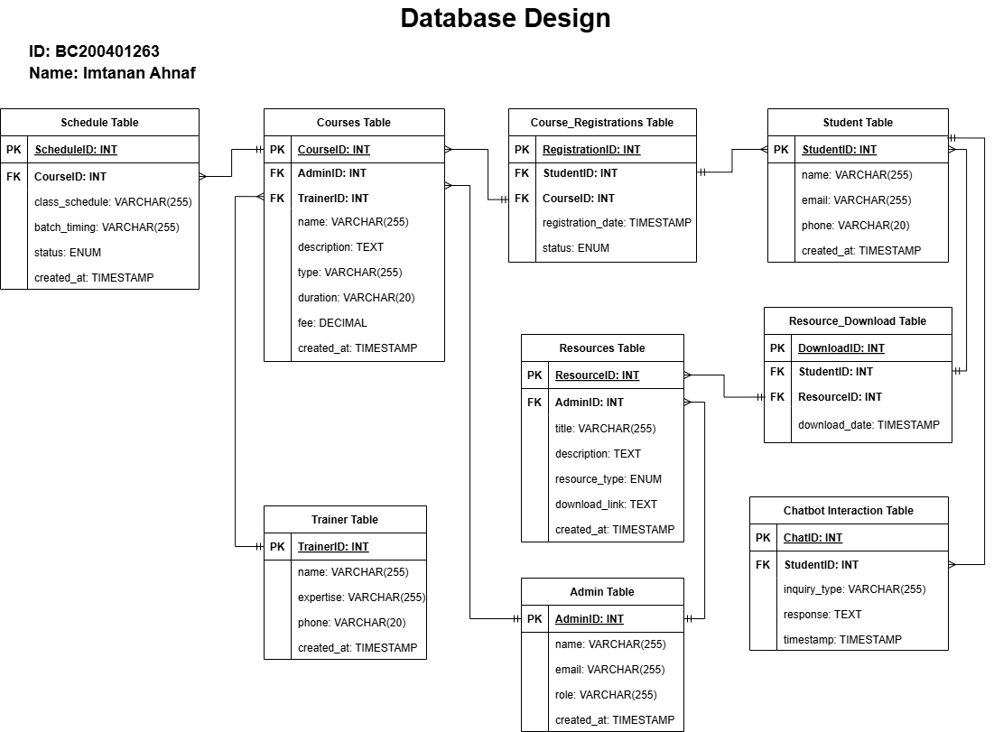
Database Diagram

Slide 21
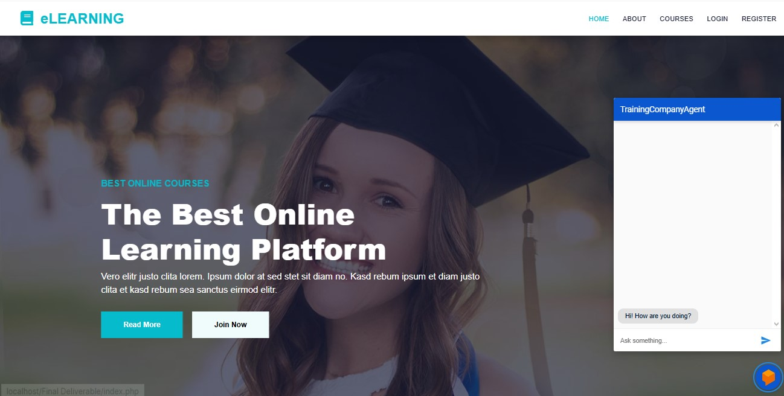
User Interfaces

Slide 22
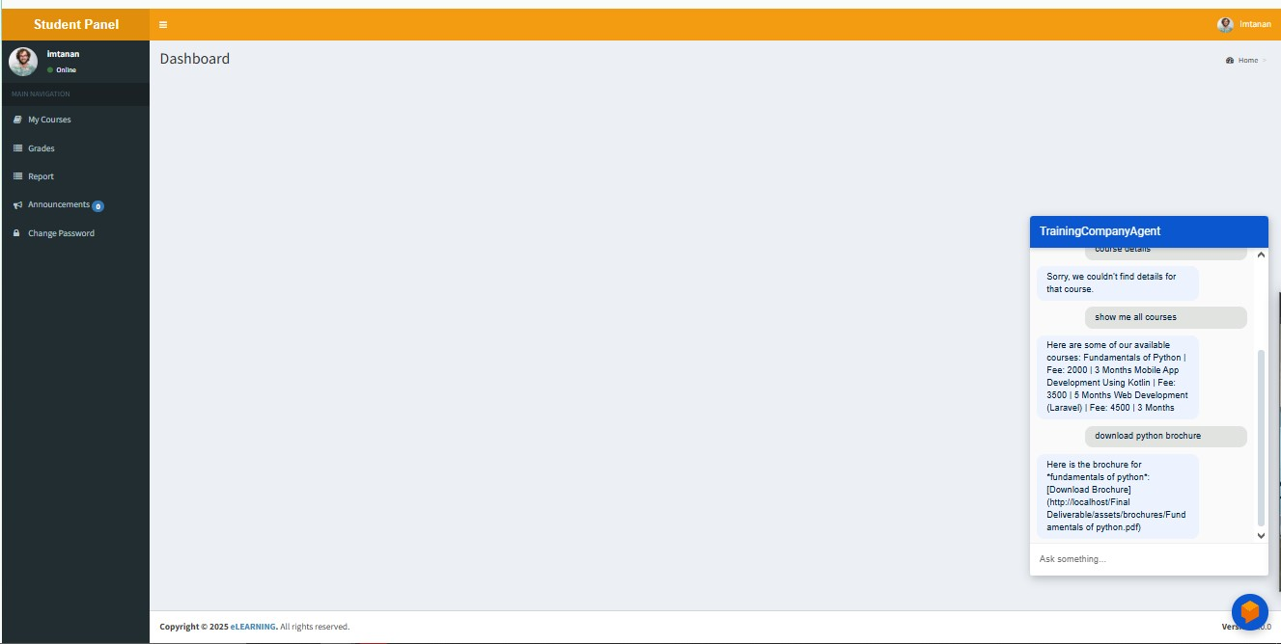
User Interfaces

Slide 23
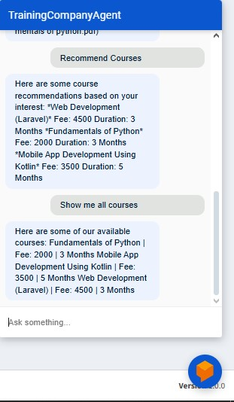
User Interfaces

Slide 24
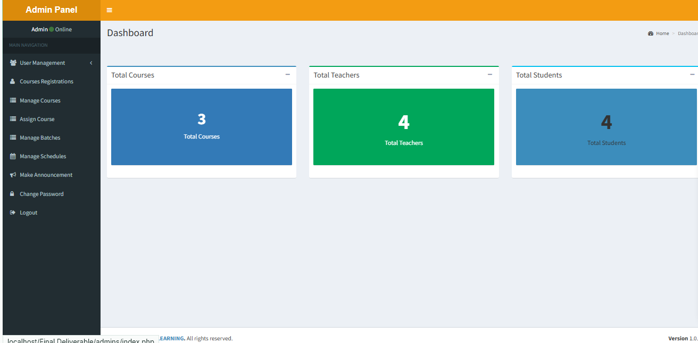
User Interfaces

Slide 25
Tools
Development & NLP Tools:
Dialogflow – For designing and training the NLP chatbot
PHP – Backend scripting and server-side logic
HTML/CSS/JavaScript – Frontend development
MySQL – Database management
VS Code – Code editor/IDE
XAMPP – Local server environment for PHP and MySQL
Admin LTE templates
Dialogflow Testing Console – To simulate and test user interactions

