Slide 1
Machine Learning
And KTAB: Vehicle Choice
Ben Wise

Slide 2
Problem
Use machine learning to find a model of vehicle choice by consumers
Input data is approximately 275K survey responses for 2015
Household characteristics
Household preferences
Vehicle choice
We will use Neural Networks to learn a KTAB model to predict vehicle choice
TensorFlow opensource toolkit from Google
Progress so far
Possible Future Applications

Slide 3
Project Goals
Primary goals
Demonstrate KTAB method can process objective data, not just expert opinion
Demonstrate that embedding knowledge of CDMP improves a neural net
Proof of concept: producing reliable policy recommendations is not a goal.
But identifying important factors in vehicle choice might be a side-product
Of the many possible “machine learning” techniques, we chose neural networks:
Build human capital for later projects
Interest junior staff who want to work in a hot field
Help build a data pipeline for future big data tasks

Slide 4
Project Summary
Obtained and configured TensorFlow (TF) on both GPU and CPU-only machines
Dr. Wise obtained high-performance GPU, which is located in USA but may be used for this project
Developed plan to convert existing vehicle choice dataset to format usable with TF
Developed TF program to generate various CDMP-structured test datasets
Developed and trained several neural networks (NN) to compare performance
Demonstrated improved performance on CDMP-structured test data by incorporating KTAB methods into NNs
Project participants: Rubal Dua, Andrew Howe, Imtenan Al-Mubarak, Ben Wise

Slide 5
Basic Machine Learning
Every NN encodes its inputs as a vector of numbers, and produces an output as a vector of numbers
Ranking Instagram selfies
Input: three numbers for each pixel of the image, representing R, G, B
Output: average score from other users, from 1 to 5 stars
AlphaGo
Input: The position on a 19x19 Go board, representing Black, White, or Empty at each point: 1083 numbers that are 0 or 1.
Output: a ranking of how good it would be to move to each position, i.e. a vector of 361 floating point numbers
Identifying objects in images
Input: R, G, B values for each pixel
Output: the probability that each known object-type describes that picture
Output can cover potentially tens of thousands of types
NNs tend to be very large, so specialized GPU hardware desirable.

Slide 6
Basic Machine Learning
A generic NN has an three main parts:
input layer (e.g. pixels of an image),
output layer (e.g. number of stars),
several “hidden layers” between
The hidden layers extract features that are useful for predicting the correct output.
The goal of the learning process is to determine …
what features are used,
how low-level features are computed from inputs,
how features are computed from lower-level features,
how top-level features are combined to determine the answer
Features are not specified in advance, they are learned.
Identifying and interpreting features is done after training is complete
Only the network topology is determined by a person.

Slide 7
Basic Machine Learning
Any computable function can be learned by a basic neural net with 2 hidden layers
Combinatorial explosion: with just 2, the layers must be extremely large
A more practical approach is to have narrower layers, but deeper network, so as to get enough combinations
Digit recognition: 95% accuracy using generic NN, two hidden layers
AlphaGo has 17 hidden layers, mostly customized to Go
It is common to improve both accuracy and speed by customizing the layers of a NN to take advantage of patterns known to exist in the data.
For images, relationships between nearby pixels are important (e.g. edge detection). Convolutional NN process squares of adjacent pixels, raising digit recognition over 98% accuracy
For time series, it is important to remember what happened earlier in the sequence. Recurrent NNs encode memory of past features.
In a series of characters representing computer code, a RNN learns to count indentations so as to de-indent exactly the right amount.
We built a custom layer to represent a kind of CDMP

Slide 8
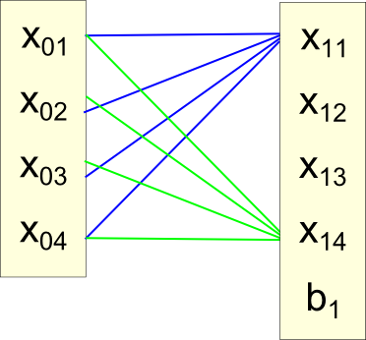
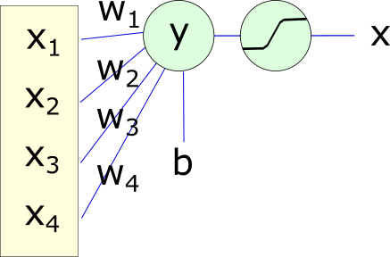
Basic Machine Learning
All the values from one layer are used to generate each value in the next
Weighted sum, plus a bias: x₁ = W₁ * x₀ + b₁
Clip with a nonlinear bound
All are done in parallel, with different weights and biases for each connection.

Slide 9
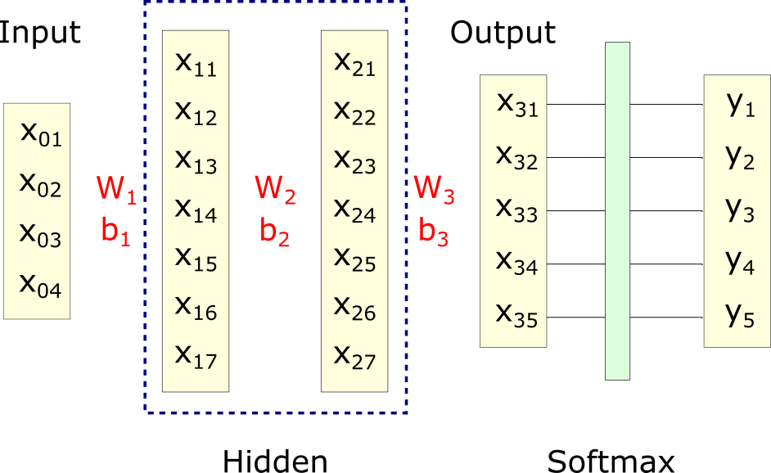
Basic Machine Learning
Layer 0 holds inputs. Layer 3 is the output. This example has two hidden layers.
Between layers, matrix of weights W, and vector of biases, b, are learned
Final output X values are normalized into probabilities
Probability that each possible category is correct in this case.
Standard TF function for this is “SoftMax”

Slide 10
Basic Machine Learning
Strictly, the Y value is the final output, but because there is no learning between final X and Y, it is not include in the layer-count
With just input and output, there is one layer of interconnections to be learned
Input to output: (W1,b1) maps X0 into X1
With one hidden layer, there are two layers of interconnections to learn
Input to hidden: (W1,b1) maps X0 into X1
Hidden to output: (W2, b2) maps X1 into X2
With two hidden layers, three layers of interconnections to learn
Input to hidden #1: (W1,b1) maps X0 into X1
Hidden #1 to hidden #2: (W2, b2) maps X1 into X2
Hidden #2 to output: (W3, b3) maps X2 into X3

Slide 11
Basic Machine Learning
Training a NN is “only” adjusting all the parameters in all the W and b so as to minimize the average categorization error.
TF can …
Efficiently perform the matrix operations to process values from input to output
Calculate many thousands of partial derivatives that specify how must to adjust each parameter to minimize categorization error.
TF only “knows” the derivatives of its built-in functions
The general-purpose C++ library underlying KTAB could not be used, because we do not now have algebraic formulae for the implied derivatives
Probably feasible in a second phase.
A particular KTAB-style CDMP can be easily specified in TF, and it formed the basis of our customized NN layer.

Slide 12
The Enumerated Model of Politics
KTAB’s fundamental representation of CDMP is an enumerated set of options, and interest groups promoting those options:
Various policies to reduce water consumption in KSA
Number of nuclear power plants to reopen in Japan
Degree of electric power network interconnection among GCC members
An “actor” represents a set of interests and exerts influence to promote those interests
For water reduction, most actors pursue revenue for agricultural interests, one pursues reduced water usage
For power plants, some actors pursue local economic interests, nuclear safety interests, national energy security interests, and so on.
Every actor has a weight, which describes how effective it is in promoting its interest.
If several actors prefer the same option, their influences combine to make it more likely.
Balance of exerted influence determines which options are most likely to be implemented.
Notes:
Bullet 1: The exertion of informal influence is fundamental to political negotiation, as it is often the decisive foundation of vote-casting.
Bullet 2: The PCE is extremely flexible, and lacks restrictive assumptions present in other frameworks.
Bullet 2: Ben showed how the PCE relates to negotiation related to positions along a spatial dimension.
Bullet 2: Additionally, the state may relate to such diverse topics as: differential taxation policy, division of scarce resources, or prioritization of a list of discrete activities.
Bullet 2: These are examples of decision topics for which it is more logical to think of as a decision for selecting an option among a collection or enumeration.
Bullet 3: Where i indexes the actors, w is their bargaining weights, u are their utility functions, x & y are two possible options.
Bullet 3: This is called the “proportional voting rule”.
Bullet 4: c(x:y) indicates actors in the coalition supporting x over y

Slide 13
The Enumerated Model of Politics
For vehicle choice by households, the options are different categories of vehicles.
Our dataset has multiple vehicle attributes, which we will group into seven categories for the NN to predict:
Large, small, or medium gas; diesel; electric; hybrid; flex
The interests (aka “actors”) of households are not pre-specified.
We specify the topology of the NN, so we decided there will be four interests.
The NN will learn a set of interests which are useful in predicting vehicle choice
The task of the NN is to learn how to describe each household’s individual CDMP, given the attributes of that household.
NN learns parameters and features for setting up a CDMP, but not solving it.
KTAB methodology describes what structure a CDMP should have, so the NN does not have any ability to “tune” the CDMP itself.
Notes:
Bullet 1: The exertion of informal influence is fundamental to political negotiation, as it is often the decisive foundation of vote-casting.
Bullet 2: The PCE is extremely flexible, and lacks restrictive assumptions present in other frameworks.
Bullet 2: Ben showed how the PCE relates to negotiation related to positions along a spatial dimension.
Bullet 2: Additionally, the state may relate to such diverse topics as: differential taxation policy, division of scarce resources, or prioritization of a list of discrete activities.
Bullet 2: These are examples of decision topics for which it is more logical to think of as a decision for selecting an option among a collection or enumeration.
Bullet 3: Where i indexes the actors, w is their bargaining weights, u are their utility functions, x & y are two possible options.
Bullet 3: This is called the “proportional voting rule”.
Bullet 4: c(x:y) indicates actors in the coalition supporting x over y

Slide 14
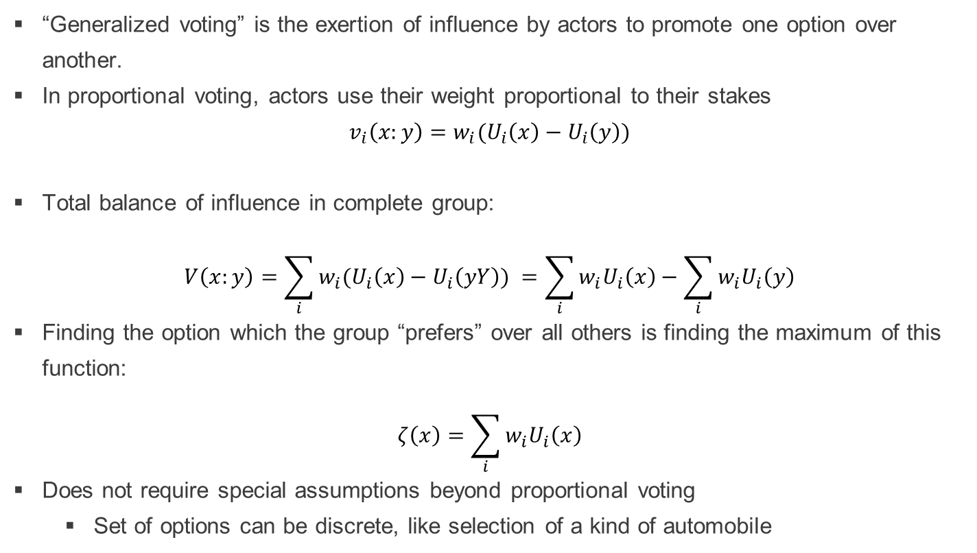
CDMP with Proportional voting
“Generalized voting” is the exertion of influence by actors to promote one option over another.
In proportional voting, actors use their weight proportional to their stakes
$$v_{i}\left(x:y\right)=w_{i}(U_{i}\left(x\right)−U_{i}\left(y\right))$$
Total balance of influence in complete group:
$$V\left(x:y\right)=\sum_{i}{w_{i}(U_{i}\left(x\right)−U_{i}\left(yY\right)) }=\sum_{i}{w_{i}U_{i}\left(x\right)}−\sum_{i}{w_{i}U_{i}\left(y\right)}$$
Finding the option which the group “prefers” over all others is finding the maximum of this function:
$$ζ\left(x\right)=\sum_{i}{w_{i}U_{i}\left(x\right)}$$
Does not require special assumptions beyond proportional voting
Set of options can be discrete, like selection of a kind of automobile

Slide 15
CDMP in KTAB
The fundamental representation of CDMP in KTAB is probabilistic
Fixed set of actors and a vector of their weights,
A set of policy options
The matrix of how much each actor values each options
KTAB estimates a distribution for the probability that the whole group will choose each option
For a quick proof of principle project, it was not feasible to compute the derivatives of a Probabilistic Condorcet Election, so the full C++ library for all the different ways to calculate the probabilities in different situations could not be used.
However, computing the central position is feasible as 5-dimensional tensor manipulations in TF, so our customized NN layers use the central position theorem to estimate vehicle choice.
Notes:
Bullet 1: In a simple case of only two options in the State, we show here the calculations needed. The probabilistic Condorcet winner is whichever option produces the highest probability.

Slide 16
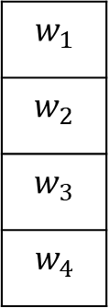
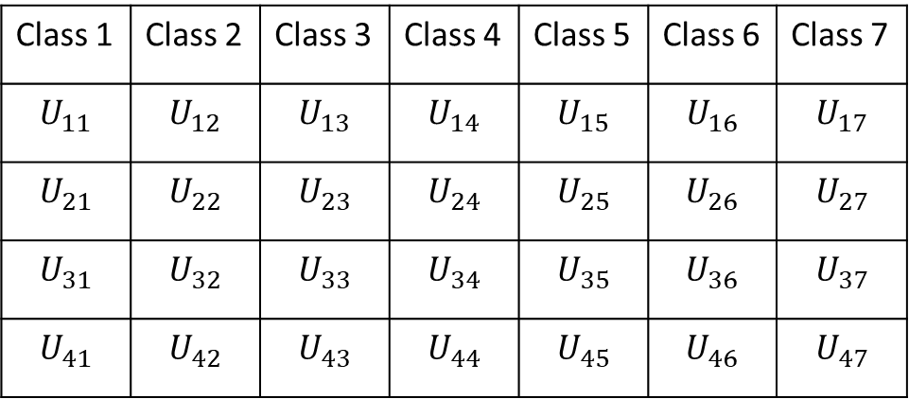
Combine ML with KTAB
Class 1 | Class 2 | Class 3 | Class 4 | Class 5 | Class 6 | Class 7
$$U_{11}$$ | $$U_{12}$$ | $$U_{13}$$ | $$U_{14}$$ | $$U_{15}$$ | $$U_{16}$$ | $$U_{17}$$
$$U_{21}$$ | $$U_{22}$$ | $$U_{23}$$ | $$U_{24}$$ | $$U_{25}$$ | $$U_{26}$$ | $$U_{27}$$
$$U_{31}$$ | $$U_{32}$$ | $$U_{33}$$ | $$U_{34}$$ | $$U_{35}$$ | $$U_{36}$$ | $$U_{37}$$
$$U_{41}$$ | $$U_{42}$$ | $$U_{43}$$ | $$U_{44}$$ | $$U_{45}$$ | $$U_{46}$$ | $$U_{47}$$
$$w_{1}$$
$$w_{2}$$
$$w_{3}$$
$$w_{4}$$
TF seeks a mapping from responses to CDMP which, on average, leads the CDMP accurately to predict the vehicle choice,
Learn a general mapping that takes each household’s survey responses and sets up a particular CDMP for that household. That CDMP is solved via CPT to estimate the vehicle choice.
With four interests and seven classes of vehicle to choose, NN must learn how to estimate 32 separate CDMP parameters for each household: 4 weights, 28 utilities

Slide 17
Synthesizing Test Data
Full data set has not yet been converted to TF-usable form.
Debugged NN model on synthesized test data
TF program to generate structured datasets
All parameters easily varied
100K rows in each data set
Each household response is formed from its own 8-vector of random seeds.
Four weights are set by non-linear transformation of the seed.
Two multiple-choice questions
First has three possible answers, coded “one hot”.
Checking third response is coded as [0, 0, 1]
Second has five possible answers, also coded as “one hot”
Selected vehicle is chosen using CDMP model, where the utility matrix used depends on answers to the multiple-choice questions.
Six numerical responses are determined as linear combination of seeds, to represent partial information in responses like income, children, etc.

Slide 18
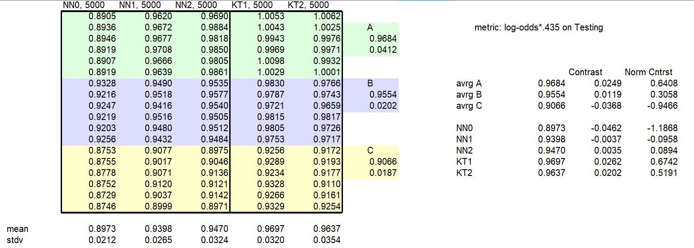
Training Results
For testing, we synthesized data with 18 values per household (easily changed).
As each feature (neuron) in first hidden layer could be defined by interaction of several responses, we specified 36 neurons (easily changed)
TF processes survey data in batches, so input vector X₀ is actually a matrix indexed by (household, response).
Three synthesized datasets, with set C the most difficult.
Six training sessions on each dataset for each of five neural nets; 90 runs.
Reported result is out-of-sample test data, not performance on training data
No opportunity to optimize response on testing data: never during training
Three generic NNs, with 0, 1, or 2 hidden layers.
Two KTAB-based NNs, with 1 or 2 hidden layers
All hidden layers were 28 wide.

Slide 19
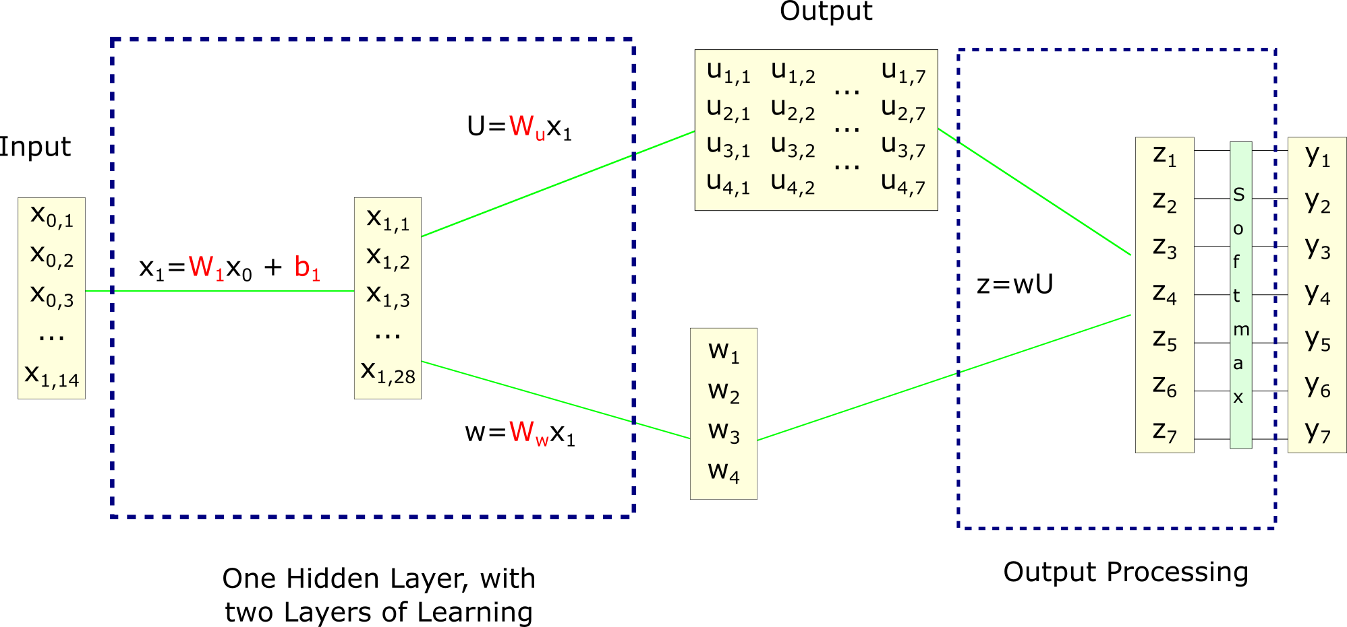
Best NN was KTAB-based, with 1 hidden layer (KT1)
NN “learns” by adjusting the red parameters so that Y accurately predicts the vehicle choice by each household (on average).
W₁ is a 2-dimensional matrix: 28 x 18
W_{w} is a 2-dimensional matrix: 4 x 28
W_{u} is a 3-dimensional cube: 4 x 7 x 28
Input is actually 100 x 14 matrix, representing 100 samples in a training batch with 14 attributes each.
Output is 100 x 7 matrix: 100 samples in a batch, 7 categories

Slide 20
Best NN was KT1
With two layers of interconnections to learn, KT1 has same complexity as NN1
Different data set might have different optimal architecture (easily changed).
Just as Softmax has no learning and hence does not contribute to layer-count, the CDMP is a fixed function without learning, and so does not contribute to count

Slide 21
Structure of KT1 network
Input layer has 14 numerical values representing survey response of each household.
W₁ extracts first layer of features by linear combinations of responses, with clipping.
Because features are interactions of responses, hidden layer is wider than original data. Two-way interactions alone provide (14 x 13) / 2 = 91 possible features.
Many more 3, 4, … -way interactions can be represented in the W matrix
NN identifies what sub-set of possible features are most useful.
W_{w} holds 28 canonical weight-vectors (all learned from the data).
Combines them according to the features of this household to estimate the weights for each interest.
W_{u} holds 28 canonical utility-matrices (all learned from the data).
Feature-weighted combination is estimated utility matrix for this household, stating how much each interest is satisfied by a particular vehicle.
A more complex data set will probably require a modified architecture
Much wider, to represent more responses and more possible features
2 or 3 hidden layers, to extract more subtle features and interactions.

Slide 22
Next Steps
Convert the 2015 vehicle choice data to usable form.
Design a sampling / training plan to compensate for any problems that might be identified in the dataset, if any.
Possibly obtain GPU to speed processing
Modify existing NN code to try several architectures
Generic NNs for base-line
Customized with KTAB layer to determine if it helps or hurts accuracy.

Slide 23
Future Application Areas
Potential applications will be influenced by the TF technology and data availability
To train any NN, we need many basically similar examples of a CDMP
275K household choices
In a presidential election, every combination of counties and demographics
There must be some set of outcomes common to all the CDMPs
Class of vehicle chosen
Fraction to each candidate
There must be a reasonable expectation that some common set of interests are involved in each of the CDMPs
Not specified in advance but learned by NN
Possible examples
Vehicle choice in China
Crop choices on farms in KSA
Commuting patterns by vehicles in KSA
Household energy choices in KSA

Slide 24
Machine Learning
With KTAB: Vehicle Choice
Ben Wise

Slide 25
Central Position Theorem
Cost of exerting influence suggests proportional voting rule:
$$v_{i}\left(x:y\right)=w_{i} ×\left(U_{i}\left(x\right)−U_{i}\left(y\right)\right)$$
A different CW exists, the Central Position (CP), which has very desirable properties:
Exists in multiple dimensions and discrete options
Exists for unimodal or multi-modal utility functions
The CP is the position which maximizes
$$ζ\left(x\right)=\sum_{i}{w_{i}U_{i}\left(x\right)}$$
This function apparently was first derived by Arrow in 1963 using stricter conditions
And at least five times since, each under different detailed assumptions
Simple proof for the general case is apparently not widely known.

Slide 26
Probabilistic Condorcet Election
The winner of the PCE is chosen by maximizing the probabilistic ratio of the coalition strengths over all pairs of options in the state S; it is called the Probabilistic Condorcet Winner.
Two important benefits of a PCE:
The Probabilistic Condorcet Winner will always exist.
The results of a PCE are probabilities, so we have data by which to make probabilistic inference about the process.
TF can compute derivatives of conditional probabilities, so this could be used in a second phase of the project.
Notes:
Bullet 1: In a simple case of only two options in the State, we show here the calculations needed. The probabilistic Condorcet winner is whichever option produces the highest probability.

