Slide 1
DreamEEG
Visual Imagery Decoder
for people with ALS & Locked-In Syndrome
Md. Imtiaj Alam Sajin: 26-94090-2
Md. Samiul Islam Saif: 26-94151-2
Notes:
About 15 seconds. Say: DreamEEG. We want to build a better visual-imagery decoder so a brain-computer interface can actually help people with ALS and locked-in syndrome communicate.

Slide 2
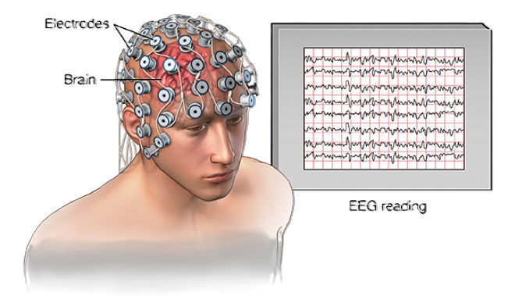
MOTIVATION
Problem Statement
1
ALS & locked-in syndrome trap an intact mind in a still body
A brain-based channel is often the only way left to communicate.
THE REAL GAP
Decoding isn’t yet accurate or reliable enough to be someone’s
only voice.
2
Most EEG-BCIs rely on motor imagery
But that routes through the motor system, exactly what ALS destroys.
Visual imagery (VI), picturing an object, is a motor-free path
Intuitive and promising, but the neural signals are weak and noisy.
Objects sit at just 62%, and tested only on the same person.
The bottleneck is the decoder itself, so that’s what we set out to improve.
3
4
A new VI dataset exists (Gao et al., 2026), yet decoding is still weak
The best baseline (EEGNet) reaches only about 75%, and just 62% on objects.
PROBLEM 02
Notes:
Amyotrophic lateral sclerosis (ALS), often called Lou Gehrig's disease, is a progressive, fatal neurological disorder. It destroys motor neurons.

Slide 3
DATA
The Dataset We Will Use
1. Source: Gao et al. (2026), Scientific Data · open · VI-focused, not motor imagery · new, no prior work
2. Participants: 22 healthy · aged 20 to 23 · 5 female · 2 sessions on different days
3. Recording: 32 channels · 1000 Hz · 10-20 layout · shielded room
4. Stimuli: 10 images · 3 categories: figures, animals, objects
5. Trial (17 s): fixation 3 s → image 4 s → mask 2 s → imagery 4 s → rest · decode the 4 s imagery
6. Task: 3-class within a category (dog vs fish vs bird) · chance 33% · 120 / 120 / 160 trials
7. Quality: open BIDS format · raw + preprocessed · baseline code (MNE, PyTorch)
Dataset: https://figshare.com/articles/dataset/EEG_Dataset_for_Visual_Imagery/30227503
Dataset’s own paper here: https://www.nature.com/articles/s41597-025-06512-5
DATASET 03
Notes:
Just hit the key facts: open VI dataset, brand new. 22 healthy people, two sessions. 32 channels at 1000 Hz. 10 images in three categories, abstract to concrete. Each trial is 17 seconds and we decode only the 4 second imagery window. Task is 3-class within a category, chance 33%. Open with baseline code, so we start immediately.

Slide 4
AIMS
Research Objectives
01
02
03
PRIMARY
Stronger decoder
Fix the weakest task
Lightweight & practical
Design a combined CNN-Transformer that beats the EEGNet baseline.
Lift object-category accuracy (62%) toward figures & animals (~75%).
Few parameters, single-GPU, deployable for real assistive use.
04
05
06
Stable over time
Generalize to new users
Clinical relevance
Stay consistent day to day (session 1 → session 2).
Cut per-user calibration via transfer learning / alignment.
Reliable enough to aid ALS / locked-in communication.
OBJECTIVES 03
Notes:
Lead with the primary aim: a stronger, combined decoder that beats EEGNet. Number 2 targets the weak object category specifically. Number 3 keep it lightweight so it can actually reach patients. Numbers 4 and 5 are robustness: stable over days, and generalizing to new users to cut calibration. Number 6 is the point of all of it: reliable enough to help ALS and locked-in users. Do not read all six, group them.

Slide 5
PRIOR WORK
Literature Review
Decoding backbones
Visual-imagery decoding
Clinical BCIs for ALS
Lawhern 2018 · EEGNet
compact CNN, the baseline we must beat
Gao 2026 · our VI dataset
EEGNet 75% / 62% objects, within-subj.
Birbaumer 1999 · first EEG speller
proof: paralysed can spell
Song 2022 · EEG Conformer
CNN+Transformer, SOTA on MI/emotion
Wilson 2023 · semantic VI set
open comparison dataset
Vansteensel 2016 · implanted BCI
locked-in ALS types at home
Wang 2025 · DBConformer
dual-branch, about 8x fewer params
Kilmarx 2024 · VI feasibility
works, but high variance / modest acc.
Willett 2023 · 62 wpm speech BCI
frontier, but invasive & per-user
LITERATURE 04
Notes:
One, decoders: EEGNet is our baseline; Conformer and DBConformer show CNN+Transformer hybrids win, the basis for our model. Two, VI work including our dataset at 75% and 62%. Three, robustness and transfer: how we stay stable and cut calibration. Four, clinical ALS BCIs: powerful but slow or invasive, which is why a better non-invasive VI decoder matters.

Slide 6
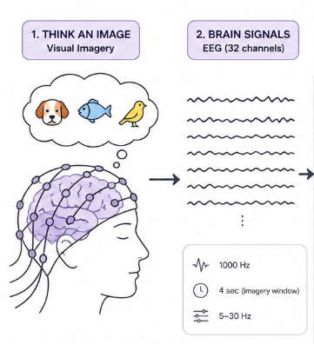
PROPOSED METHOD
Our Model & Hypothesis
HYPOTHESIS
Our approach would be initially test and find which probes/channels are more related for our problem to work. Then use customized model
PROPOSED ARCHITECTURE
SHARED FRONT-END
DUAL-STREAM ENCODER (variance-coupled · our key edge)
EEG EPOCH
32 ch × 4 s
preprocessed
5-30 Hz
Multi-scale Temporal Conv
parallel kernels 32 · 64 · 96 · 128
Mean pool
Pμ · first order
Gated Dual-Attention
Transformer × 4 · spatial + temporal gates
FUSION HEAD
concat → conv → softmax
3 classes
dog · fish · bird
Depthwise Spatial Conv
C × 1 · BatchNorm · ELU
Log-var pool
Pσ² · band-power
Gated Dual-Attention
Transformer × 4 · spatial + temporal gates
METHOD 06
Notes:
This is not a generic CNN plus Transformer. We adapt our own decoder, VC-DATNet, which topped a ten-architecture inner-speech benchmark at about 131K parameters. Read the hypothesis, then the diagram left to right. A shared front end: a multi-scale temporal convolution with four kernel sizes, then a depthwise spatial convolution. Then the key part, a dual-stream encoder: one stream on the mean, one on the log-variance, which is band-limited power, the ERD and ERS cue that EEGNet throws away by pooling only the mean. Each stream goes through a four-layer gated dual-attention Transformer. We concatenate, run a small conv head, and classify the three within-category items. That variance stream plus gated attention is our edge, and the model stays small enough for real assistive use.

Slide 7
EVALUATION
The Bar to Beat & Our Plan
BASELINE TO BEAT: EEGNet (Gao et al., 2026)
OUR STAGED PLAN
Within-subject, 3-class within-category · chance = 33%
1
Reproduce the EEGNet & CSP+KNN baseline, to confirm our pipeline matches their numbers.
Figures
75.1%
Animals
75.8%
2
Build & tune the hybrid CNN-Transformer, our core contribution, to beat the baseline.
Objects
62.0%
Target the object category with attention / augmentation to lift the weakest class.
3
Objects is the weak spot. Closing this gap is our main improvement target, and the hardest, most useful case.
Add alignment + transfer learning for stability across sessions and less calibration.
4
Dataset: 22 subjects · 32 ch @ 1000 Hz · 2 sessions · open BIDS + baseline code.
EVALUATION 07
Notes:
Left: their EEGNet baseline is the honest bar, 75% figures and animals but only 62% on objects, chance 33%. Objects is where the real headroom is, and it is the hardest case. Right: our four-step plan: reproduce the baseline, build the hybrid model, specifically attack the object category, then add alignment and transfer for robustness. Be explicit: success means a measurable gain over EEGNet, not a vague promise. Skip or compress this slide first if over time.

Slide 8
Thank you
Questions & Discussion
A stronger, lighter VI decoder that beats the EEGNet baseline, so a BCI can actually help ALS & locked-in users.
Sajin & Saif · DreamEEG · Midterm Proposal
Notes:
Q&A 5 minutes. Likely questions: Why not motor imagery? ALS breaks it. Why will a hybrid beat EEGNet? Conformer and DBConformer already show CNN plus Transformer wins on EEG. Why is objects low? Fine structural similarity, for example watch vs scissors, so attention and augmentation should help. Cross-subject? A robustness goal, not the headline. Scope: keep 3-class within-category, or extend to 10-class, invite the teacher's view.

