Slide 1
Measuring the Impact of Index Types and Tuning Settings on Query Execution Plans in PostgreSQL and MariaDB
An access-path study across two independently written optimisers
Md. Imtiaj Alam Sajin
26-94090-2 | 26-94090-2@student.aiub.edu
Supervisor
Dr. Ashraf Uddin
Notes:
This is an empirical study of how two relational engines choose an access path, and whether the tuning advice written for that decision actually works. The reason there are two engines rather than one is the core of the talk: with a single system you cannot tell a property of cost-based optimisation from a quirk of one product.

Slide 2
MOTIVATION
A decision nobody sees, and advice nobody measured
Scan the table, or use an index, and if so which one.
One decision per query, invisible to the user, worth up to two orders of magnitude in runtime.
The literature attributes bad plans to cardinality misestimation. That work targets join ordering. The single-relation access-path decision has not been isolated the same way.
Four widely recommended practices
Extended statistics for correlated columns
Lower random_page_cost on SSD storage
Add a BRIN index, it costs almost nothing
Enable Multi-Range Read in MariaDB
Every one is sound in the case it was written for. This study measures where each stops being sound.
2
Notes:
The starting point. Every query needs one decision made for it, and the same query on the same data can be a hundred times slower depending on it. Because the decision is invisible, a large body of tuning advice has grown around helping the database make it. That advice is written by good engineers and it sounds right. Almost none of it has been measured under controlled conditions, so nobody knows the conditions under which it holds.

Slide 3
Two engines chosen (Postgres vs MariaDB)
A single-system study cannot separate a property of cost-based access-path selection from an artefact of one implementation.
Both systems run identical generated data, identical queries, identical metrics and a matched 128 MB buffer pool.
3
Notes:
This is the slide that explains why the study has two databases rather than one, and it is the frame for everything after it. If you measure one optimiser and find a failure, you cannot tell whether you have found something about cost-based optimisation or a bug in one product. Two independently written engines let you separate those. When both fail the same way it points at a shared design assumption. When only one fails it is an implementation choice. Every result from here on is labelled one way or the other.

Slide 4
METRICS
Two measures, deliberately kept apart
R = time of the plan chosen / time of the fastest plan available
1.0
Access-path regret measures the decision. The comparison is against plans the engine really had, forced one at a time, so a slow engine is not penalised for being slow.
q-error measures the estimate: the factor by which the predicted row count misses the truth. Reported separately throughout, because the paper's main negative result is that the two come apart.
the engine made the best choice available to it
23,480
measurements across both engines
4
Notes:
Two definitions. Regret is how many times slower the plan the engine chose was than the fastest plan actually available to it, measured by forcing each index configuration separately and re-running the same query. A regret of one means it did the best it could. That separates the quality of the decision from the raw speed of the engine, which matters when comparing two products. Q-error is the standard measure of estimation accuracy. The whole paper turns on these two being reported separately.

Slide 5
EXPERIMENTAL DESIGN
Symmetric, controlled, and seeded
Queries Executed
Table size
PostgreSQL
MariaDB
Factor | Variations / Levels
Data Distributions | 11 Datasets (Skew: Zipf 0.0–1.5, Dependency: 0–1.0, Clustering: 0–1.0)
Index Schemes | 10 Configurations (None, B-tree, Hash, BRIN, Composite, All-Indexes)
Table Scales | 7 Scales (1M to 10M rows)
Tuning Parameters | 16 Settings (random_page_cost 1.0–4.0, Extended Stats ON/OFF)
Execution Matrix | 23,480 total query runs in PostgreSQL 17.1 & MariaDB 10.4
1M
2,398
1,232
1.25M
654
336
1.5M
654
336
2M
654
336
3M
654
336
5M
654
336
10M
2,398
1,232
Configuration sweeps
6,230
5,040
Total
14,296
9,184
10 index configurations, 4 query families, 8 selectivity targets. Seven runs per query, first discarded. Parallelism and JIT off.
5
Notes:
The design in one slide. Data is generated rather than taken from a benchmark, because a fixed dataset fixes skew, correlation and clustering at whatever values it happens to have, and then you cannot attribute an effect to any one property. Generating it also means the true row count is known for every query, so misestimation is measured rather than inferred. Both engines cover the same seven table sizes, so the comparison is symmetric rather than one system being probed harder.

Slide 6
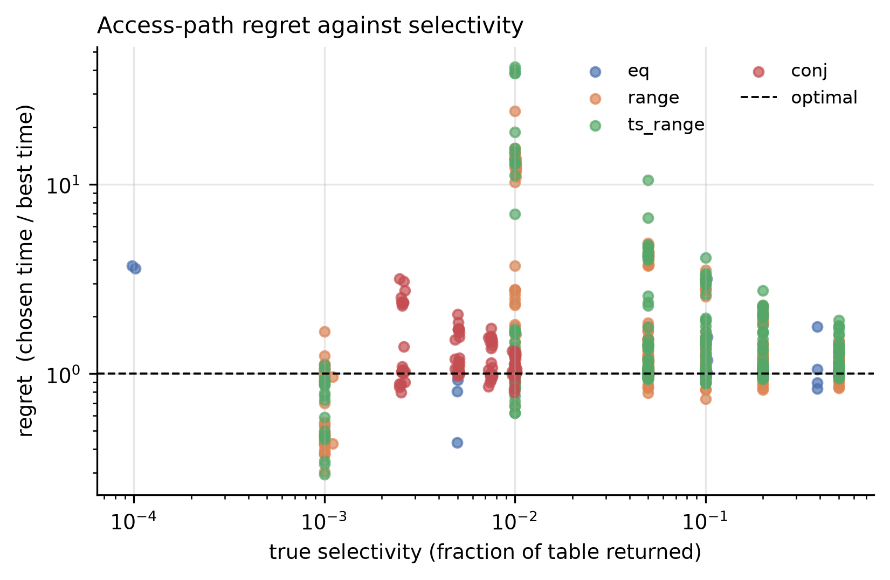
RESULT 1
Selection quality differs by an order of magnitude
Engine
Queries
Chose badly
Median regret
Worst case
PostgreSQL
130
2.3%
1.01
1.39x
MariaDB
153
66.0%
1.34
7.91x
Read the last two columns together
At 1 million rows, PostgreSQL chose a materially worse access path in only 2.3% of queries, with a median regret of just 1%.
MariaDB, however, made such choices in 66% of queries, and a worst case of 7.91 times slower. So the important finding is that the two optimizers have very different failure profiles."
6
Notes:
The first result and the frame for the comparison. On identical data PostgreSQL picks the best available plan 97.7 percent of the time. That matters because it means the PostgreSQL failures I show later are specific, identifiable defects rather than a generally weak optimiser. MariaDB errs on two thirds of queries. But notice the last column: its median error is mild. Wrong often, mostly by a little.

Slide 7
RESULT 1, DECOMPOSED
The two engines fail on different families
Family
PG n
PG wrong
PG median
PG q-error
MDB n
MDB wrong
MDB median
MDB q-error
conj
19
10.5%
1.044
71.3
20
45.0%
1.067
1.00
eq
3
0.0%
1.013
1.00
3
100.0%
6.837
1.29
range
55
1.8%
1.013
1.01
66
71.2%
1.347
1.84
ts_range
53
0.0%
1.001
1.01
64
65.6%
1.343
1.97
PostgreSQL errs almost only on conjunctions, and that is exactly where its estimation error is worst, 71.3. Here the textbook story holds.
MariaDB estimates conjunctions perfectly at 1.00 and still errs on 45% of them. On equality it is wrong every time, by a median of 6.8x, with a near-correct estimate.
7
Notes:
Breaking that down by query family shows the difference is not uniform. PostgreSQL's only real weakness is the conjunctive family, ten percent, and note its estimation error there is 71, by far the worst number in its column. MariaDB is the mirror image. Its estimates on conjunctions are perfect, exactly 1.00, yet it still chooses badly 45 percent of the time. And look at equality: three queries, wrong on all three, median regret 6.8. Perfect knowledge, wrong decision.

Slide 8
MECHANISM
The gap is a difference in plan repertoire
Family
PG bitmap
PG index
PG seq
MDB bitmap
MDB index
MDB seq
conj
110
0
0
7
103
0
eq
88
0
0
0
88
0
range
88
0
0
0
55
33
ts_range
60
19
9
0
55
33
PostgreSQL sorts row locations into physical order before touching the heap, so even a wrong choice reads the disk sequentially. That puts a ceiling on how bad a mistake can be.
MariaDB has no equivalent enabled. A mistaken index scan becomes random single-row fetches, and there is no ceiling.
On conjunctions MariaDB's
raw access types are
ref 103, index_merge 7.
It merges two indexes only
at full correlation.
8
Notes:
Here is the mechanism behind that, and it is the most important structural result in the comparison. This counts what each engine actually chose when given every index. PostgreSQL answers almost everything with a bitmap scan: it collects the matching row locations, sorts them into physical order, then reads the heap in order. MariaDB never forms one except seven times on conjunctions. It either does a direct index lookup or gives up and scans the whole table, sixty six times, where PostgreSQL scanned nine. The difference in outcomes is a difference in the plans available, not in how carefully each engine costs them.

Slide 9
ONE ROW FROM THE RAW DATA
MariaDB's worst case was not an estimation failure
Field
Value
It knew roughly how many rows were coming back and still chose to fetch a tenth of the table one row at a time.
Fixing the statistics would not have changed this decision. The cost model, not the estimate, is what ranked the index scan first.
dataset / family
skew10 / eq
true rows
101,636 (10.2% of the table)
estimated rows
218,632
q-error
2.151 (near-correct for an optimiser)
path chosen
index scan
best path available
sequential scan
time taken
1,969.7 ms
time if scanned
248.9 ms
regret
7.92x
9
Notes:
One row from the raw data makes the point concretely. This is MariaDB's single worst measurement. A query returning ten percent of a million rows. It estimated 218 thousand against a true 101 thousand, so the estimate was off by only a factor of two, which for an optimiser is essentially correct. It chose an index scan. Scanning the whole table would have taken 249 milliseconds. It took 1,970. The estimate was fine. The decision was not.

Slide 10
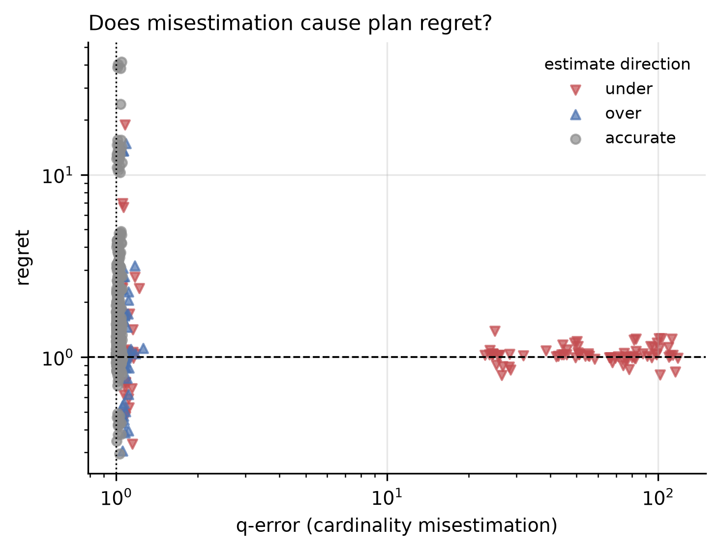
RESULT 2, THE MAIN NEGATIVE RESULT
Misestimation does not explain misselection
98.2%
of bad access-path choices had an essentially correct row estimate
Value
Bad choices examined
113
Median q-error among them
1.017
A perfect estimate
1.000
The remedy most tuning advice reaches for is aimed at a cause that is not operating here.
10
Notes:
That was not an isolated case. Across every bad choice in PostgreSQL, the median estimation error is 1.017, where a perfect estimate is 1.0. In 98 percent of the cases where the optimiser chose a slower path, it had the row count essentially right. This is the paper's main negative result and it cuts against the standard account, which attributes bad plans to misestimation. For this decision, better statistics cannot be the remedy, because the statistics were already correct.

Slide 11
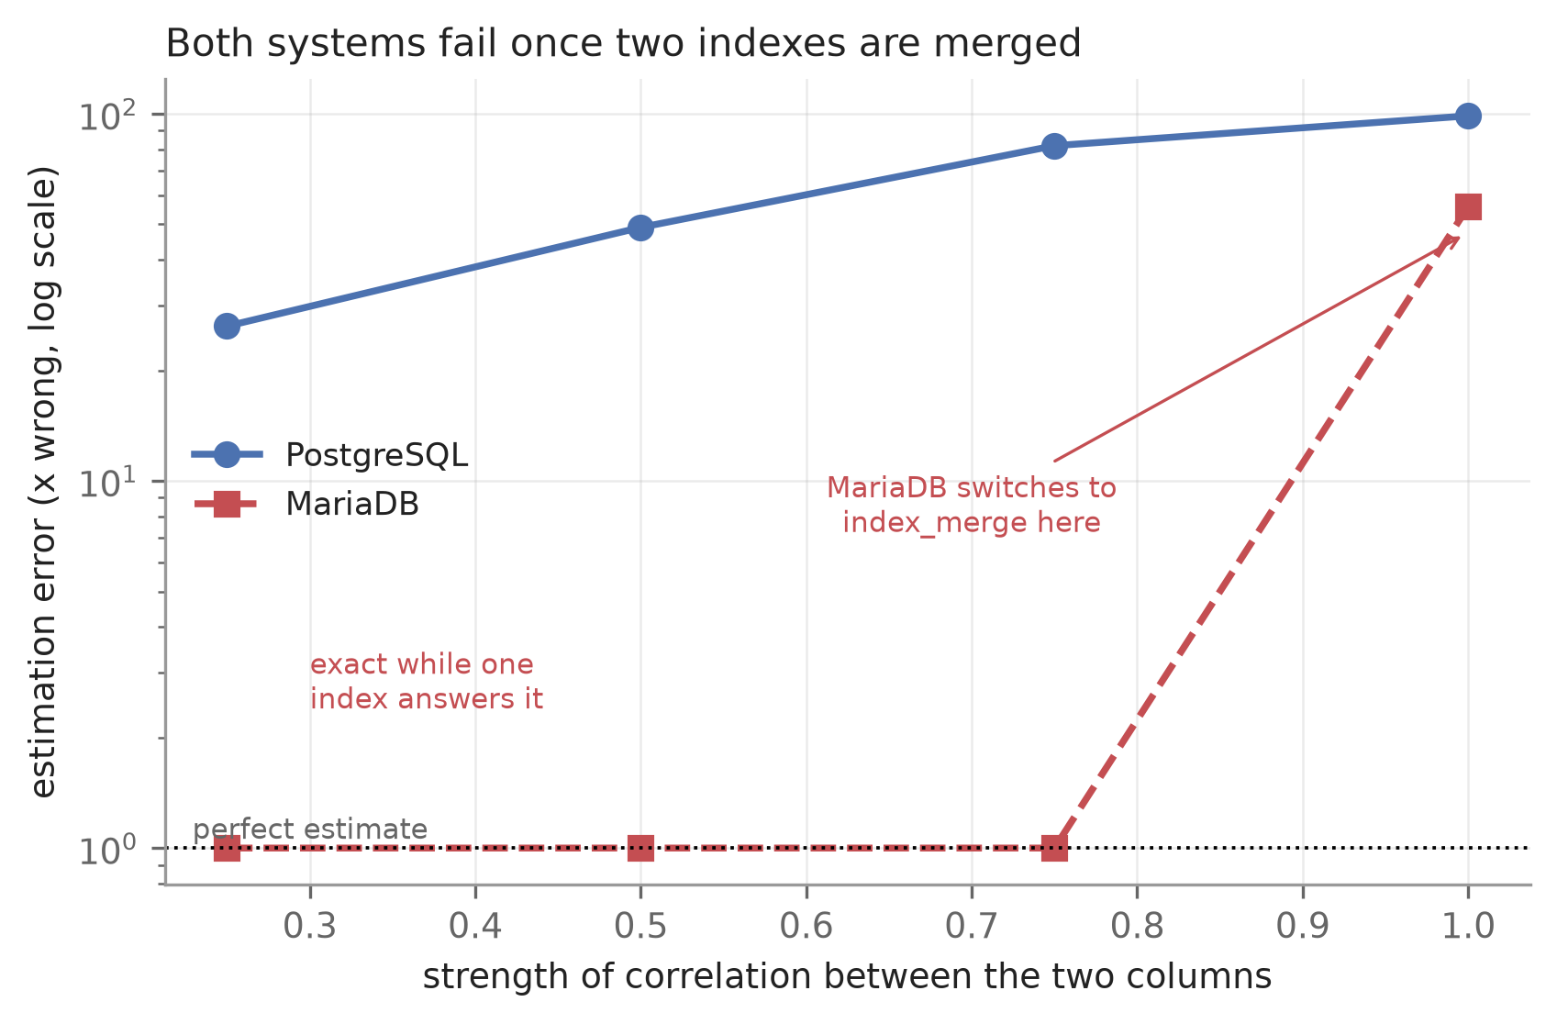
RESULT 3 / WHAT IS GENERAL
Both engines fail once no single index covers both columns
Correlation
PostgreSQL dependent
independent
MariaDB dependent
independent
0.00
1.13
1.08
1.00
1.00
0.25
26.39
1.37
1.00
1.00
0.50
49.01
2.14
1.00
1.00
0.75
81.82
3.44
1.00
1.00
1.00
98.65
98.00
55.84
1.00
The independent columns are the control. Same queries, uncorrelated data. Both engines stay near 1.0, so the error tracks correlation rather than the query shape.
Both are accurate only while one index measures both columns directly. Once none does, both multiply two separate guesses and both get it wrong.
11
Notes:
Now the two-engine payoff, and this is the result I would most want a reviewer to look at. Correlated conjunctions. PostgreSQL's error climbs with correlation, from 1.13 up to 98.65. MariaDB is perfect, exactly 1.00, all the way up to full correlation, where it jumps to 55.84. The right-hand columns are the control: the same queries on independent columns, where both stay near one until the very end. Two independently written engines, accurate while a single index covers both columns, both failing once it does not. That makes this a design problem, not a bug in either product.

Slide 12
THE CLASSIFICATION
What generalises, and what belongs to one product
General to cost-based optimisers
Specific to one implementation
Per-column composition fails under correlation
Both engines accurate to 1.00 with one covering index, both wrong without one.
Good selection quality is PostgreSQL's, not the norm
2.3% versus 66.0% on identical data. Not a property of relational optimisers.
Estimation quality and plan quality come apart
Correct row counts accompany 98.2% of PostgreSQL's bad choices.
The damage ceiling comes from bitmap scans
MariaDB has no equivalent enabled, so its worst case is unbounded by scale.
Advice ships without its boundary
All four practices tested help in one regime and harm in another.
The BRIN misselection is a PostgreSQL costing defect
MariaDB cannot form the plan at all, so it cannot make this mistake.
12
Notes:
So the study sorts its own findings into two piles, and this is what I mean by what the research truly identifies. On the left, things that showed up in both engines and are therefore properties of cost-based access-path selection. On the right, things only one engine does, which are implementation choices, and the other engine shows what the alternative buys you.

Slide 13
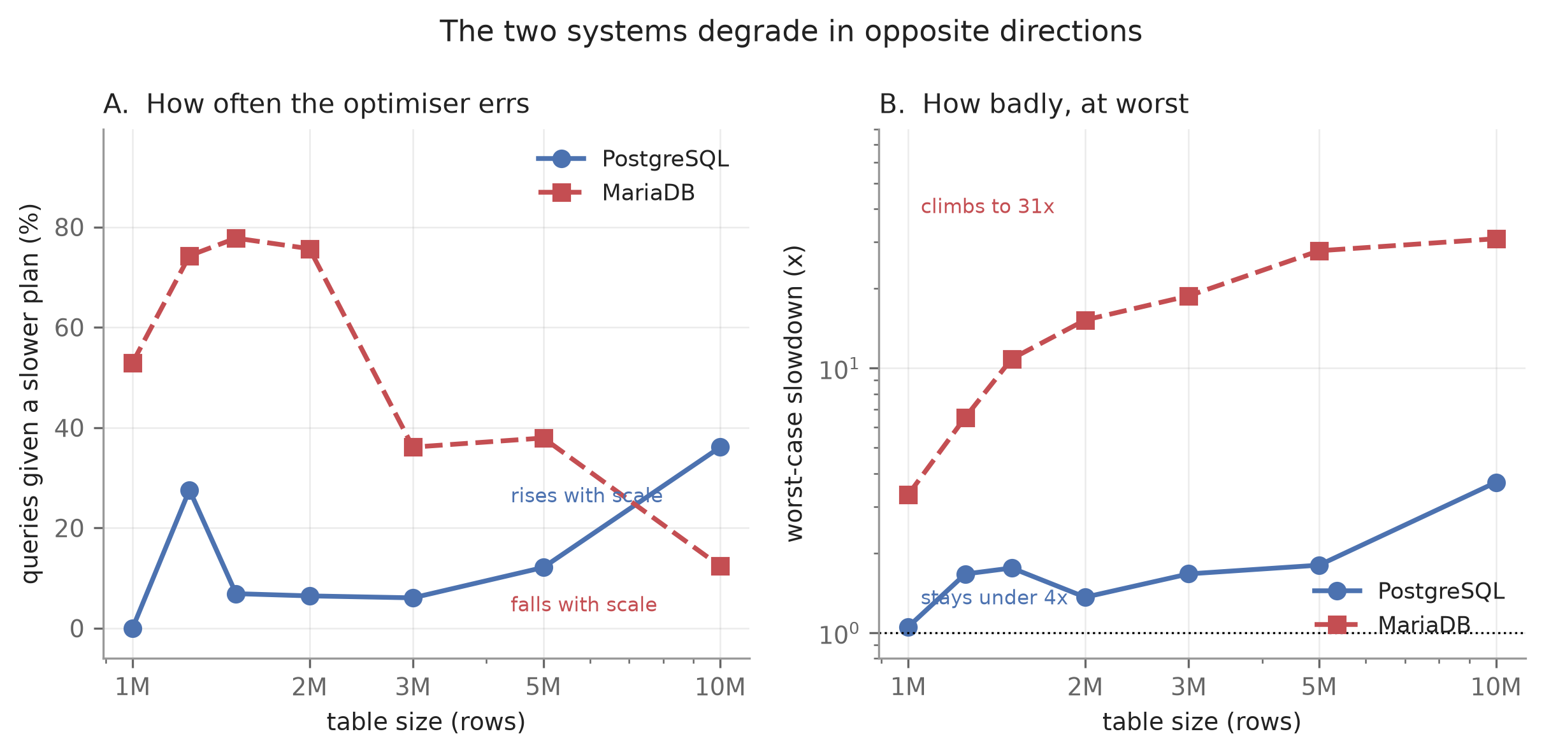
RESULT 4
The two engines degrade in opposite directions
Table size
PostgreSQL wrong
worst case
MariaDB wrong
worst case
1M
0.0%
1.1x
52.9%
3.3x
1.25M
27.6%
1.7x
74.3%
6.5x
1.5M
6.9%
1.8x
77.8%
10.9x
2M
6.5%
1.4x
75.7%
15.2x
3M
6.1%
1.7x
36.1%
18.8x
5M
12.1%
1.8x
37.9%
27.8x
Wrong often but never badly is easier to operate than wrong rarely but catastrophically.
Frequency and severity are separate questions, and here they do not even move in the same direction.
10M
36.1%
3.7x
12.4%
30.9x
Both engines judged only against plans the other could also have formed, so neither is held to a stricter standard.
13
Notes:
Measuring both across all seven scales shows they do not merely differ by degree, they degrade in opposite directions. As tables grow PostgreSQL gets wrong more often, from never up to 36 percent, but its worst case never exceeds 3.7. MariaDB goes the other way: wrong less often, down from 53 to 12 percent, while its worst case climbs to 31. The operational reading matters. A database wrong often but never badly is easier to run than one wrong rarely but catastrophically, and summarising either with a single number hides exactly this.

Slide 14
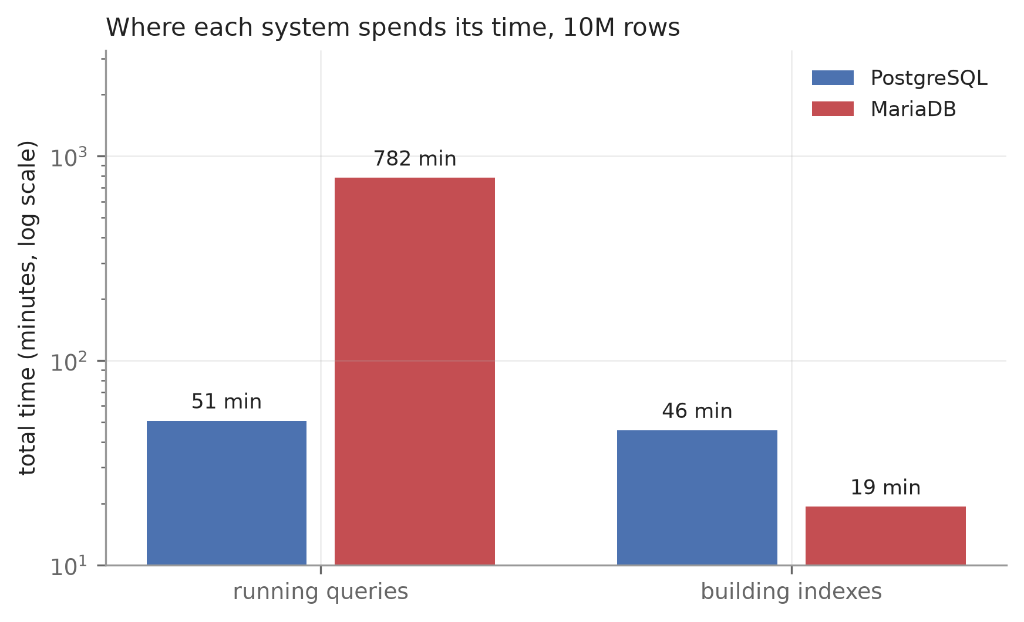
RESULT 5
Which cost dominates is a property of the engine
Time running queries
Time building indexes
PostgreSQL 17.1
50.8 min
45.6 min
MariaDB 10.4.28
781.8 min
19.3 min
Ratio
15.4x slower
2.4x faster
A study measuring only build time and a study measuring only query time would rank these two engines in opposite orders.
Measured at 10M rows, matched 128 MB pools, counting only index types both engines support.
14
Notes:
The resource picture inverts too. At ten million rows, counting only index types both engines have, PostgreSQL splits its time roughly evenly between building indexes and running queries. MariaDB builds in twenty minutes and then spends thirteen hours querying. The consequence is on the bottom line: a study that measured only build time and a study that measured only query time would rank these two databases in opposite orders. Which cost dominates is a property of the engine, not of the workload.

Slide 15
RESULT 6 / RULING OUT THE OBVIOUS OBJECTION
The deficit cannot be configured away
MariaDB configuration
Total time
vs default
Conjunction q-error
Enabling MRR makes the workload 7% slower.
Verified that it genuinely engaged rather than being ignored: EXPLAIN reports a rowid-ordered scan and the plan JSON carries the marker, neither of which appears with MRR off.
Statistics depth changes total time by at most 13% and leaves the conjunction error untouched. MariaDB's accuracy there comes from index dives, not from the statistical machinery.
ucs3 (statistics depth)
100.7 s
0.87
55.84
ucs5
102.1 s
0.88
55.84
no_index_merge
107.0 s
0.92
55.59
mrr_on_costbased
108.4 s
0.93
55.84
default
116.1 s
1.00
55.84
mrr_on_sorted
121.9 s
1.05
55.84
mrr_on
123.8 s
1.07
55.84
1M rows, five datasets, 5,040 measurements. No configuration closes the gap with PostgreSQL.
15
Notes:
The obvious objection is that MariaDB was left on defaults. It does have a comparable mechanism, Multi-Range Read, which sorts row identifiers before fetching. It ships switched off. If turning it on closed the gap, the whole difference would be a configuration choice rather than a design one, so I swept all the settings that govern these decisions, five thousand and forty more measurements. Nothing closes the gap. Turning MRR on makes the workload seven percent slower, and I verified it genuinely engaged by checking the plan output. The last column is worth noting too: the estimation error sits at 55.84 in every configuration but one.

Slide 16
RESULT 6, CONTINUED
Why it cannot close it: the buffer is bounded
mrr_buffer_size
1% selectivity
5%
10%
A fourth backfiring practice
"Enable MRR" is reasonable advice on the same grounds as the other three: the mechanism is real and the reasoning sound. At the shipped buffer size it makes the workload slower, and the second setting that would help is not mentioned alongside it.
MRR disabled
1.00
1.00
1.00
256 KB (shipped default)
1.44
1.27
1.02
8 MB
0.65
1.48
1.05
64 MB
0.66
0.97
1.00
MRR orders identifiers inside a fixed buffer. A bitmap scan materialises the whole qualifying set before touching the heap, so it has no such bound.
At its best, on the one query class where it helps, MRR recovers about a third of one query's runtime against a cross-system gap of 15.4x.
16
Notes:
And the reason MRR does not close the gap is a size limit, which is worth showing because it turns a vague claim into a bounded one. MRR sorts within a buffer that defaults to 256 kilobytes; a bitmap scan materialises the entire qualifying set. Raising the buffer to eight megabytes does help, but only on the narrowest queries: 0.65 at one percent selectivity, gone by five percent, nothing at ten. At its very best it recovers about a third of one query class against a cross-system gap of fifteen times. So this is a fourth piece of advice that backfires at its shipped setting.

Slide 17
RESULT 7 / POSTGRESQL-SPECIFIC
Adding an index makes the plan worse
194x
Table size
With BRIN
Without
Worst case
1M
73.3%
2.3%
18.8x
10M
30.1%
32.3%
2.6x
slower on a controlled test where the only change was that a BRIN index existed alongside the B-tree
MariaDB cannot form this plan at all, which is how we know it is a costing defect rather than something inherent to having two usable indexes.
Confined to tables that still fit in the buffer pool, which is exactly the size at which BRIN is recommended as a free addition.
0.34 ms becomes 65.95 ms
17
Notes:
Turning to PostgreSQL's own failure, which is the largest single effect in the study. Adding a BRIN index alongside an existing B-tree on the same column, because BRIN is small and people treat it as free. The bad-choice rate goes from 2.3 percent to 73.3. On a controlled test where the only change was whether the BRIN index existed, one query went from a third of a millisecond to sixty six.

Slide 18
RESULT 7, THE MECHANISM
Located in the source, not inferred
choose_bitmap_and() in optimizer/path/indxpath.c
When two indexes can answer the same predicate, PostgreSQL keeps one and discards the other, choosing whichever is cheaper to scan.
That cost is indextotalcost, the cost of reading the index alone. It excludes the heap fetches the query must then perform.
A BRIN index is small by design, so it wins that comparison almost always, and the index thrown away is the faster one.
Index
Cost used to decide
Actual query time
BRIN
12.13 (kept)
65.95 ms
B-tree
213.35 (discarded)
0.34 ms
The index that costs 17x less to read is the one that runs 194x slower.
A design consequence of comparing index scan costs in isolation, which is why no setting removes it.
18
Notes:
I traced that to a specific line rather than leaving it as an observation. When two indexes can answer the same predicate, PostgreSQL keeps one and discards the other, choosing whichever is cheaper to scan. But that cost is the cost of reading the index alone; it does not include the heap fetches the query then performs. A BRIN index is small by design, so it wins that comparison almost always, and the index being discarded is the one that would have run two hundred times faster.

Slide 19
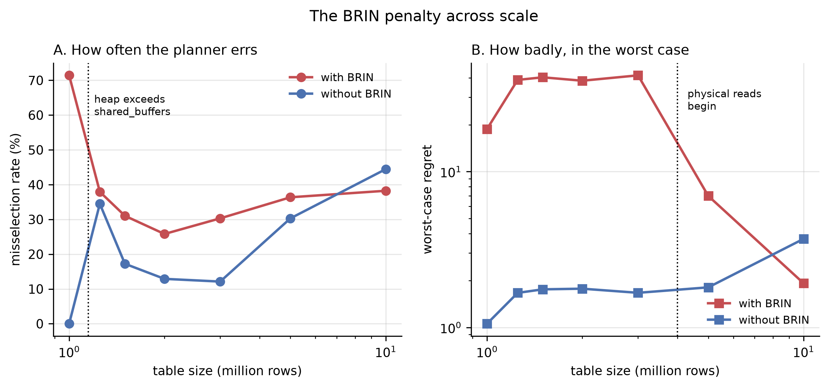
RESULT 8 / REPORTING BOUNDARIES
Frequency and severity move in opposite directions
Table size
Heap
In pool
Chose badly
Worst case
1M
112 MB
yes
71.4%
18.8x
1.25M
140 MB
no
37.9%
38.8x
1.5M
168 MB
no
31.0%
40.3x
2M
223 MB
no
25.8%
38.3x
3M
335 MB
no
30.3%
41.5x
5M
558 MB
no
36.4%
7.0x
A two-point scale test would have reversed this conclusion.
Frequency collapses at the memory boundary; severity doubles there and only subsides much later. The worst damage lands on databases sized two to three times their memory.
10M
1,116 MB
no
38.2%
1.9x
19
Notes:
And the effect has a boundary that is worth reporting carefully, because it is where a two-point study would have gone wrong. The problem occurs while the table fits in the buffer pool, as expected. But read the two right-hand columns separately. How often it goes wrong collapses at the memory boundary, from 71 percent to 38. How badly it goes wrong doubles at that same boundary and stays high to three million rows. Testing only the smallest and largest sizes would have concluded the problem simply disappears as tables grow. It does not; the worst damage lands on databases sized two to three times their memory.

Slide 20
THE PATTERN
Four practices, each sound, each with an unstated boundary
Extended statistics
for correlated columns
Fixes the estimate 108x
Query 2.7x slower
Lower random_page_cost
because the disk is an SSD
Default already within 6% of optimal
Lowering it 2.3x worse
Add a BRIN index
it is small and cheap
Bad choices 2.3% to 73.3%
Worst case 194x
Enable Multi-Range Read
MariaDB, ships switched off
Mechanism genuinely engages
Workload 7% slower
In three of four the advice delivers exactly what it promises, and the plan gets worse anyway.
20
Notes:
Pulling the four practices together. Each one is sound in the case it was written for. Each one, under conditions I can now name, makes things worse. And in three of the four the advice improves the thing it promises to improve. Extended statistics really do fix the estimate, by a factor of 108. The plan still gets worse. That is the pattern the paper is really about: the advice targets a proxy, and the proxy is not what determines the outcome.

Slide 21
VALIDITY
Including one explanation I had to withdraw
19
automated checks before any measurement is accepted
Generated data validated against PostgreSQL's own pg_stats, so the generator is checked against something outside my control.
1.79%
median coefficient of variation above the 1 ms floor
24.47% below it, which is why that floor exists. Outlying runs are retained, not deleted; the median absorbs up to two in six.
3
of my own errors found, corrected and reported
Including a claim I refuted myself: disabling the merge plan left the error at 55.84 against 55.59, so the merge shows the error rather than causing it.
All 23,480 raw measurements, seeded generators and the analysis notebook are public and re-run with one command.
21
Notes:
On trustworthiness, briefly, because this is where a reviewer presses. Nineteen automated checks run before any measurement is accepted, including validating the generated data against PostgreSQL's own internal statistics, so the generator is checked against something outside my control. Dispersion is reported rather than hidden. And three of my own errors were found and are reported rather than removed. The one I would highlight is the third: I had claimed the correlated-column failure was caused by the plan shape that merges two indexes. I tested that by switching the plan off, and the error stayed the same, 55.59 against 55.84. So the merge is where the error becomes visible, not where it comes from. I only found the real cause by trying to refute myself.

Slide 22
WHAT THE STUDY IDENTIFIES
Four claims
1
The cause is the cost model, not the statistics
98.2% of bad choices carried correct row estimates. Better statistics cannot repair a comparison that omits heap work, so the fix belongs in costing.
2
Tuning advice is incomplete without its conditions
All four practices tested are sound in the case they were written for and harmful outside it. None ships with that boundary stated.
3
One number cannot describe an optimiser
How often it errs and how badly it errs move in opposite directions across scale, and in opposite directions between these two engines.
4
Per-column composition is a shared weakness, not a bug
Two independently written engines are accurate only while a single index covers both columns, and both fail once none does.
22
Notes:
What the study actually identifies, in four claims. First, for this decision the cause is the cost model, not the statistics, and 98 percent of bad choices with correct estimates is the evidence. Second, tuning advice needs its conditions attached, because all four practices are sound in one regime and harmful in another. Third, an optimiser cannot be summarised by one number, because frequency and severity move in opposite directions across scale and across these two engines. Fourth, and this is what the second database bought, per-column composition under correlation is a shared design weakness rather than a bug in either product.

Slide 23
Thank you. Questions?
Everything is reproducible
23,480 raw measurements with every repetition retained, seeded generators, the analysis notebook and both write-ups.
Md. Imtiaj Alam Sajin
26-94090-2
Supervisor: Dr. Ashraf Uddin
github.com/Imtiaj-Sajin/Reseach-on-Database-Architecture
Notes:
That is the work. Two engines, seven scales, twenty three thousand measurements, everything public and reproducible with one command. Happy to take questions, and if you want any number in the deck verified I can show it coming out of the raw data.

