Slide 1
Measuring the Impact of Index Types and Tuning Settings on Query Execution Plans in PostgreSQL and MariaDB
Type 4 | Experimental and Benchmarking Project | Individual Submission
Md. Imtiaj Alam Sajin
26-94090-2 | 26-94090-2@student.aiub.edu
Supervisor
Dr. Ashraf Uddin
github.com/Imtiaj-Sajin/Reseach-on-Database-Architecture
Notes:
Good morning. My project is an experimental study of how PostgreSQL and MariaDB choose which index to use, and whether the tuning advice people give for it actually works. Everything I show is measured on my own machine and the code is public.

Slide 2
THE GAP
Index tuning advice is everywhere. Almost none of it has been measured.
Every query needs one decision made for it:
scan the whole table, or use an index, and if so, which one.
The same query on the same data can be a hundred times slower depending on that single choice, and the user never sees it happen.
So a body of advice grew around it
Create extended statistics for correlated columns
Lower random_page_cost because you have an SSD
Add a BRIN index, it is tiny and cheap
Enable Multi-Range Read in MariaDB
All four are reasonable. I tested all four.
2
Notes:
Here is the gap I started from. If you search for how to speed up a slow query you get thousands of pages of advice. Add this index, change this setting. It is written by good engineers and it sounds sensible. But almost none of it has been tested under controlled conditions, so nobody knows when it works and when it does not. That is what I measured.

Slide 3
RESEARCH QUESTIONS
Five questions
RQ1
How often does the planner pick a slower access path than one it already had?
RQ2
Is bad selectivity estimation the cause, as the literature assumes?
RQ3
Do the recommended tuning practices improve the plan, or only the estimate?
RQ4
Where are the boundaries in table size and memory at which behaviour flips?
RQ5
Which findings are general to relational optimisers, and which belong to one product?
RQ5 is why the study covers two independently written database engines rather than one.
3
Notes:
I turned that into five questions. The first two ask how good the optimiser actually is and why it fails. The next two test the advice itself. The last one asks whether what I find is a PostgreSQL quirk or something deeper, which is why I added a second database.

Slide 4
METHOD
Generated data, one property at a time
Why not TPC-H or a real dataset?
With a fixed dataset you cannot separate cause from coincidence, and you do not know the correct answer. Generating it means I control one property at a time and I know the true row count for every query, so I can say the planner was wrong rather than guess alongside it.
Property varied
Meaning
Levels
Value skew
Zipfian, some values dominate
4
Predicate correlation
Two columns move together
5
Physical clustering
Rows stored in value order
4
11 dataset configurations x 10 index configurations x 4 query families x 8 selectivity targets
Every query runs 7 times and the first is discarded. Parallelism and JIT are switched off, the buffer pool is pinned at 128 MB, and each run is seeded so it reproduces exactly.
4
Notes:
I did not use a standard benchmark like TPC-H, and that was deliberate. With a fixed dataset you cannot separate cause from coincidence. I generate the data myself, so I can move one property at a time and hold the rest still, and more importantly I know the true answer for every query. That is what lets me say the database guessed wrong instead of guessing along with it.

Slide 5
SCALE
23,480 measurements
Table size
Heap
PostgreSQL 17.1
MariaDB 10.4.28
1,000,000
112 MB
2,398
1,232
Both engines cover the
same seven table sizes,
so the comparison is
symmetric.
Buffer pool held at
128 MB throughout, so
the memory boundary
falls between rows one
and two.
1,250,000
140 MB
654
336
1,500,000
168 MB
654
336
2,000,000
223 MB
654
336
3,000,000
335 MB
654
336
5,000,000
558 MB
654
336
10,000,000
1,116 MB
2,398
1,232
Configuration sweeps
6,230
5,040
Total
14,296
9,184
Runs are resumable per measurement. Two power cuts during collection cost no data.
5
Notes:
This is the size of the experiment. Seven table sizes on both databases, from one million rows up to ten million, plus configuration sweeps on each. Twenty three thousand four hundred and eighty measurements in total. The runs took several days and survived two power cuts, which is why every measurement is written to disk as it is taken and the run resumes where it stopped.

Slide 6
THE METRIC
Access-path regret
R = time of the plan actually chosen / time of the fastest plan available
1.0
R = 1.0 means the database made the best choice it could.
The comparison is against plans the engine really had, forced one at a time by building each index configuration separately and re-running the same query. So this measures the decision, not the engine's raw speed.
Estimation quality is reported separately as q-error, the standard measure: the factor by which the row estimate misses the truth.
best choice available
194x
worst case I measured
6
Notes:
One definition I need before the results. Regret is how many times slower the plan the database chose was, compared to the best plan that was available to it at that moment. Not the theoretical best, the best it could actually have picked. A regret of one means it did the best it could. This matters because it separates the optimiser being wrong from the database simply being slow.

Slide 7
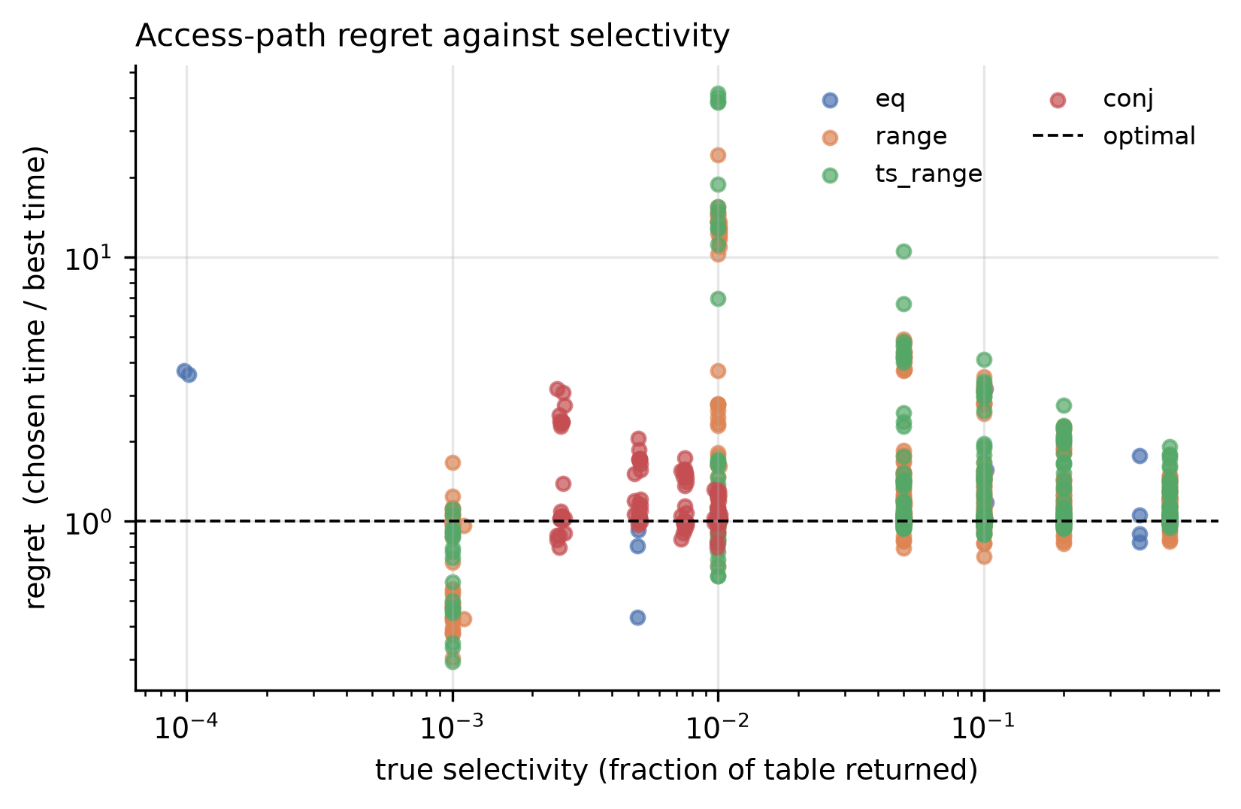
FINDING 1 / RQ1
PostgreSQL is good at this. MariaDB much less so.
Database
Queries
Chose badly
Median regret
Worst case
PostgreSQL 17.1
130
2.3%
1.01
1.39
MariaDB 10.4.28
153
66.0%
1.34
7.91
Why the difference is structural, not a tuning gap
PostgreSQL uses bitmap scans, which collect the matching row locations and sort them into disk order before fetching. MariaDB has no equivalent enabled, so it either performs a direct index lookup or falls back to scanning the whole table. It scanned the whole table for 66 queries where PostgreSQL never did once.
Left column: measured on 1,000,000 rows, identical data and queries on both engines.
7
Notes:
First result, and it is the one that frames everything else. On identical data with identical queries, PostgreSQL picks the best plan available ninety seven point seven percent of the time. So the failures I show you later are specific, identifiable problems, not a generally weak optimiser. MariaDB is wrong far more often, but notice its errors are milder. The reason is visible in the plans: PostgreSQL has bitmap scans, which sort matching rows into disk order first. MariaDB has nothing equivalent, so it either does a direct lookup or gives up and scans the whole table.

Slide 8
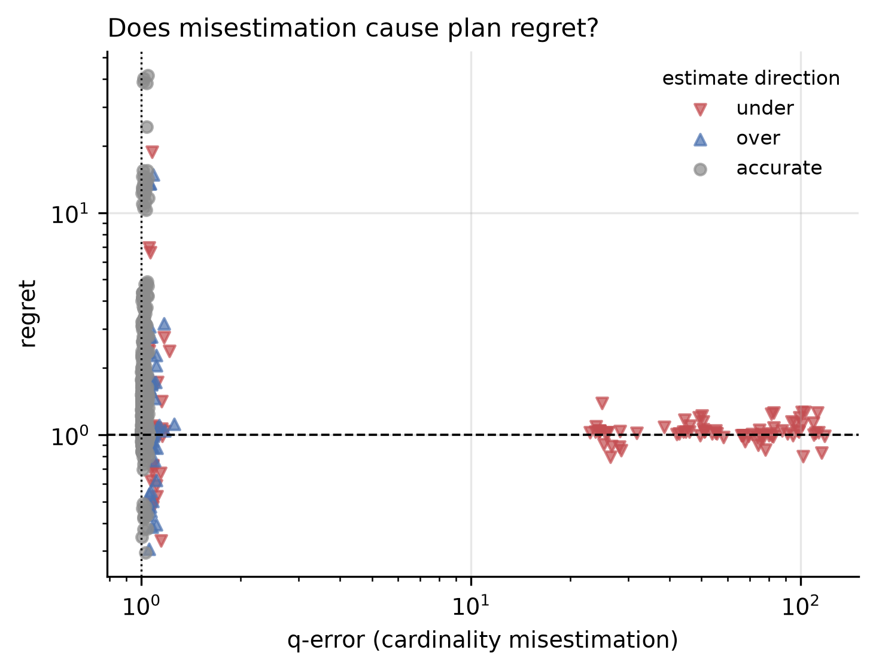
FINDING 2 / RQ2
The textbook explanation does not apply here
98.2%
of bad choices had an essentially correct row estimate
Value
Bad choices examined
113
Median q-error among them
1.017
A perfect estimate
1.000
The database knew the right numbers and chose badly anyway, so better statistics cannot be the remedy.
8
Notes:
This is the result I did not expect. The whole query optimisation literature says bad plans come from the database misjudging how many rows will come back. So I looked at every case where it chose badly and measured the estimate. The median error was one point zero one seven. A perfect estimate is one point zero. In ninety eight percent of the bad choices the database knew the right numbers and still chose the slower path. That means fixing the estimates, which is what most tuning advice tries to do, cannot fix this.

Slide 9
FINDING 3 / RQ3
Four recommended practices, measured
Extended statistics
for correlated columns
Fixes the estimate 108x. Makes the query 2.7x slower.
Lower random_page_cost
because the disk is an SSD
The default is already within 6% of optimal. Lowering it is 2.3x worse.
Add a BRIN index
it is small and cheap
Bad-choice rate goes from 2.3% to 73.3%. Worst case 194x.
Enable Multi-Range Read
MariaDB, ships switched off
At the shipped buffer size the workload gets 7% slower.
9
Notes:
Given that, I tested the advice itself. Four widely recommended practices. Each one is sensible, each one appears in official documentation or well-regarded blogs. Under conditions I can identify, all four make the workload slower. I will take them one at a time.

Slide 10
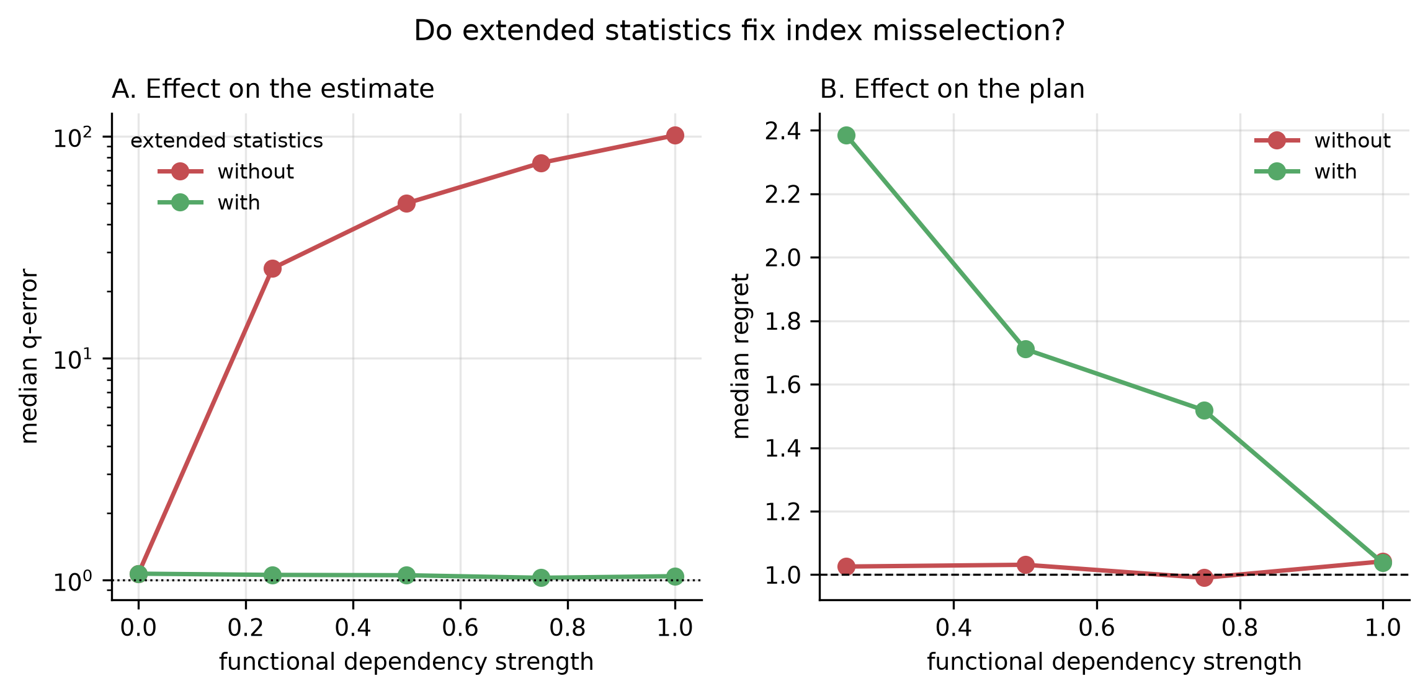
FINDING 3A
Extended statistics fix the estimate and damage the plan
Correlation
q-error without
with
Estimate
Time without
with
Result
0.25
25.2
1.11
23x better
0.93 ms
2.54 ms
2.7x slower
0.50
49.5
1.04
48x better
2.12 ms
3.53 ms
1.7x slower
0.75
75.9
1.02
75x better
2.80 ms
4.34 ms
1.6x slower
1.00
113.2
1.05
108x better
3.95 ms
5.06 ms
1.3x slower
The remedy does exactly what it claims to the estimate. The plan still gets worse at every level.
10
Notes:
First one. When two columns are correlated PostgreSQL misjudges them, and the official remedy is to create extended statistics. It works beautifully on the estimate. At full correlation it improves the estimate by a factor of one hundred and eight. And the query gets slower. Every single correlation level gets slower. The better estimate pushes the planner into a plan that costs less on paper and more in reality.

Slide 11
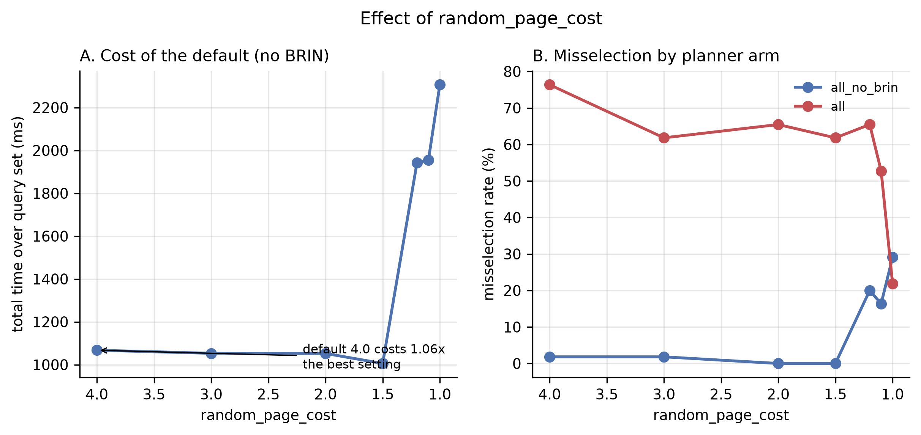
FINDING 3B
The default random_page_cost is already near optimal
Setting
Total workload time
Versus best
1.0
2,306 ms
2.3x worse
1.1
1,954 ms
1.9x worse
1.2
1,942 ms
1.9x worse
1.5
1,006 ms
best
2.0
1,053 ms
equal
3.0
1,053 ms
equal
4.0 (shipped default)
1,068 ms
within 6% of best
A caution about how this is measured
On a single query I first measured a 24x effect. Across the workload it vanishes. Tuning verdicts drawn from one query do not survive.
11
Notes:
Second one. Lowering random page cost because SSDs handle random reads well. I want to be careful here, because on one individual query I first measured a twenty four times effect and that was misleading. Measured across the whole workload, which is the honest way to do it, the shipped default of four is within six percent of the best setting, and lowering it to one makes the workload more than twice as slow.

Slide 12
FINDING 3C
Adding a BRIN index because it is small and cheap
194x
Table size
With BRIN
Without
Worst case
1,000,000
73.3%
2.3%
18.8x
10,000,000
30.1%
32.3%
2.6x
slower on a controlled test where the only change was that a BRIN index existed alongside the B-tree
The bad-choice rate rises from 2.3% to 73.3% purely because a second index exists that is never the faster one to use.
The effect is confined to tables that still fit in the buffer pool, which is exactly the size at which BRIN is most often recommended as a free addition.
0.34 ms becomes 65.95 ms
12
Notes:
Third one, and this is the largest effect in the study. Adding a BRIN index alongside an existing B-tree, on the same column, because BRIN is tiny and people treat it as free. The bad-choice rate goes from two point three percent to seventy three point three percent. On one controlled test where the only thing I changed was whether the BRIN index existed, the query went from a third of a millisecond to sixty six milliseconds.

Slide 13
FINDING 4 / THE MECHANISM
Located in the source, not inferred
choose_bitmap_and() in optimizer/path/indxpath.c
When two indexes can answer the same predicate, PostgreSQL keeps one and discards the other, choosing whichever is cheaper to scan.
That cost is indextotalcost, the cost of reading the index alone. It does not include the heap fetches the query must then perform.
A BRIN index is small by design, so it wins that comparison almost always, and the index thrown away is the faster one.
Index
Cost used to decide
Actual query time
BRIN
12.13 (kept)
65.95 ms
B-tree
213.35 (discarded)
0.34 ms
The index that costs 17x less to read is the one that runs 194x slower.
This is why the effect is a design consequence rather than a bug, and why it cannot be tuned away.
13
Notes:
I did not want to leave that as an observation, so I went into the PostgreSQL source. The function is choose_bitmap_and in indxpath.c. When two indexes can answer the same query it keeps one and throws the other away, and it decides by which index is cheaper to scan. But that cost is the cost of reading the index alone. It ignores the work the query then does on the table. A BRIN index is tiny by design, so it wins that comparison essentially always, and the index being discarded is the one that would have been almost two hundred times faster.

Slide 14
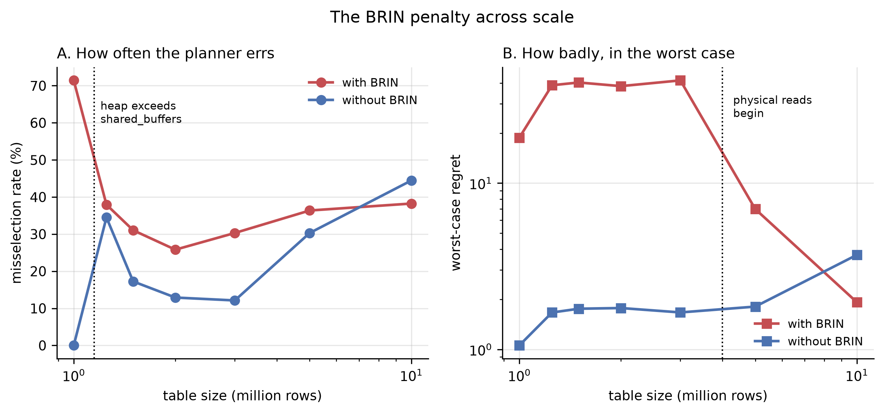
FINDING 5 / RQ4
The boundary is real, and it moves both ways at once
Table size
Heap
In pool
Chose badly
Worst case
1,000,000
112 MB
yes
71.4%
18.8x
1,250,000
140 MB
no
37.9%
38.8x
1,500,000
168 MB
no
31.0%
40.3x
2,000,000
223 MB
no
25.8%
38.3x
3,000,000
335 MB
no
30.3%
41.5x
5,000,000
558 MB
no
36.4%
7.0x
Two things happen at two different points
How often it fails collapses at the memory boundary. How badly it fails doubles there and only subsides much later. Testing two sizes would have given the opposite conclusion.
10,000,000
1,116 MB
no
38.2%
1.9x
14
Notes:
This is the slide I would most want to be asked about. The problem only happens while the table fits in the buffer pool, which you would expect. But look at the two columns separately. How often it goes wrong collapses right at the memory boundary, from seventy one percent down to thirty eight. How badly it goes wrong in the worst case does the opposite, it doubles at that same boundary and stays high all the way to three million rows. If I had tested only the smallest and the largest size, which is what most studies do, I would have concluded the problem simply disappears as tables grow. It does not.

Slide 15
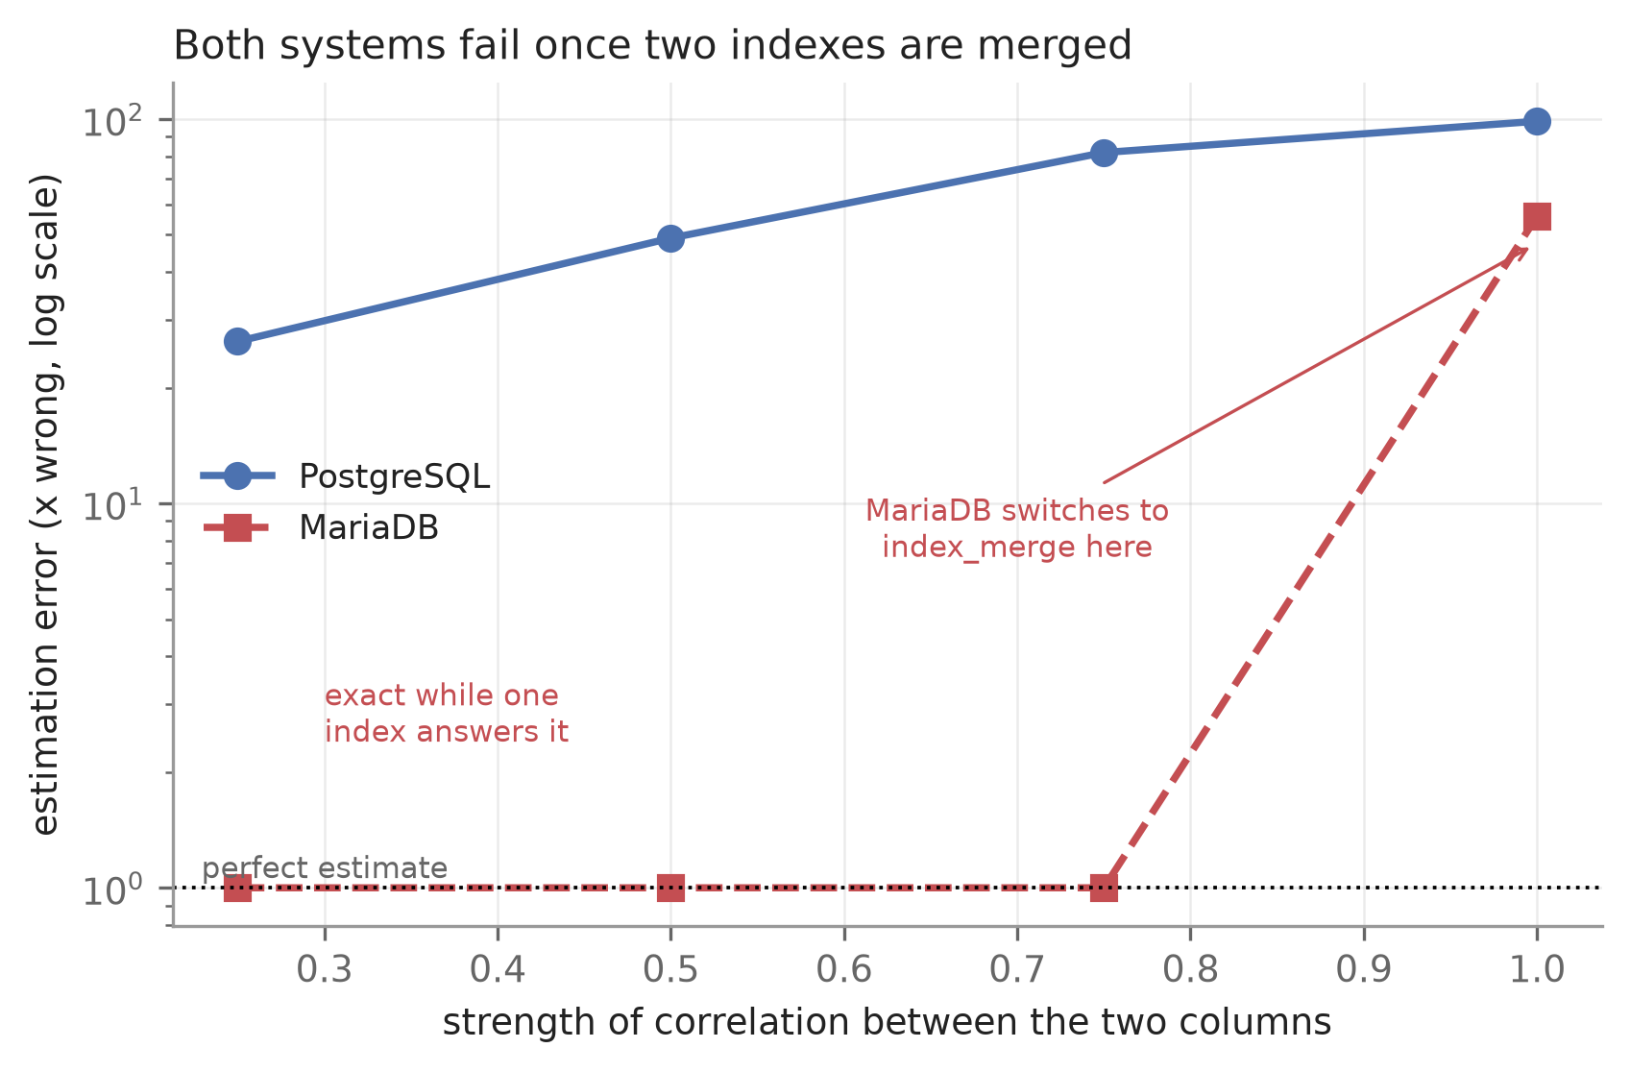
FINDING 6 / RQ5
What is general, and what belongs to one product
Correlation
PostgreSQL q-error
MariaDB q-error
MariaDB plan used
0.25
26.4
1.00
single combined index
0.50
49.0
1.00
single combined index
0.75
81.8
1.00
single combined index
1.00
98.7
55.8
merges two indexes
General: both engines are accurate only while a single index covers both columns and they can measure the answer directly. Once no such index exists, both multiply two separate guesses and both get it wrong.
Product-specific: good plan selection. PostgreSQL's 2.3% bad-choice rate is not a property of relational optimisers in general.
15
Notes:
Adding the second database is what let me separate a PostgreSQL quirk from something general. The correlated-predicate failure turned out to be general. MariaDB estimates those predicates perfectly, exactly one point zero zero, right up until no single index covers both columns. Then it fails the same way PostgreSQL does. Two independently written databases failing identically means this is a design problem in how selectivity is composed, not a bug in either product.

Slide 16
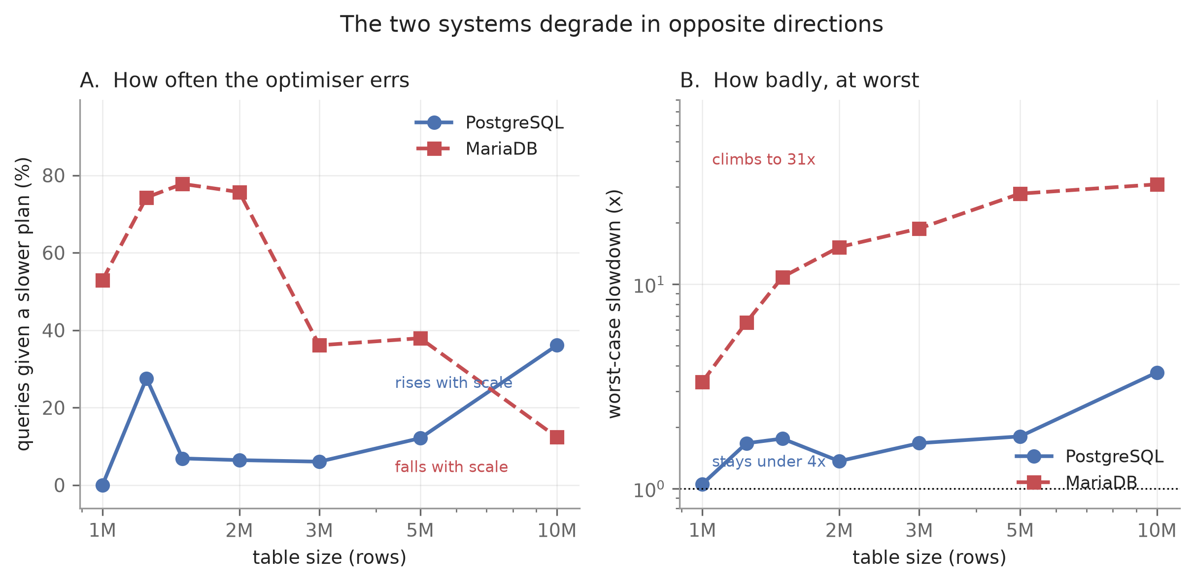
FINDING 7
The two engines degrade in opposite directions
Table size
PostgreSQL wrong
worst case
MariaDB wrong
worst case
1,000,000
0.0%
1.1x
52.9%
3.3x
1,250,000
27.6%
1.7x
74.3%
6.5x
1,500,000
6.9%
1.8x
77.8%
10.9x
2,000,000
6.5%
1.4x
75.7%
15.2x
3,000,000
6.1%
1.7x
36.1%
18.8x
5,000,000
12.1%
1.8x
37.9%
27.8x
Wrong often but never badly is easier to operate than wrong rarely but catastrophically.
Bitmap scans cap the damage: even a wrong choice reads the disk in order. MariaDB has no such ceiling.
10,000,000
36.1%
3.7x
12.4%
30.9x
Both engines judged only against plans the other could also have formed, so neither is held to a stricter standard.
16
Notes:
And they degrade in opposite directions, which I think is the most useful practical result. As tables grow PostgreSQL gets wrong more often, up to thirty six percent, but its worst case never goes past three point seven times. MariaDB goes the other way, wrong less often but its worst case climbs to thirty one times. The reason is the plan repertoire. Bitmap scans put a ceiling on how bad a mistake can be because even a wrong choice still reads the disk in order. MariaDB has no ceiling. A database wrong often but never badly is easier to run than one wrong rarely but catastrophically, and one summary number hides that completely.

Slide 17
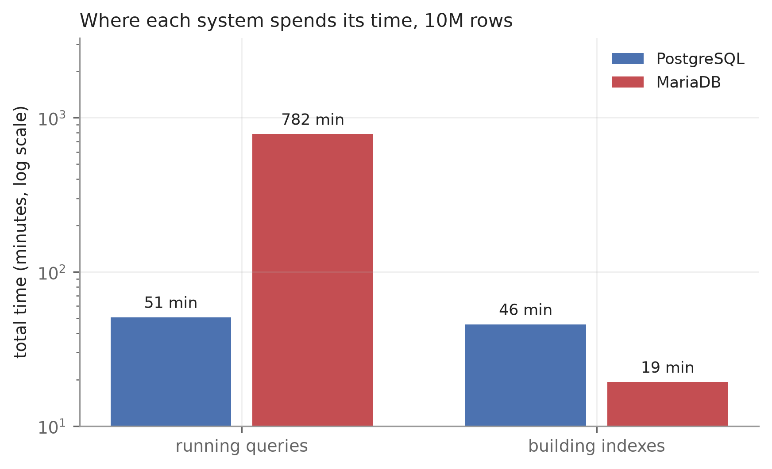
FINDING 8
Which cost dominates is a property of the engine
Time running queries
Time building indexes
PostgreSQL 17.1
50.8 min
45.6 min
MariaDB 10.4.28
781.8 min
19.3 min
Ratio
15.4x slower
2.4x faster
A study measuring only build time and a study measuring only query time would rank these two databases in opposite orders.
Measured at 10,000,000 rows with the same 128 MB pool, counting only index types both engines support.
17
Notes:
The computational cost, at ten million rows, counting only index types both databases have so the comparison is fair. PostgreSQL splits its time roughly evenly between building indexes and running queries. MariaDB builds in twenty minutes and then spends thirteen hours querying. The point I want to make is the last line: a study that measured only build time and a study that measured only query time would rank these two databases in opposite orders.

Slide 18
FINDING 10 / VALIDITY
One explanation I had to withdraw
What I claimed
That the correlated-column failure was caused by the plan shape that merges two indexes, since both engines fail while using it.
How I tested it
Switched that plan off entirely, forcing a different strategy, and re-measured the estimation error.
Configuration
q-error
Merge plan enabled
55.59
Merge plan disabled
55.84
Unchanged. So the merge is where the error becomes visible, not where it comes from.
The real cause is narrower: both engines are accurate only when one index covers both columns. Otherwise both multiply two separate guesses, whichever plan they choose.
Three of my own measurement errors were found during the study. All three are reported in the paper rather than removed.
18
Notes:
I want to show one thing I got wrong, because the correction is the better science. I had concluded that the correlated-column failure was caused by the plan shape that merges two indexes, since both databases fail while using it. Then I tested my own claim by switching that plan off entirely, which forces a completely different strategy. The error stayed the same. Fifty five point five nine against fifty five point eight four. So the merge is where the error becomes visible, not where it comes from. The real cause is narrower and more general, and I only found it by trying to refute myself.

Slide 19
VALIDITY AND REPRODUCIBILITY
What makes these numbers trustworthy
19
7
3
automated checks run before any measurement is accepted
executions per query, first discarded as warm-up
of my own errors found, corrected and reported
Includes validating the generated data against PostgreSQL's own internal statistics, so the generator is checked against something I do not control.
Parallel workers and JIT disabled, buffer pool pinned at 128 MB, dedicated tablespace, every dataset seeded so it regenerates identically.
A collapsed selectivity range on skewed data, row counts meaning different things across the two engines, and an estimate that looked too good to be real.
Public repository with raw measurements, one-command reproduction, and a notebook that executes end to end.
19
Notes:
Briefly on trustworthiness, because this is the part a marker will press on. Nineteen automated checks run before any measurement is accepted, including validating my generated data against PostgreSQL's own internal statistics, so the generator is checked against something I do not control. Everything is seeded, every measurement is written as it is taken so a power cut costs nothing, and the whole thing re-runs with one command.

Slide 20
WHAT IT MEANS
Conclusions
1
Tuning advice needs conditions attached to it
All four practices tested are sound in the case they were written for and harmful outside it. None of them ships with the boundary stated.
2
The cause is costing, not statistics
98.2% of bad choices had correct row estimates. Better statistics cannot fix a comparison that ignores heap work, so the fix belongs in the cost model.
3
One number cannot describe an optimiser
How often it errs and how badly it errs move in opposite directions across scale, and across these two engines.
4
Never generalise from one query or one table size
A 24x tuning effect vanished across the workload, and a two-point scale test would have reversed the BRIN conclusion.
20
Notes:
What it adds up to. Four pieces of common advice fail under conditions I can now name. The cause is not bad statistics, which is what almost all tuning targets, so the remedy has to be a costing change rather than a statistics change. And the practical rule I would give: never judge a tuning setting from one query, and never judge an optimiser from one table size.

Slide 21
Thank you. Questions?
Everything is reproducible
23,480 raw measurements, seeded generators, the analysis notebook and both write-ups are in the repository.
Md. Imtiaj Alam Sajin
26-94090-2
Supervisor: Dr. Ashraf Uddin
github.com/Imtiaj-Sajin/Reseach-on-Database-Architecture
Notes:
That is the work. The code, the raw measurements and the notebook are all in the repository. Happy to take questions, and if you want to see any number in the deck verified I can show it coming out of the raw data.

