Slide 1
Measuring the Impact of Index Types and Tuning Settings on Query Execution Plans in PostgreSQL and MariaDB
An access-path study across two independently written optimisers
Md. Imtiaj Alam Sajin
26-94090-2 | 26-94090-2@student.aiub.edu
Supervisor
Dr. Ashraf Uddin
Notes:
This is an empirical study of how two relational engines choose an access path, and whether the tuning advice written for that decision actually works. The reason there are two engines rather than one is the core of the talk: with a single system you cannot tell a property of cost-based optimisation from a quirk of one product.

Slide 2
MOTIVATION
A decision nobody sees, and advice nobody measured
Scan the table, or use an index, and if so which one.
One decision per query, invisible to the user, worth up to two orders of magnitude in runtime.
The literature attributes bad plans to cardinality misestimation. That work targets join ordering. The single-relation access-path decision has not been isolated the same way.
Four widely recommended practices
Extended statistics for correlated columns
Lower random_page_cost on SSD storage
Add a BRIN index, it costs almost nothing
Enable Multi-Range Read in MariaDB
Every one is sound in the case it was written for. This study measures where each stops being sound.
2
Notes:
The starting point. Every query needs one decision made for it, and the same query on the same data can be a hundred times slower depending on it. Because the decision is invisible, a large body of tuning advice has grown around helping the database make it. That advice is written by good engineers and it sounds right. Almost none of it has been measured under controlled conditions, so nobody knows the conditions under which it holds.

Slide 3
Two engines chosen (Postgres vs MariaDB)
A single-system study cannot separate a property of cost-based access-path selection from an artefact of one implementation.
Both systems run identical generated data, identical queries, identical metrics and a matched 128 MB buffer pool.
3
Notes:
This is the slide that explains why the study has two databases rather than one, and it is the frame for everything after it. If you measure one optimiser and find a failure, you cannot tell whether you have found something about cost-based optimisation or a bug in one product. Two independently written engines let you separate those. When both fail the same way it points at a shared design assumption. When only one fails it is an implementation choice. Every result from here on is labelled one way or the other.

Slide 4
METRICS
Two measures, deliberately kept apart
R = time of the plan chosen / time of the fastest plan available
1.0
Access-path regret measures the decision. The comparison is against plans the engine really had, forced one at a time, so a slow engine is not penalised for being slow.
q-error measures the estimate: the factor by which the predicted row count misses the truth. Reported separately throughout, because the paper's main negative result is that the two come apart.
the engine made the best choice available to it
23,480
measurements across both engines
4
Notes:
Two definitions. Regret is how many times slower the plan the engine chose was than the fastest plan actually available to it, measured by forcing each index configuration separately and re-running the same query. A regret of one means it did the best it could. That separates the quality of the decision from the raw speed of the engine, which matters when comparing two products. Q-error is the standard measure of estimation accuracy. The whole paper turns on these two being reported separately.

Slide 5
EXPERIMENTAL DESIGN
Symmetric, controlled, and seeded
Queries Executed
Table size
PostgreSQL
MariaDB
Factor | Variations / Levels
Data Distributions | 11 Datasets (Skew: Zipf 0.0–1.5, Dependency: 0–1.0, Clustering: 0–1.0)
Index Schemes | 10 Configurations (None, B-tree, Hash, BRIN, Composite, All-Indexes)
Table Scales | 7 Scales (1M to 10M rows)
Tuning Parameters | 16 Settings (random_page_cost 1.0–4.0, Extended Stats ON/OFF)
Execution Matrix | 23,480 total query runs in PostgreSQL 17.1 & MariaDB 10.4
1M
2,398
1,232
1.25M
654
336
1.5M
654
336
2M
654
336
3M
654
336
5M
654
336
10M
2,398
1,232
Configuration sweeps
6,230
5,040
Total
14,296
9,184
10 index configurations, 4 query families, 8 selectivity targets. Seven runs per query, first discarded. Parallelism and JIT off.
5
Notes:
The design in one slide. Data is generated rather than taken from a benchmark, because a fixed dataset fixes skew, correlation and clustering at whatever values it happens to have, and then you cannot attribute an effect to any one property. Generating it also means the true row count is known for every query, so misestimation is measured rather than inferred. Both engines cover the same seven table sizes, so the comparison is symmetric rather than one system being probed harder.

Slide 6
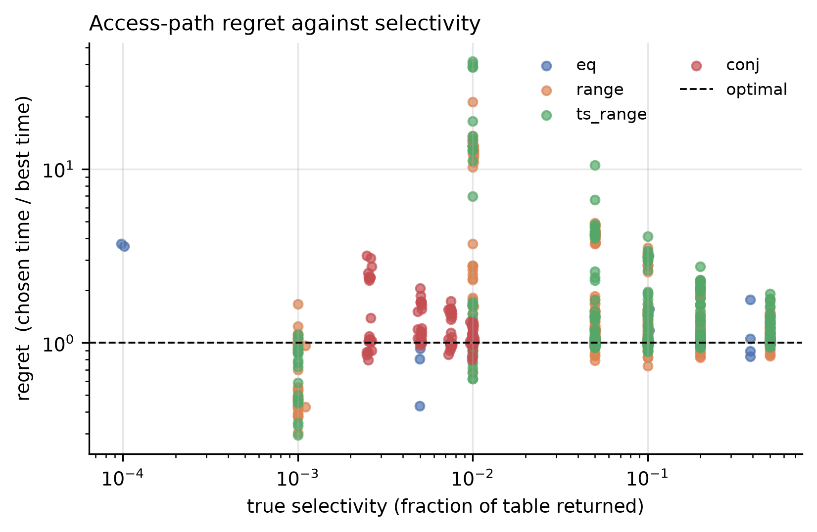
RESULT 1
Selection quality differs by an order of magnitude
Engine
Queries
Chose badly
Median regret
Worst case
PostgreSQL
130
2.3%
1.01
1.39x
MariaDB
153
66.0%
1.34
7.91x
Read the last two columns together
At 1 million rows, PostgreSQL chose a materially worse access path in only 2.3% of queries, with a median regret of just 1%.
MariaDB, however, made such choices in 66% of queries, and a worst case of 7.91 times slower. So the important finding is that the two optimizers have very different failure profiles."
6
Notes:
The first result and the frame for the comparison. On identical data PostgreSQL picks the best available plan 97.7 percent of the time. That matters because it means the PostgreSQL failures I show later are specific, identifiable defects rather than a generally weak optimiser. MariaDB errs on two thirds of queries. But notice the last column: its median error is mild. Wrong often, mostly by a little.

Slide 7
WHY THE TWO ENGINES DIFFER
The gap is the plans available, not the care taken
What the engine chose
PostgreSQL
MariaDB
Bitmap scan (sorts rows into disk order)
346
7
Direct index lookup
19
301
Gave up, scanned the whole table
9
66
A bitmap scan puts a ceiling on how bad a mistake can be, because even a wrong choice still reads the disk in order.
MariaDB has no ceiling. A mistaken index scan becomes random single-row fetches.
This is one design decision,
not a tuning gap. It is why
PostgreSQL errs rarely and
mildly, and MariaDB errs
often and sometimes badly.
Counted over the free-choice configuration, all four query families, 1,000,000 rows.
7
Notes:
So why is MariaDB wrong so much more often? It is not that it costs plans less carefully. It is that it has fewer plans to choose from. This counts what each engine actually picked when handed every index. PostgreSQL answers almost everything with a bitmap scan, which sorts the matching row locations into disk order before fetching them. MariaDB never forms one. It either does a direct index lookup or gives up and scans the whole table, sixty six times, where PostgreSQL did it nine times. That single difference explains the gap.

Slide 8
POSTGRESQL ONLY, FROM HERE TO SLIDE 10
Adding one more index broke it
Same engine, same data, same queries. The only difference is whether a BRIN index exists.
Indexes available to the planner
Chose badly
Worst case
B-tree only (this is the 2.3% from slide 6)
2.3%
1.4x
B-tree + a BRIN index on the same column
73.3%
18.8x
People add BRIN indexes because they are tiny and look free.
It is free in disk space. It is not free in plan quality.
MariaDB has no BRIN index,
so it cannot make this mistake
at all. That is how we know it
is a PostgreSQL costing defect,
not something unavoidable.
1,000,000 rows. The effect appears only while the table still fits in the 128 MB buffer pool.
8
Notes:
Everything from here is about PostgreSQL alone, and I want to be clear about that because MariaDB does not have a BRIN index at all, so it cannot make this particular mistake. On slide six I said PostgreSQL chooses well, 2.3 percent bad. That number was measured without a BRIN index. Now watch what happens when I add one. Same engine, same data, same queries. The only difference between these two rows is whether a BRIN index exists on the column beside the B-tree. Bad choices go from 2.3 percent to 73.3 percent, and the worst case goes from 1.4 times to nearly 19. So this is not a contradiction of slide six. It is what adding one supposedly free index does to it.

Slide 9
RULING OUT THE OBVIOUS CAUSE
It was not a case of bad estimates
98.2%
It knew how many rows were coming back.
It knew both indexes existed.
It still picked the slower one.
So running ANALYZE or adding statistics cannot fix this. You cannot improve a number that was already right.
Which leaves the question the next slide answers: if the estimates were right, what did it get wrong?
of those 113 bad choices had the row count essentially correct (median error 1.017)
The 113 bad choices from the previous slide, PostgreSQL at 1,000,000 rows. A perfect estimate is 1.000.
9
Notes:
So why did it choose badly? The textbook answer is that the database misjudged how many rows would come back. I checked. Of those 113 bad choices, 98 percent had the row count essentially right. The median estimation error was 1.017, where a perfect estimate is 1.000. So it knew how many rows were coming. It knew both indexes existed. And it still picked the slower one. That rules out the usual explanation, and it rules out the usual fix, because running ANALYZE or adding statistics cannot improve a number that was already correct. Which leaves one question: if the estimates were right, what did it get wrong?

Slide 10
THE ACTUAL CAUSE
It compares the wrong thing
When two indexes can answer the same query, PostgreSQL keeps whichever is cheaper to read, and ignores the cost of fetching the rows afterwards.
Index
Cost it used to decide
How long the query actually took
BRIN (kept)
12.13
65.95 ms
B-tree (discarded)
213.35
0.34 ms
The index that costs 17x less to read is the one that runs 194x slower.
A BRIN index is tiny, so it always wins that comparison. But it only narrows the search to a range of blocks, so the query then has far more rows to check.
choose_bitmap_and() in optimizer/path/indxpath.c. A design consequence, which is why no setting turns it off.
10
Notes:
Here is the answer, and I found it by reading the PostgreSQL source code. There is a function called choose_bitmap_and. When two indexes can both answer the same query, it keeps one and throws the other away, and it decides by asking which index is cheaper to read. That sounds reasonable. The problem is that reading the index is only half the job. After reading it, the query still has to go and fetch the actual rows from the table, and that cost is not counted in the comparison. A BRIN index is tiny, so it is always cheaper to read, so it always wins. But BRIN only narrows the search to a block range, so the query then has to scan far more rows. Look at the numbers: the index that costs 17 times less to read is the one that runs 194 times slower. It compares the wrong quantity.

Slide 11
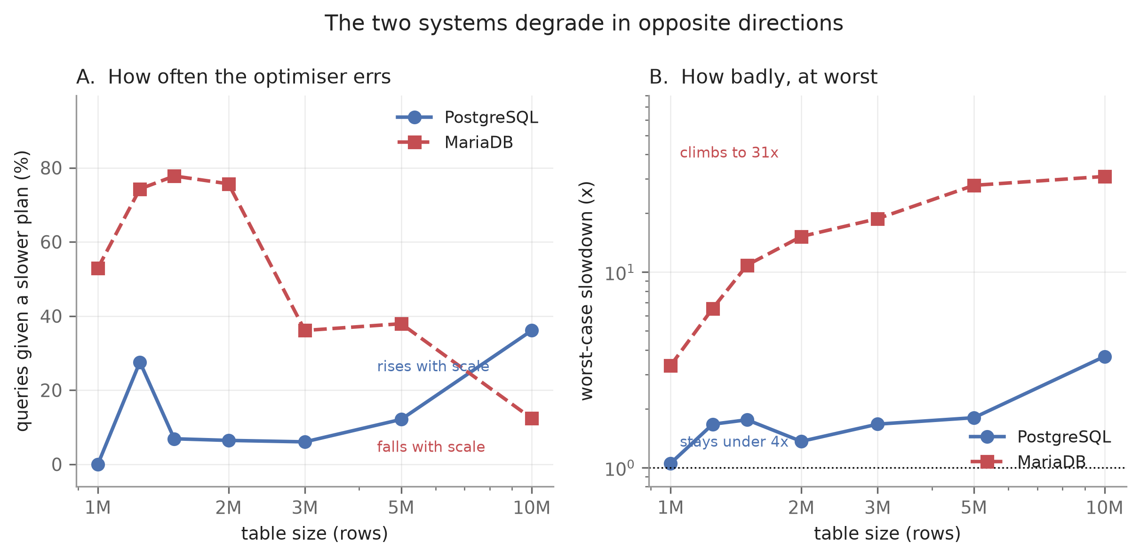
HOW THEY FAIL AS DATA GROWS
The two engines fail in opposite directions
PostgreSQL
gets wrong more often as tables grow, 0% to 36%, but never by more than 3.7x.
MariaDB
gets wrong less often, 53% down to 12%, but its worst case climbs to 30.9x.
Wrong often but never badly is easier to run than wrong rarely but catastrophically.
Left: how often it errs. Right: how badly, at worst.
Seven table scales, 1 to 10 million rows. Each engine judged only against plans the other could also have formed.
11
Notes:
Measuring both engines across all seven table sizes shows they do not just differ by degree, they fail in opposite ways. As tables grow, PostgreSQL gets wrong more often but its worst case stays small, never past 3.7 times. MariaDB gets wrong less often but its worst case climbs to 31 times. The practical point is the one on the right: a database that is wrong often but never badly is easier to live with than one wrong rarely but catastrophically. If you summarise either engine with a single number you lose exactly this.

Slide 12
THE PATTERN
Four recommended practices, all four backfire
WHAT IT PROMISES
WHAT WE MEASURED
Extended statistics
for correlated columns
Fixes the estimate 108x
Query up to 2.7x slower
Lower random_page_cost
because the disk is an SSD
Default is already near optimal
Lowering it 2.3x worse
Add a BRIN index
it is small and cheap
Costs almost no space
Bad choices 2.3% to 73.3%
Enable Multi-Range Read
MariaDB, ships switched off
The mechanism does engage
Workload 7% slower
In three of four the advice delivers exactly what it promises, and the plan gets worse anyway.
12
Notes:
Pulling it together. We tested four pieces of advice that appear in official documentation and well-regarded blogs. Every one of them is sensible. Every one of them, under conditions we can now name, makes things worse. And look at the middle column: in three of the four the advice does exactly what it promises. Extended statistics really do fix the estimate, by a factor of 108. The query still gets slower. That is the pattern of the whole study: the advice improves a proxy, and the proxy is not what determines the outcome.

Slide 13
WHAT WE RECOMMEND
What to do, and what not to do
DO
DO NOT
+
Measure the whole workload, not one query
A 24x tuning effect vanished across the workload.
–
Add a BRIN index next to a B-tree
Same column, table in memory: bad choices 2.3% to 73.3%, worst 194x.
+
Test more than two table sizes
Frequency and severity moved in opposite directions.
–
Add extended statistics for a faster plan
Estimate improved 108x, query 1.3x to 2.7x slower.
+
Report how often and how badly, separately
One number hides which engine is safer to run.
–
Lower random_page_cost for an SSD
At 1.0 the workload was 2.3x worse than the default.
+
Keep shipped defaults until measured otherwise
The default random_page_cost was within 6% of optimal.
–
Enable MariaDB MRR at its default buffer
7% slower; helps only at 8 MB and only on narrow queries.
All four were reasonable advice. None of it shipped with the conditions under which it stops being true.
13
Notes:
So what do we actually recommend. On the left, four things to do. Measure the whole workload, not one query, because we had a 24 times effect on one query that vanished across the workload. Test more than two table sizes, because the problem moved in two directions at once and two points would have given us the opposite answer. Report how often and how badly separately, because they move in opposite directions. And keep the shipped defaults unless your own measurement says otherwise. On the right, four things not to do, each with the number that justifies it. And the line at the bottom is the one sentence I would want people to remember: every one of these was good advice, it just never came with the conditions attached.

