Slide 1
Introduction
My Name is : Imtiaz Ali
Current Semester 5 Afternoon
Certified (CHFI)

Slide 2
Project Overview
Hostel Management System (HMS) digitalizes and automates
hostel operations
Manages registration, room allocation,
fees, complaints, inspections, food notifications, and reports
Goals: Reduce manual work, improve accuracy
and security, increase convenience

Slide 3
System Introduction
Manages activities for students, staff, admin, CEO
Students: Register, upload fees, request room changes, submit complaints
Admin: Records, room allocation, payments, inspections, mess, reporting
Staff: Food service and notifications
CEO: Reviews reports, oversees performance

Slide 4
System-Level Functional Requirements
Automatic late fee alerts
Tracks seat availability and inventory
Monthly reminders for electrical inspections
24/7 CCTV monitoring
Meal notifications via mobile app

Slide 5
Key Actors
Admin
Student
Staff
CEO

Slide 6
Admin Functionalities
Register students, allocate rooms, update payments
Manage inspections and mess/food
Review complaints
Send monthly report to CEO

Slide 7
Student Functionalities
Register profile via app
Upload fee challan
Cancel seat, change room
Submit complaints, mark attendance, give feedback

Slide 8
Staff Functionalities
Request and update food items
Send meal notifications

Slide 9
CEO Functionalities
Review monthly reports
Check complaints summary
Approve stock payments

Slide 10
Actor → Use Case Mapping
Admin: registration, room allocation, payments, inspections, mess, complaints, reports
Student: registration, fee upload, cancel seat, complaints, room changes, attendance, feedback, meal alerts
Staff: food requests, updates, notifications
CEO: view reports/complaints, approve payments

Slide 11
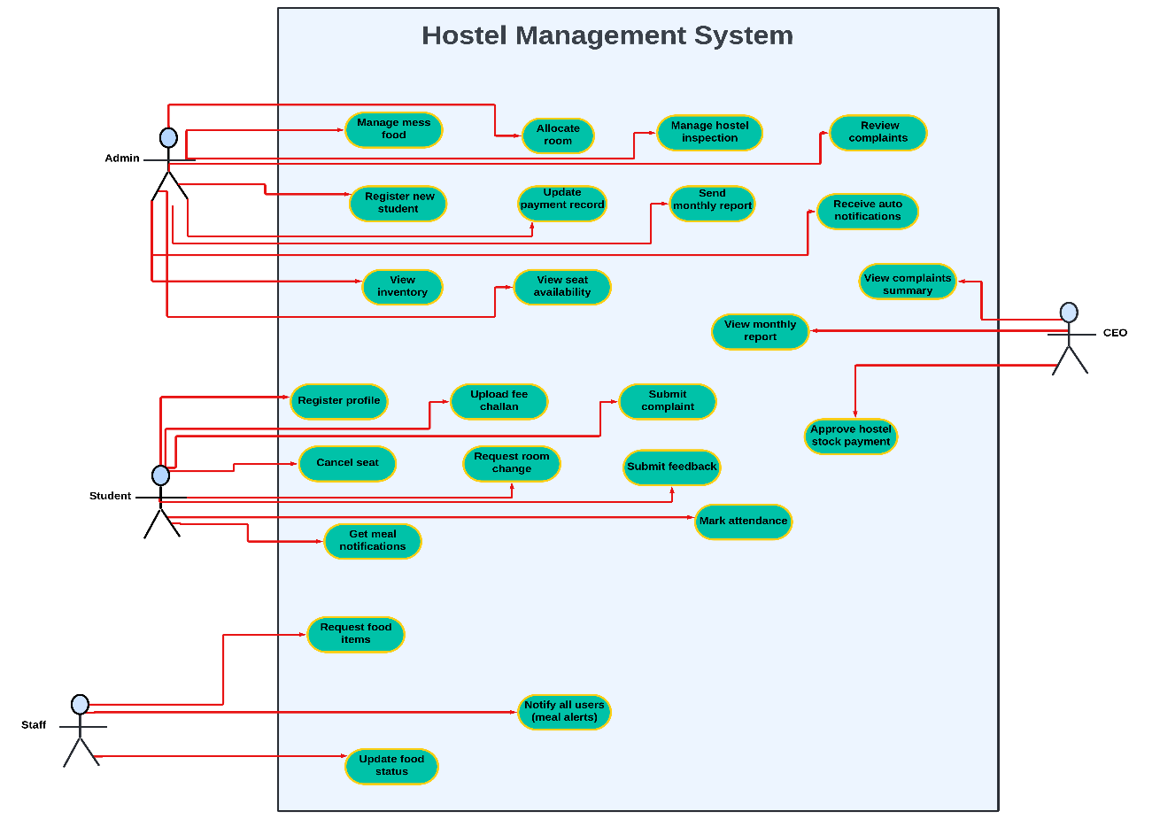
Hostel Management System Use Case Diagram

Slide 12
Automated System Functions
Late fee notifications
Monthly inspection reminders
Inventory alerts
Security monitoring

Slide 13
Object Diagram (Samples & Associations)
Students (Name, ID, Room, Fee Status)
Rooms (Number, Capacity, Status)
Payments (Amount, Month, Status)
Complaints (Description, Status)
Admin/Staff (Name, ID, Duties)
Associations: Student↔Room/Payments/Complaints, Admin↔Complaints, Staff↔Rooms

Slide 14
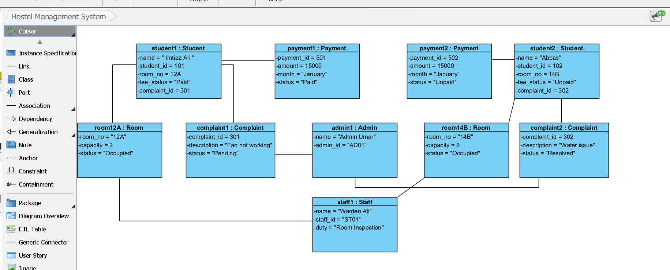
Object Diagram OF Hostel Management System

Slide 15
Communication Diagram
(Complaint Process)
Student submits complaint to system
System alerts admin
Admin reviews and forwards to staff
Staff updates complaint status
System responds to student, summarizes for CEO

Slide 16
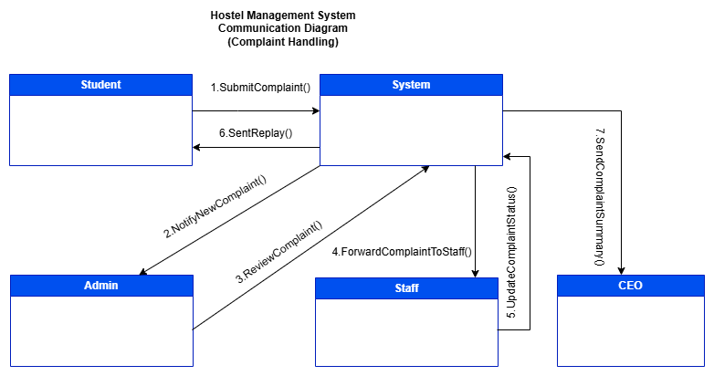
Hostel Management System Communication Diagram (Complaint Handling)

Slide 17
Timing Diagram (Attendance Process)
Student idle → Sends attendance request
System processes then forwards to admin
Admin verifies record
Confirmation sent to student

Slide 18
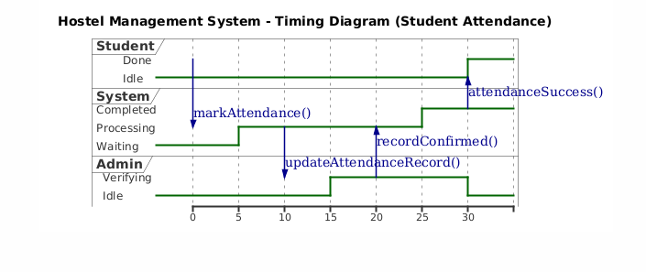
Hostel Management System Timing Diagram (Student Attendance)

Slide 19
Test Case (TDD)
1.RED (TDD Phase) → Write failing Test First
2. GREEN (TDD Phase) → Implement Minimum Code to Pass Test
3.Refactored Version: (TDD Phase) Remove duplication, improve readability

Slide 20
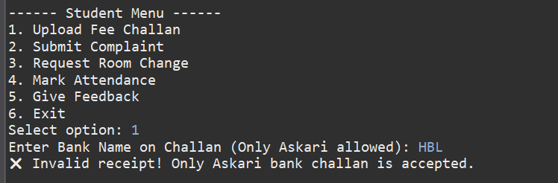
1.RED (TDD Phase) → Write failing Test First

Slide 21
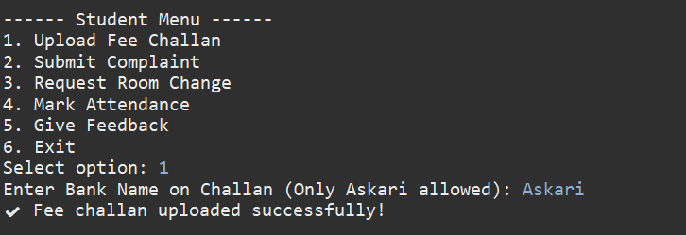
2. GREEN (TDD Phase) → Implement Minimum Code to Pass Test

Slide 22
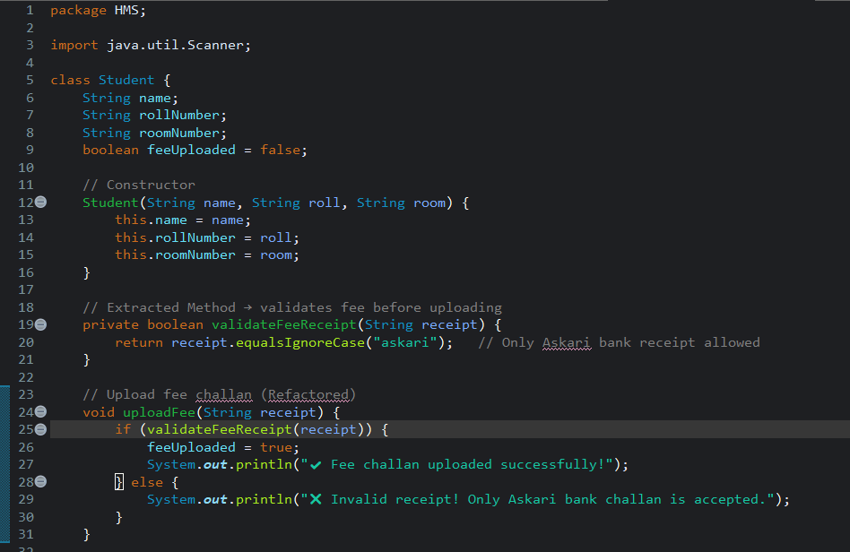
3.Refactored Version: (TDD Phase) Remove duplication, improve readability
Refactor
Code For
Fee Receipt

Slide 23
Test Case Table for Student Fee Module
Step No. | Step Details | Expected Result | Actual Result | Status
TC-01 | Open Student Module and select "Upload Fee Challan" from menu | System sets feeUploaded = true and shows: "✔ Fee challan uploaded successfully!" | ✔ Fee challan uploaded successfully! | PASS
TC-02 | Try uploading fee challan again (when already uploaded) | System should show a message: "Fee already uploaded!" (Refactored validation) | Fee already uploaded! | PASS
TC-03 | System tries to upload challan with invalid student object (null student – negative test) | System should NOT crash. It should show: "Error: Student not found!" | Error: Student not found! | PASS / EXPECTED
TC-04 | Student uploads challan but system fails internally (simulate by forcing exception) | System should catch exception and show: "Upload failed. Try again." | Upload failed. Try again. | PASS / EXPECTED
TC-05 | Student selects Fee Upload but enters wrong menu input (invalid option) | System should show: "Invalid option!" | Invalid option! | PASS

Slide 24
Conclusion
The Hostel Management System automates key hostel tasks such as fee upload, complaints, room requests, attendance, and feedback. Using OOP, refactoring, and TDD, the system becomes easy to maintain and extend. It improves efficiency, reduces manual effort, and provides a strong foundation for future upgrades.

